Slide 1
LECTURE 5 • DAY 2, 12:00–12:30
Using graphs and tables to summarise your results
SORT IT Module 3 • Data analysis and interpretation of results • Timor-Leste
Notes:
TIMING: 30 minutes, immediately before lunch. Energy will be low and people will be hungry. Keep it fast and visual. Do not lecture - show charts and ask questions.
This lecture sets up the 90-minute group work after lunch, so your real goal is to give them the two checklists (table anatomy, chart choice) they will use at 13:30.

Slide 2
“If your figure needs a paragraph to explain it, redraw the figure.”
Notes:
Open with this. It gets a nod of recognition from anyone who has ever reviewed a paper.

Slide 3
START HERE
The only question that matters
▪ Before you build any table or chart, finish this sentence:
▪ “This table shows the reader that …”
▪ If you cannot finish it in one sentence, you do not know what the table is for — and you are not ready to build it.
Notes:
This single test eliminates most bad figures before they are drawn. Ask two or three participants to try it out loud on their own main result. It is usually harder than they expect, which is the point.

Slide 4
Part 1
Tables
Eight things every good table has

Slide 5
TABLES
The eight parts
# | Part | Why
1 | Number and title | What, who, where, when
2 | Total N stated | The reader never has to add up your column
3 | Rows in a sensible order | By frequency, or natural order — never alphabetical by accident
4 | n and % together | “96 (53.3)” — count lets them check, % lets them compare
5 | Consistent decimals | One decimal place. “78.75324%” is false precision
6 | Headers name the denominator | “n (%) of 160 evaluated”
7 | A footnote per exclusion | This is where honesty lives
8 | No vertical lines | Three horizontal rules. Journal standard
Notes:
Go fast. They have this on Factsheet 5. Point at items 2, 6 and 7 - those are the three that reviewers actually complain about.

Slide 6
TABLES
Before — what most first drafts look like
Outcome | Number | Percent
Cured | 96 | 53.33333
Treatment completed | 30 | 16.66667
Died | 14 | 7.777778
Lost to follow up | 16 | 8.888889
Failed | 4 | 2.222222
Not evaluated | 12 | 6.666667
 | 180 | 100
Notes:
Ask the room: 'What is wrong with this?' Collect answers. They will get the decimals immediately.
Push them for the harder ones: no title. No denominator stated. And where are the 8 patients still on treatment? They have silently vanished - 180 registered, but only 172 accounted for here. Wait - the total says 180. So which is it? Nobody can tell. That is the failure.

Slide 7
TABLES
After — publishable
Treatment outcome | n (%)
Cured | 96 (53.3)
Treatment completed | 30 (16.7)
Treatment success | 126 (70.0)
Died | 14 (7.8)
Lost to follow-up | 16 (8.9)
Treatment failed | 4 (2.2)
Not evaluated (transferred out) | 12 (6.7)
Still on treatment | 8 (4.4)
Total | 180 (100.0)
Notes:
Table 2. Treatment outcomes among patients registered for TB treatment in eight municipalities, Timor-Leste, 2024 (N = 180).
Footnote: percentages are of all 180 registered. Treatment success using the WHO evaluated cohort (excluding 12 not evaluated and 8 still on treatment) was 126/160 (78.8%).
THE POINT: every one of the 180 patients is accounted for. Both denominators are given. Nothing is hidden. A reader can rebuild this table themselves.

Slide 8
Part 2
Graphs
Pick the chart that answers your question

Slide 9
GRAPHS
Which chart? Read across.
My question is… | Use | Not
How many in each category? | Bar chart | Pie chart
How is one continuous variable spread? | Histogram | Bar chart
How does it change over time? | Line chart | Bar chart
How do groups compare on a distribution? | Box plot | Bar of means
Is there a relationship between two continuous variables? | Scatter plot | Line chart
What proportion of a whole, across groups? | Stacked bar | Several pies
Where does my cohort lose people? | Flow diagram | Table
Notes:
Factsheet 6 has this with the 'why' column. Do not read it aloud. Move straight to the charts - showing beats telling here.

Slide 10
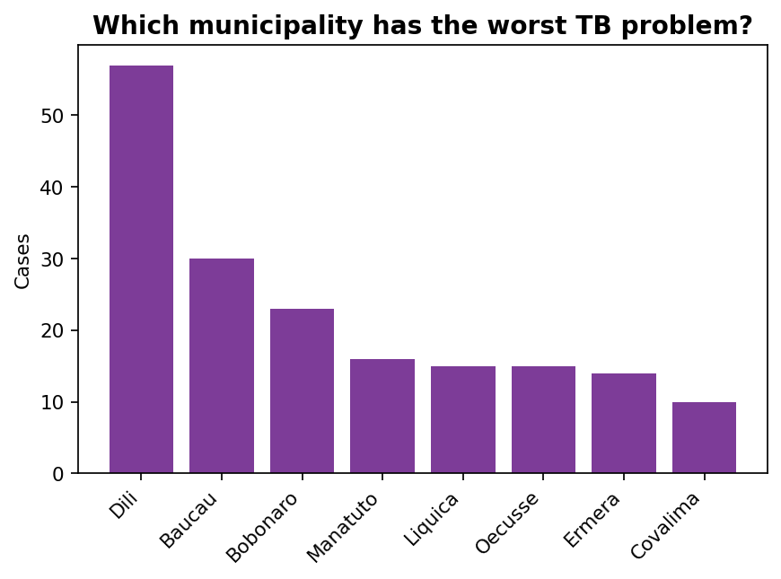
GRAPHS
Which municipality has the worst TB problem?
Notes:
Ask the question. Wait. Everybody says Dili - it has by far the tallest bar, 57 cases.
Then show the next slide.

Slide 11
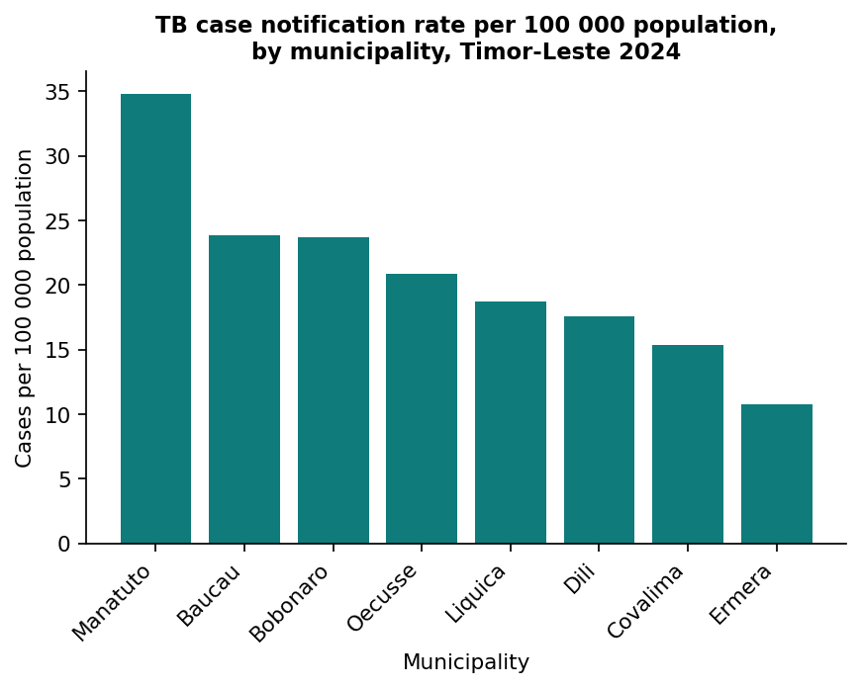
GRAPHS
Now per 100 000 population.
Notes:
Dili drops to SIXTH out of eight. Manatuto - one of the shortest bars on the previous slide, just 16 cases - has the highest rate in the country.
'If you had sent extra resources based on the first chart, you would have sent them to the wrong district.'
RULE: when you compare places, plot rates, not counts. Always state your population source.
This comes back as Chart Doctor Patient 3 and as the final question in tomorrow's quiz.

Slide 12
GRAPHS
The four ways a graph lies
Common crimes
The five checks
▪ Truncated y-axis — exaggerates small differences
▪ Counts where you need rates
▪ Pie chart with nine slices
▪ Bar of means hiding the spread
▪ Both axes labelled, with units
▪ y-axis starts at zero
▪ n is stated on the chart
▪ Survives black and white printing
▪ All decoration deleted
Notes:
Run through the left column fast - they will meet all four in the gallery walk.
The right column is the checklist they must run on their own charts this afternoon. Tell them explicitly: 'I will be walking round at 13:30 asking you these five questions about your chart.'

Slide 13
AFTER LUNCH • 35 minutes
Chart Doctor
1. Six sick charts are taped around the room
2. Your team diagnoses each one: what is wrong?
3. Then prescribe: what would you do instead?
4. One sticky note per chart. Prize for the best diagnosis.
Notes:
See A4_Chart-Doctor_FACILITATOR.
Set this up during lunch so the posters are already on the walls when they come back in - it changes the mood of the room immediately.

Slide 14
A table gives exact values. A graph shows shape and comparison.
Choose one. Never show the same numbers as both.
Notes:
Closing slide. Then release them for lunch, on time.

