Slide 1
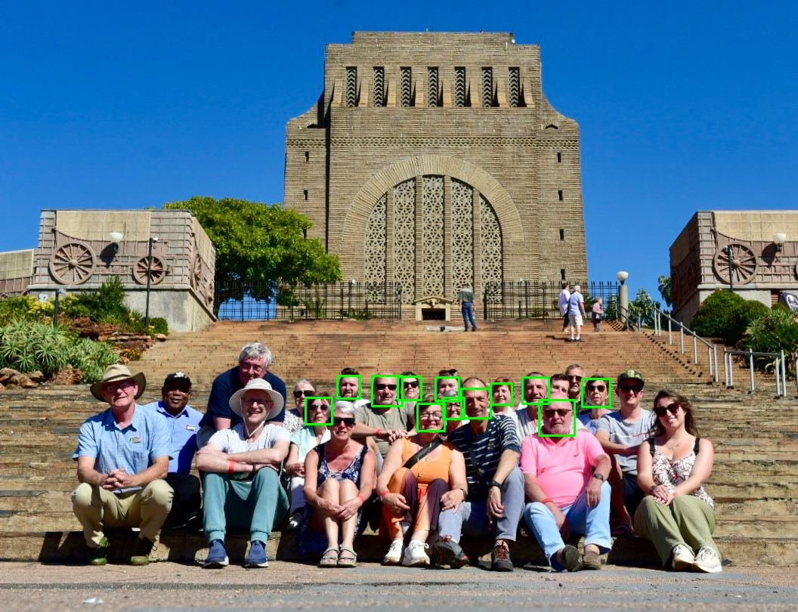
Face Detection (Demo)

