Slide 1
Phishing Awareness Training
Presented by Azmi Alsarayrah

Slide 2
What is phishing?
Phishing is a type of cyber attack where attackers disguise themselves as trustworthy entities to deceive individuals into divulging sensitive information such as usernames, passwords, credit card numbers, or other personal data. This is typically accomplished through deceptive emails, websites, or text messages that appear to be from legitimate sources like banks, online services, or other reputable organizations.

Slide 3
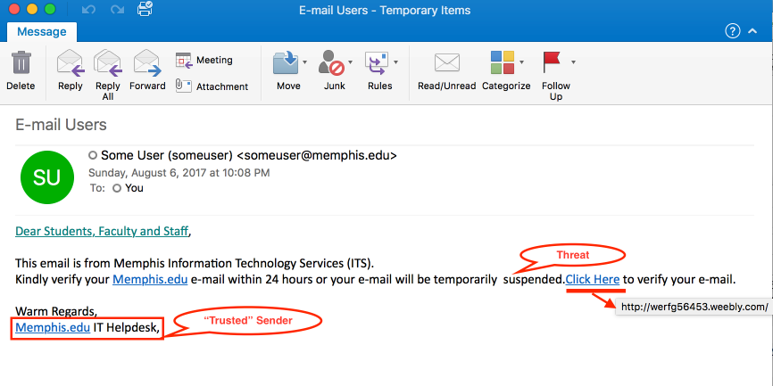
Types of Phishing attacks
Email Phishing: method where attackers send emails to individuals or organizations with the goal of tricking them into clicking on a link which is exactly the same as the original website making them login revealing sensitive information, such as login credentials

Slide 4
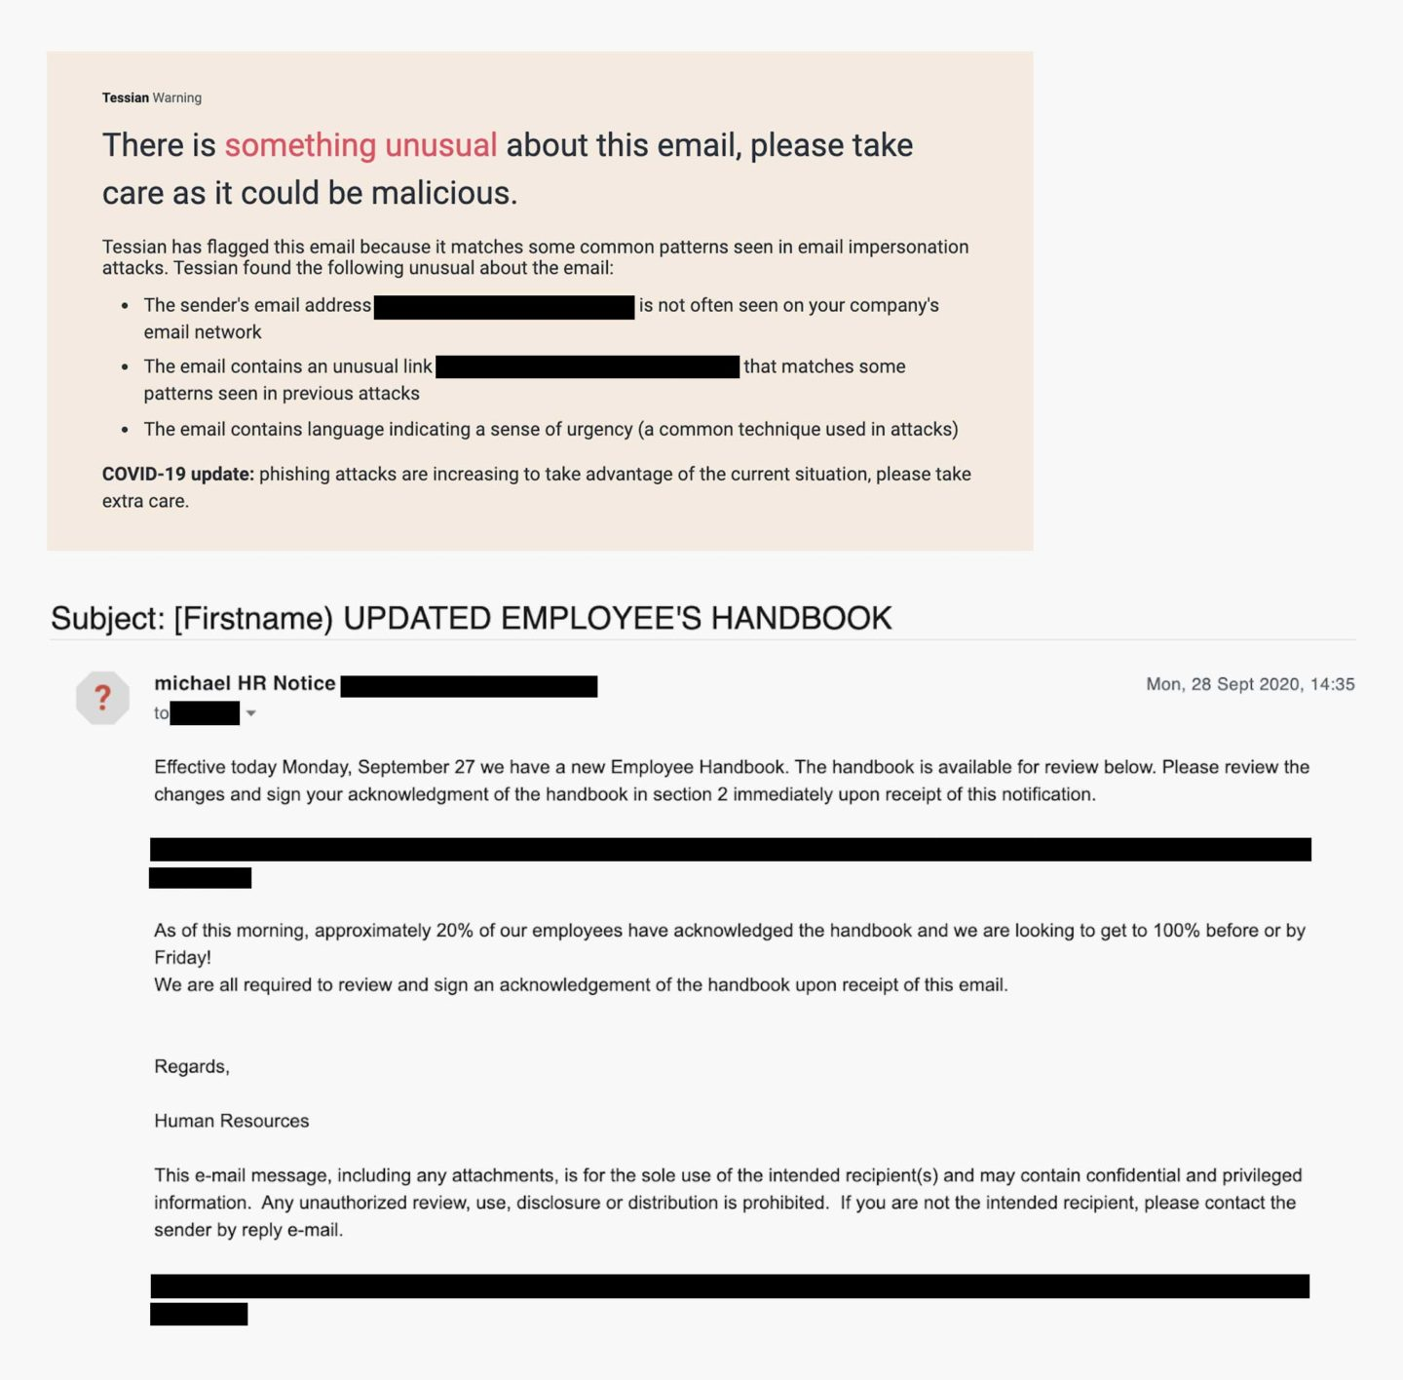
Spear Phishing: is targeting high value individuals, organization, groups. Unlike traditional phishing which is often sent to large number of people.

Slide 5
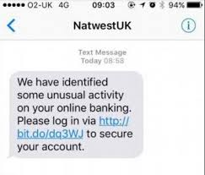
Smishing phishing: Smishing is a form of phishing attack that occurs via SMS or text messaging. Similar to traditional email phishing, smishing attempts to deceive individuals into divulging sensitive information or performing certain actions by sending fraudulent text messages.

Slide 6
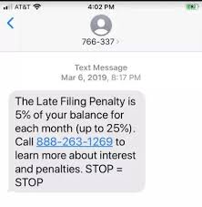
Vishing phishing: Vishing, short for "voice phishing," is a type of social engineering attack conducted over the phone or through voice communication channels such as VoIP. In vishing attacks, attackers use deception to manipulate individuals into divulging sensitive information or performing certain actions, typically by impersonating trusted entities such as banks, government agencies, or tech support.

Slide 7
How do I protect again phishing attacks?
One way to protect your organization from phishing is user education.
Education should involve all employee’s.
High-level executives are often a target teach them how to recognize a phishing email and what to do when they receive one.
Simulation exercises are also key for assessing how your employee’s react to a staged phishing attack.
IT will NEVER ask for your password over email, please be wary of any emails asking for passwords. Never send passwords, bank account numbers, or other private information in an email.
Look for https:// and a lock icon in the address bar before entering any private information on a website.

Slide 8
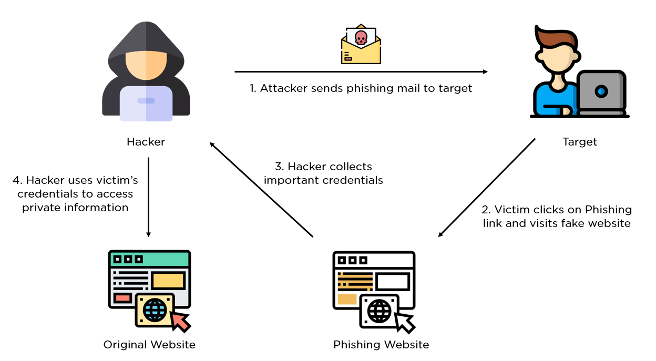
How does phishing work?

Slide 9
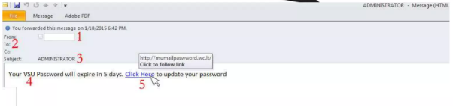
Example of a phishing attack
The first question you have to ask is , “Do I know this person?” or “Am I expecting an email from the person?” if you answered no to either question, you must take a harder look at other aspects of the email
Phishing emails will often come with subjects that are in all capitals or have multiple exclamation marks in order for you to think that this email is important.
Hovering you mouse over the link, you can see that this is not taking you to the legit website but rather to an external site. This site would either prompt you for a password, then steal that password, or would download a malicious file infecting your computer

Slide 10
Signs of a Vishing phishing
You’ve been specially selected (for this offer).
You 'll get a free bonus if you buy our product.
You’ve won one of five valuable prizes.
You’ve won big money in a foreign lottery.

Slide 11
Conclusion
No single technology will completely stop phishing, however combination of a good organization and practice, proper application of current technologies, and improvements in a security technology has the potential to drastically reduce the prevalence of phishing and the losses suffered from it.

