Slide 1
Covid-19-Unemployment Analysis

Slide 2
Motivation and Data Source
Recent budget cut in New York.
Lots of people lost their jobs.
Unemployment rate went up specially during the COVID-19 period.
It is interesting to see how the pandemic has an impact on our daily life.
Data used in this project is from Kaggle.com

Slide 3
End User and Problem Solved
Local government, including city or state finance department.
Institution who dealing with personal banking, health insurance and etc.
If the unemployment rate is predicted to rise up,
1) the government would have to worry more about unemployment benefits;
2) banking institution would have to worry about default loans;
3) insurance company would have to worry about policy cancellation.
This project would offer an early heads-up for interested parties to prepare for possible impact.

Slide 4
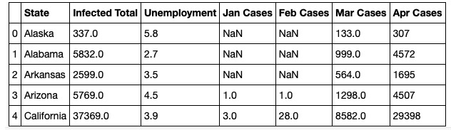
Key Point 1
First, finding the correlation between total infected cases and unemployment rate.
After some data cleaning and merging datasets, I have the following:

Slide 5
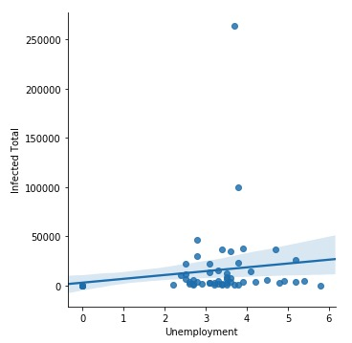

Key Point 1
Compute the correlation:

Slide 6
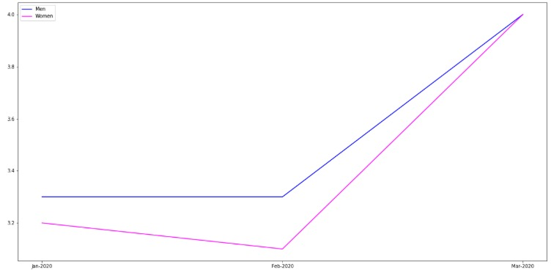
Key Point 2
Second, finding the general trend on unemployment rate with respect to different demographics.
Here, I divided the demographics into gender and race.

Slide 7
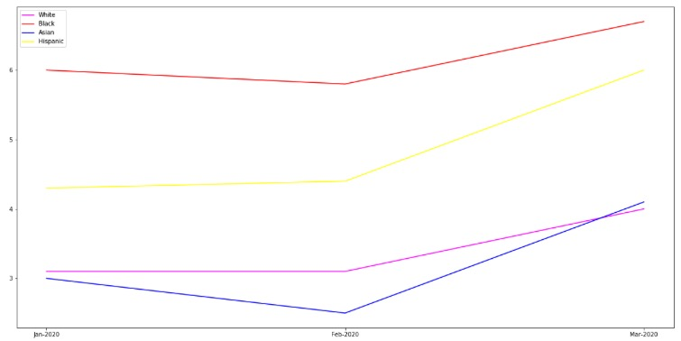
Key Point 2

Slide 8
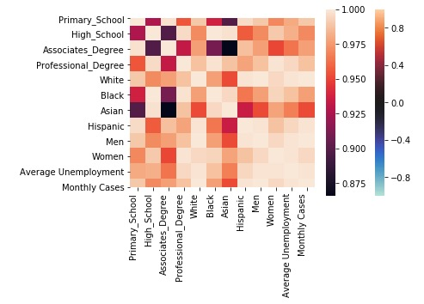
Key Point 2
Correlation heatmap:

Slide 9
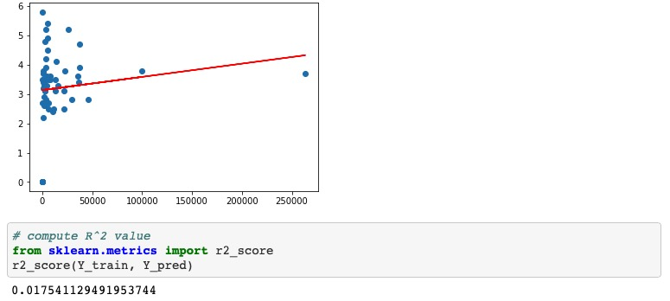
Key Point 3
Lastly, building a model to predict unemployment rate based on total infected cases using different algorithms.
Linear Regression: not good

Slide 10
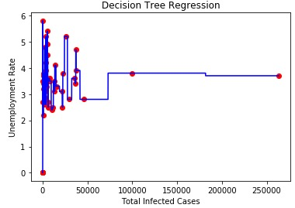
Key Point 3
Decision trees: overfitting

Slide 11
Shortcoming and Improvement
The dataset used was not fully up to date.
Once obtaining more real time updated data, the project result can be well improved.
Machine learning model in this project was undermined by lack of data.
The model will be much improved with bigger and more detailed datasets, instead of per state unemployment rate, I would like to have per county, per neighborhood and more. The same goes to the COVID-19 dataset.

