Slide 1

Cooking agent
A Multi-Agent Recipe Discovery System
Students:
Turushev Timur
Egor Shmelev
Ran Duan
Jorge Sosa
Course Project

Slide 2

Problem statement
Finding the right recipe is still difficult - even with LLMs
Users often have multiple constraints: dietary needs, allergies, available ingredients, preferred cuisines.
Generic recipe search is too broad
Often returns irrelevant or impractical results.
LLM-only solutions are unreliable
They may hallucinate non-existent dishes or provide inconsistent steps.
Lack of personalization
Users must repeat the same requirements every time.

Slide 3

Solution
A Multi-Agent System (MAS) that coordinates several specialized LLM agents to deliver accurate and personalized recipe discovery.
Specialized roles (clarification, retrieval, critic, planner) handle their own tasks.
Structured collaboration ensures validation and refinement at each step.
Personalization built-in: constraints, preferences, and available ingredients are accounted for automatically.
Reliable outputs through cross-checking and iterative improvement.

Slide 4
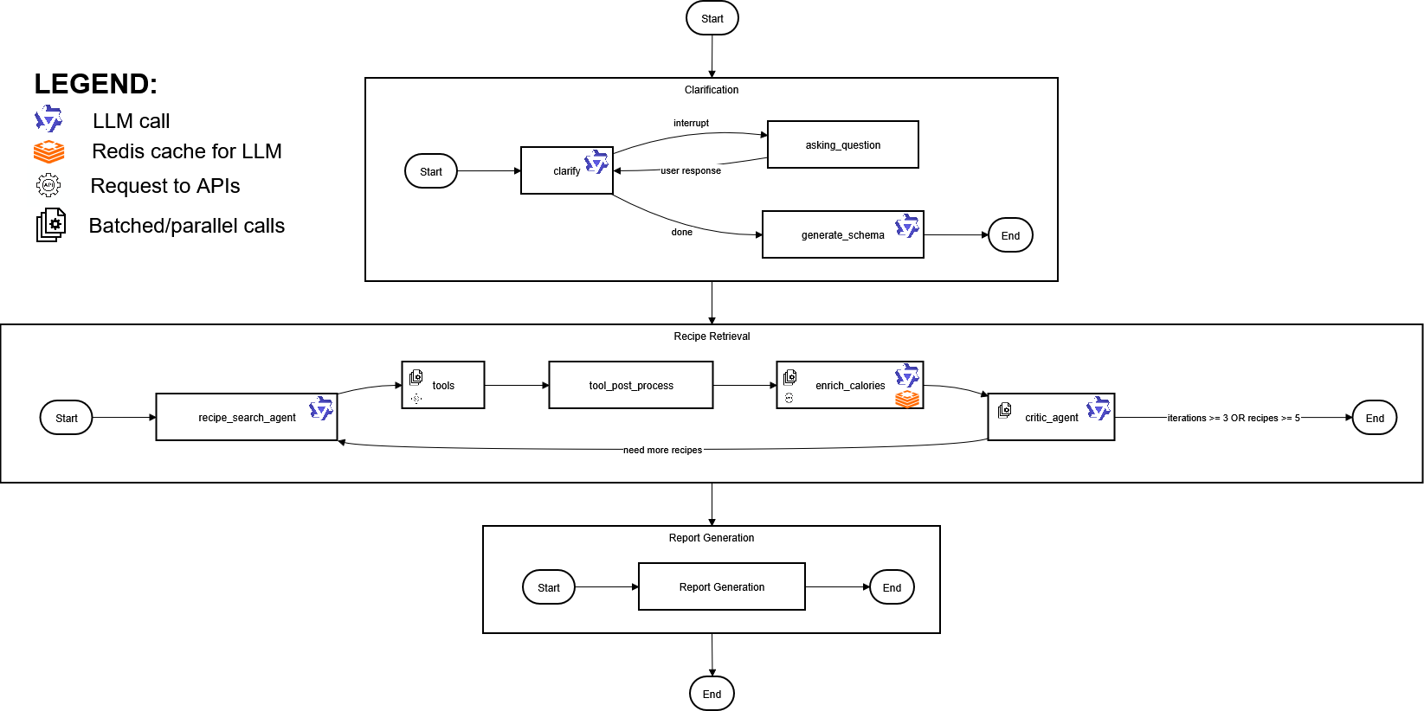
Agent architecture
Search recipes with tools (MealDB API Client interaction)
Get nutrition info using OpenFoodFacts API Client / Redis
Clarified recipe requirements
Structured list of recipes that follow the user requirements

Slide 5
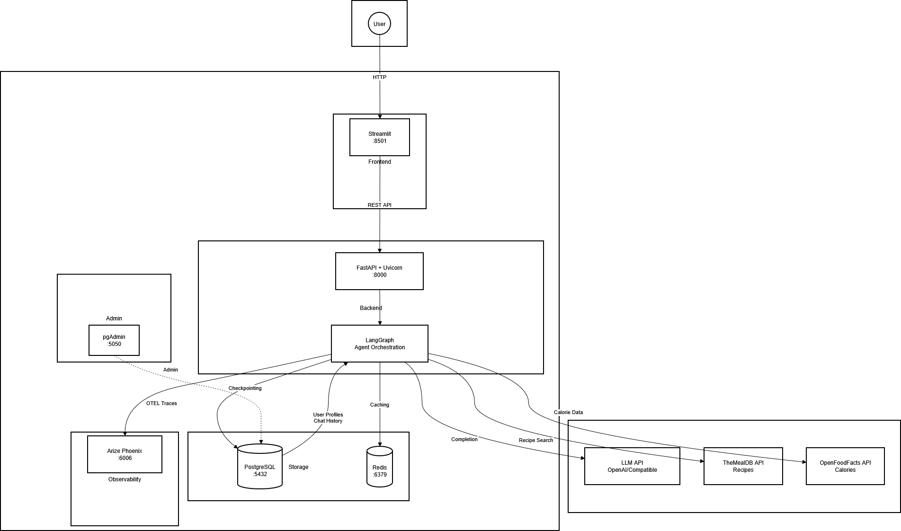
System architecture

Slide 6
Agents
Agent name | Description | Input | Output
Clarification agent | Interprets and clarifies the user’s request | Raw user’s recipe requirements | Clarified and structured requirements
Schema generation agent | Converts conversation context and DB info into a structured query | Message history + user data from the database | Pydantic schema with extracted user preferences, restrictions and summarized query
Retrieval agent | Chooses and executes retrieval tools | Pydantic schema for user request + chat history | Pydantic schema with retrieved recipe candidates (via tools/API)
Enrichment agent | Adds nutritional and calorie data to recipes | Pydantic schema with recipes and ingredients | Enriched recipe schema with nutrition info
Critic agent | Selects recipes that satisfy user preferences and generates feedback to retrieval agent | Recipes from previous agent | Selected recipes + feedback to retrieval agent

Slide 7
Interactions
Clarification subgraph:
Clarification agent gathers and refines user info via LangGraph
Schema generation agent combines accumulated user data + DB info to create a unified Pydantic schema - a detailed plan for the next steps
Retrieval subgraph:
Retrieval agent uses the schema (plan) to call external tools
Tool outputs are parsed into recipe schemas.
Enrichment agent adds nutritional and additional details to recipes
Critic agent evaluates enriched recipes, filters compliant ones, and generates feedback for the retrieval agent, creating a feedback loop
Key insight:
Clarification subgraph sets the plan
Retrieval and critic form a loop akin to the ReAct pattern — retrieval acts, critic observes and guides next steps

Slide 8
Tools (LangChain)
Tool | Purpose | Args | API | Note
search_recipes_by_name | Finds specific dishes | recipe name | The Meal DB | Dynamic selection by retrieval agent
search_recipes_by_ingredient | Include/exclude ingredients | include ingredient, exclude ingredient | The Meal DB | Dynamic selection by retrieval agent
search_recipes_by_area | Browse cuisines by region | area name, exclude ingredient | The Meal DB | Dynamic selection by retrieval agent
get_nutrition | Get nutrition info by ingredient name | ingredient name | OpenFoodFacts | Used statically (i.e. forced) in enrichment agent

Slide 9

Memory
Short-term
Stored in RAM:
Conversation history
Graph state
Stored in Redis cache:
All API requests
Calls to enrichment agent
Long-term
Stored in postgres DB:
User preferences
User restrictions
User summarized previous queries
Langgraph checkpoints

Slide 10
Fault tolerance
Retries
All API calls are wrapped in tenacity retries
Enrichment API has LLM fallback. Since this API is problematic, if it totally fails, LLM guesses on its own calories for ingredients
All LLMs have native langgraph’s ChatOpenAI retries on request
All structured outputs are wrapped in custom retries with fallback to parsing raw json manually
Structured output models
Most of the fields for structured output models have few shot examples
Most of the fields has explicit pydantic restrictions (e.g. min_length = 1)
For models which must extract IDs (e.g. of recipes) from input, in order to be totally sure we parse generated ids with regex
Anti recursion
ReAct loop (critique <-> retrieval) is capped by max 3 iterations
Overall graph recursion limit aka max steps is set to 25

Slide 11
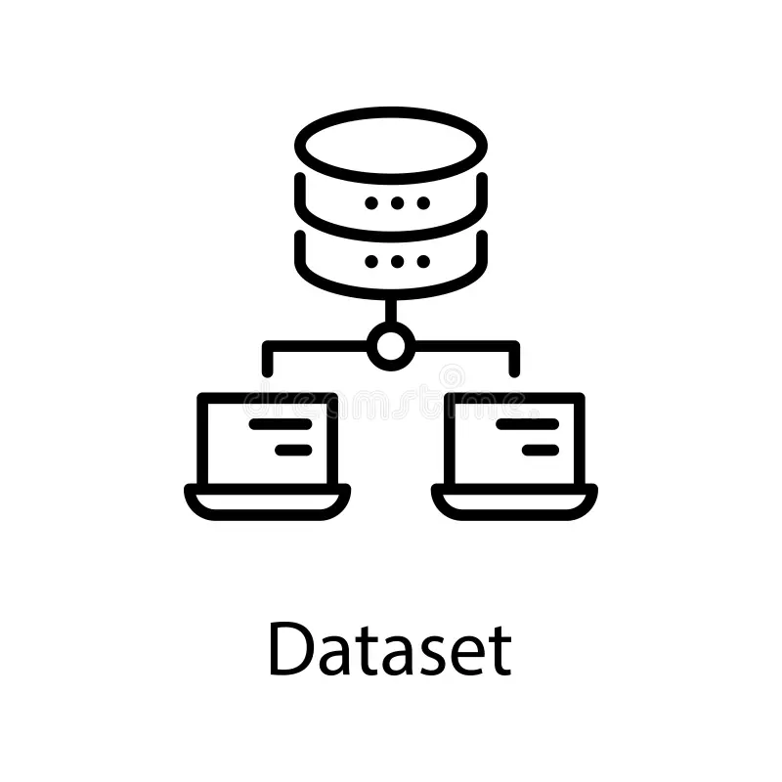

Final
Future Improvements
Vector-based memory (retrieval-augmented personalization or recipe retrieval)
Add more recipe data sources (e.g., Spoonacular)
Key Challenges
Limited flexibility of TheMealDB API and rate limits of OpenFoodFacts API
Calorie estimates depend on ingredient quantity quality
No shopping list

Slide 12
Thank For Watching

