Slide 1
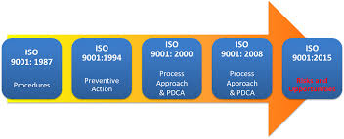
ISO-9001:2015 Where we have been and where we are going

Slide 2
Transition – Key to success
Understand the requirements
Conduct a gap analysis
Don’t let concerns with auditability and documented information drive bureaucracy into your quality management system.
Implement changes that add maximum value to your organization.

Slide 3
Agenda
Context of the Organization
Process Approach and Risk Based Thinking

Slide 4
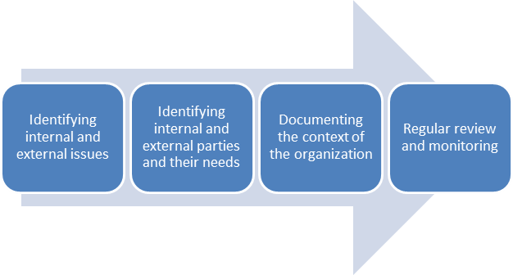
Context of the Organization

Slide 5
Context of the Organization
The new requirement reads: “The organization shall determine external and internal issues that are relevant to its purpose and its strategic direction and that affect its ability to achieve the intended result(s) of its quality management system.”

Slide 6
Decision making and ISO-9001:2015
The first is a quality principle quoted from ISO 9000:2015, namely “evidence-based decision making.” It is not hard to understand that better decisions are made when they are based on evidence rather than by conjecture.
The second is found in Clause 0.1, “Addressing risks and opportunities associated with its context and objectives.” Addressing risks means proactively managing uncertainties. The simple meaning of “managing uncertainties” is that decisions should be made with consideration of the possible positive and negative consequences that the uncertain future may bring.
Finally, in Clause 5.1, entitled Leadership and Commitment, there is a requirement for top management: “Ensuring that the quality policy and quality objectives are established for the quality management system and are compatible with the context and strategic direction of the organization.” Top management’s most basic role is strategic decision-making for the organization.

Slide 7
Decisions are to be made based on evidence. Evidence is found in the CONTEXT of the organization.

Slide 8
Internal Context
Vision
Mission
Strategic objectives and direction
Organizational Chart
SOPs
Resources
Culture

Slide 9
External Context
Legal
Social
Political
Regulatory
Financial
Economic
Market Trends

Slide 10
Examples
Customer pressures and complaints can force organizations to change policies such as product returns and customer and technical support .
Technological changes can provide new and more effective ways to handle communications, operations, shipping and logistics.
Governments regulatory and trade policies can play a significant role in determining how businesses operate, especially in regard to international trade, taxation, and regulations
The media, including social media, can have a huge impact on a company’s image and public relations. A bad news video or news report can go viral pretty fast, and if your organization doesn’t provide an acceptable response, the negative publicity and effects can last a long time.
Sociological forces often drive what, where and how consumers buy product and services. There is an increasing trend in the number of consumers purchasing products online and reading reviews before making a purchase.
The multinational and multicultural trend in workforce composition can cause significant changes in hiring and retention of competent human resources.

Slide 11

Risk Based Thinking Examples and Ideas
Purchasing
Design and Development
Process

Slide 12
Purchasing Supplier Approval and Re-Evaluation
Do all raw materials create the same risk for your final product?
Do all suppliers bring the same risk to your business?
Does your current QMS account for these differences?

Slide 13
Design and Development
Design FMEA – for actual design
Risk Registers – for project risks

Slide 14
The Process Approach and Risk Based Thinking
Assign a Process Owner
Define the process
Identify the inputs and outputs
Define measures of effectiveness and efficiency
Identify risks and opportunities
Report on the status of each process

Slide 16
Process Definition
Should include: Process Owner, Inputs and Outputs, Process, Process Metrics and RISK

Slide 17
Process Review
Should include: Inputs and Outputs, Process, Process Metrics and RISK

Slide 18
Process Owner’s Meetings
Owner/Co-Owner Reporting
Process Metrics
Current State
Recent Updates
Plans moving forward
Audit Nonconformance's (Internal and External)
Dashboard
RISK

Slide 19
Purchasing Measurable: # Supplier Nonconformance's Process Owner: Goals 2016: 10% Reduction from ’15 Risk: Production interruptions due to material shortages
Risks and Opportunities:
Risk – This rate of supplier rejects has resulted in 280 hours of line shut downs in 2015, and the trend is not improvement moving into 2016.
Opportunity: IF the shipping damage issues could be solved, we could eliminate 24 % of the nonconforamnces and 20% of the hours of line interruption
Corrective Action Plans:
Task | Responsibility | Target Date

Slide 20
Quarterly Business Reviews (Management Representative and Process Owners)
Review of identified risk within each key process
Has the risk changed?
Have high risk issues been addressed?
Does performance to objectives reflect risk mitigation?

Slide 21
Integrated Systems and RISK
ISO-9001
ISO-14000
FSSC- 22000, SQF, BRC (Food Standards)

Slide 22
Hazard Analysis for food safety
Hazard Analysis - Food Safety
(1) | (2) | (3) | (4) | (5) | (6) | (7) | (8) | (9) | (10)
Process Step | List each process step from the Process Flow Diagram | Does this process step INTRODUCE or INTENSIFY a potential food safety hazard? If YES identify the hazard(s). Assess probability, severity and risk per columns 4, 5 and 6. | Likelihood | Severity | Risk | Justification of Risk Level Assessment | List the support programs that CONTROL or ELLIMINATE this hazard. Do the support program(s) control the hazard to an acceptable level? If yes, proceed to the next process step. If no, proceed to column 9. | Is this hazard CONTROLLED or ELIMINATED (or reduced to an acceptable level) at a subsequent process step? If YES, this step is not a CCP. Identify the subsequent process step and proceed to the next process step. If the hazard is not controlled at this process step, go to column 10 and assign a CCP number. | CCP or oPRP
1 | Receive raw materials | B- Pathogen contamination due to uncontrolled transportation | L | M | 2 | Raw materials are received covered and/or packaged, Trailer Checks, Sealed Truck | Purchasing Program Shipping and Receiving Program | Yes | No
 |  | C- Chemical contamination due to uncontrolled transportation | L | M | 2 | Raw materials are received covered and/or packaged, Trailer Checks, Sealed Truck | Purchasing Program Shipping and Receiving program Chemical Control Program | Yes | No
 |  | P- Physical contamination with extraneous material due to uncontrolled transpiration | L | L | 1 | Raw materials are received covered and/or packaged, Trailer Checks, Sealed Truck | Purchasing Program Shipping and Receiving Program Glass and Brittle Plastics Program Metal and Blade Control Program | Yes | No

Slide 23
ISO-14000 Aspects and Impacts

Slide 24
Quality Risk Assessment

Slide 25
What should you do?
Identify what the risks and opportunities are in your organization – it depends on context
Analyze and prioritize the risks and opportunities in your organization
what is acceptable?
what is unacceptable?
Plan actions to address the risks
how can I avoid or eliminate the risk?
how can I mitigate the risk?
Implement the plan – take action
Check the effectiveness of the actions – does it work?
Learn from experience – continual improvement

