Slide 1
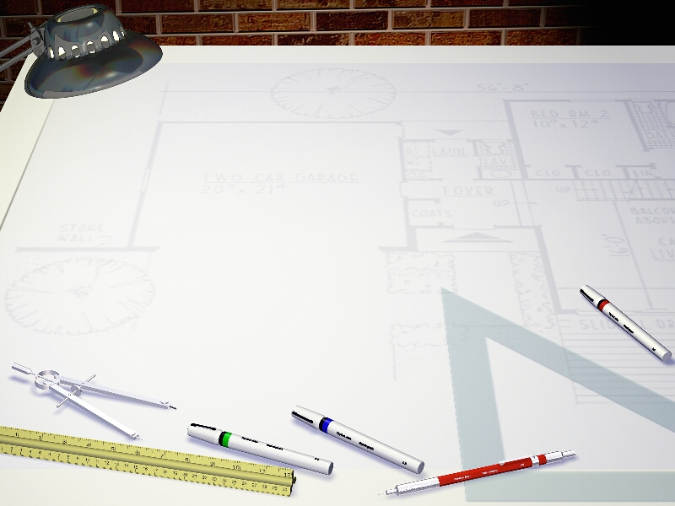
Virtualization: Techniques and Applications
CSE 598F
Introduction and Overview
Lecture 1: January 11, 2011
Instructor: Bhuvan Urgaonkar

Slide 2
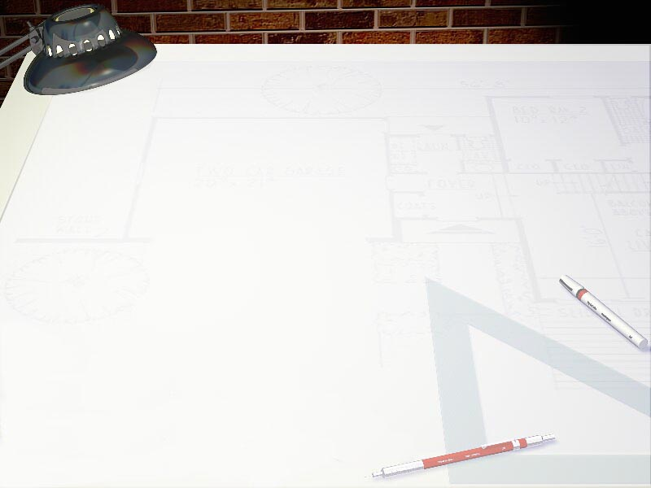
About me
Bhuvan Urgaonkar
  Research areas
    OS, distributed systems, storage, performance evaluation
  Office hours: TR 4-5pm, or by appointment
  Office: 338D, IST Building
  E-mail: bhuvan @ cse . psu . edu
Welcome!

Slide 3
Administrative Stuff

Slide 4
Online resources
Course Web page:
  http://www.cse.psu.edu/~bhuvan/teaching/spring11/598f.html
All material will be available via ANGEL
“Virtual” text-book
  Virtual Machines by Smith and Nair
  Encourage you to buy it, but not absolutely necessary
    We will have scribe notes: coming up

Slide 5
Seeking help via e-mail
ANGEL’s course mailing list
  Use with care
You are welcome to e-mail us any questions, complains, suggestions, etc.
  Make sure to include “CSE 598F” in the subject
  If we don’t respond soon enough, send a reminder or talk to me after class

Slide 6
Grading
Semester-long projects OR 3 short programming assignments: 60%
  More information in a few days
Class participation: 20%
Paper presentation OR scribe notes: 20%
  I will assign duties as the semester progresses

Slide 7
Computing resources
Linux accounts for projects
E-mail me if you don’t have an account or have any doubts/problems

Slide 8
Assumed background
Good background in OS and basic background in architecture
We will need some distributed computing concepts later in the course
  Will cover these
Talk to me if you have doubts

Slide 9
Before we begin …
Some advice
  Speak up in class, ask questions
  Attend all classes
  Make sure you read assigned material
  Make good use of office hours

Slide 10
Virtualization:
Introduction & Background

Slide 11
Managing Complexity in Computer Systems
Levels of abstraction separated by well-defined interfaces
  E.g., ISA
  E.g., system call interface
  E.g., file system
  And many, many more!

Slide 12
Interfaces: Pros and Cons
Interfaces enable decoupling of design tasks
  E.g., Intel makes chips, MS makes OS
  Ease of design, implementation, upgrades, …_x0003_
Interfaces impose constraints on flexibility, generality, performance (even creativity?)
  E.g., a binary needs a particular OS even if the ISA stays same

Slide 13
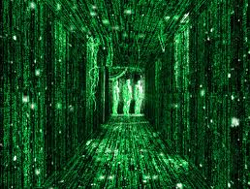
Virtualization as a relaxer of constraints
Broad definition: Making a system appear and behave like another system
  Retain benefits of interfaces while overcoming their constraints

Slide 14
Virtualization: Definition
When a system (or subsystem) is virtualized, its interface and all resources visible through the interface are mapped onto the interface and resources of another system (real or virtual!) actually implementing it
Isomorphism between a guest and a host system (Goldberg and Popek, 1974)

Slide 15
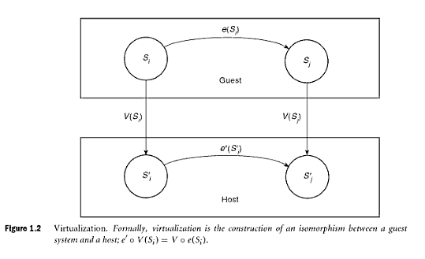
An isomorphism between a guest and a host system

Slide 16
Studying Virtualization: Two Approaches
System being virtualized
  CPU
  Single machine
  Group of machines connected by a network
  Storage, etc.
Reason for virtualization
  Sharing and Costs
  Usability/Programming ease
  Protection/Security
  Performance
  Fault tolerance

Slide 17
Quick Tour of Topics
  http://www.cse.psu.edu/~bhuvan/teaching/spring11/schedule.html

Slide 18
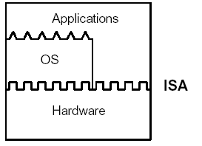
Standard System Layers
Benefits
  decoupled design tasks
  software reuse across varying hardware configurations and generations

Slide 19
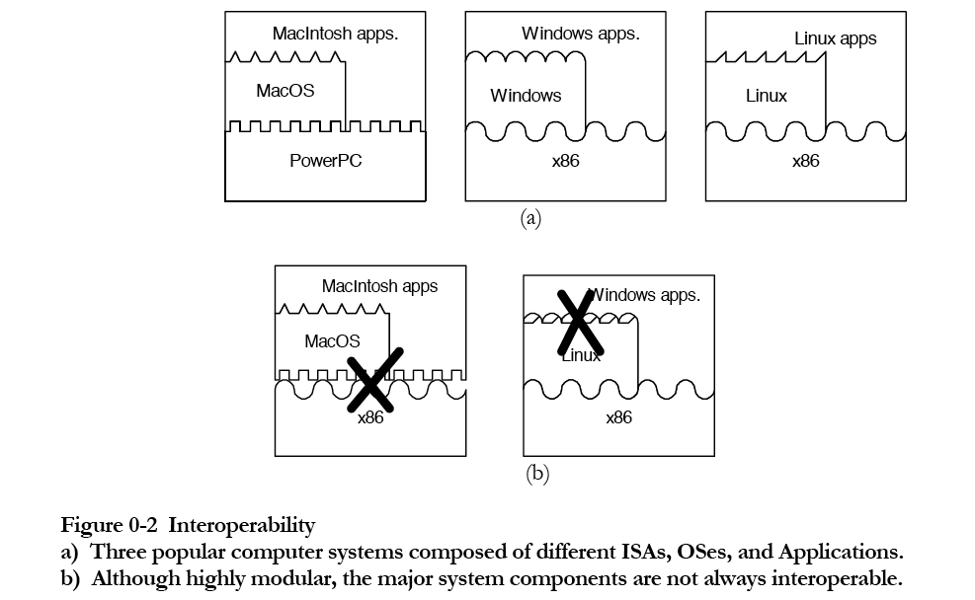
Interoperability Constraints
Significant problem in emergent environment that need code to run anywhere
  E.g., data centers, cloud computing, p2p systems,grids

Slide 20
Innovation Constraints
New S/W implementation may have to restrict itself to old ISA
H/W innovation limited due to the need to support fixed ISA
  Or need to continue support for old ISA

Slide 21
Performance Optimization Constraints
Suboptimal performance across interfaces
  Architects, OS designers, application builders work independently
Program binaries often optimized only for certain processors
  Compiler development lags processor development
    Binaries optimized for older versions of processors

Slide 22
OS Homogeneity Constraints
All applications must be written for the same OS
  Apps for different OSes => need multiple machines
    Big problem in modern data centers
    “Server sprawl”
  All apps must share the problems in this one OS

Slide 23
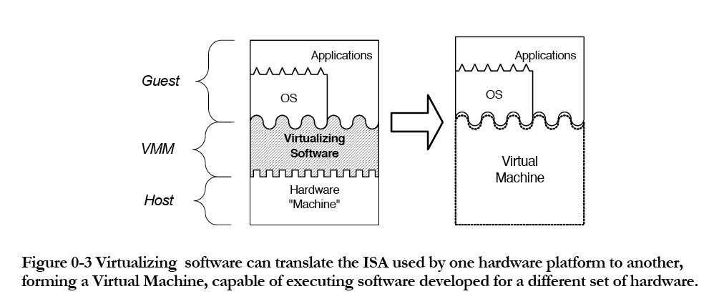
Virtual Machines - Solution to these problems

Slide 24
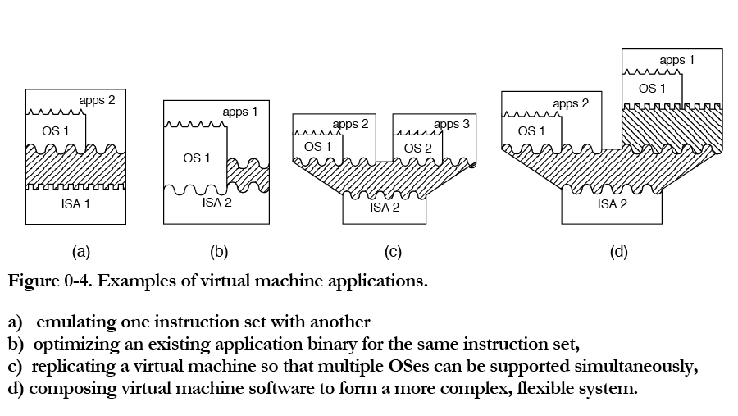
Virtual Machines - Applications

Slide 25
Classifying VMs
Based on what is meant by “machine”
  Process-level view
    Virtual address space, user-level registers & instructions
    Virtualized I/O devices (e.g., files) accessed by system calls
  System-level view
    A “real” machine
Correspondingly
  Process virtual machines
  System virtual machines

Slide 26
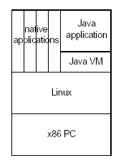
Process Virtual Machine
Capable of supporting (only) an individual process
E.g., JVM
  Appears as a process to the “host” OS (Linux in this case)
Another example would be a process-level VM that emulates PowerPC instructions letting Linux/PowerPC apps to run on the system shown to the left

Slide 27
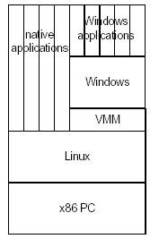
System Virtual Machine
Capable of supporting a complete system environment
  Multi-programmed system, I/O devices, …
We will study some examples
  UML, Xen, VMWare

Slide 28
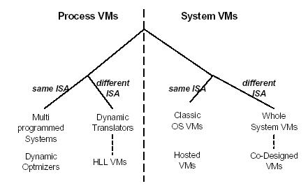
Taxonomy Overview

Slide 29
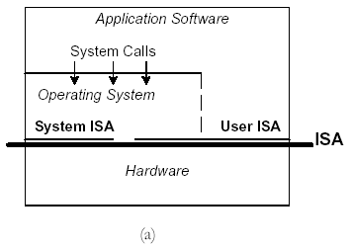
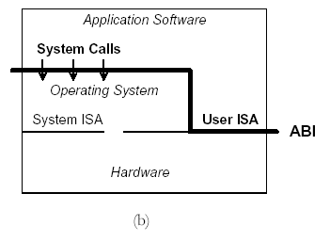
ISA and ABI
Instruction Set Architecture separates hardware from rest
Application Binary Interface separates processes from rest

Slide 30
Process versus System VMs
Process level VMs provide ABI to application
System VMs provide ISA to OS and applications

Slide 31
Process VMs (1)
Multiprogramming
  same ISA, same OS
  replicates ABI so that each process thinks it has its own machine

Slide 32
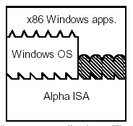
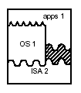
Process VMs (2)
“Emulation” and “Dynamic Binary Translation”
  OS is same, ISA is different
  better known as “interpretation” and “compilation”
Dynamic Optimizers
  same OS and ISA
  performance is purpose

Slide 33

System VMs (1)
Classic System VMs
  VMM (Virtual Machine Monitor) provides replication and resource management
  possible benefits: flexibility,
  utilization, isolation
  similar to
  what an OS does
  for processes
  sits on hardware
  (super) privileged mode

Slide 34
System VMs (2)
Hosted System VMs
  Like classic system VM, but operates within process space
  Common to Classic/Hosted System VM:
    try to do as much as you can natively
    more difficult for hosted VMs than for classic VMs
    underlying ISA can make big difference

Slide 35
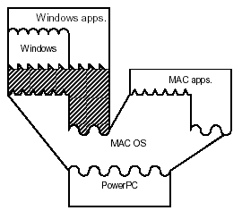
System VMs (3)
Whole System VMs
  ISA is different
  no “native” execution possible.
  Complete emulation/translation
  required.
  Usually done as a
  hosted VM

Slide 36
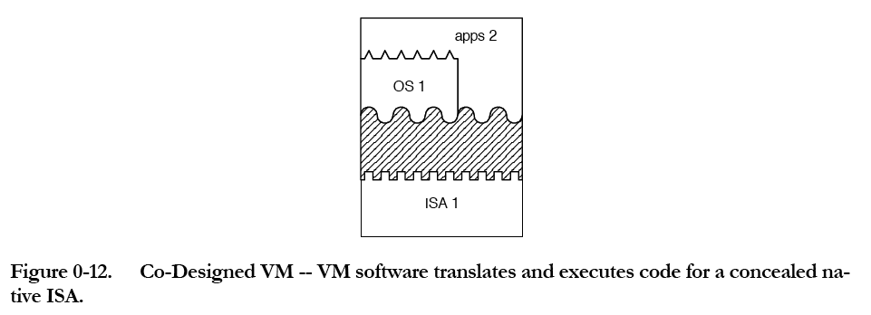
System VMs (4)
Co-Designed VMs

Slide 37
System VMs (4)
Co-Designed VMs
  use synthetic custom ISA at bottom
  goal: reconcile diverging requirements between ISA and microarchitecture
  no “native” execution possible
  Emulation/translation
    can be joint effort by hardware and software
    can be made completely transparent

Slide 39
Questions
What category do the following fit in? Why?
  JVM
  BOCHS
    Complete x86 emulation on a UNIX machine, written in C++
  Linux/FreeBSD Jails
  Cywin, XWin32
  Simics

