Slide 1
Solving the Diet Problem
MGT 207

Slide 2

Revisit McDonald’s Diet Problem
You want your diet to meet some nutritional standards.
According to your daily diet plan you need to have
at least 100 percent of the U.S. RDA of vitamin C and calcium;
at least 55 grams of protein; and at most 2000 calories.
You are wondering if this can be accomplished by eating at McDonald’s.
Can you design a least-cost McDonald’s daily meal plan that meets your
daily nutritious standard?

Slide 3
McDonald’s Diet Problem Formulation
Data for the McDonald’s Diet Problem
1. What must be decided?
2. What measure should we use to compare alternative sets of decisions?
3. What restrictions limit our choices?
Diet Plan
x1 = # of hamburgers x4 = # of Garden Salads
x2 = # of Big Macs x5 = # of Baked Apple Pies
x3 = # of Chicken McNuggets
Money Spent on McDonald’s Diet
Calories obtained ≤ 2000
Protein obtained ≥ 55 gram
Vitamin C obtained ≥ 100% of U.S. RDA
Calcium obtained ≥ 100% of U.S. RDA

Slide 4
McDonald’s Diet Problem Formulation
4. Formulate the objective function:
MIN 0.69x₁+ 1.99x₂+ 1.99x₃+ 2.05x₄+ 0.79x₅
5. Formulate the constraints:
Calories: 260x₁+ 560x₂ + 250x₃+ 35x₄+ 260x₅ ≤ 2000
Protein (in g):13x₁ +25x₂ + 15x₃ + 2x₄ + 3x₅ ≥ 55
Vit. C (in %): 2x₁ + 2x₂ + 2x₃ + 40x₄+40x₅ ≥ 100
Calcium (in %):15x₁+ 25x₂ + 2x₃ + 4x₄+ 2x₅ ≥ 100
6. Do we need non-negativity constraints?
x_{i} ≥ 0 , i=1,2,3,4,5
7. Write down the total problem formulation:
MIN 0.69x₁+ 1.99x₂+ 1.99x₃+ 2.05x₄+ 0.79x₅
s.t.
Calories: 260x₁+ 560x₂ + 250x₃+ 35x₄+ 260x₅ ≤ 2000
Protein (in g):13x₁ +25x₂ + 15x₃ + 2x₄ + 3x₅ ≥ 55
Vit. C (in %): 2x₁ + 2x₂ + 2x₃ + 40x₄+40x₅ ≥ 100
Calcium (in %):15x₁+ 25x₂ + 2x₃ + 4x₄+ 2x₅ ≥ 100
x_{i} ≥0, i=1,2,3,4,5

Slide 5
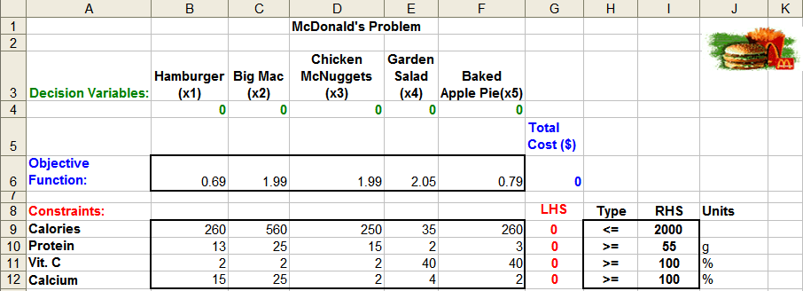
McDonald’s Problem – Spreadsheet Setup
Decision variable cells
B4:F4
Objective function cell
G6
Constraint cells
G9:G12
Enter parameters in variable cells B6:F6, B9:F12, I9:I12
Decision variable cells: fill zeros as initial values in cells B4:F4
Objective function cell:
G6 = SUMPRODUCT(B4:F4,B6:F6)
Constraint cells:
G9 = SUMPRODUCT($B$4:$F$4, B9:F9)
Copied to G10:G12

Slide 6
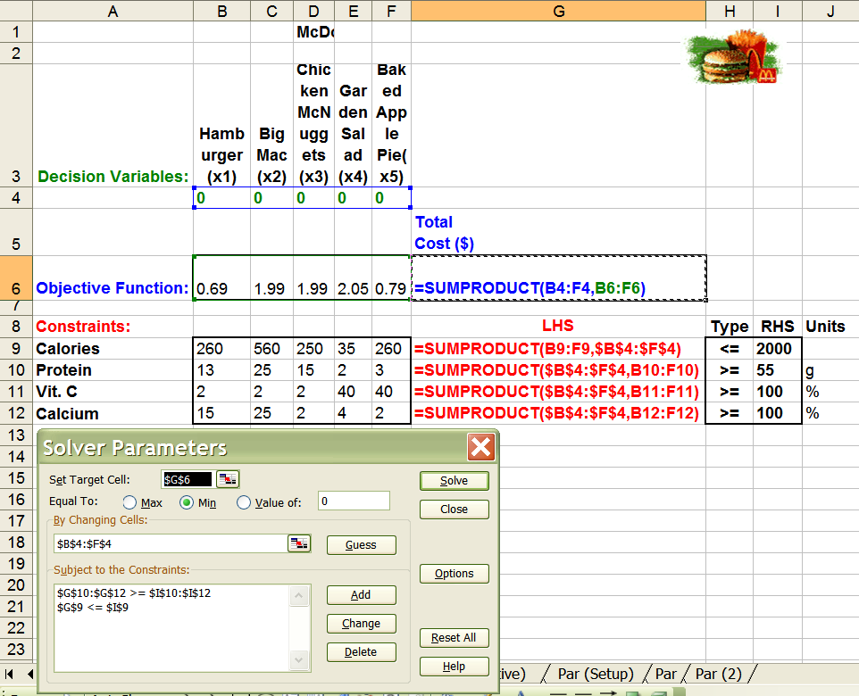
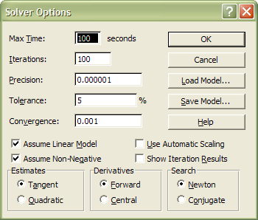
McDonald’s Problem – Use of Solver
[03] Tools -> Solver ...
[07] Data tab -> Data Tools
What-If Analysis
Solver
Objective: MIN G6
Variables: B4:F4
Constraints: G9 <= I9
G10:G12>= I10:I12
Options: Assume Linear Model
Assume Non-Negative

Slide 7
Answer Report-Binding & Slack Constraints
Optimal objective
function value
Optimal decision
variable values
(or Optimal
Solution)
Constraints:
Binding means LHS=RHS, implies Slack =0
Not Binding means LHS>(<)RHS, implies Slack>(<)0

Slide 8
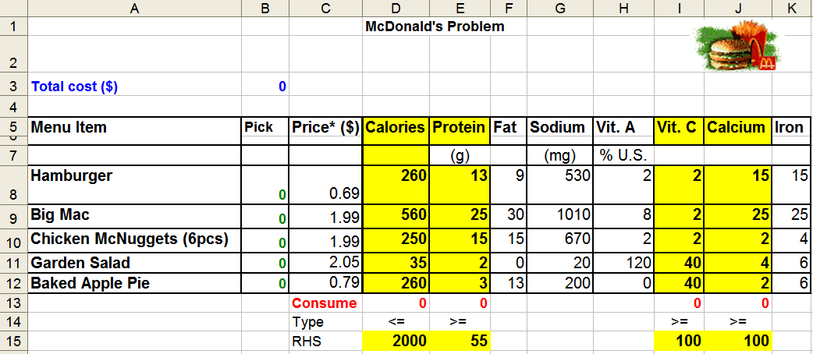
Alternative Spreadsheet Setup
Build model upon the existing data structure
Decision variable cells
B8:B12
Objective function cell
B3
Constraint cells
D13:E13, I13:J13
Decision variable cells: fill zeros as initial values in cells C8:K12
Objective function cell:
B3 = SUMPRODUCT( C8:C12,$B$8:$B$12)
Constraint cells:
D13 = SUMPRODUCT(D8:D12,$B$8:$B$12)
Copied to E13, I13:J13
Objective: MIN B3
Variables: B8:B12
Constraints: D13 <= D15
E13>= E15
I13:J13 >= I15:J15
Options: Assume Linear Model
Assume Non-Negative

Slide 9
Linear Programming Terms
Decision variables
The controllable inputs to the model
Should completely describe the decisions to be made
e.g. In the McDonald’s diet problem: #s of hamburgers, Big Macs, Chicken McNuggets, Garden Salads, and Apple Pies
Objective function
The decision maker wants to maximize (usually revenue or profit) or minimize (usually cost) some function of decision variables. The function to be maximized or minimized is called the objective function.
e.g. In the McDonald’s diet problem: minimize cost (money spent on McDonald’s food)
Constraints
Restrictions placed on a decision variable or a group of decision variables
e.g. In the McDonald’s diet problem: nutrition requirements, i.e., calories, protein, vitamin C, Calcium

Slide 10
Linear Programming Definition
A linear programming (LP) is an optimization problem for which we do the following:
(1) We attempt to maximize/minimize a linear function of a finite number of decision variables.
Linear function: each variable appears in a separate term together with its coefficient
(2) The values of the decision variables must satisfy a finite set of constraints. Each constraint must be a linear equation or a linear inequality.
(3) A sign restriction is associated with each variable. For any variable, x_{i}, the sign restriction specifies that either x_{i} must be nonnegative (x_{i} ≥ 0) or that x_{i} may be unrestricted in sign.
e.g. 2x + 3y, 3.5x, 7.5y
2x + 3y = 10
3x + 4.5y ≤ 100
4x - 3.5y ≥ 50
Is a linear constraint?

Slide 11
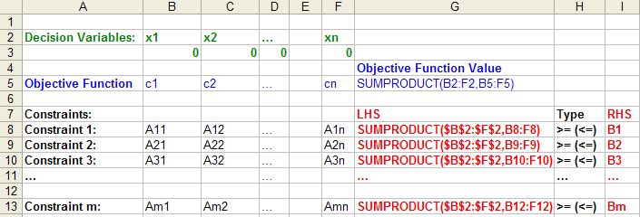
Example
McDonald’s Diet Problem:
MIN 0.69x₁+ 1.99x₂+ 1.99x₃+ 2.05x₄+ 0.79x₅ Linear Objective Function
s.t.
Calories: 260x₁+ 560x₂ + 250x₃+ 35x₄+ 260x₅ ≤ 2000
Protein (in g): 13x₁ +25x₂ + 15x₃ + 2x₄ + 3x₅ ≥ 55 Linear
Vit. C (in %): 2x₁ + 2x₂ + 2x₃ + 40x₄+40x₅ ≥100 Constraints
Calcium (in %): 15x₁+ 25x₂ + 2x₃ + 4x₄+ 2x₅ ≥100
Non-negativity: x₁≥ 0, x₂ ≥ 0, x₃≥ 0, x₄≥ 0, x₅≥ 0 Sign Restriction
General Example:
MAX(MIN) c₁ x₁ + c₂ x₂ + c₃ x₃ + …. +c_{n} x_{n}
ST:
Constraint 1: A₁₁ x₁ + A₁₂ x₂ + A₁₃ x₃ + …. +A_{1n} x_{n} > (≤) B₁
Constraint 2: A₂₁ x₁ + A₂₂ x₂ + A₂₃ x₃ + ….+ A_{2n} x_{n} > (≤) B₂
Constraint 3: A₃₁ x₁ + A₃₂ x₂ + A₃₃ x₃ + …. +A_{3n} x_{n} > (≤) B₃
………
………
Constraint m: A_{m1} x₁ + A_{m2} x₂ + A_{m3} x₃ +…+A_{mn} x_{n} > (≤) B_{m}
x_{i}'s ≥ 0 or unrestricted

