Slide 1
MGT 207 Production and Operations Management
Process Strategy and Analysis

Slide 2
Agenda
Process Strategies
Process Focus, Repetitive Focus, Product Focus, Mass Customization
Process Investment
Break-Even Analysis
Process Analysis
Capacity
Throughput
Notes:
Add a slide on productivity etc. concepts in second hw problem

Slide 3
Process Strategy
The objective is to create a process to produce offerings that meet customer requirements within cost and other managerial constraints

Slide 4
Process, Volume, and Variety
Figure 7.1
Volume
Low Volume
Repetitive Process
High Volume
High Variety
one or few units per run,
(allows customization)
Process Focus
projects, job shops (machine, print, hospitals, restaurants)
Mass Customization
(difficult to achieve, but huge rewards)
Dell Computer
Changes in Modules
modest runs, standardized modules
Variety (flexibility)
Repetitive
(autos, motorcycles, home appliances)
Harley-Davidson
Changes in Attributes (such as grade, quality, size, thickness, etc.)
long runs only
Poor Strategy (Both fixed and variable costs are high)
Product Focus
(commercial baked goods, steel, glass, beer)
Frito-Lay

Slide 5
Process Choice Based on Costs
Fixed vs. Variable Costs

Slide 6
Crossover Chart Example
Evaluate three different accounting software products
Calculate crossover points between software A and B and between software B and C
 | TOTAL FIXED COST | DOLLARS REQUIRED PER ACCOUNTING REPORT
Software A | $200,000 | $60
Software B | $300,000 | $25
Software C | $400,000 | $10

Slide 7
Crossover Charts
$
Variable costs
$
Variable costs
$
Variable costs
Fixed costs
Fixed costs
Fixed costs
Low volume, high variety
Process A
Repetitive
Process B
High volume, low variety
Process C
$
Total process B costs
Total process A costs
Total process C costs
400,000
300,000
200,000
Fixed cost Process C
Fixed cost Process B
Fixed cost Process A
Figure 7.3
(2,857)
V₁
V₂
(6,666)
Volume

Slide 8
Process Choice Based On Capacity
Bottleneck Analysis

Slide 9
Outline
Capacity
Bottleneck Analysis and the Theory of Constraints

Slide 10
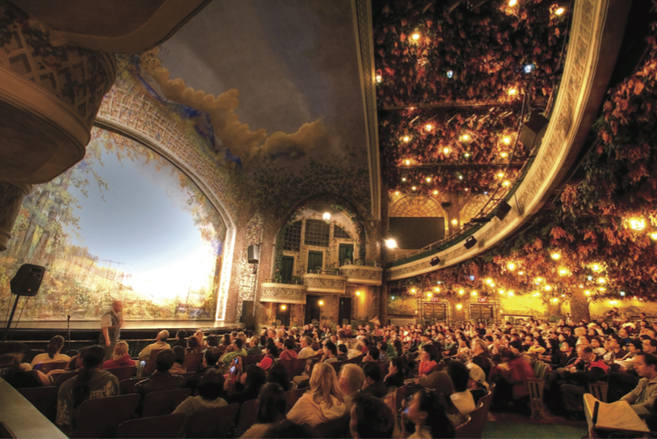
Capacity
The throughput, or the number of units a facility can hold, receive, store, or produce in a period of time
Determines fixed costs
Determines if demand will be satisfied
Notes:
This slide provides some reasons that capacity is an issue. The following slides guide a discussion of capacity.

Slide 11
Design and Effective Capacity
Design capacity is the maximum theoretical output of a system
Normally expressed as a rate
Effective capacity is the capacity a firm expects to achieve given current operating constraints
Often lower than design capacity
Notes:
This slide can be used to frame a discussion of capacity.
Points to be made might include:
- capacity definition and measurement is necessary if we are to develop a production schedule
- while a process may have “maximum” capacity, many factors prevent us from achieving that capacity on a continuous basis.
Students should be asked to suggest factors which might prevent one from achieving maximum capacity.

Slide 12

Design and Effective Capacity
TABLE S7.1 | Capacity Measurements
MEASURE |  | DEFINITION | EXAMPLE
Design capacity |  | Ideal conditions exist during the time that the system is available | Machines at Frito-Lay are designed to produce 1,000 bags of chips/hr., and the plant operates 16 hrs./day. Design Capacity = 1,000 bags/hr. × 16 hrs. = 16,000 bags/day
Notes:
This slide can be used to frame a discussion of capacity.
Points to be made might include:
- capacity definition and measurement is necessary if we are to develop a production schedule
- while a process may have “maximum” capacity, many factors prevent us from achieving that capacity on a continuous basis.
Students should be asked to suggest factors which might prevent one from achieving maximum capacity.

Slide 13

Design and Effective Capacity
TABLE S7.1 | Capacity Measurements
MEASURE |  | DEFINITION | EXAMPLE
Effective capacity |  | Design capacity minus lost output because of planned resource unavailability (e.g., preventive maintenance, machine setups/changeovers, changes in product mix, scheduled breaks) | Frito-Lay loses 3 hours of output per day (= 0.5 hrs./day on preventive maintenance, 1 hr./day on employee breaks, and 1.5 hrs./day setting up machines for different products). Effective Capacity = 16,000 bags/day – (1,000 bags/hr.) (3 hrs./day) = 16,000 bags/day – 3,000 bags/day = 13,000 bags/day
Notes:
This slide can be used to frame a discussion of capacity.
Points to be made might include:
- capacity definition and measurement is necessary if we are to develop a production schedule
- while a process may have “maximum” capacity, many factors prevent us from achieving that capacity on a continuous basis.
Students should be asked to suggest factors which might prevent one from achieving maximum capacity.

Slide 14

Design and Effective Capacity
TABLE S7.1 | Capacity Measurements
MEASURE |  | DEFINITION | EXAMPLE
Actual output |  | Effective capacity minus lost output during unplanned resource idleness (e.g., absenteeism, machine breakdowns, unavailable parts, quality problems) | On average, machines at Frito-Lay are not running 0.25 hr./day due to late parts and machine breakdowns. Actual Output = 13,000 bags/day – (1,000 bags/hr.) (0.25 hr./day) = 13,000 bags/day – 250 bags/day = 12,750 bags/day
Notes:
This slide can be used to frame a discussion of capacity.
Points to be made might include:
- capacity definition and measurement is necessary if we are to develop a production schedule
- while a process may have “maximum” capacity, many factors prevent us from achieving that capacity on a continuous basis.
Students should be asked to suggest factors which might prevent one from achieving maximum capacity.

Slide 15
Utilization and Efficiency
Utilization is the percentage of design capacity actually achieved
Utilization = Actual output/Design capacity
Efficiency is the percentage of effective capacity actually achieved
Efficiency = Actual output/Effective capacity

Slide 16
Bakery Example
Design Capacity
Actual production last week = 148,000 rolls
Effective capacity = 175,000 rolls
Design capacity = 1,200 rolls per hour
Bakery operates 7 days/week, three 8-hour shifts
Design capacity = (7 x 3 x 8) x (1,200) = 201,600 rolls
Notes:
It might be useful at this point to discuss typical equipment utilization rates for different process strategies if you have not done so before.

Slide 17
Bakery Example
Utilization
Actual production last week = 148,000 rolls
Effective capacity = 175,000 rolls
Design capacity = 1,200 rolls per hour
Bakery operates 7 days/week, 3 - 8 hour shifts
Design capacity = (7 x 3 x 8) x (1,200) = 201,600 rolls
Utilization = 148,000/201,600 = 73.4%
Notes:
It might be useful at this point to discuss typical equipment utilization rates for different process strategies if you have not done so before.

Slide 18
Bakery Example
Efficiency
Actual production last week = 148,000 rolls
Effective capacity = 175,000 rolls
Design capacity = 1,200 rolls per hour
Bakery operates 7 days/week, 3 - 8 hour shifts
Design capacity = (7 x 3 x 8) x (1,200) = 201,600 rolls
Utilization = 148,000/201,600 = 73.4%
Efficiency = 148,000/175,000 = 84.6%
Notes:
It might be useful at this point to discuss typical equipment utilization rates for different process strategies if you have not done so before.

Slide 19
Bakery Example
Design Capacity
Actual production last week = 148,000 rolls
Effective capacity = 175,000 rolls
Design capacity = 201,600 rolls per line
Efficiency = 84.6%
Expected output of new line = 130,000 rolls
Design capacity = 201,600 x 2 = 403,200 rolls
Expansion
Notes:
It might be useful at this point to discuss typical equipment utilization rates for different process strategies if you have not done so before.

Slide 20
Bakery Example
Effective
Capacity
Actual production last week = 148,000 rolls
Effective capacity = 175,000 rolls
Design capacity = 201,600 rolls per line
Efficiency = 84.6%
Expected output of new line = 130,000 rolls
Design capacity = 201,600 x 2 = 403,200 rolls
Effective capacity = 175,000 x 2 = 350,000 rolls
Expansion
Notes:
It might be useful at this point to discuss typical equipment utilization rates for different process strategies if you have not done so before.

Slide 21
Bakery Example
Actual Output
Actual production last week = 148,000 rolls
Effective capacity = 175,000 rolls
Design capacity = 201,600 rolls per line
Efficiency = 84.6%
Expected output of new line = 130,000 rolls
Design capacity = 201,600 x 2 = 403,200 rolls
Effective capacity = 175,000 x 2 = 350,000 rolls
Actual output = 148,000 + 130,000 = 278,000 rolls
Expansion
Notes:
It might be useful at this point to discuss typical equipment utilization rates for different process strategies if you have not done so before.

Slide 22
Bakery Example
Utilization
Efficiency
Actual production last week = 148,000 rolls
Effective capacity = 175,000 rolls
Design capacity = 201,600 rolls per line
Efficiency = 84.6%
Expansion
Expected output of new line = 130,000 rolls
Design capacity = 201,600 x 2 = 403,200 rolls
Effective capacity = 175,000 x 2 = 350,000 rolls
Actual output = 148,000 + 130,000 = 278,000 rolls
Utilization = 278,000/403,200 = 68.95%
Efficiency = 278,000/350,000 = 79.43%
Notes:
It might be useful at this point to discuss typical equipment utilization rates for different process strategies if you have not done so before.

Slide 23
Managing Capacity and Demand
Demand exceeds capacity
Curtail demand by raising prices, scheduling longer lead times, discouraging marginally profitable business
Long-term solution is to increase capacity
Capacity exceeds demand
Stimulate market
Product changes
Adjusting to seasonal demands
Produce products with complementary demand patterns

Slide 24
Process Analysis
Determine system capacity and throughput time
Panda Express wants to know how many customers they can serve in a day
Amazon is interested in learning how many packages they can process and ship from its warehouses
Identify bottlenecks in a process and understand how to manage them

Slide 25
Capacity and Throughput
Process time
Time required to produce a unit at a workstation
Subways have three work stations
Throughput time
(Flow time)
Time required to get through the entire process from start to end
Throughput
Average rate units actually being processed (output/unit time)
Capacity
Maximum average output rate (output/unit time) that the system can maintain under normal conditions
Throughput is Less Than or Equal to Capacity
Notes:
Capacity: the maximum productive capability of a process or facility, usually measured as a quantity of output per unit time (rate).
How many of you would agree with that flow time is a measure of capacity? No it is not. CAPACITY IS ALWAYS A RATE!!

Slide 26
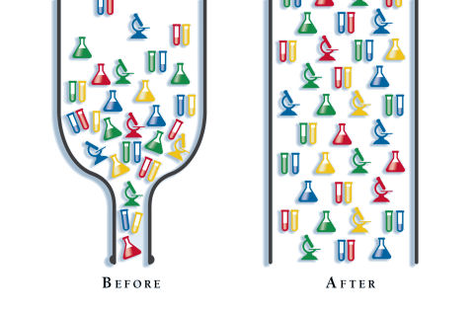
What is a Bottleneck?
Bottleneck
Definition
The step in the production/service delivery process:
a) that has the lowest capacity when measured
using a comparable unit of measure and, therefore,
b) that limits the overall output of the system.
How Do You
Find A
Bottleneck?
a) On paper: Determine the capacity - using a comparable measure - of each step in the process.
b) Line of sight: Find the place in the production process that has the highest level of Work-In-Process (WIP) inventory.
Notes:
Focus the story with an example - say a steel mill - that involves several steps.
Some steps operate at a high processing rate, others at a low processing rate. Somewhere, in the process, one or more of those steps are dragging down the production rate - i.e. the slowest ones. They are the bottlenecks.
Focus on issue of comparable units of measure.

Slide 27
Capacity Analysis
Assembly line
Order
Bread
Fill
Toaster
Wrap/
Deliver
30 sec/sandwich
15 sec/sandwich
20 sec/sandwich
40 sec/sandwich
37.5 sec/sandwich
$$Capacity=3600\frac{sec}{hr}x\frac{1}{40} \frac{sandwich}{sec}=90 sandwiches/hr$$
$Throughput time=30+15+20+40+37.5=142.5 sec$
Instead, we can convert processing times (sec/sandwich) to capacity of the individual stages (e.g. sandwiches/hr) and pick the stage with the lowest capacity

Slide 28



Capacity Analysis: Parallel Processes
First assembly line
Bread
Fill
Toaster
Order
15 sec/sandwich
20 sec/sandwich
40 sec/sandwich
Wrap/
Deliver
30 sec/sandwich
Bread
Fill
Toaster
37.5 sec/sandwich
15 sec/sandwich
20 sec/sandwich
40 sec/sandwich
Second assembly line
$\frac{\text{15}}{\text{2}}\text{=7.5}$ sec/sand
$\frac{\text{20}}{\text{2}}\text{=10 }$sec/sand
$\frac{\text{40}}{\text{2}}\text{=20}$ sec/sand
$$\text{Capacity}\text{=}\frac{\text{1}}{\text{37.5}} \frac{\text{sandwich}}{\text{sec}}\text{x} \text{3600}\frac{\text{sec}}{\text{hr}}\text{=96 }\text{sandwiches}\text{/}\text{hr}$$
$\text{Throughput} \text{time}\text{=30+15+20+40+37.5=142.5 }\text{sec}$
Has the capacity of the restaurant doubled after doubling the capacity of the (previous) bottleneck?

Slide 29
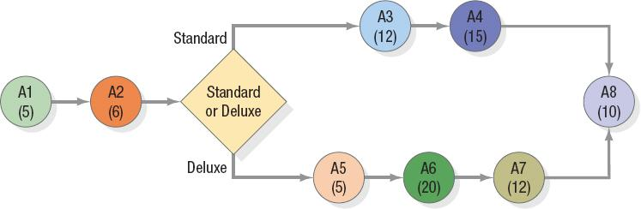
Example 1 (1 of 4)
Keith’s Car Wash offers two types of washes: Standard and Deluxe. The process flow for both types of customers is shown in the following chart. Both wash types are first processed through steps A1 and A2. The Standard wash then goes through steps A3 and A4 while the Deluxe is processed through steps A5, A6, and A7. Both offerings finish at the drying station (A8). The numbers in parentheses indicate the minutes it takes for that activity to process a customer.
Figure 6.1 Process Flow for Keith’s Car Wash

Slide 30
Q1
Q: Which step is the bottleneck for the Standard car wash process? For the Deluxe car wash process?
A: Step A4 is the bottleneck for the Standard car wash process, and Step A6 is the bottleneck for the Deluxe car wash process, because these steps take the longest time in the flow.

Slide 31
Q2
Q: What is the capacity (measured as customers served per hour) of Keith’s Car Wash to process Standard and Deluxe customers? Assume that no customers are waiting at step A1, A2, or A8.
A: The capacity for Standard washes is 4 customers per hour because the bottleneck step A4 can process 1 customer every 15 minutes. The capacity for Deluxe car washes is 3 customers per hour.

Slide 32
Q3
Q: If 60 percent of the customers are Standard and 40 percent are Deluxe, what is the average capacity of the car wash in customers per hour?
A: The average capacity of the car wash (0.6 x 4)+(0.4 x 3) = 3.6 customers per hour

Slide 33
Q4
Q: Where would you expect Standard wash customers to experience waiting lines, assuming that new customers are always entering the shop and that no Deluxe customers are in the shop? Where would the Deluxe customers have to wait, assuming no Standard customers?
A: Standard wash customers would wait before steps A1, A2, A3, and A4 because the activities that immediately precede them have a higher rate of output (i.e., smaller processing times). Deluxe wash customers would experience a wait in front of steps A1, A2, and A6 for the same reasons. A1 is included for both types of washes because the arrival rate of customers could always exceed the capacity of A1.

Slide 34
Drum-Buffer-Rope Systems (1 of 3)
Drum-Buffer-Rope
A planning and control system that regulates the flow of work-in-process materials at the bottleneck or the capacity constrained resource (C C R) in a productive system

Slide 35
Drum-Buffer-Rope Systems (2 of 3)
The bottleneck schedule is the drum because it sets the beat or the production rate for the entire plant and is linked to market demand.
The buffer is the time buffer that plans early flows into the bottleneck and thus protects it from disruption.
The rope represents the tying of material release to the drumbeat, which is the rate at which the bottleneck controls the throughput of the entire plant.
Buffer management constantly monitors the execution of incoming bottleneck work.

Slide 36
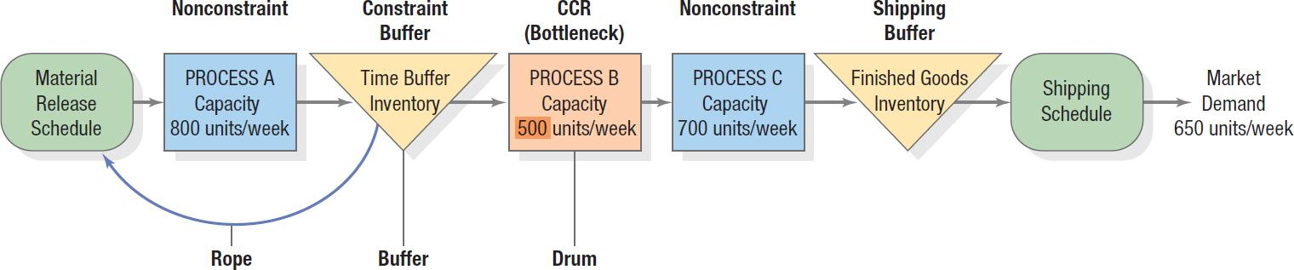
Drum-Buffer-Rope Systems (3 of 3)
Figure 6.3 Drum-Buffer-Rope System

Slide 37
Summary
A bottleneck is a point in the production process where work slows down or stalls, creating a constraint on the overall flow. It's like the narrowest part of a bottle – it determines the maximum rate at which liquid can flow out.
Bottlenecks can occur anywhere in the production chain, from machines breaking down to inefficient processes or even a lack of skilled labor.
Identify the bottleneck: Thoroughly analyze your production process to pinpoint where the slowdown is occurring.

