Slide 1
Modeling and Solving Constraints
Erin Catto
Blizzard Entertainment
Notes:
Just one approach, but a ubiquitous one.

Slide 2
Executive Summary
Constraints are used to simulate joints, contact, and collision.
We need to solve the constraints to stack boxes and to keep ragdoll limbs attached.
Constraint solvers do this by calculating impulse or forces, and applying them to the constrained bodies.

Slide 3
Overview
Constraint Formulas
Deriving Constraints
  Joints, Motors, Contact
Building a Constraint Solver

Slide 4
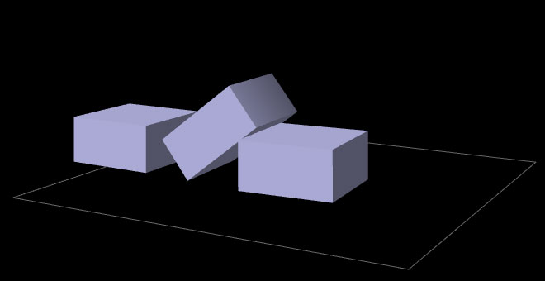
Constraint Types
Contact and Friction

Slide 5
Constraint Types
Ragdolls

Slide 6
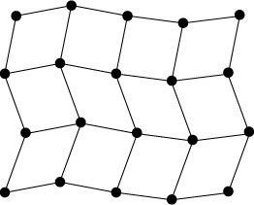
Constraint Types
Particles and Cloth

Slide 7
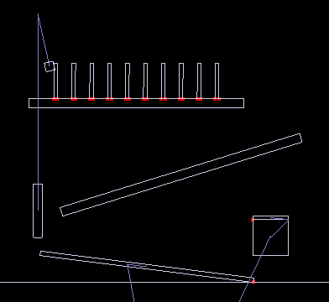
Show Me the Demo!

Slide 8

Motivation
Bead on a Rigid Wire (2D)
Implicit Function
This is a constraint equation!

Slide 9



Velocity
The normal vector is perpendicular to the curve.
So this dot product is zero:
Notes:
This is constraint on the velocity.

Slide 10

Velocity Constraint
Position Constraint:
If C is zero, then its time derivative should be zero.
Velocity Constraint:
Notes:
Cdot = dC/dt

Slide 11
Velocity Constraint
Velocity constraints define the allowed motion.
Velocity constraints can be satisfied by applying impulses.
More on that later.

Slide 12

The Jacobian
Due to the chain rule the velocity constraint has a special structure:
J is the Jacobian.

Slide 13

The Jacobian
The Jacobian is perpendicular to the velocity.
Notes:
J maps Cartesian motion into constraint motion.

Slide 14

The Velocity Map
v
J
Cartesian
Space
Velocity
Constraint
Space
Velocity

Slide 15
Constraint Force
Assume the wire is frictionless.
What is the force between the wire and the bead?

Slide 16

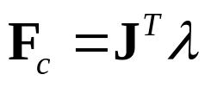
Lagrange Multiplier
Intuitively the constraint force F_{c} is parallel to the normal vector.
Direction known.
Magnitude unknown.
implies
Notes:
JT maps forces in the constraint space into Cartesian space.

Slide 17
Lagrange Multiplier
Lambda is the constraint force signed magnitude.
How do we compute lambda?
That is the solver’s job.
Solvers are discussed later.

Slide 18

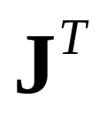
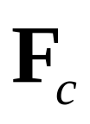
The Force Map
Constraint
Space
Force
Cartesian
Space
Force

Slide 19
Work, Energy, and Power
Work = Force times Distance
Work has units of Energy (Joules)
Power = Force times Velocity (Watts)

Slide 20

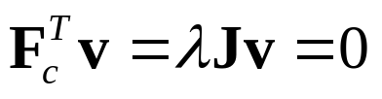
Principle of Virtual Work
Constraint forces do no work, so they must be perpendicular to the allowed velocity.
Assertion:
Proof:
So the constraint force doesn’t affect energy.

Slide 21


Constraint Quantities
Position Constraint
Velocity Constraint
Jacobian
Lagrange Multiplier

Slide 22
Why all the Painful Abstraction?
To put all manner of constraints into a common form for the solver.
To allow us to efficiently try different solution techniques.

Slide 23
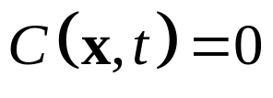

Time Dependence
Some constraints, like motors, have prescribed motion.
This is represented by time dependence.
Position:
Velocity:
velocity bias

Slide 24
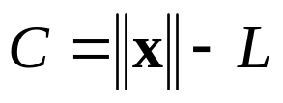
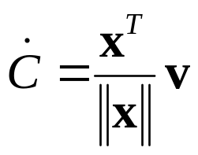
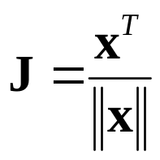


Example: Distance Constraint
Position:
x
y
L
Velocity:
particle
Jacobian:
is the tension
Velocity Bias:
Notes:
particle attached to ground by a massless rod. lambda is the tension.

Slide 25
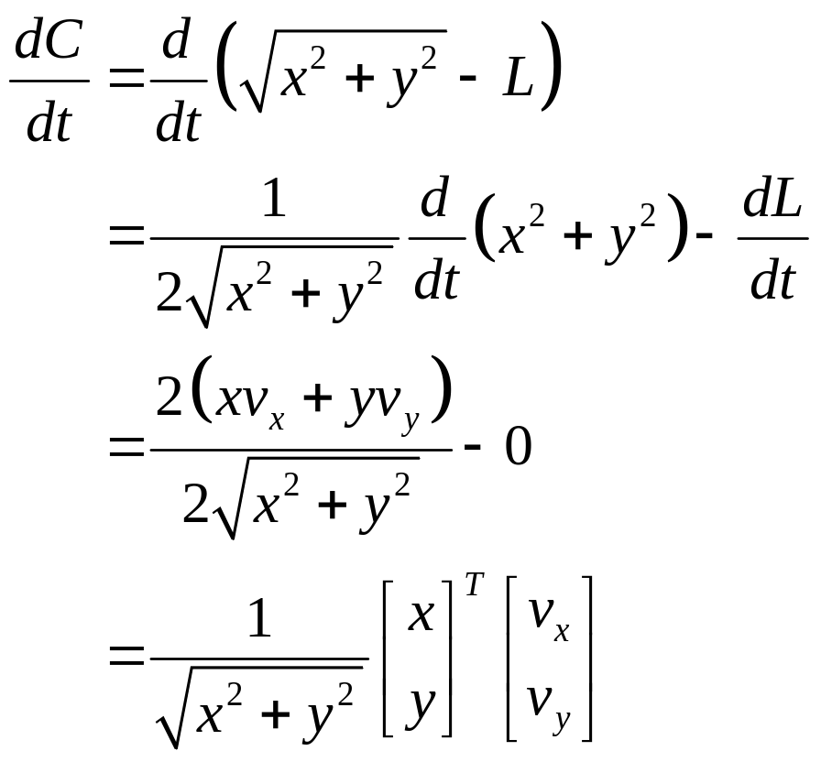
Gory Details

Slide 26
Computing the Jacobian
At first, it is not easy to compute the Jacobian.
It helps to have the constraint equation first.
It gets easier with practice.
Try to think in terms of vectors.

Slide 27

A Recipe for J
Use geometry to write C.
Differentiate C with respect to time.
Isolate v.
Identify J by inspection (and b).
Don’t compute partial derivatives!

Slide 28
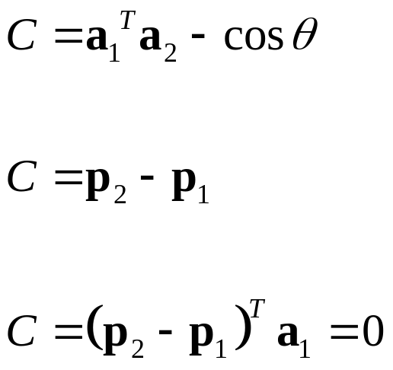
Homework
Angle Constraint:
Point Constraint:
Line Constraint:

Slide 29

Newton’s Law
We separate applied forces and
constraint forces.

Slide 30
Types of Forces
Applied forces are computed according to some law: F = mg, F = kx, etc.
Constraints impose kinematic (motion) conditions.
Constraint forces are implicit.
We must solve for constraint forces.

Slide 31
Constraint Potpourri
Joints
Motors
Contact
Restitution
Friction

Slide 32
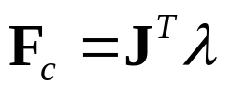

Joint: Distance Constraint
x
y
v

Slide 33



Motors
A motor is a constraint with limited force (torque).
Example
A Wheel
Note: this constraint does work.

Slide 34



Velocity Only Motors
Example
Usage: A wheel that spins at a constant rate.
We don’t care about the angle.

Slide 35

Inequality Constraints
So far we’ve looked at equality constraints (because they are simpler).
Inequality constraints are needed for contact, joint limits, rope, etc.

Slide 36


Inequality Constraints
What is the velocity constraint?
If
enforce:
Else
skip constraint

Slide 37

Inequality Constraints
Force Limits:
Inequality constraints don’t suck.

Slide 38
Contact Constraint
Non-penetration.
Restitution: bounce
Friction: sliding, sticking, and rolling

Slide 39




Non-Penetration Constraint
body 2
(separation)
body 1

Slide 40
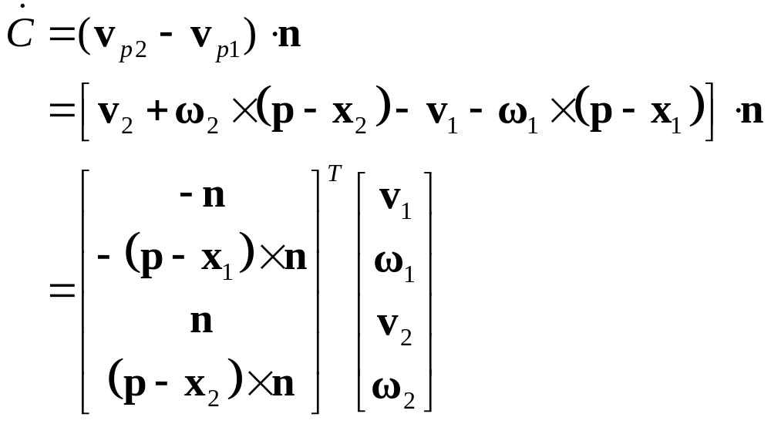
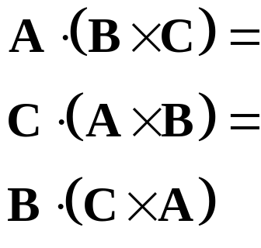
Non-Penetration Constraint
Handy Identities
J
v

Slide 41
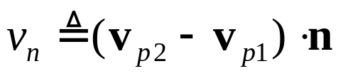
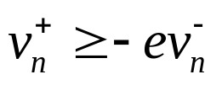
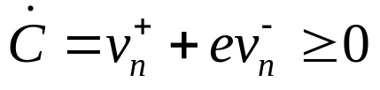
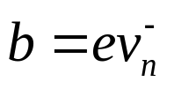
Restitution
Relative normal velocity
Velocity Reflection
Adding bounce as a velocity bias

Slide 42
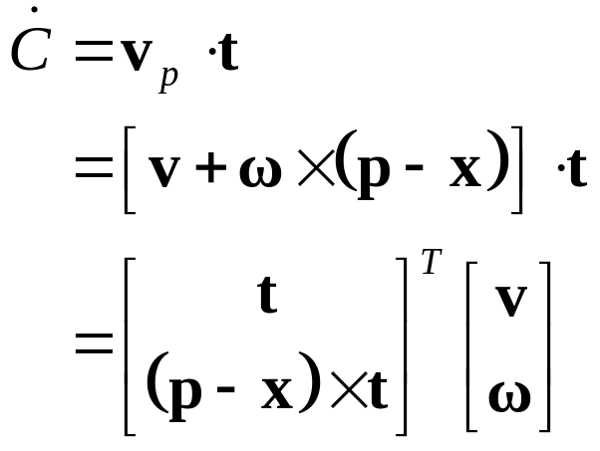

Friction Constraint
Friction is like a velocity-only motor.
The target velocity is zero.
J
v

Slide 43
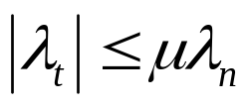


Friction Constraint
The friction force is limited by the normal force.
Coulomb’s Law:
Or:
Where:

Slide 44
What is a Solver?
Collect all forces and integrate velocity and position.
Apply constraint forces to ensure the new state satisfies the constraints.
We must solve for the constraint forces because they are implicit.

Slide 45
Solver Types
Global Solvers (slow)
Iterative Solvers (fast)

Slide 46
Solving A Chain
Global:
solve for λ1, λ2, and λ3 simultaneously.
λ₁
λ₂
Iterative:
while !done
solve for λ1
solve for λ2
solve for λ3
λ₃

Slide 47
Sequential Impulses (SI)
An iterative solver.
SI applies impulses at each constraint to correct velocity errors.
SI is fast and stable (usually).
Converges to a global solution (eventually).

Slide 48
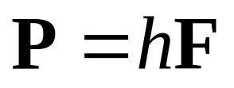
Why Impulses?
Easier to deal with friction and collision.
Velocity is more intuitive than acceleration.
Given the time step, impulse and force are interchangeable.

Slide 49
Sequential Impulses
Step1:
Integrate applied forces, yielding new velocities.
Step2:
Apply impulses sequentially for all constraints, to correct the velocity errors.
Step3:
Use the new velocities to update the positions.

Slide 50
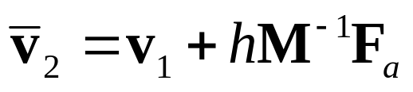
Step 1 :
Integrate Applied Forces
Euler’s Method
This new velocity tends to violate the velocity constraints.

Slide 51
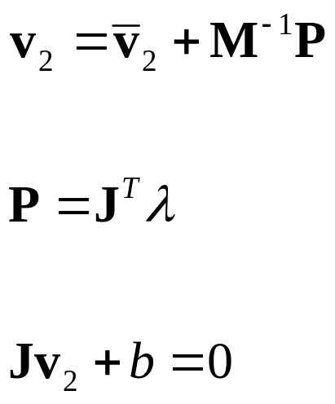
Step 2:
Apply Corrective Impulses
For each constraint, solve:
Newton:
Virtual Work:
Velocity Constraint:

Slide 52
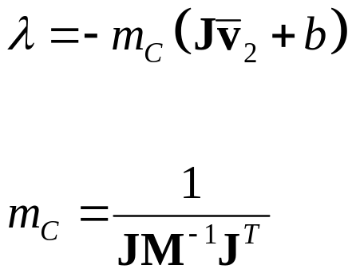
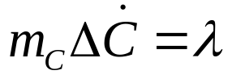
Step 2: Impulse Solution
The scalar m_{C} is the effective mass seen by
the constraint impulse:

Slide 53
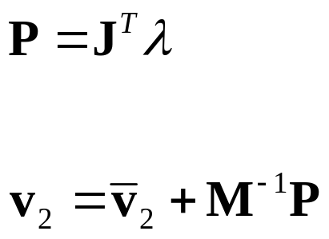
Step 2: Velocity Update
Now that we solved for lambda, we can use it
to update the velocity.

Slide 54
Step 2: Iteration
Loop over all constraints until you are done:
  - Fixed number of iterations.
  - Corrective impulses become small.
  - Velocity errors become small.

Slide 55
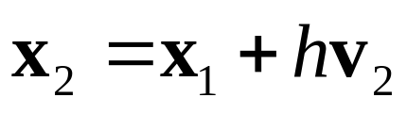
Step 3: Integrate Positions
Use the new velocity:
This is the Symplectic Euler integrator.

Slide 56
Extensions to Step 2
Handle position drift.
Handle force limits.
Handle inequality constraints.

Slide 57
Handling Position Drift
Velocity constraints are not obeyed precisely.
Joints will fall apart.

Slide 58
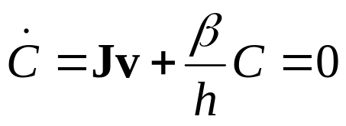

Baumgarte Stabilization
Feed the position error back into the velocity constraint.
New velocity constraint:
Bias factor:

Slide 59
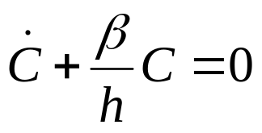
Baumgarte Stabilization
What is the solution to:
???
ODE …
First-order differential equation …

Slide 60
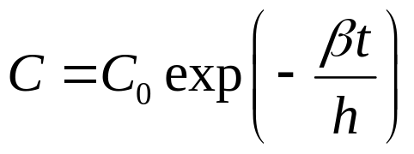
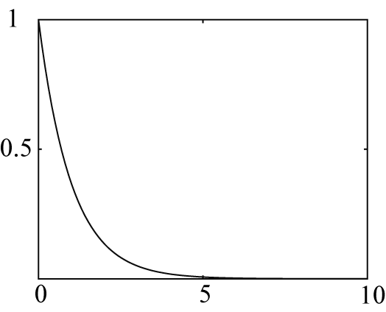
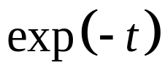
Answer

Slide 61
Tuning the Bias Factor
If your simulation has instabilities, set the bias factor to zero and check the stability.
Increase the bias factor slowly until the simulation becomes unstable.
Use half of that value.

Slide 62
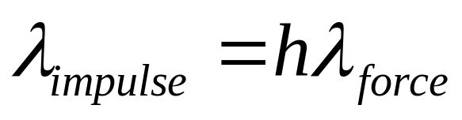
Handling Force Limits
First, convert force limits to impulse limits.

Slide 63
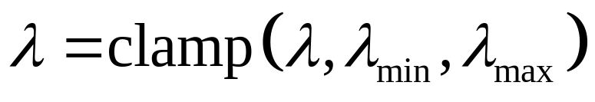
Handling Impulse Limits
Clamping corrective impulses:
Is it really that simple?
Hint: no.

Slide 64
How to Clamp
Each iteration computes corrective impulses.
Clamping corrective impulses is wrong!
You should clamp the total impulse applied over the time step.
The following example shows why.

Slide 65
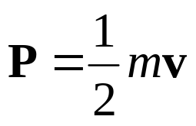

Example: Inelastic Collision
A Falling Box
v
Global Solution

Slide 66


Iterative Solution
iteration 1
constraint 1
constraint 2
constraint 1
Suppose the corrective impulses are too strong.
What should the second iteration look like?

Slide 67
Iterative Solution
iteration 2
To keep the box from bouncing, we need
downward corrective impulses.
In other words, the corrective impulses are
negative!

Slide 68
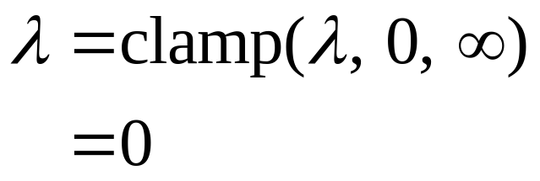
Iterative Solution
But clamping the negative corrective impulses
wipes them out:
This is a nice way to introduce jitter into
your simulation. ☺

Slide 69
Accumulated Impulses
For each constraint, keep track of the total impulse applied.
This is the accumulated impulse.
Clamp the accumulated impulse.
This allows the corrective impulse to be negative when the accumulated impulse is still positive.

Slide 70
New Clamping Procedure
Step A:
Compute the corrective impulse, but don’t apply it.
Step B:
Add the corrective impulse to the accumulated impulse.
Step C:
Clamp the accumulated impulse.
Step D:
Compute the change in the accumulated impulse.
Step E:
Apply the impulse found in Step D.

Slide 71
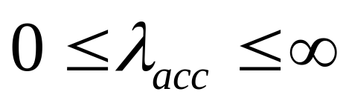
Handling Inequality Constraints
Before iterations, determine if the inequality constraint is active.
If it is inactive, then ignore it.
Clamp accumulated impulses:

Slide 72
Inequality Constraints
A problem:
overshoot
gravity
active
inactive
active
Jitter is not nice!

Slide 73
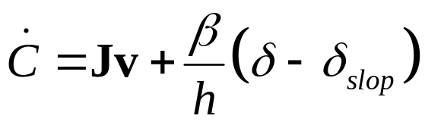

Preventing Overshoot
Allow a little bit of penetration (slop).
If separation < slop factor
Else
Note: the slop factor will be negative (separation).

Slide 74
Other Important Topics
Warm Starting
Split Impulses

Slide 75
Warm Starting
Iterative solvers use an initial guess for the lambdas.
So save the lambdas from the previous time step.
Use the stored lambdas as the initial guess for the new step.
Benefit: improved stacking.

Slide 76
Step 1.5
Apply the stored lambdas.
Use the stored lambdas to initialize the accumulated impulses.

Slide 77
Step 2.5
Store the accumulated impulses.

Slide 78
Split Impulses
Baumgarte stabilization affects momentum.
This is bad, bad, bad!
Unwanted bounces
Spongy contact
Jet propulsion

Slide 79

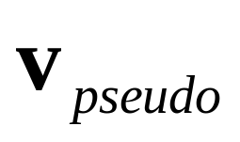
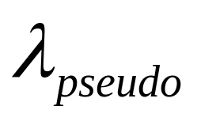
Split Impulses
Use different velocity vectors and impulses.
Real:
Pseudo:
Two parallel solvers.

Slide 80
Split Impulses
The real velocity only sees pure velocity constraints.
The pseudo velocity sees position feedback (Baumgarte).
The Jacobians are the same!

Slide 81
Pseudo Velocity
The pseudo velocity is initialized to zero each time step.
The pseudo accumulated impulses don’t use warm starting (open issue).

Slide 82
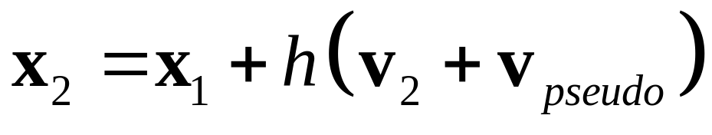
Step 3 (revised):
Integrate Positions
Use the combined velocity:

Slide 83
Further Reading
http://www.cs.cmu.edu/~baraff/sigcourse/notesf.pdf
http://www.gphysics.com/downloads/
http://www.continuousphysics.com
And the references found there.

Slide 84
Box2D Demo
An open source 2D physics engine.
http://www.gphysics.com/box2d
A test bed and a learning aid.

