Slide 1
Modeling and Solving Constraints
Erin Catto
Blizzard Entertainment
Notes:
Just one approach, but a ubiquitous one.

Slide 2
Basic Idea
Constraints are used to simulate joints, contact, and collision.
We need to solve the constraints to stack boxes and to keep ragdoll limbs attached.
Constraint solvers do this by calculating impulse or forces, and applying them to the constrained bodies.

Slide 3
Overview
Constraint Formulas
  Jacobians, Lagrange Multipliers
Modeling Constraints
  Joints, Motors, Contact
Building a Constraint Solver
  Sequential Impulses

Slide 4
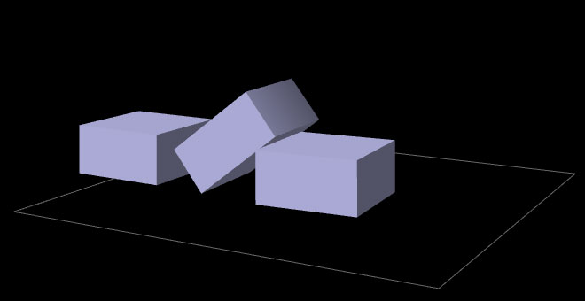
Constraint Types
Contact and Friction

Slide 5
Constraint Types
Ragdolls

Slide 6
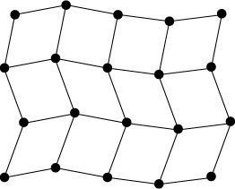
Constraint Types
Particles and Cloth

Slide 7
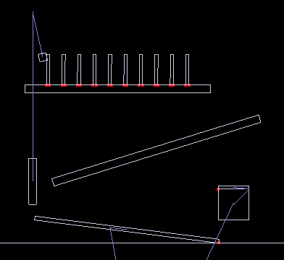
Show Me the Demo!

Slide 8
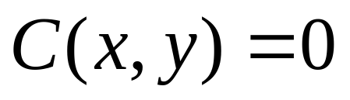
Bead on a 2D Rigid Wire
Implicit Curve Equation:
This is the position constraint.

Slide 9


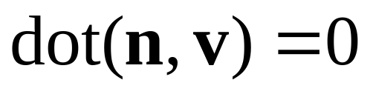
How does it move?
The normal vector is perpendicular to the velocity.
Notes:
This is constraint on the velocity.

Slide 10
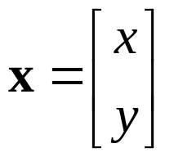
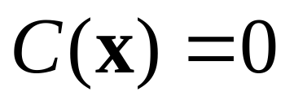
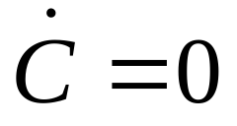
Enter The Calculus
Position Constraint:
If C is zero, then its time derivative is zero.
Velocity Constraint:
Notes:
Cdot = dC/dt

Slide 11
Velocity Constraint
Velocity constraints define the allowed motion.
Next we’ll show that velocity constraints depend linearly on velocity.

Slide 12
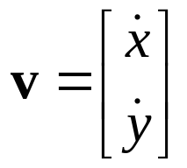
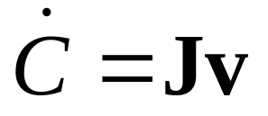
The Jacobian
Due to the chain rule the velocity constraint has a special structure:
J is a row vector called the Jacobian.
J depends on position.
The velocity constraint is linear.

Slide 13

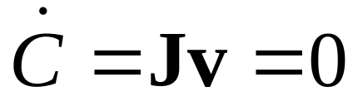
The Jacobian
The Jacobian is perpendicular to the velocity.
Notes:
J maps Cartesian motion into constraint motion.

Slide 14
Constraint Force
Assume the wire is frictionless.
What is the force between the wire and the bead?

Slide 15

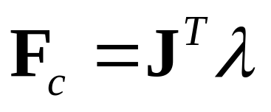
Lagrange Multiplier
Intuitively the constraint force F_{c} is parallel to the normal vector.
Direction known.
Magnitude unknown.
implies
Notes:
JT maps forces in the constraint space into Cartesian space.

Slide 16
Lagrange Multiplier
The Lagrange Multiplier (lambda) is the constraint force signed magnitude.
We use a constraint solver to compute lambda.
More on this later.

Slide 17
Jacobian as a CoordinateTransform
Similar to a rotation matrix.
Except it is missing a couple rows.
So it projects some dimensions to zero.
The transpose is missing some columns, so some dimensions get added.

Slide 18

Velocity Transform
v
J
Cartesian
Space
Velocity
Constraint
Space
Velocity

Slide 19

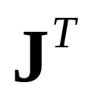
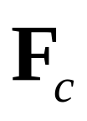
Force Transform
Constraint
Space
Force
Cartesian
Space
Force

Slide 20
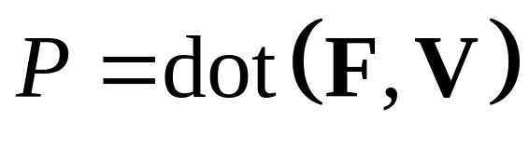
Refresher: Work and Power
Work = Force times Distance
Work has units of Energy (Joules)
Power = Force times Velocity (Watts)

Slide 21

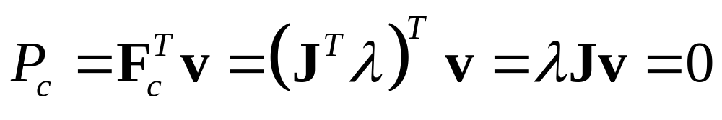
Principle of Virtual Work
Principle: constraint forces do no work.
We can ensure this by using:
Proof (compute the power):
The power is zero, so the constraint does no work.

Slide 22


Constraint Quantities
Position Constraint
Velocity Constraint
Jacobian
Lagrange Multiplier

Slide 23
Why all the Painful Abstraction?
We want to put all constraints into a common form for the solver.
This allows us to efficiently try different solution techniques.

Slide 24
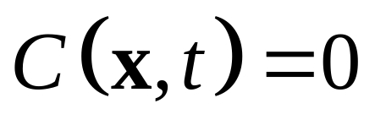
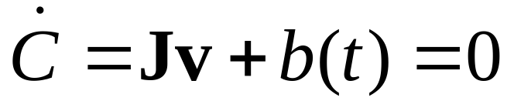
Addendum:
Modeling Time Dependence
Some constraints, like motors, have prescribed motion.
This is represented by time dependence.
Position:
Velocity:
velocity bias

Slide 25
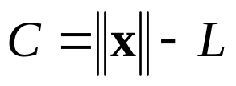
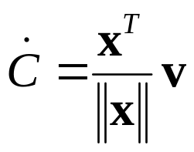
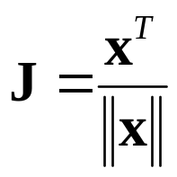


Example: Distance Constraint
Position:
x
y
L
Velocity:
particle
Jacobian:
is the tension
Velocity Bias:
Notes:
particle attached to ground by a massless rod. lambda is the tension.

Slide 26
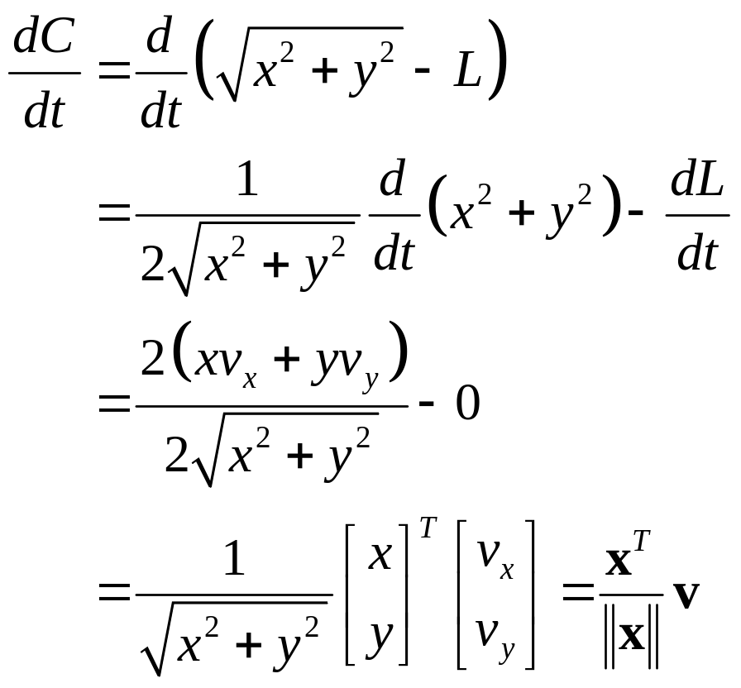
Gory Details

Slide 27
Computing the Jacobian
At first, it is not easy to compute the Jacobian.
It gets easier with practice.
If you can define a position constraint, you can find its Jacobian.
Here’s how …

Slide 28
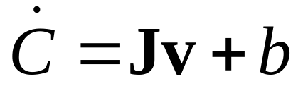
A Recipe for J
Use geometry to write C.
Differentiate C with respect to time.
Isolate v.
Identify J and b by inspection.

Slide 29
Constraint Potpourri
Joints
Motors
Contact
Restitution
Friction

Slide 30
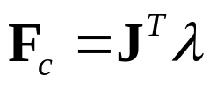

Joint: Distance Constraint
x
y
v

Slide 31



Motors
A motor is a constraint with limited force (torque).
Example
A Wheel
Note: this constraint does work.

Slide 32



Velocity Only Motors
Example
Usage: A wheel that spins at a constant rate.
We don’t care about the angle.

Slide 33
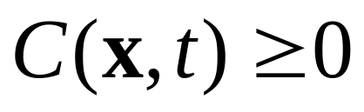
Inequality Constraints
So far we’ve looked at equality constraints (because they are simpler).
Inequality constraints are needed for contact and joint limits.
We put all inequality position constraints into this form:

Slide 34


Inequality Constraints
The corresponding velocity constraint:
If
enforce:
Else
skip constraint

Slide 35
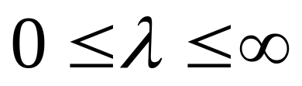
Inequality Constraints
Force Limits:
Inequality constraints don’t suck.

Slide 36
Contact Constraint
Non-penetration.
Restitution: bounce
Friction: sliding, sticking, and rolling

Slide 37

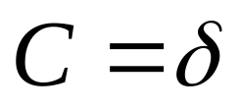


Non-Penetration Constraint
body 2
(separation)
body 1

Slide 38
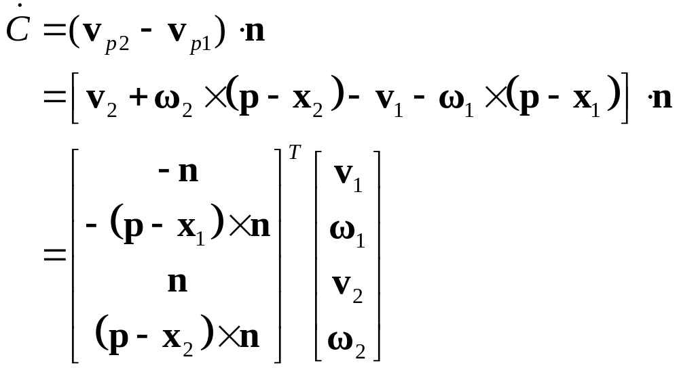
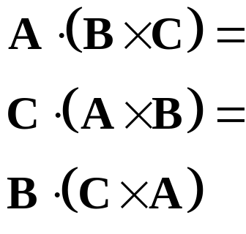
Non-Penetration Constraint
Handy Identities
J

Slide 39
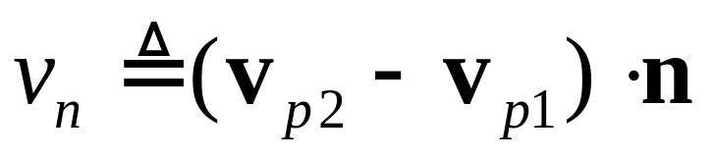
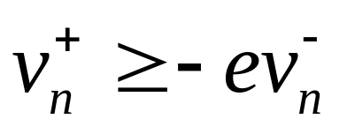
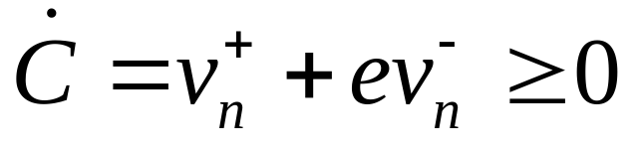
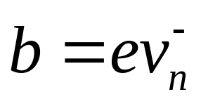
Restitution
Relative normal velocity
Velocity Reflection
Adding bounce as a velocity bias

Slide 40
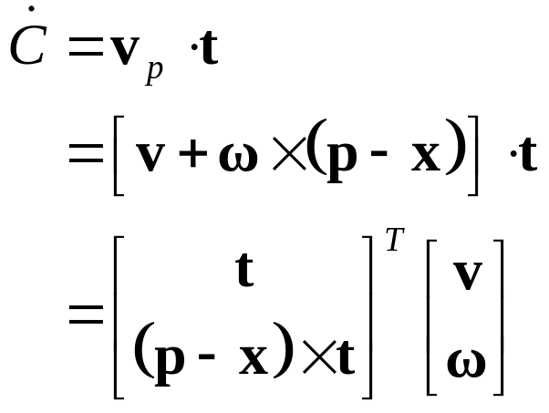

Friction Constraint
Friction is like a velocity-only motor.
The target velocity is zero.
J

Slide 41
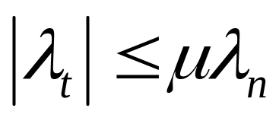
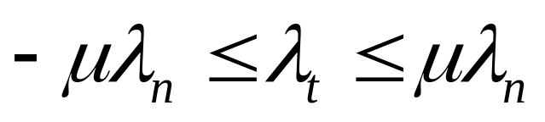
Friction Constraint
The friction force is limited by the normal force.
Coulomb’s Law:
In 2D:
3D is a bit more complicated. See the references.

Slide 42
Constraints Solvers
We have a bunch of constraints.
We have unknown constraint forces.
We need to solve for these constraint forces.
There are many ways different ways to compute constraint forces.

Slide 43
Constraint Solver Types
Global Solvers (slow)
Iterative Solvers (fast)

Slide 44



Solving a Chain
Global:
solve for λ1, λ2, and λ3 simultaneously.
λ₁
λ₂
Iterative:
while !done
solve for λ1
solve for λ2
solve for λ3
λ₃

Slide 45
Sequential Impulses (SI)
An iterative solver.
SI applies impulses at each constraint to correct the velocity error.
SI is fast and stable.
Converges to a global solution.

Slide 46
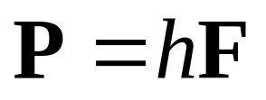
Why Impulses?
Easier to deal with friction and collision.
Lets us work with velocity rather than acceleration.
Given the time step, impulse and force are interchangeable.

Slide 47
Sequential Impulses
Step1:
Integrate applied forces, yielding tentative velocities.
Step2:
Apply impulses sequentially for all constraints, to correct the velocity errors.
Step3:
Use the new velocities to update the positions.

Slide 48
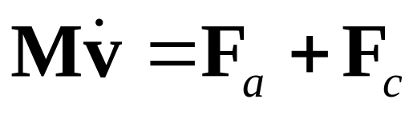
Step 1: Newton’s Law
We separate applied forces and
constraint forces.
mass matrix

Slide 49
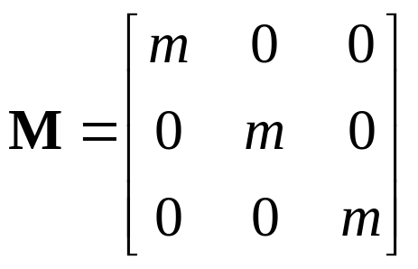
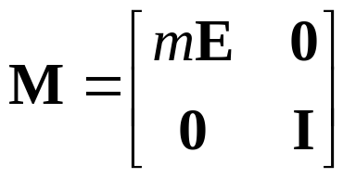
Step 1: Mass Matrix
Particle
Rigid Body
May involve multiple particles/bodies.

Slide 50
Step 1: Applied Forces
Applied forces are computed according to some law.
Gravity: F = mg
Spring: F = -kx
Air resistance: F = -cv²

Slide 51
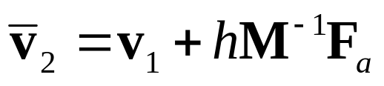
Step 1 :
Integrate Applied Forces
Euler’s Method for all bodies.
This new velocity tends to violate the velocity constraints.

Slide 52
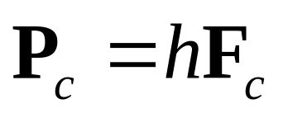
Step 2:
Constraint Impulse
The constraint impulse is just the time step times the constraint force.

Slide 53
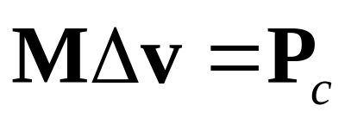
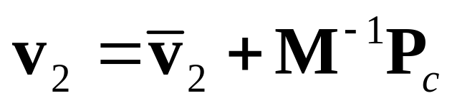
Step 2:
Impulse-Momentum
Newton’s Law for impulses:
In other words:

Slide 54
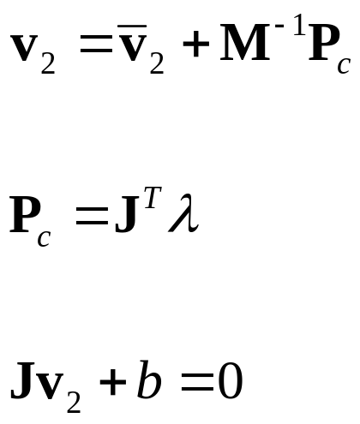
Step 2:
Computing Lambda
For each constraint, solve these for λ:
Newton’s Law:
Virtual Work:
Velocity Constraint:
Note: this usually involves one or two bodies.

Slide 55
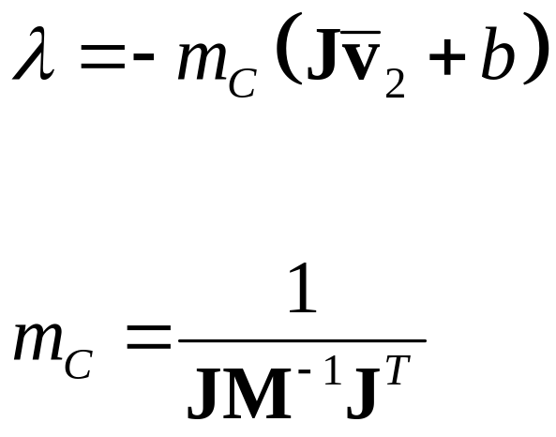
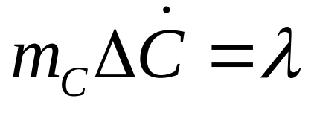
Step 2: Impulse Solution
The scalar m_{C} is the effective mass seen by
the constraint impulse:

Slide 56
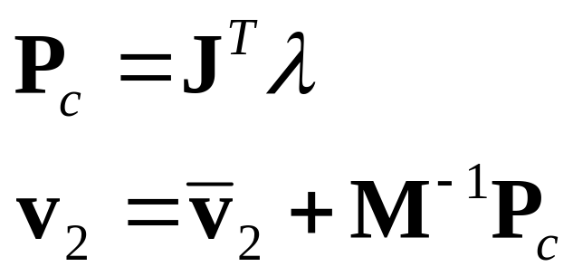
Step 2: Velocity Update
Now that we solved for lambda, we can use it
to update the velocity.
Remember: this usually involves one or two bodies.

Slide 57
Step 2: Iteration
Loop over all constraints until you are done:
  - Fixed number of iterations.
  - Corrective impulses become small.
  - Velocity errors become small.

Slide 58
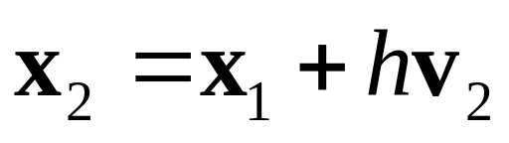
Step 3: Integrate Positions
Use the new velocity to integrate all body positions (and orientations):
This is the symplectic Euler integrator.

Slide 59
Extensions to Step 2
Handle position drift.
Handle force limits.
Handle inequality constraints.
Warm starting.

Slide 60
Handling Position Drift
Velocity constraints are not obeyed precisely.
Joints will fall apart.

Slide 61
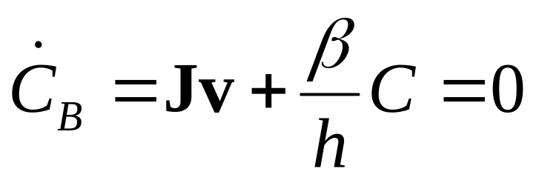

Baumgarte Stabilization
Feed the position error back into the velocity constraint.
New velocity constraint:
Bias factor:

Slide 62

Baumgarte Stabilization
What is the solution to this?
First-order differential equation …

Slide 63



Answer

Slide 64
Tuning the Bias Factor
If your simulation has instabilities, set the bias factor to zero and check the stability.
Increase the bias factor slowly until the simulation becomes unstable.
Use half of that value.

Slide 65

Handling Force Limits
First, convert force limits to impulse limits.

Slide 66

Handling Impulse Limits
Clamping corrective impulses:
Is it really that simple?
Hint: no.

Slide 67
How to Clamp
Each iteration computes corrective impulses.
Clamping corrective impulses is wrong!
You should clamp the total impulse applied over the time step.
The following example shows why.

Slide 68


Example: 2D Inelastic Collision
A Falling Box
v
Global Solution

Slide 69


Iterative Solution
iteration 1
constraint 1
constraint 2
constraint 1
Suppose the corrective impulses are too strong.
What should the second iteration look like?

Slide 70
Iterative Solution
iteration 2
To keep the box from bouncing, we need
downward corrective impulses.
In other words, the corrective impulses are
negative!

Slide 71

Iterative Solution
But clamping the negative corrective impulses
wipes them out:
This is one way to introduce jitter into
your simulation. ☺

Slide 72
Accumulated Impulses
For each constraint, keep track of the total impulse applied.
This is the accumulated impulse.
Clamp the accumulated impulse.
This allows the corrective impulse to be negative yet the accumulated impulse is still positive.

Slide 73
New Clamping Procedure
Compute the corrective impulse, but don’t apply it.
Make a copy of the old accumulated impulse.
Add the corrective impulse to the accumulated impulse.
Clamp the accumulated impulse.
Compute the change in the accumulated impulse using the copy from step 2.
Apply the impulse delta found in Step 5.

Slide 74

Handling Inequality Constraints
Before iterations, determine if the inequality constraint is active.
If it is inactive, then ignore it.
Clamp accumulated impulses:

Slide 75
Inequality Constraints
A problem:
overshoot
gravity
active
inactive
active
Aiming for zero overlap leads to JITTER!

Slide 76


Preventing Overshoot
Allow a little bit of penetration (slop).
If separation < slop
Else
Note: the slop will be negative (separation).

Slide 77
Warm Starting
Iterative solvers use an initial guess for the lambdas.
So save the lambdas from the previous time step.
Use the stored lambdas as the initial guess for the new step.
Benefit: improved stacking.

Slide 78
Step 1.5
Apply the stored impulses.
Use the stored impulses to initialize the accumulated impulses.

Slide 79
Step 2.5
Store the accumulated impulses.

Slide 80
Further Reading &
Sample Code
http://www.gphysics.com/downloads/

Slide 81
Box2D
An open source 2D physics engine.
http://www.box2d.org
Written in C++.

