Slide 1
Trust and Blockchain Technologies
Mike Ormond, Microsoft Ltd

Slide 2
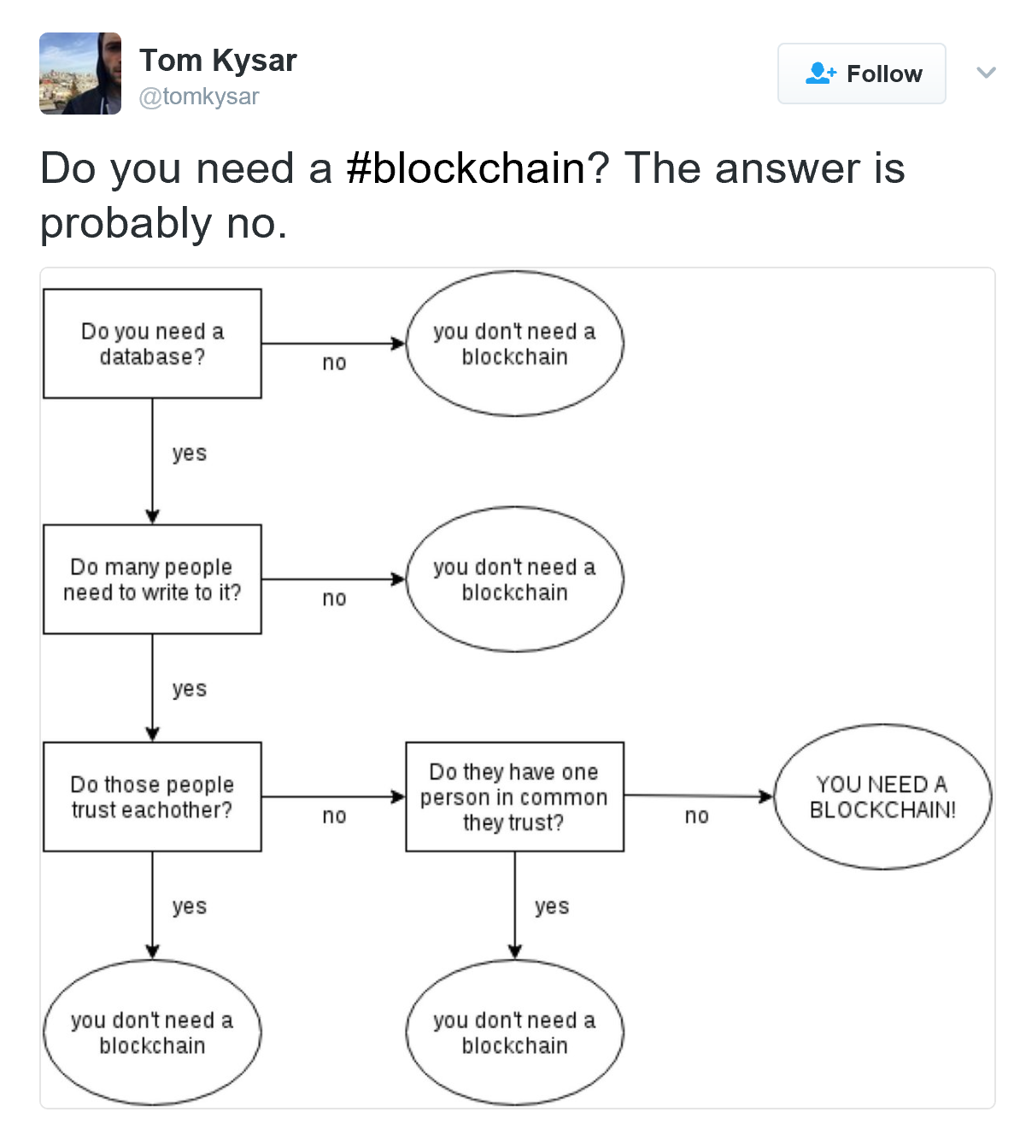

Slide 3

What does a Blockchain offer me?
Immutability
Distributed
Decentralised
Open
Trust

Slide 4
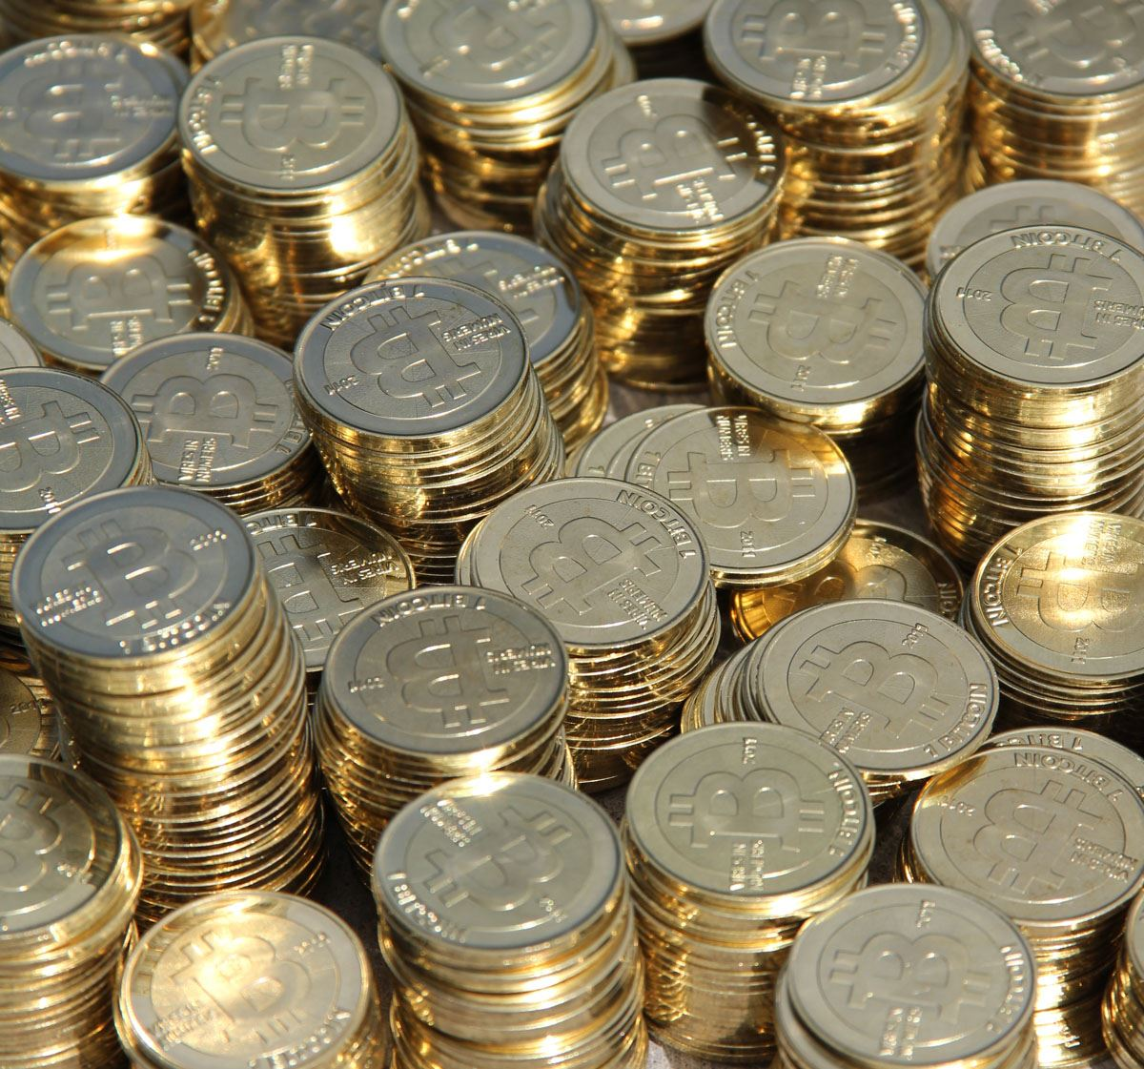
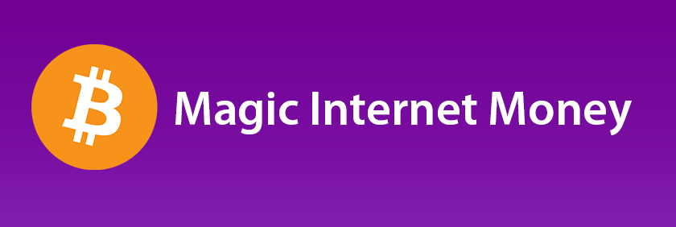
"bitcoin" (CC BY 2.0) by stevegarfield @ flickr
"bitcoin" (CC BY 2.0) by Sean MacEntee @ flickr

Slide 5
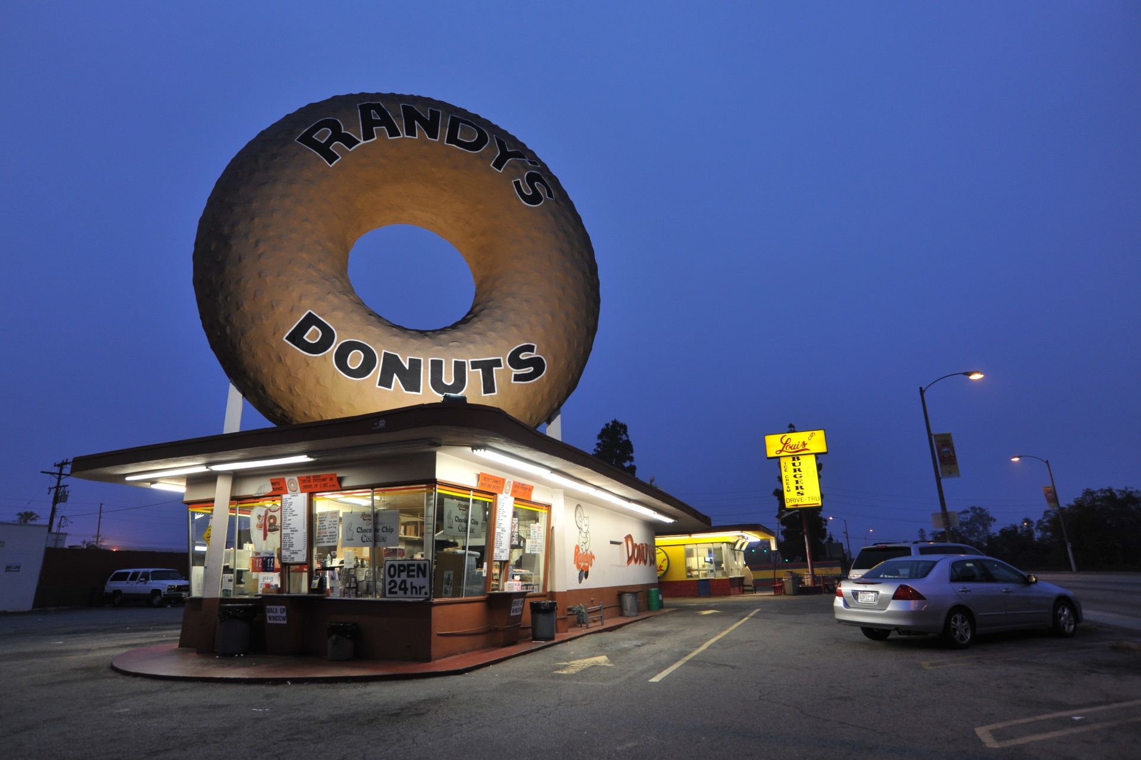
"Randy’s" (CC BY 2.0) by Extra Medium @ flickr

Slide 6
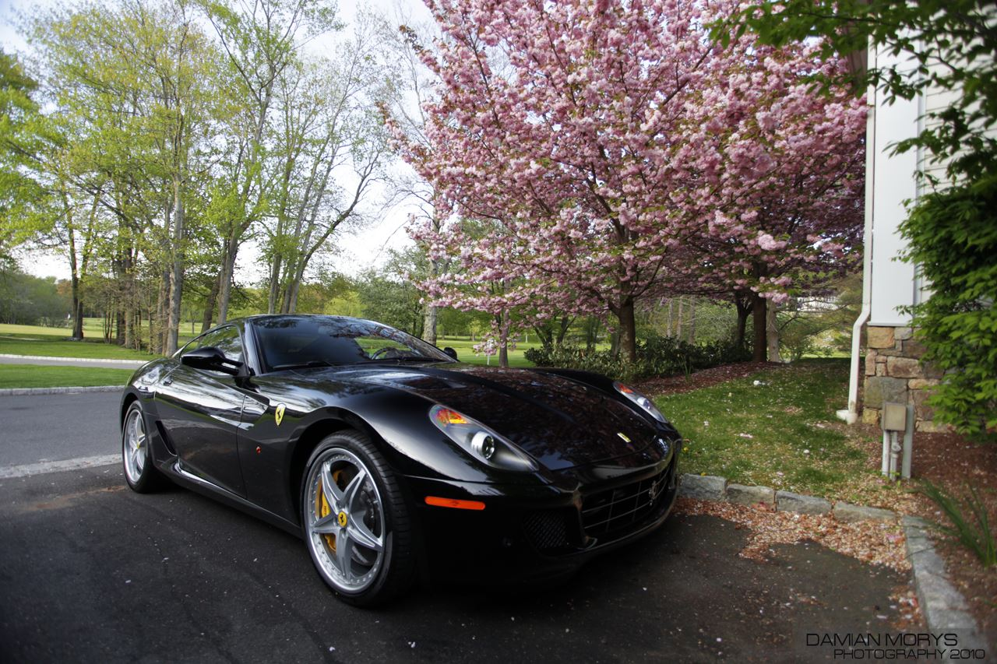
"599 HGTE." (CC BY 2.0) by Damian Morys Photography @ flickr

Slide 7

"Blue And Pink Piggy Banks" (CC BY-SA 2.0) by kenteegardin @ flickr

Slide 8




Slide 9
Peer
Peer

Slide 10
Peer
Peer
Peer

Slide 11
Bob
Mo
Alice
FROM | TO | INPUT | INPUT £ | OUTPUT | OUTPUT £
Bob | Alice | #0 | 100 | #1 | 100

Slide 12
Bob
Mo
Alice
FROM | TO | INPUT | INPUT £ | OUTPUT | OUTPUT £
Bob | Alice | #0 | 100 | #1 | 100
Alice | Mo | #1 | 100 | #2, #3 | 50, 50

Slide 13
Bob
Mo
Alice
Alice balance?
Pat
FROM | TO | INPUT | INPUT £ | OUTPUT | OUTPUT £
Bob | Alice | #0 | 100 | #1 | 100
Alice | Mo | #1 | 100 | #2, #3 | 50, 50
Alice | Pat | #3 | 50 | #4, #5 | 20, 30

Slide 14
Bob
Mo
Alice
Pat
FROM | TO | INPUT | INPUT £ | OUTPUT | OUTPUT £
Bob | Alice | #0 | 100 | #1 | 100
Alice | Mo | #1 | 100 | #2, #3 | 50, 50
Alice | Pat | #3 | 50 | #4, #5 | 20, 20
- £10

Slide 15





Bob
16UjcYNBG9GTK4uq2f7yYEbuifqCzoLMGS
Blockchain Client
cf23df2207d99a74fbe169e3eba035e633b65d94
https://thenounproject.com/term/miner/144300/

Slide 16
Demo - Hashing

Slide 17
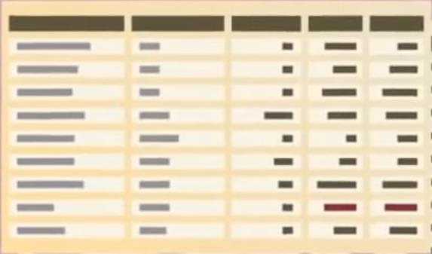
0x4fb8…
Bob
0xe618…
Geoff
0x88d2…
Transaction x
0xa37dcd8d2f8bb9f…
New Block
Previous Block
0x09aa5...
Transaction 9
Transaction 8
Transaction 7
Transaction 6

Slide 18
The chain forms
Block 0 (0x23e79…)
Block 1 (0x09aa5……)
Block 2 (0x7b5…)
Genesis Block
Previous Block
0x23e79...
Previous Block
0x09aa5...
Transaction 9
Transaction 3
Transaction 8
Transaction 2
Transaction 5
Transaction 7
Transaction 1
Transaction 4
Transaction 6

Slide 19


Consensus
HEADERS
HEADERS
GENERATION TRANSACTION
TRANSACTION #3
TRANSACTION #1
Mining
TRANSACTION #0
Block n
Block n-1
Unconfirmed transactions
Create new candidate block
Add reference to previous block
Add generation transaction
Fill block with transactions
Provide proof of work*
Broadcast block to peers
PRIORITY | ID | FROM | TO
5 | 3 | ALICE | PAT
4 | 1 | MO | BOB
4 | 0 | BOB | ALICE
3 | 2 | PAT | ALICE
2 | 5 | ALICE | BOB
1 | 4 | ALICE | MO
https://thenounproject.com/term/miner/42900/

Slide 20
Consensus
HEADERS
HEADERS
Mining
Block n + 1
Block n
Unconfirmed transactions
Create new candidate block
Add reference to previous block
Add generation transaction
Fill block with transactions
Provide proof of work*
Broadcast block to peers
PRIORITY | ID | FROM | TO
5 | 3 | ALICE | PAT
4 | 1 | MO | BOB
4 | 0 | BOB | ALICE
3 | 2 | PAT | ALICE
2 | 5 | ALICE | BOB
1 | 4 | ALICE | MO
7. Go back to step 1
https://thenounproject.com/term/miner/42900/

Slide 21
Trust
Signing gives us authenticity
Hashing gives us integrity
Validation gives us predictability
Stake / Reward controls behaviour
Behaviour achieves consensus
Consensus gives us trust

Slide 22

Smart Contracts
Blockchain 3.0
+ Cloud Servicing
Multilayer Middleware
+ Cryptlets
Blockchain 2.0
+ Smart Contracts
Logic Tier
Blockchain 1.0
Simple Ledgers that record transactions

Slide 23
















Applications
Currency
Smart Contracts
Identity
Distributed Storage
Decentralised Notary
Voting
Asset Tracking
Exchanges
Decentralised Apps
Industries
Finance
Retail
Agriculture
Insurance
Healthcare
Energy
Government
Charity

Slide 24
Demo - Tierion

Slide 25



Microsoft’s Strategy
Project Bletchley
Bletchley is Microsoft’s architectural approach to building an Enterprise Consortium Blockchain Ecosystem
Partnership
Research + Development
Trusted Cloud

Slide 26
Follow Up
SIGN UP FOR AN AZURE ACCOUNT
https://azure.microsoft.com/
READ ABOUT BLOCKCHAIN ON AZURE
https://azure.microsoft.com/en-gb/solutions/blockchain/
TRY THE CONSORTIUM BLOCKCHAIN TEMPLATE
https://azure.microsoft.com/en-us/blog/project-bletchley-blockchain-infrastructure-made-easy/
FIND OUT MORE ABOUT PROJECT ‘BLETCHLEY’
https://github.com/Azure/azure-blockchain-projects/tree/master/Bletchley

Slide 27
Thank you

