Slide 1
What is Driving the Houston (MSA) House Price Index?

Slide 2

House Price Index
The HPI published by the Federal Housing Finance Agency (FHFA) is a specialized index for measuring changes in home prices. It’s essentially a snapshot of home prices across the United States, in a specific region of the country or even as close as your city.
Population
Employment
Building Permits
Interest Rates

Slide 3
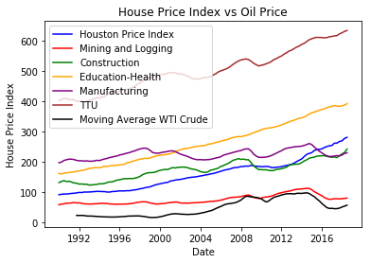
Population Growth

Slide 4
Employment by Occupation

Slide 5
Payroll Employment

