Slide 1
Factors Driving the Houston House Price Index
DGJ Group
De Vo, Gage Grewal, John Fallon

Slide 2
House Price Index (HPI)
Index for measuring changes in single-family home prices.
HPI is not adjusted for inflation.
HPI data normalized to 100 for year 1995.

Slide 3

Houston MSA
(MSA – Metropolitan Statistical Area)

Slide 4
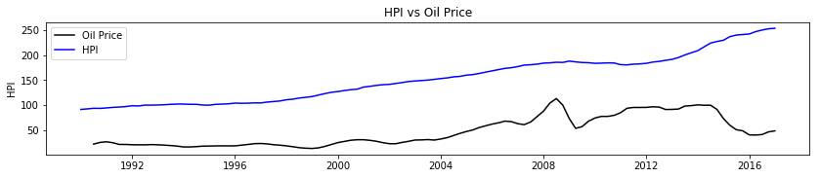
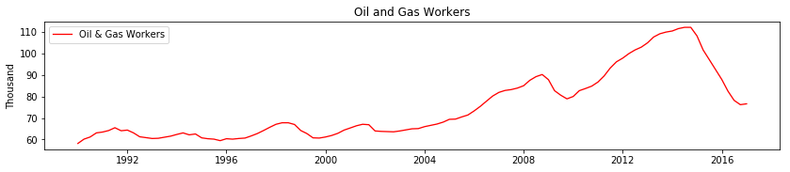
Houston HPI vs Oil Price

Slide 5
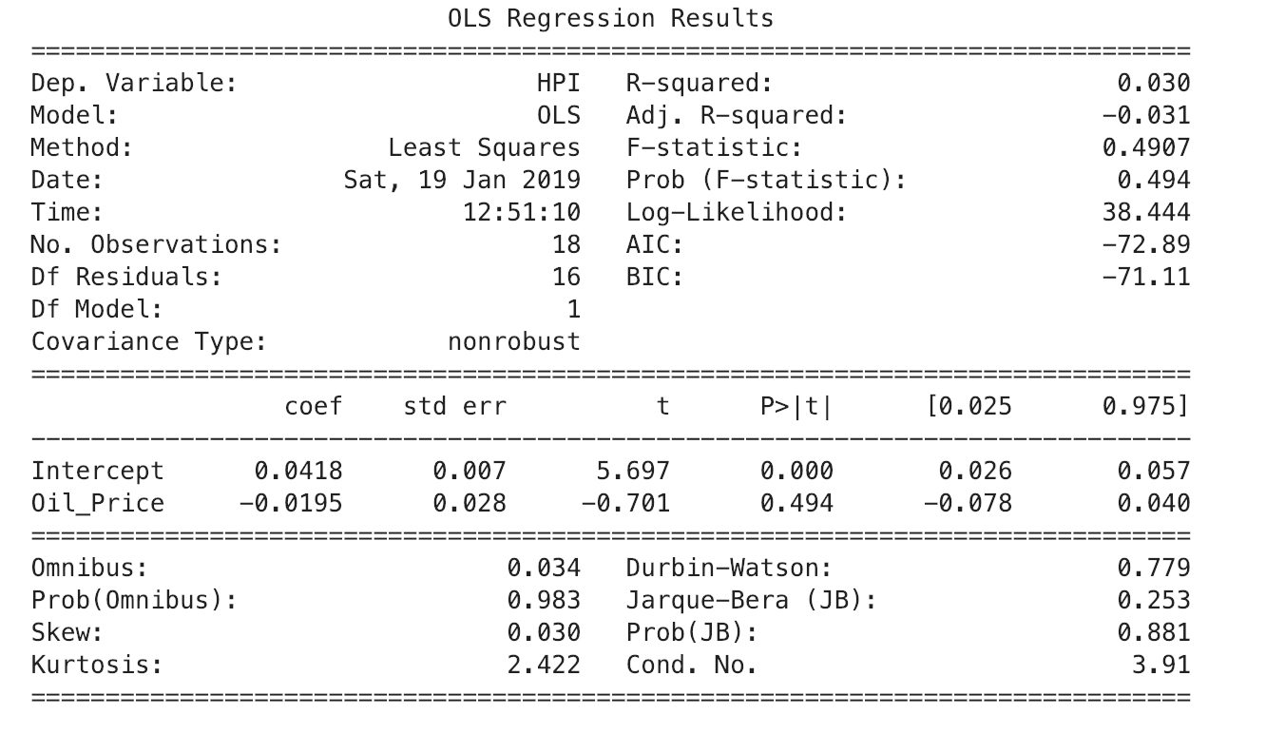
Regression Analysis – HPI vs Oil Price

Slide 6
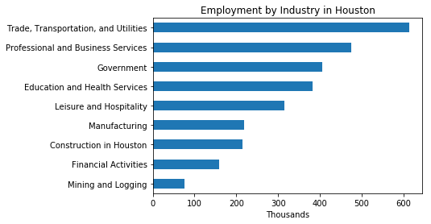
Houston Employment by Industry

Slide 7
Other Key Factors
Population
Mortgage & Interest Rates
Consumer Price Index (CPI)
Building Permits
Unemployment
Construction Cost Index

Slide 8
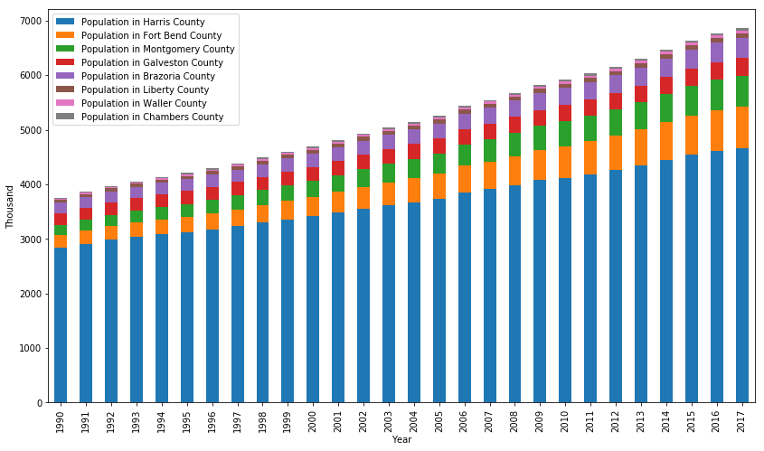
Population

Slide 9
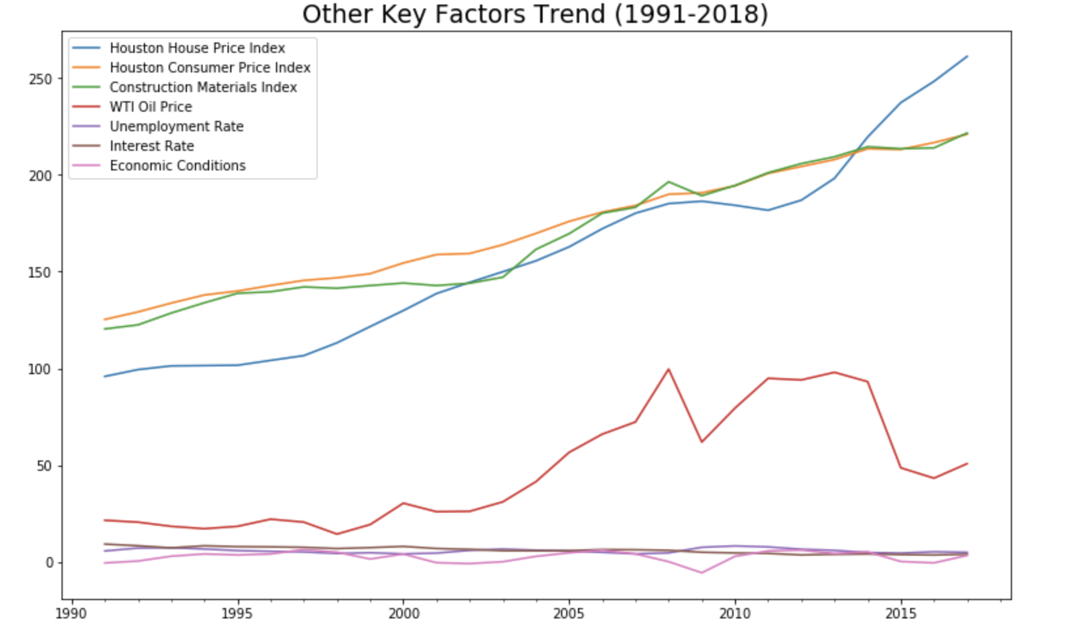

Slide 10
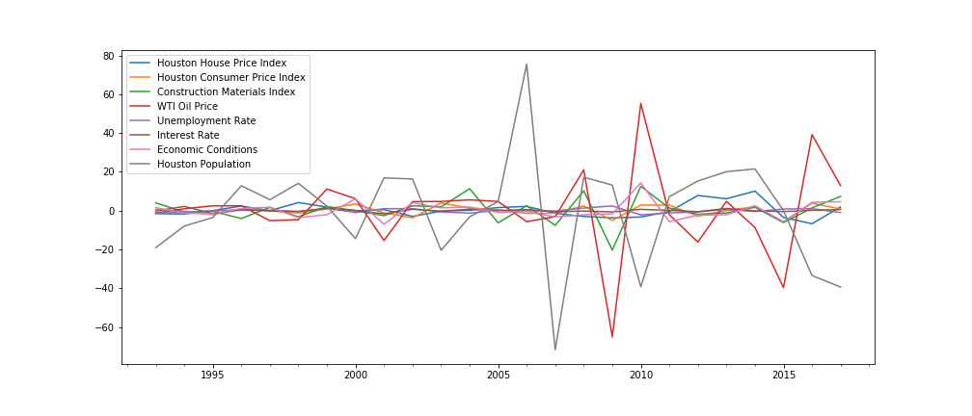
Data Transformed by Differences

Slide 11
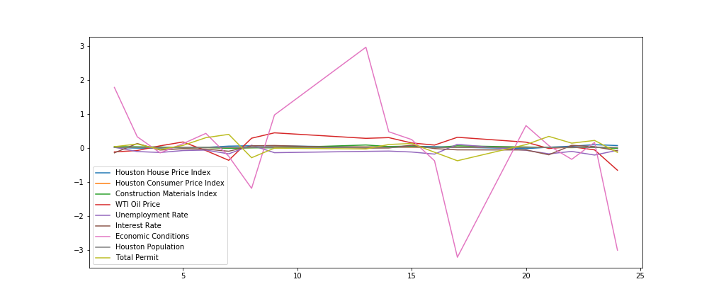
Data Transformed by Differences & Log

Slide 12
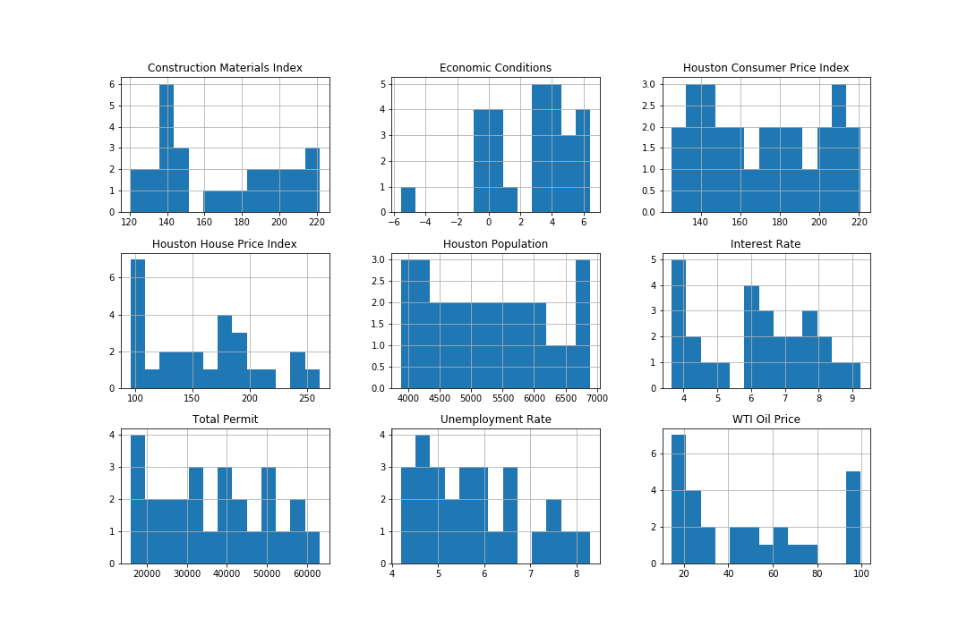
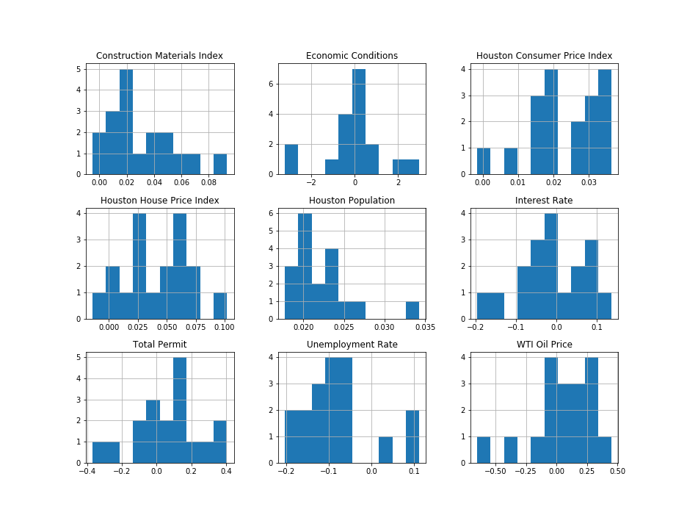
Histogram of Raw Data (before and after log transformation)

Slide 13
Multiple Regression
SUMMARY OUTPUT
Regression Statistics
Multiple R | 0.814093734
R Square | 0.662748607
Adjusted R Square | 0.28334079
Standard Error | 0.025283619
Observations | 18
ANOVA
 | df | SS | MS | F | Significance F
Regression | 9 | 0.010049942 | 0.00111666 | 1.74679745 | 0.221975243
Residual | 8 | 0.005114091 | 0.000639261
Total | 17 | 0.015164033
 | Coefficients | Standard Error | t Stat | P-value | Lower 95% | Upper 95% | Lower 95.0% | Upper 95.0%
Intercept | -0.067593311 | 0.053632426 | -1.260306795 | 0.243075902 | -0.191269909 | 0.056083286 | -0.191269909 | 0.056083286
Houston Consumer Price Index | 0.212692593 | 1.17956545 | 0.180314363 | 0.861389709 | -2.507390212 | 2.932775398 | -2.507390212 | 2.932775398
Construction Materials Index | -0.378244893 | 0.426897516 | -0.886032078 | 0.401448344 | -1.36267233 | 0.606182544 | -1.36267233 | 0.606182544
WTI Oil Price | 0.006648949 | 0.038266833 | 0.17375227 | 0.866376295 | -0.081594526 | 0.094892424 | -0.081594526 | 0.094892424
Unemployment Rate | -0.071365272 | 0.110359167 | -0.646663744 | 0.535957442 | -0.325853969 | 0.183123424 | -0.325853969 | 0.183123424
Interest Rate | -0.010724954 | 0.089412515 | -0.119949136 | 0.907481095 | -0.216910584 | 0.195460676 | -0.216910584 | 0.195460676
Economic Conditions | -0.001258244 | 0.008216042 | -0.153144827 | 0.882076431 | -0.020204471 | 0.017687982 | -0.020204471 | 0.017687982
Houston Population | 5.805368473 | 1.995800976 | 2.908791279 | 0.019625423 | 1.203043169 | 10.40769378 | 1.203043169 | 10.40769378
Total Permit | -0.016601109 | 0.072243098 | -0.229795084 | 0.824017612 | -0.183193992 | 0.149991775 | -0.183193992 | 0.149991775

Slide 14
Simplified Regression
SUMMARY OUTPUT
Regression Statistics
Multiple R | 0.707653879
R Square | 0.500774012
Adjusted R Square | 0.434210547
Standard Error | 0.022465202
Observations | 18
ANOVA
 | df | SS | MS | F | Significance F
Regression | 2 | 0.007593753 | 0.003796877 | 7.523256358 | 0.005460456
Residual | 15 | 0.007570279 | 0.000504685
Total | 17 | 0.015164033
 | Coefficients | Standard Error | t Stat | P-value | Lower 95% | Upper 95% | Lower 95.0% | Upper 95.0%
Intercept | -0.056140422 | 0.032753196 | -1.714044091 | 0.107102966 | -0.125952206 | 0.013671363 | -0.125952206 | 0.013671
Construction Materials Index | -0.403254209 | 0.20676234 | -1.950327164 | 0.070078822 | -0.843957705 | 0.037449287 | -0.843957705 | 0.037449
Houston Population | 4.904045725 | 1.436209579 | 3.41457528 | 0.003841166 | 1.842837471 | 7.965253979 | 1.842837471 | 7.965254

Slide 15
Conclusion
HPI = -0.06 – (CMI*0.40) + (H_pop*4.90)
HPI = House Price Index
CMI = Construction Material Index
H_pop = Houston Population (thousands)

