Slide 1
Factors Driving the Houston House Price Index
DGJ Group
De Vo, Gage Grewal, John Fallon

Slide 2
House Price Index (HPI)
Index for measuring changes in single-family home prices.
HPI is not adjusted for inflation.
HPI data normalized to 100 for year 1995.

Slide 3

Houston MSA
(Metropolitan Statistical Area)

Slide 4
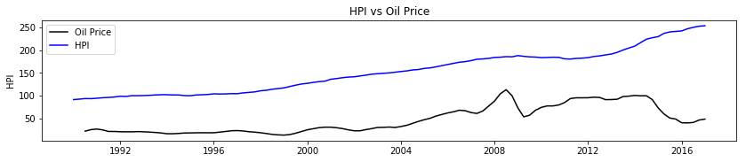
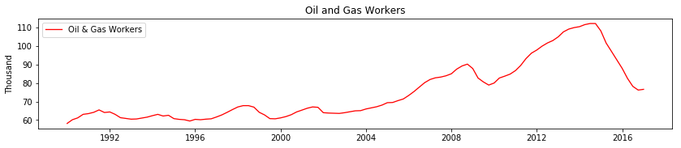
Houston HPI vs Oil Price

Slide 5
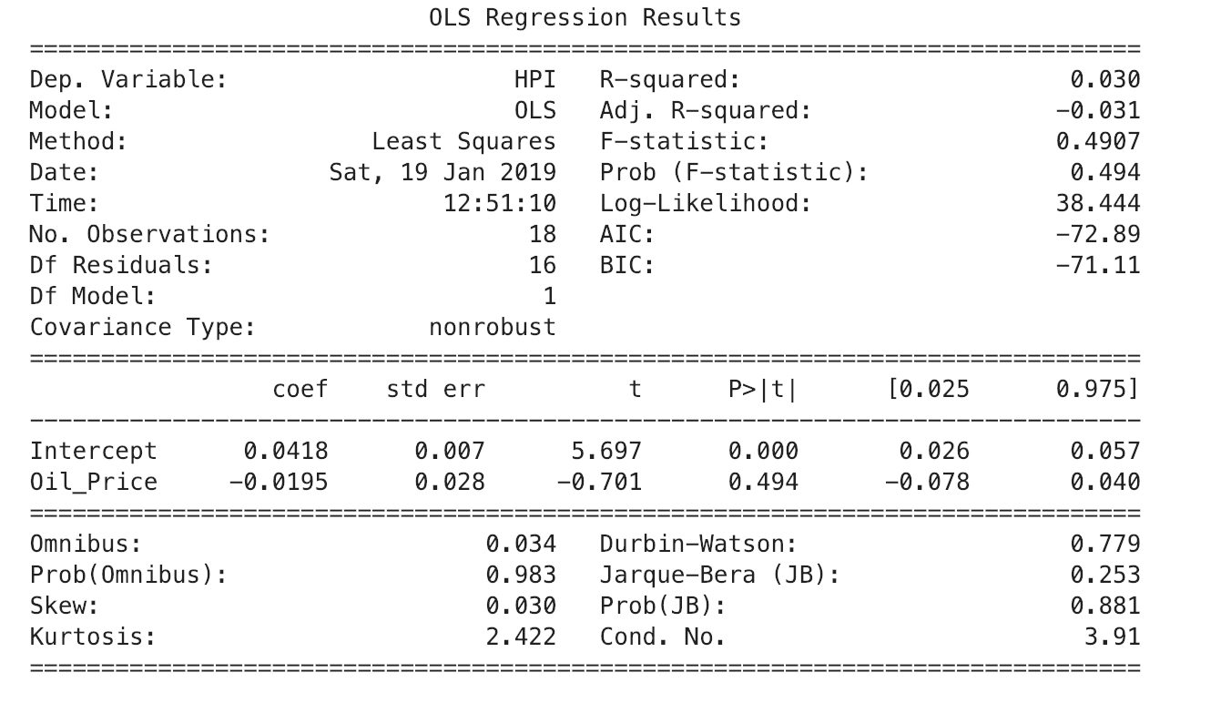
Regression Analysis – HPI vs Oil Price

Slide 6
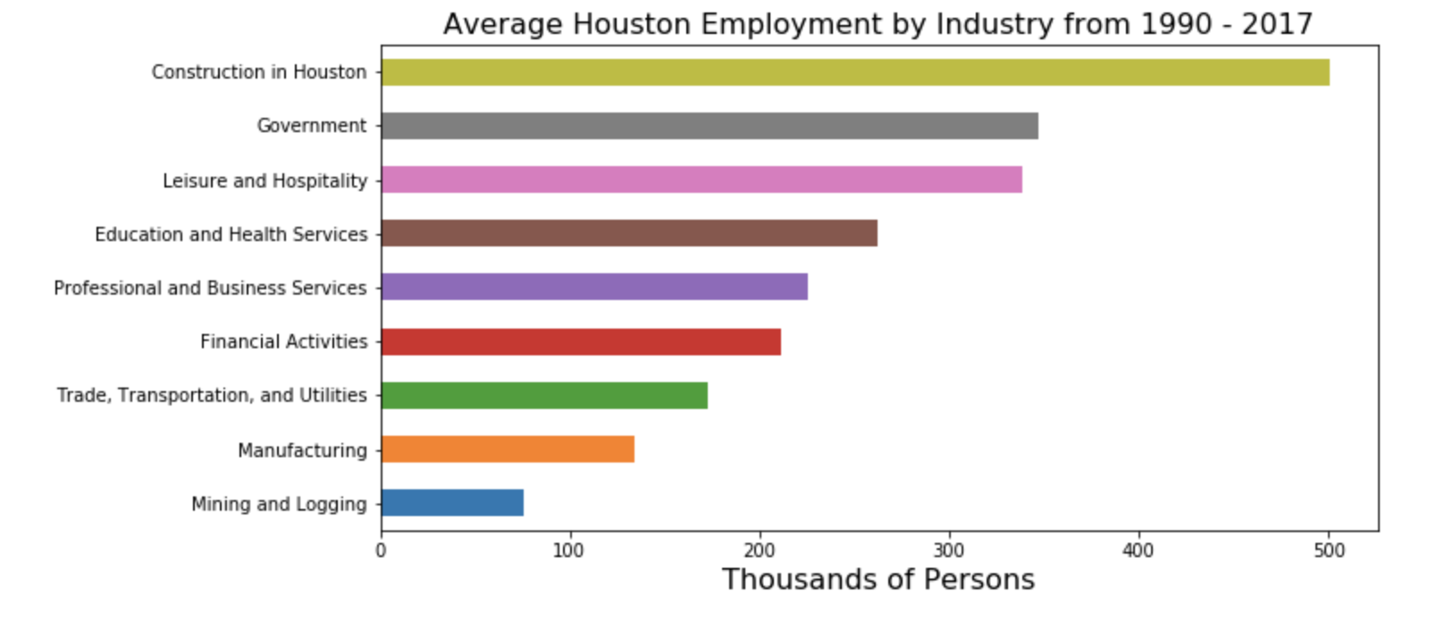
Houston Employment by Industry

Slide 7
Other Factors
Population
Mortgage & Interest Rates
Consumer Price Index (CPI)
Building Permits
Unemployment
Construction Cost Index
Notes:
All yearly
No seasonal adjusted

Slide 8
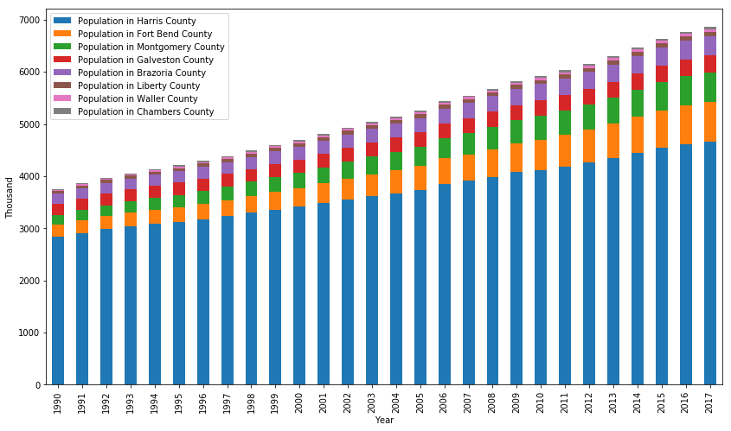
Population vs time

Slide 9
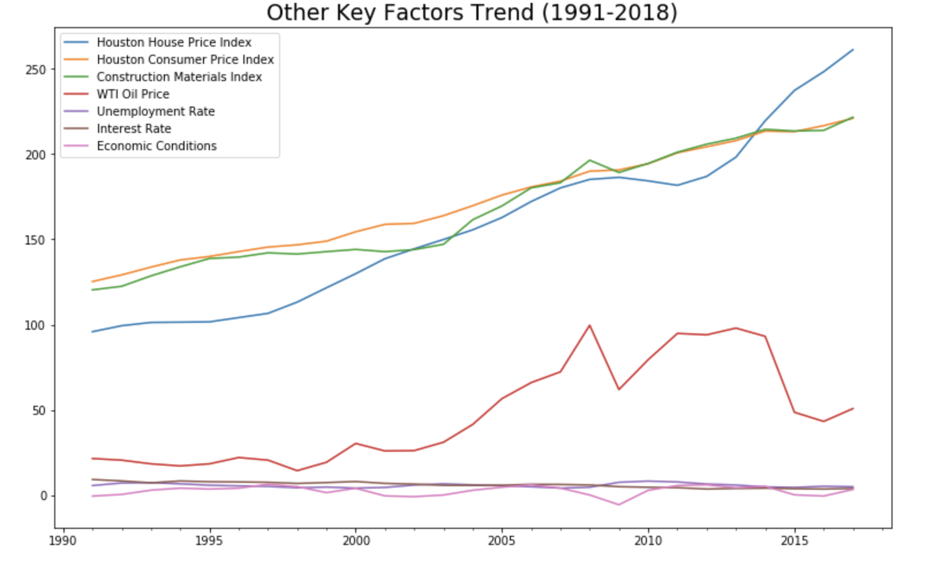

Slide 10
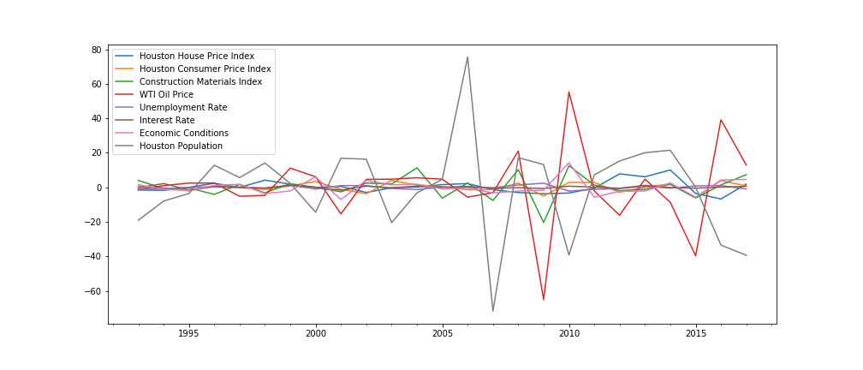
Data Transformed by First Differences
Notes:
Central limit theorem - large sample size → mean sample will approximately equal to mean of population

Slide 11
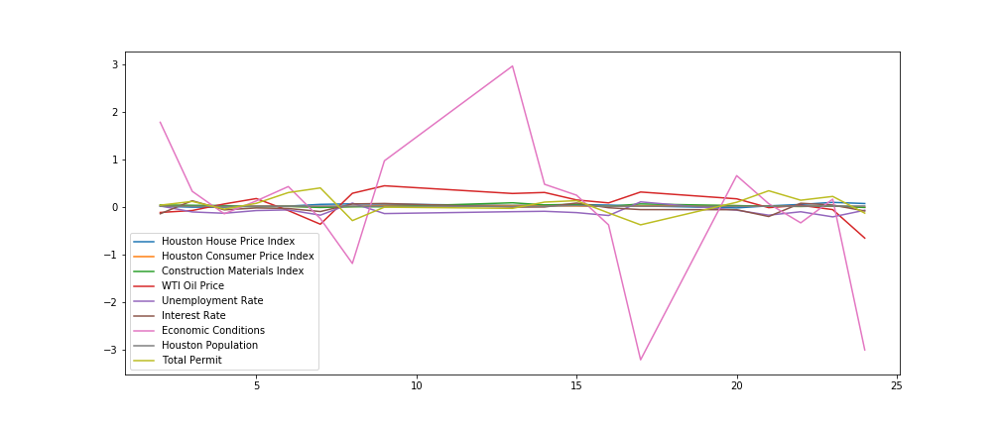
Data Transformed by Differences & Log

Slide 12
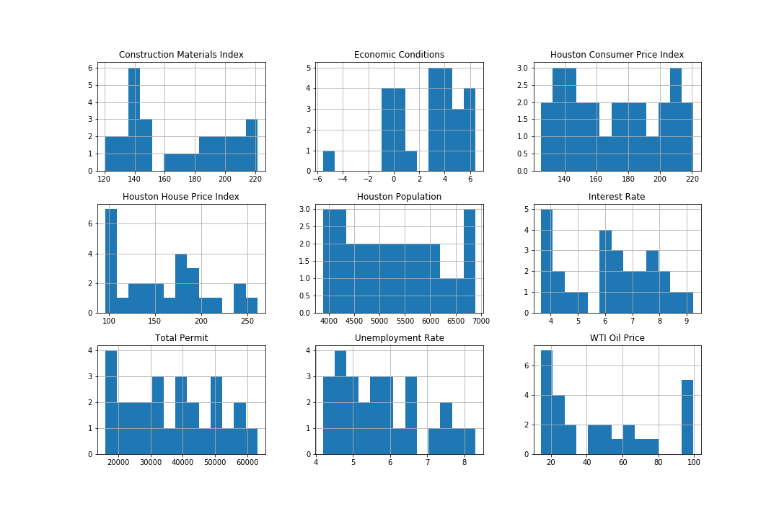
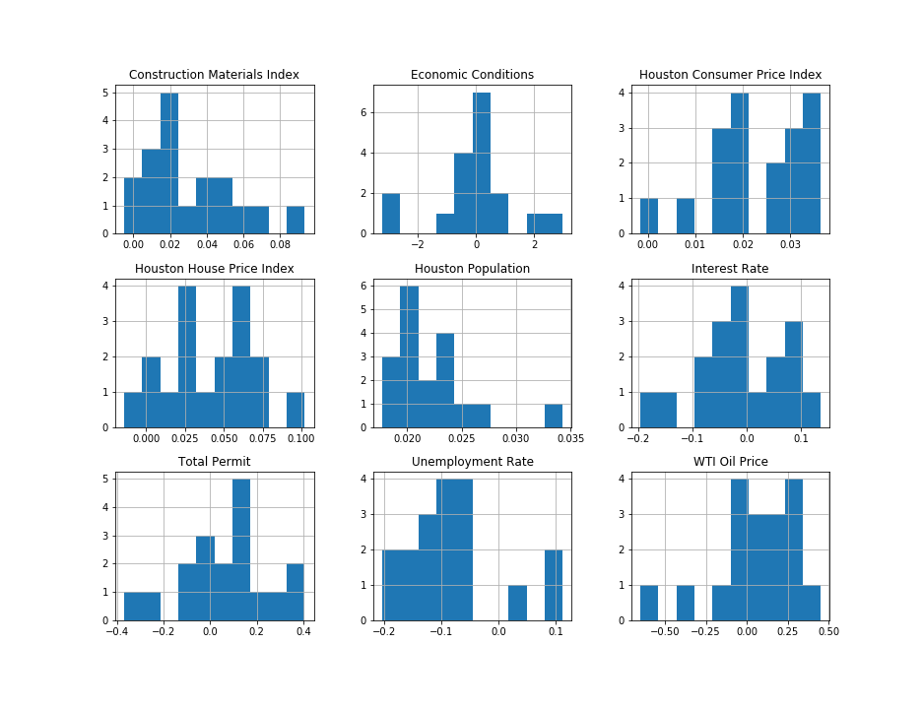
Histogram Comparison
Before
After
Notes:
Key note about interpreting log-log

Slide 13
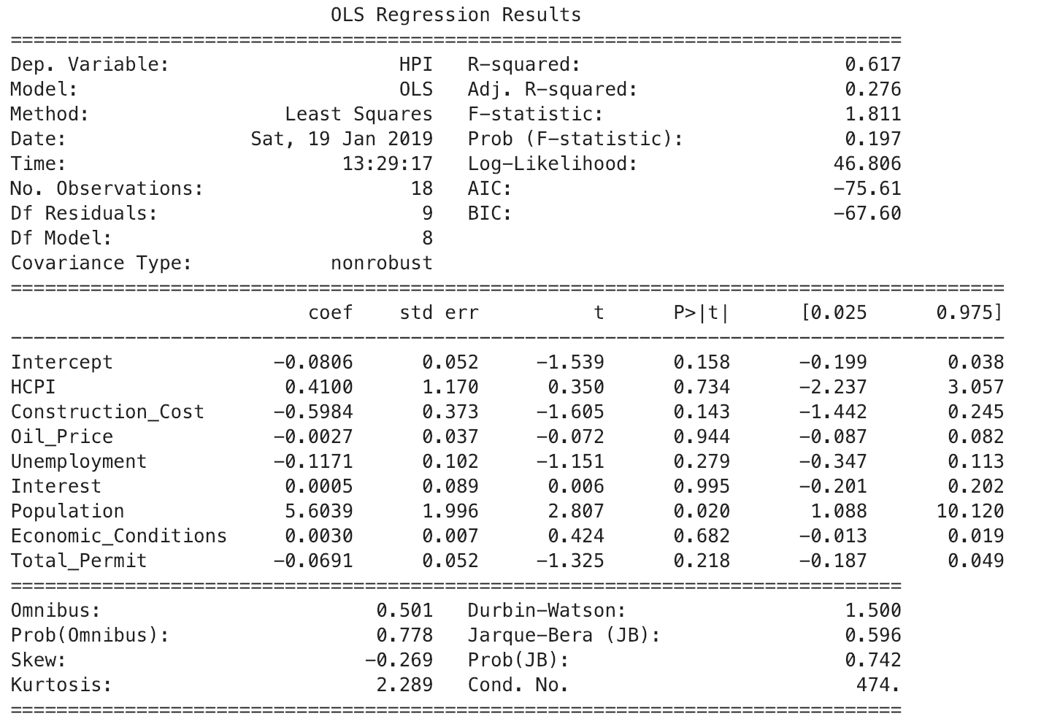
Multiple Regression
Notes:
Durbin-Watsion : auto-correlation between variable . Rule of thumb 1.5 – 2.5 is normal

Slide 14
Simplified Regression
SUMMARY OUTPUT
Regression Statistics
Multiple R | 0.707653879
R Square | 0.500774012
Adjusted R Square | 0.434210547
Standard Error | 0.022465202
Observations | 18
ANOVA
 | df | SS | MS | F | Significance F
Regression | 2 | 0.007593753 | 0.003796877 | 7.523256358 | 0.005460456
Residual | 15 | 0.007570279 | 0.000504685
Total | 17 | 0.015164033
 | Coefficients | Standard Error | t Stat | P-value | Lower 95% | Upper 95% | Lower 95.0% | Upper 95.0%
Intercept | -0.056140422 | 0.032753196 | -1.714044091 | 0.107102966 | -0.125952206 | 0.013671363 | -0.125952206 | 0.013671
Construction Materials Index | -0.403254209 | 0.20676234 | -1.950327164 | 0.070078822 | -0.843957705 | 0.037449287 | -0.843957705 | 0.037449
Houston Population | 4.904045725 | 1.436209579 | 3.41457528 | 0.003841166 | 1.842837471 | 7.965253979 | 1.842837471 | 7.965254

Slide 15
Regression Equation
HPI = -0.06 – (CMI*0.40) + (H_pop*4.90)
HPI = House Price Index
CMI = Construction Material Index
H_pop = Houston Population (thousands)

Slide 16
Limitations
Small Data Sample (1990 – 2018)
01
Underestimated effect of oil price on other variables
02
Notes:
Population is recorded on yearly bases – others varibales needs to be
Oil price is underestimate and it is indirectly transformed through other factors. Do correlation between oil/price and copnstrcution cos

Slide 17
Future Work
Investigate how Houston population changes (migration, birth..)
Correlation between other variables and oil price.
Notes:
Population is recorded on yearly bases – others varibales needs to be

Slide 18
Thank You !
Q & A ?

