Slide 1
ETL: Extract, Transform, Load
The Data Bootcamp

Slide 2
ETL
Data integration is an important part of working with data.
Extract: read the data, often from multiple sources
Transform: clean and structure the data in desired form
Load: write the data into a database for storage

Slide 3
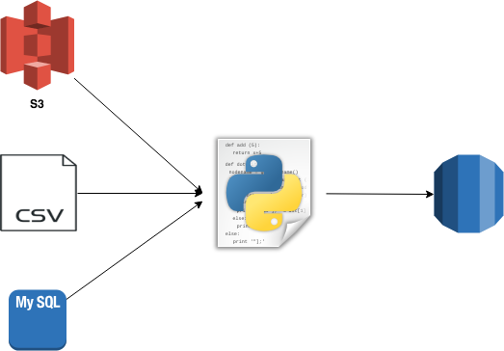
Extract
Data may come from disparate sources, such as:
CSV files
JSON files
HTML tables
SQL databases
Spreadsheets
Extract

Slide 4
Transform
Transform the data to suit business needs.
This may include:
Data Cleaning
Summarization
Selection
Joining
Filtering
Aggregating
Note: We will use Python and Pandas for transformation, but this could be done with SQL or a specialized ETL tool.
Transform

Slide 5
Load
Load the data into a final database that can be used for future analysis or business use.
Can be a relational or non-relational database
Can be local or in the cloud
Can be a data lake or data warehouse
Load

Slide 6
Requirements
Requirement | Solo | Duo
Proposal | Required | Required
Number of Sources | 2 | 3
Source code on Github | Required | Required
Final Report | Required | Required
Flask API | Optional | Required

Slide 7
Proposal
Your name (and partner if Duo)
Data sets you intend to use
What useful investigation could be done with the final database
Whether final DB will be relational or nonrelational, and why

Slide 8
Types of Sources
You must use at least two sources of different types
”Flat file”
CSV/TSV/DSV File
Excel File
SQL Database
Mongo Database
Scraped Web Page
Web API

Slide 9
Final Report
Data Sources
Detailing the process of the extraction, transformation, and loading steps
What data sources you chose, and why
Explication why you have performed the types of transformations you did
Why you chose the type of the final database
Schema of the tables/collections in the final database
Hypothetical use cases for your database

Slide 10

If you finish early
Build a Flask API (required if you are a duo group)
Build a Flask web API that responds with JSON of queried data in your database
Ask instructional staff for help if you would like to load it to a live server (we use Heroku)
THEN you may work on this week’s homework
THEN you can start on the Julia lessons if you have time leftover! (Cam is still working on these)

Slide 11
Questions to consider in your ETL
Is my data redundant?
Is there a way to normalize this data?
Can I accomplish the same thing with less code?
Is my code maintainable? If I let someone else read it, would they understand it without me being there?
Why would someone want to use my final dataset?

Slide 12
TODAY:
Find some data, then get a proposal to Cam ASAP
I like Google Docs, but will suffer your Word files.
Expect feedback, you may need to revise!
If you need to pivot, we can discuss that.

Slide 13
Questions / Discussion
Notes:
It’s important to keep in mind why you joined this class. Let’s talk about your goals.

