Slide 1
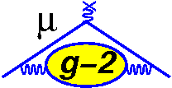


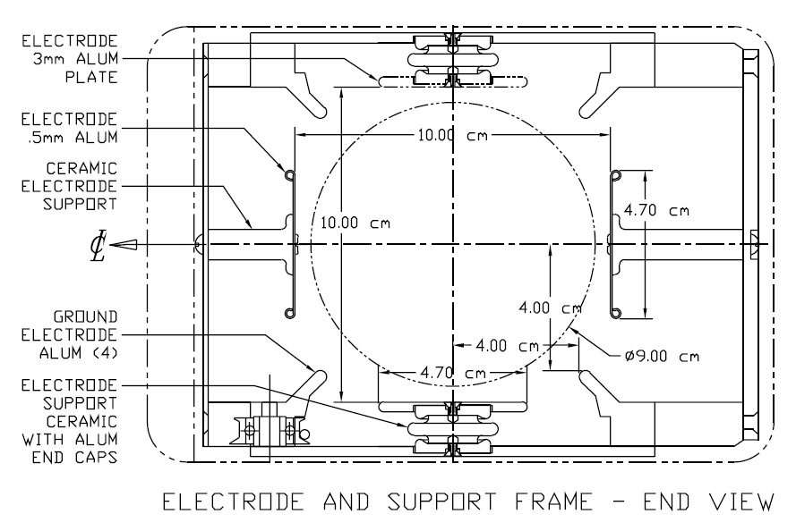
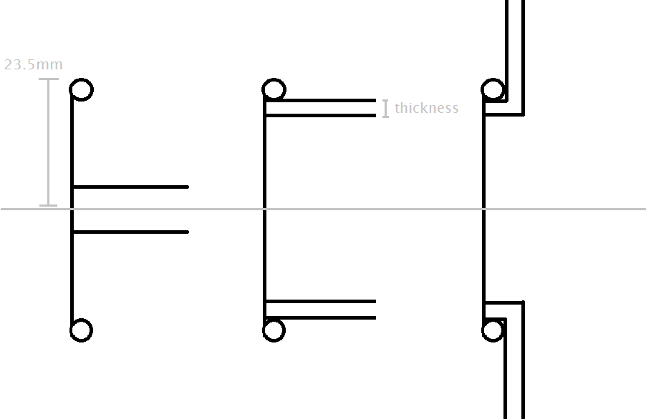
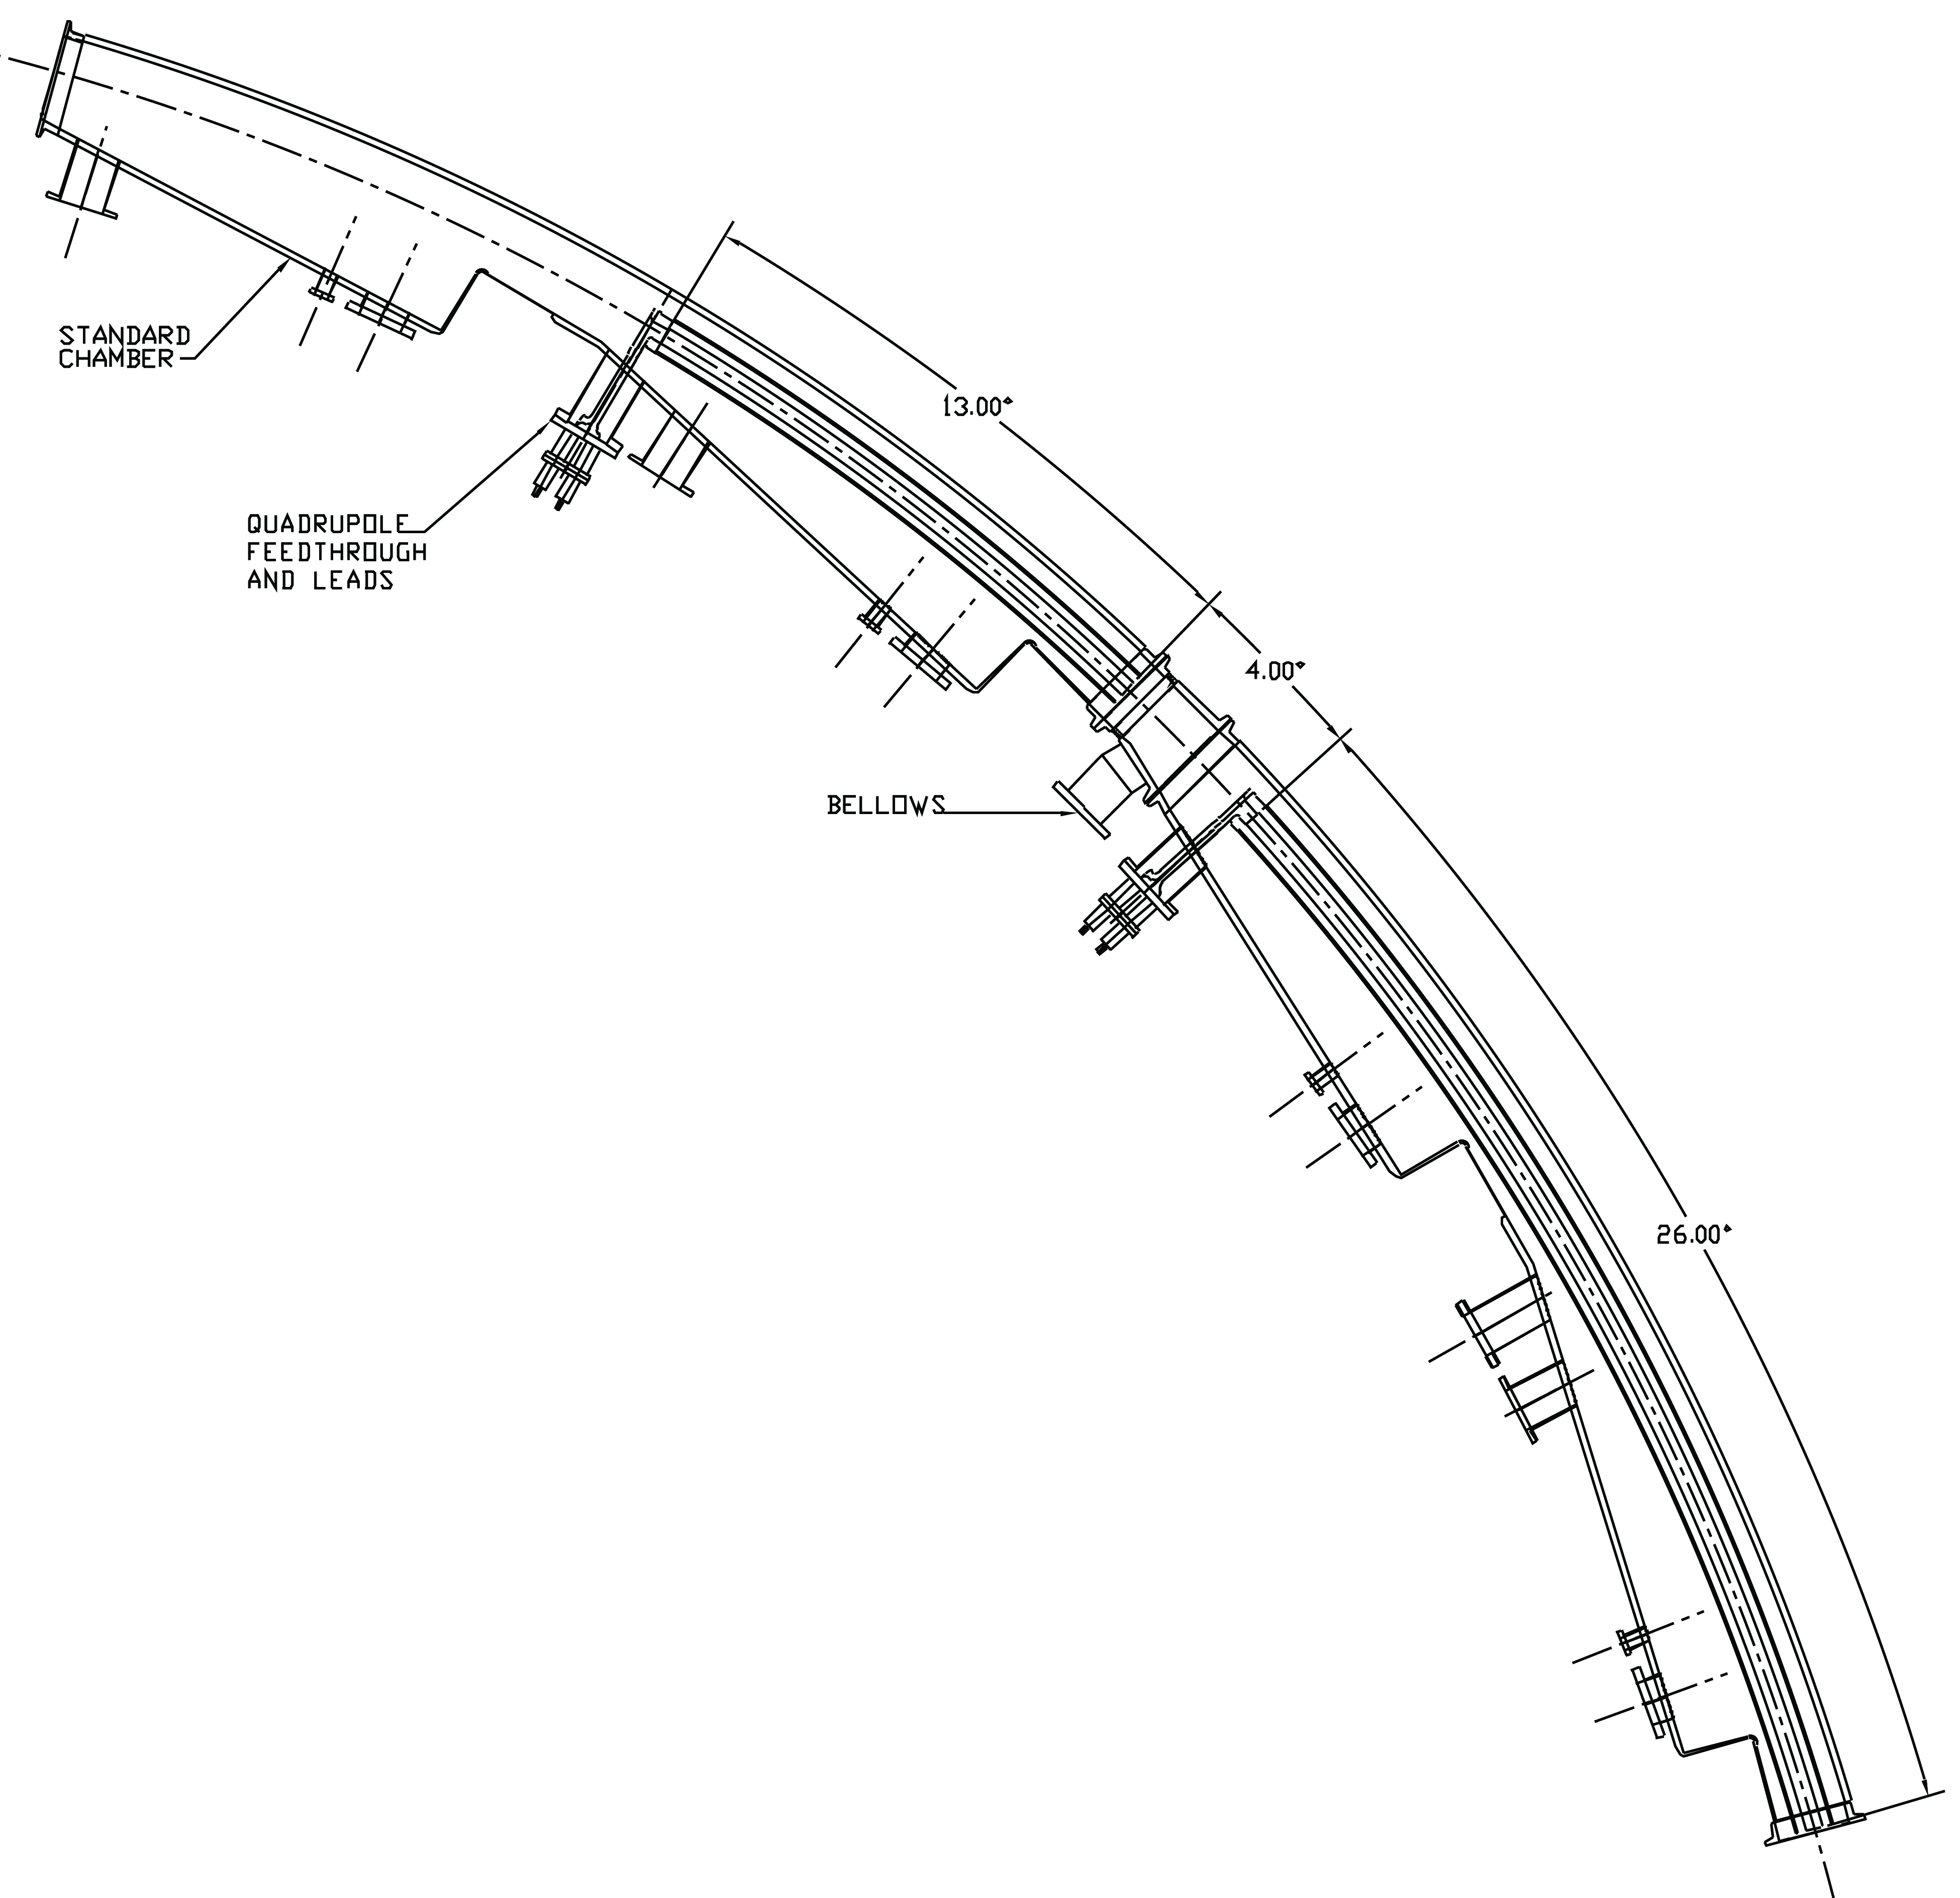
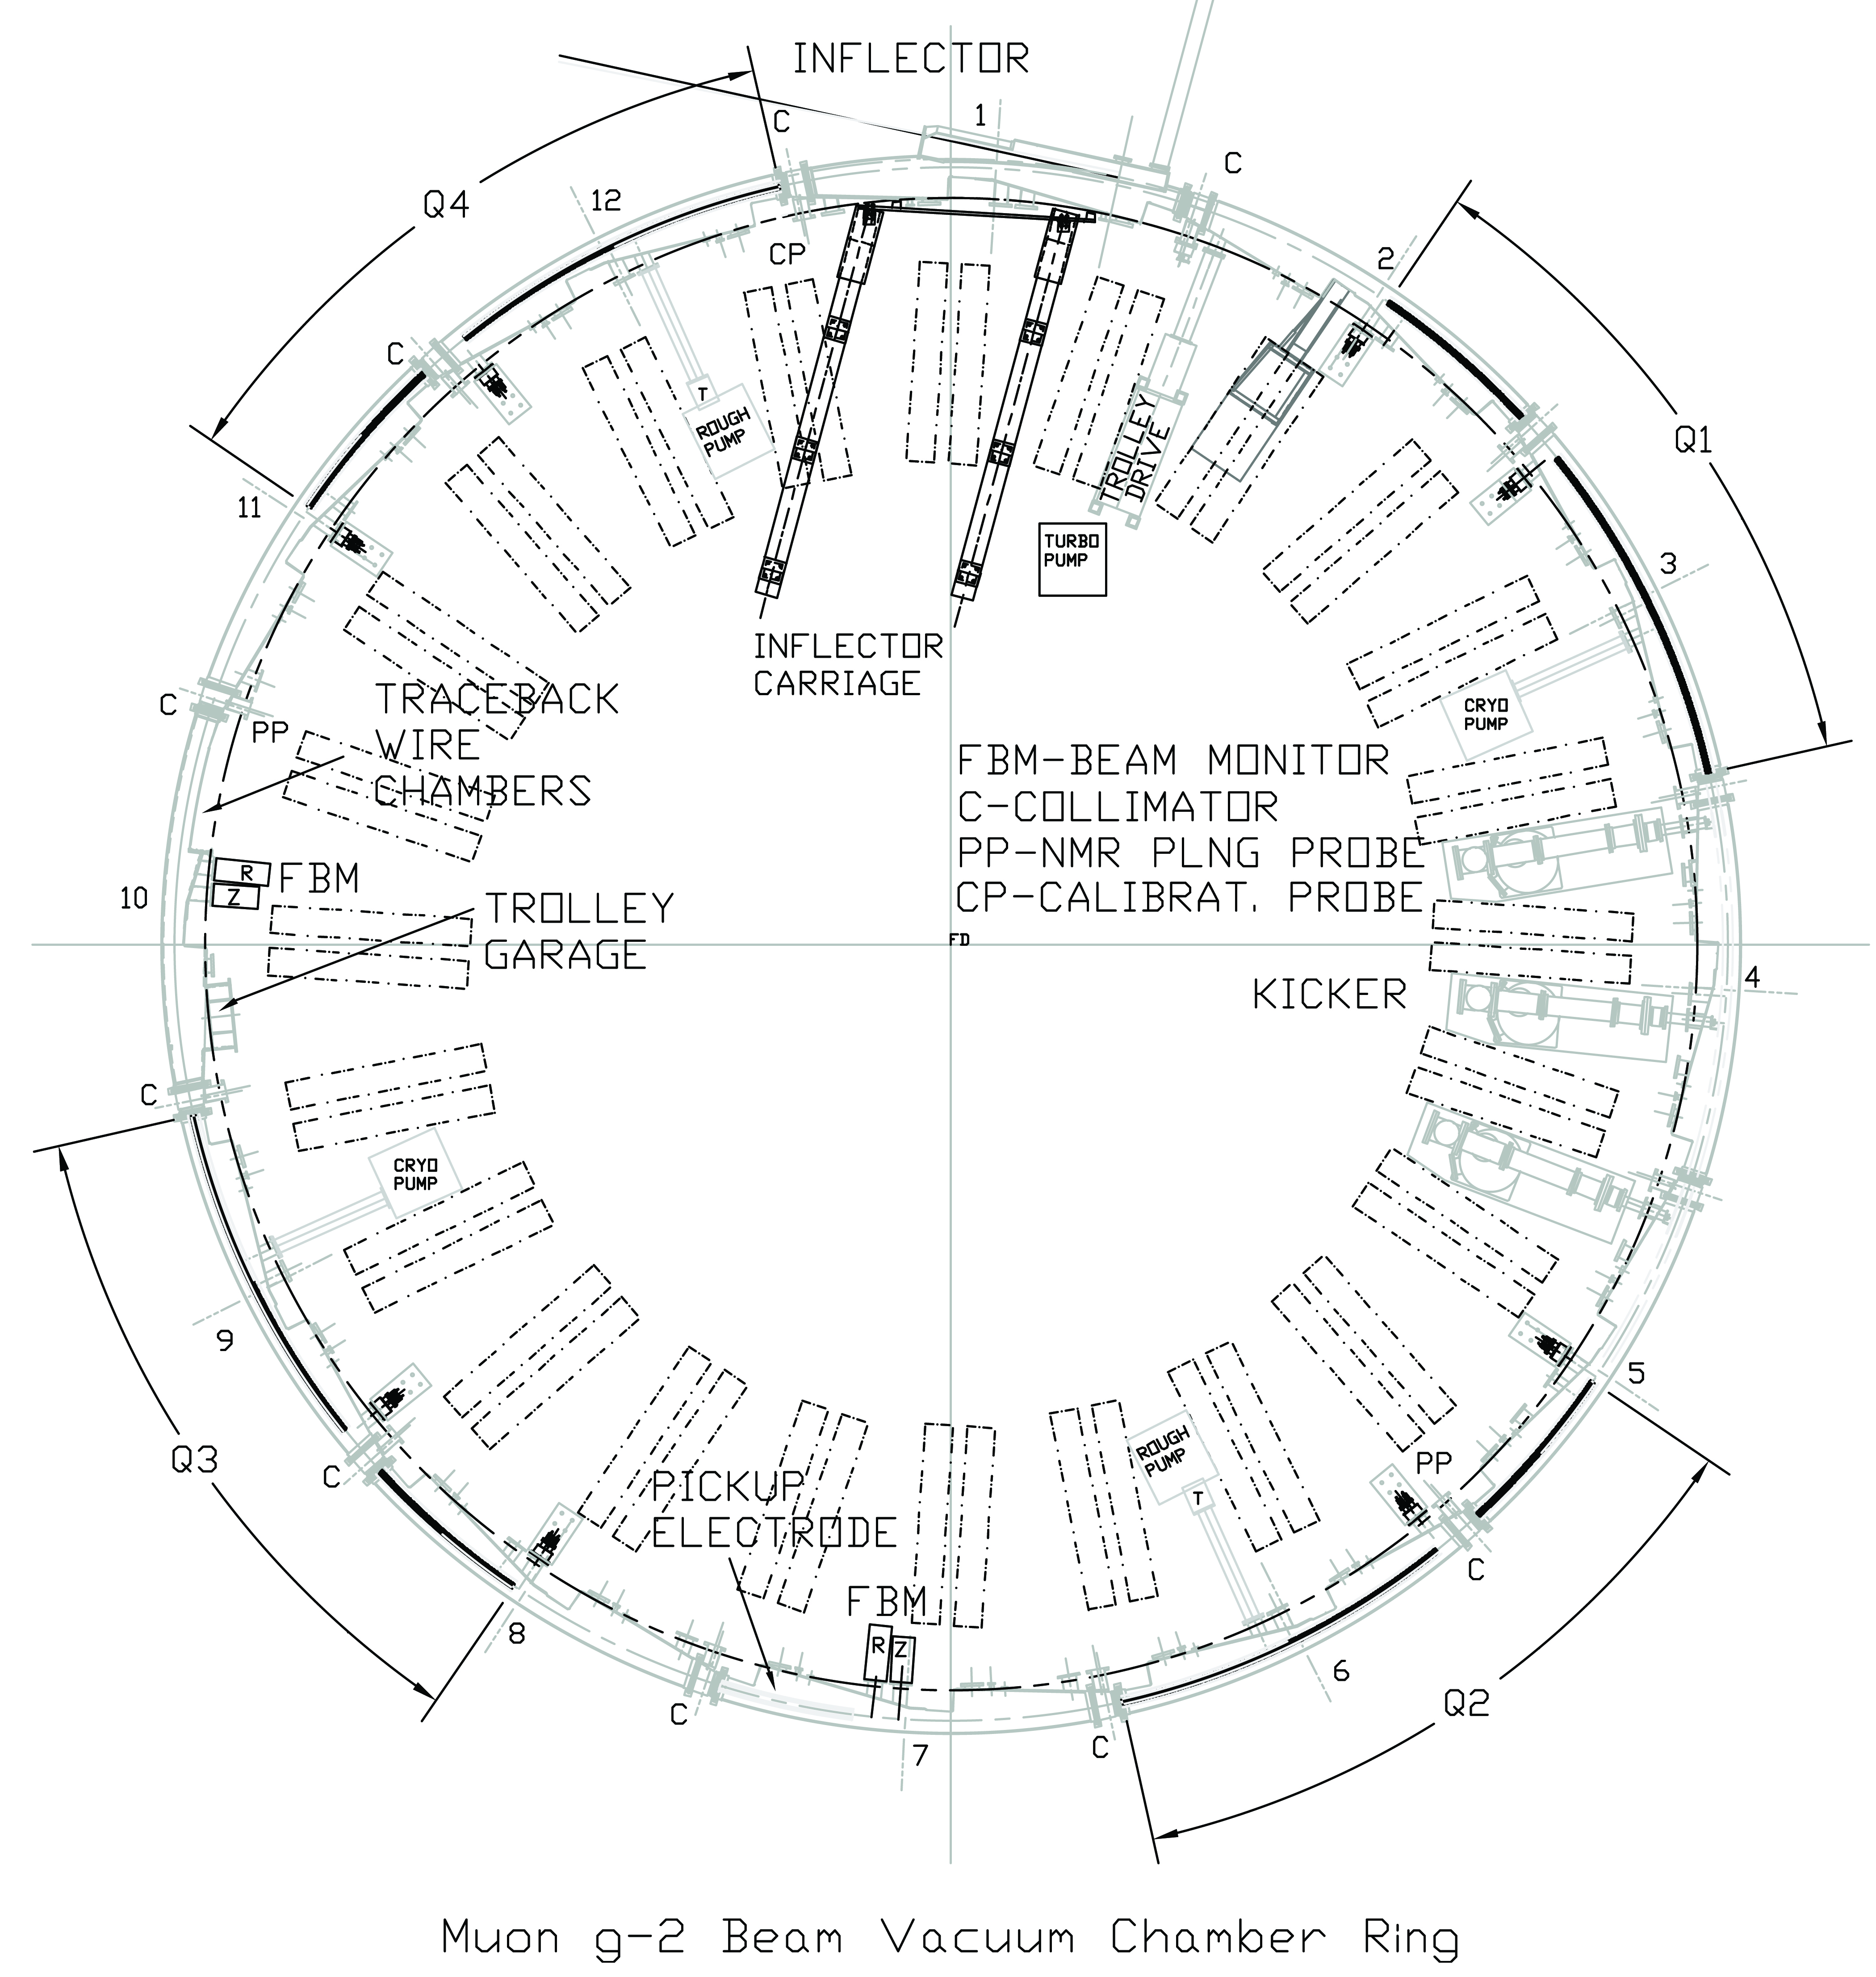
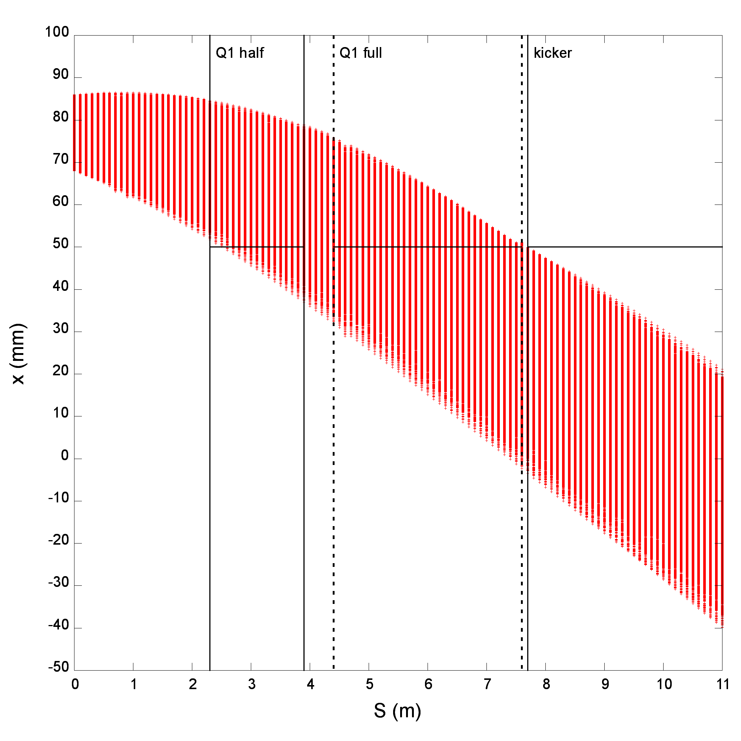




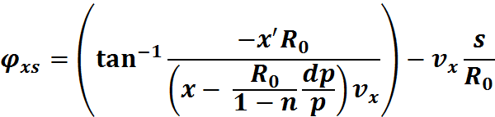

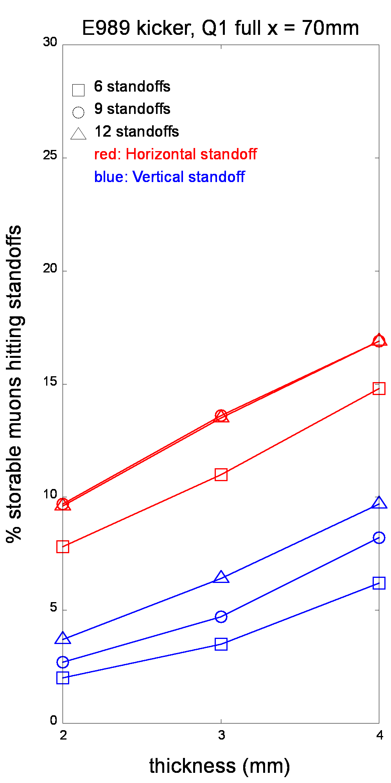
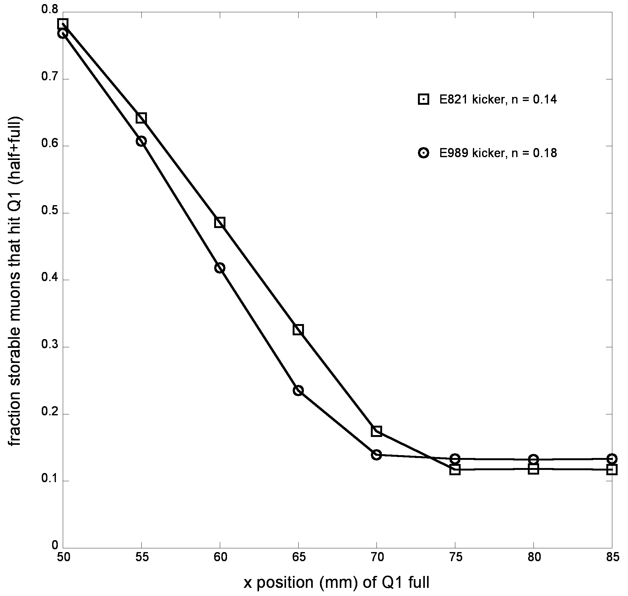


A study of muon injection efficiency improvements involving the electrostatic focusing quadrupoles in the Muon g-2 Experiment
David X. Wu, Dartmouth College, Hanover, NH 03755
William M. Morse, Physics Department, Brookhaven National Laboratory, Upton, NY 11973
Abstract
Vacuum chamber electric field and inflector tilt
The measurement of the muon anomalous magnetic moment is a precise test of the validity of the Standard Model of particle physics. Previous measurement of the anomaly shows a significant discrepancy between theory and experiment, signaling possibility of new particles and subatomic forces. To verify and build upon those previous measurements, a new measurement of the muon anomalous magnetic moment at Fermilab has been approved to measure the anomaly to a greater precision, 0.14 parts per million, which requires a greater number of stored muons. In the Fermilab Muon g-2 Experiment, polarized muons kept in the ring by an ultra-uniform magnetic field and focused using four electrostatic quadrupoles. A significant source of muon losses in the past has been muon scattering and energy loss crossing the first quadrupole outer plate. The muons crossing the outer electrode plate scatter and lose energy, resulting in an estimated 40% reduction in the number of stored muons. A proposed improvement on the number of stored muons is to reposition the outer electrode horizontally. We calculate that moving the electrode horizontally from 50 mm to 70 mm will increase the number of stored muons by 600%. We also propose an improved electrode support design, which increases the number of stored muons by 400%.
Between the outer electrode and the vacuum chamber there exists an electric field due to the potential difference between the negatively charged outer electrode and grounded vacuum chamber. We simplify this field to an electric dipole field, which decreases the radius of curvature of the muons to 7.102 meters in the region between the outer electrode and vacuum chamber. From the inflector exit to the start of half, in the gap between quadrupole sections, and inside the quadrupole region, the radius of curvature is 7.112 meters. With n = 0.18, voltage is 31kV, radius = 7.099m.
We also studied the effect of tilting the inflector in x' on the number of storable muons. A negative tilt (-1 mrad) resulted in 2% less muons hitting both the E821 kicker and E989 kicker, which slightly increased the number of muons storable. A positive tilt (+1 mrad) resulted in 2% more muon hitting both types of kickers and slightly decreased the number of muons storable.
Results
Quadrupole Support Designs
If the outer electrode is left at x = 50mm, then we see that all muons will hit the plate and the particles will scatter and lose energy. We see that few muons cross x = 50mm before 3.9m so we propose only moving the full electrode (as opposed to moving both full and half) out radially. We calculate that the maximum horizontal position of muons hitting full is 72mm. If we move the full outer electrode to x > 72mm, only muons that go through the half outer electrode will scatter or lose energy. With the full outer electrode at x = 70mm and the half outer electrode at x = 50mm, we calculate that 13% of storable muons will hit the outer electrode (half + full). This is a 6-fold improvement from the calculated 78% that hit the outer electrode in E821.
Monte Carlo Simulation
Muon beam phase space
Here we also study the number of muons that go through the standoffs of varying design, thickness, and number. Three designs are considered: the E821 design, a thin horizontal standoff design, and a thin vertical standoff design. The percent storable muons hitting the E821 quadrupole support geometry is 31% for the full outer plate x = 50mm and 27% for x = 75mm. We propose a thin vertical standoff design to minimize muon energy loss and scattering. With three standoffs per half-quadrupole and a thickness of 4mm, only 8% of storable muons hit the standoffs for the proposed outer electrode horizontal location. This is a 4-fold improvement for the new experiment.
We calculate the phase space of the muon beam from the end of the inflector until the kicker region, centered approximately 11 meters downstream of the inflector. The horizontal and vertical position of a muon as a function of distance downstream from the inflector are given below. We solve for Ax and Ay at the s at which the muon crosses into the quadrupole field. R is the radius of the storage ring, 7.112 m , n is the field index, 0.14, p is the muon momentum, p initial is the “magic momentum,” 3.094 GeV/c, s is the distance downstream of the inflector, v is the tune. A is the amplitude of the betatron oscillations, phi is the phase of the betatron oscillations. They are calculated at the distance, s, at which the beam crosses into storage.
Muon injection efficiency
We only consider muons that are storable, i.e., within the storage ring admittance assuming a perfect kick. We must examine the beam downstream of the first quadrupole to see which muons are worth considering, i.e., storable. We cut from consideration muons that do not fall within 0.25% of the magic momentum. Then we fit the distribution of muon momentum to the E821 stored muon momentum distribution. Next we cut the muons that hit the outer kicker plate positioned at x = 50mm. Since the kicker plate is thick, most of the muons that hit the plate will be lost. This cuts 26% of injected muons for the E821 kicker and 35% injected muons for the E989 kicker geometry. Finally, we cut muons that are not accepted into the storage ring circular aperture. After these cuts, 8.9% of injected muons are storable, assuming the E821 kicker geometry and n = 0.14 (8.3% for E989 kicker and n = 0.18), with a perfect kick.
Simulation validity
Acknowledgements
The checks on the accuracy of the simulation are as follows. The injection efficiency after the cuts simulated is 8.9%, which is close to the 10.5% estimation given for an ideal kick going through no material. The phase space plots simulated show that the phase space agrees with the experimental 90 degree rotation after a quarter of a turn. In this simulation, we assume uniform magnetic field, a perfect kicker field, and smooth betatron oscillation approximations. Further GEANT4 simulations should verify these results.
I would like to acknowledge and thank my mentor, Bill Morse for his generous support and guidance. I would also like to thank Vladimir Tishchenko and Yannis Semertzidis for their support and help. Finally, I thank the Office of Education Programs and Brookhaven National Laboratory.

