Slide 1
Machine Learning Part 2
Gaoyang Ye

Slide 2
What did I do?

Slide 3
Training/Testing data
Matrix we got from “bag of words”
Randomly separate the data in the radio of 6:1(roughly) into Training and Testing

Slide 4
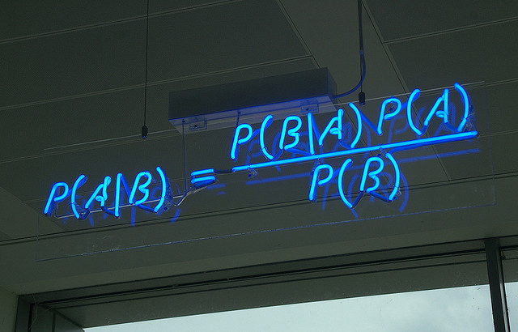
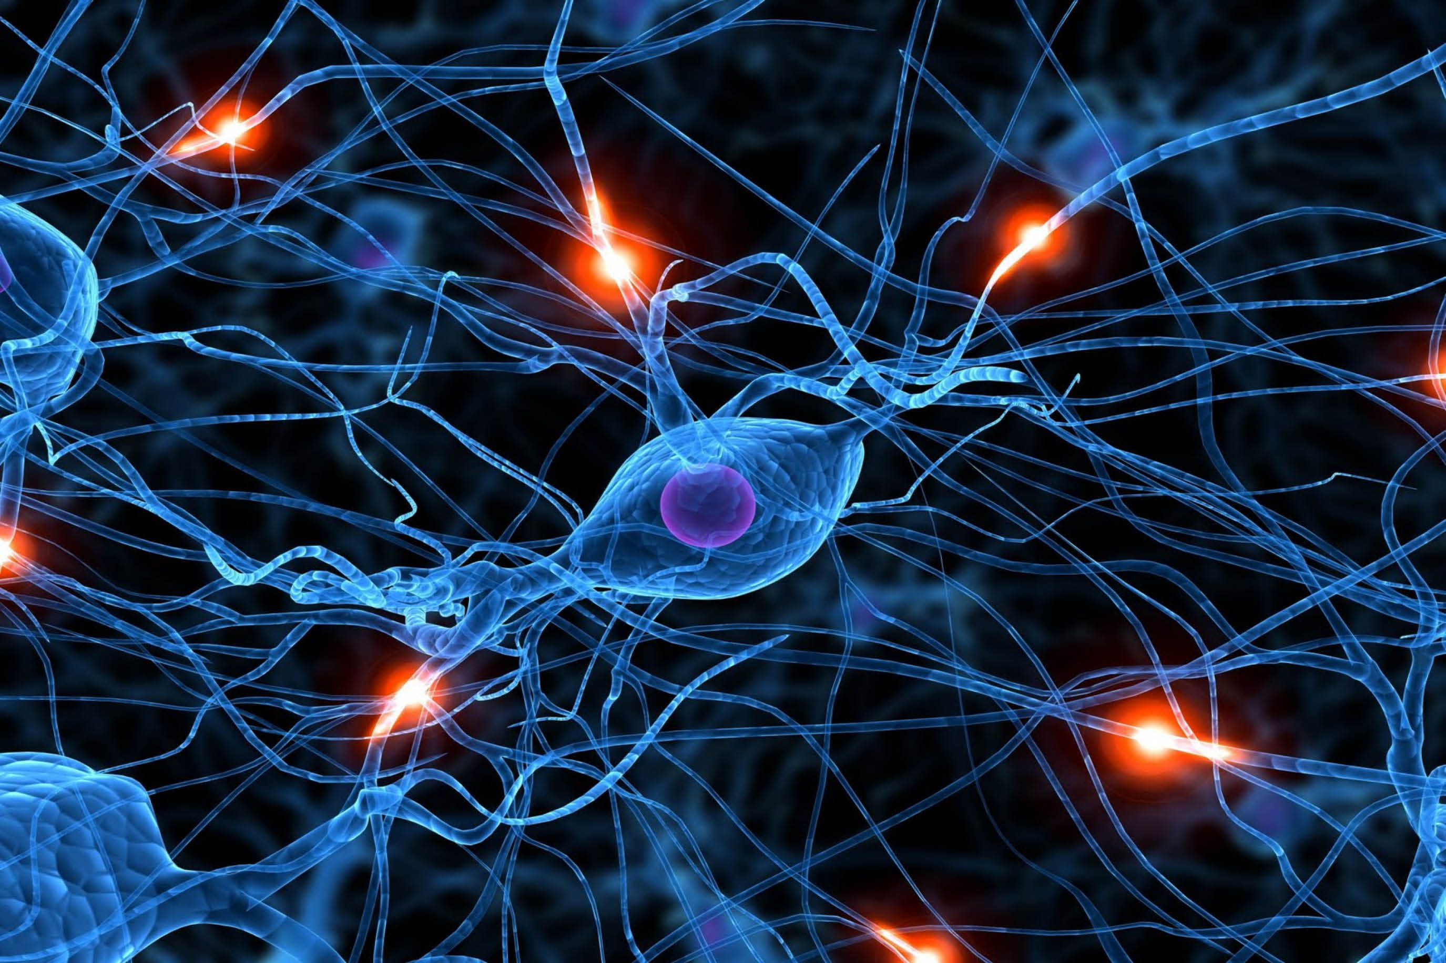
Model
Naïve Bayes
Neural Network

Slide 5
Runtime
Naïve Bayes:
Few seconds
Neural Network:
Around 30 min in one computer
One minute in cluster

Slide 6
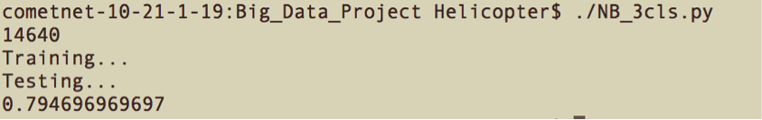
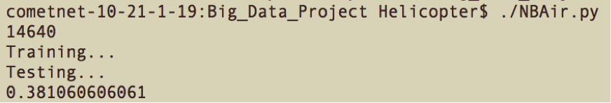
Accuracy
Naïve Bayes:
Three classes: 79.5%
Twelve Classes: 38.1%

Slide 7
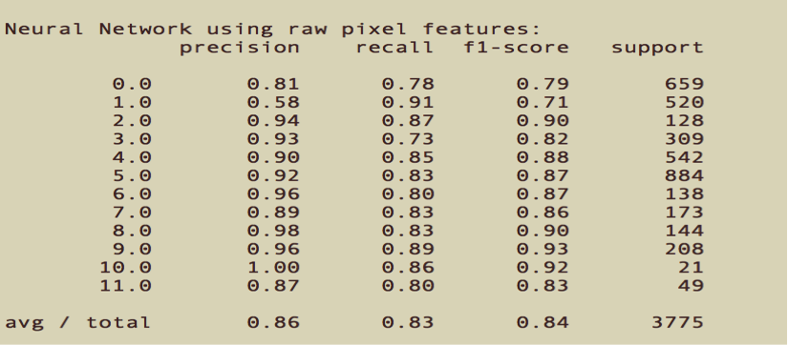
Accuracy
Neural Network:
86% for twelve classes!

Slide 8
Avoiding Overfitting
Scikit-learn package has some inner mechanism to avoid overfitting
Compare result of Spark multilayer perceptron classifier and Scikit-learn package

Slide 9
Thank you!

