Slide 1
Part2.1 Objective
In this part we’ll focusing on the original data, what insight we can retrieve from the data set
Sample questions are like:
overall sentiment(negative, neutral, positive percentage)
percentage of tweets per airline
Proportion of negative, neutral and positive sentiment tweets per airline
Reasons for negative sentiment tweets
Reasons for negative sentiment per airline
Tweet location exploration
Tweet time zone study

Slide 2
DATA FLOW
Data file loading in
Filter records
Group by attributes
Count each records

Slide 3
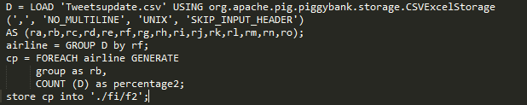
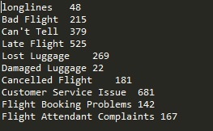
Sample Code
Results

Slide 4
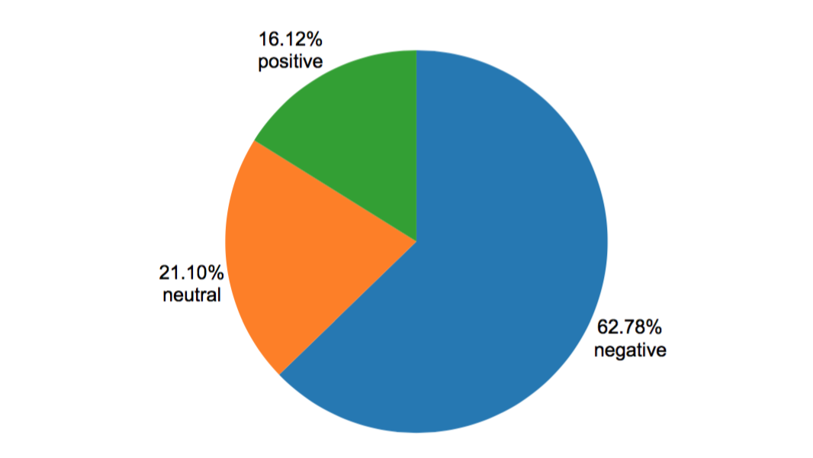
Analysis overall sentiment analysis

Slide 5
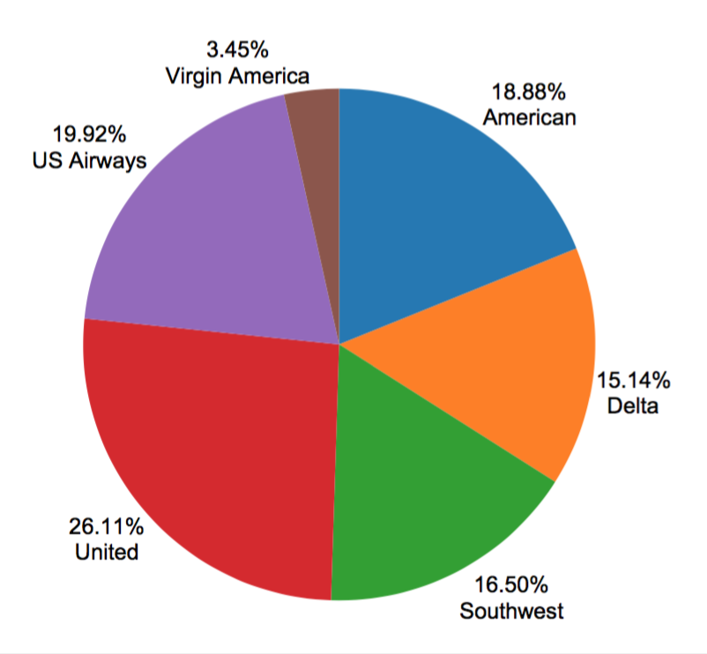
Percentage of tweets per airline

Slide 6
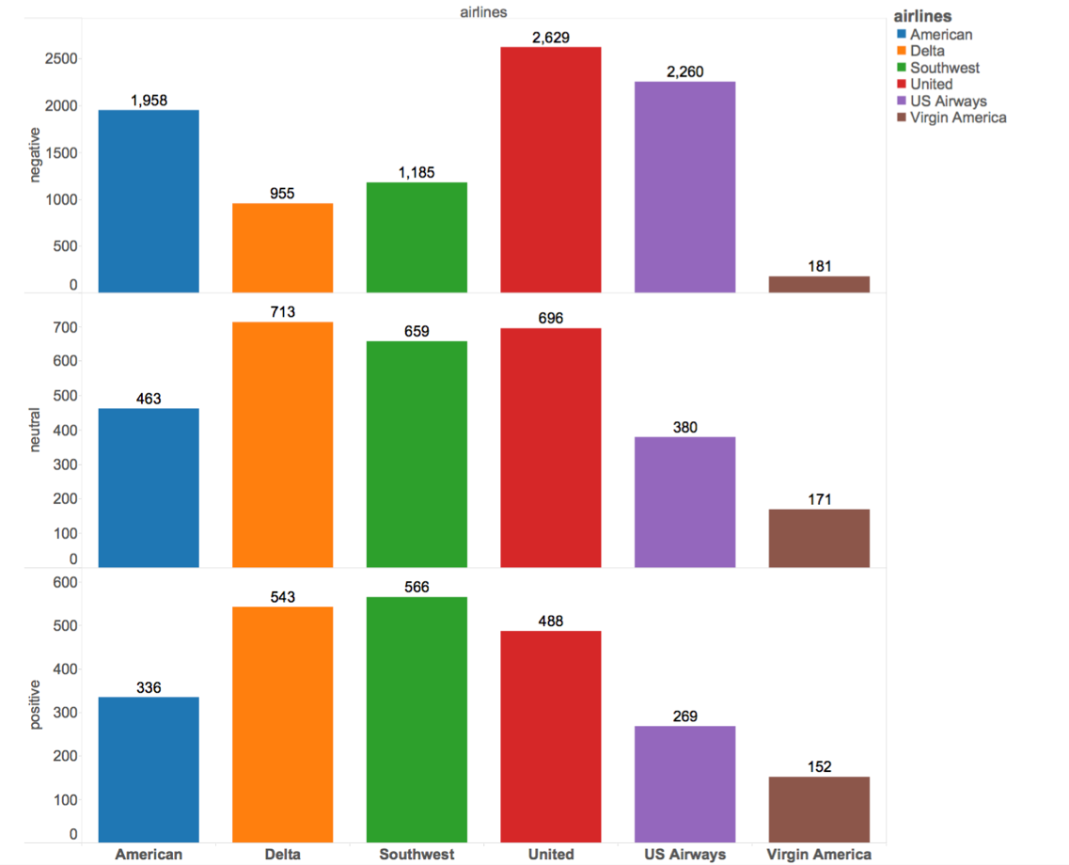
negative, neutral positive sentiment tweets per airline

Slide 7
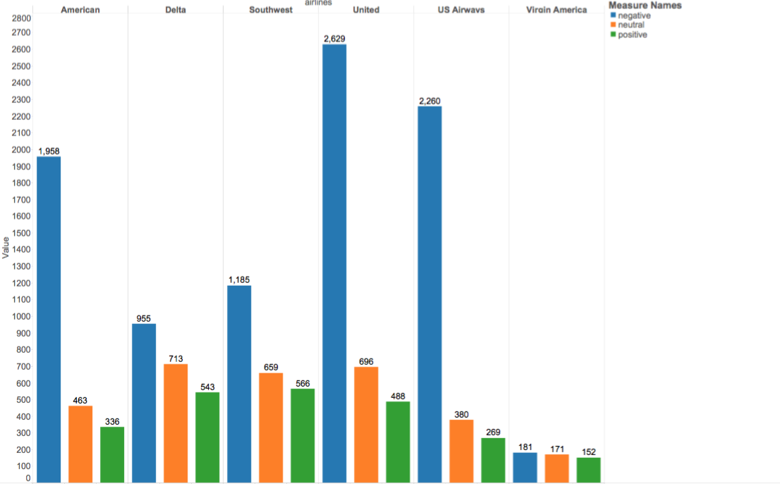
negative, neutral positive sentiment tweets per airline 2

Slide 8
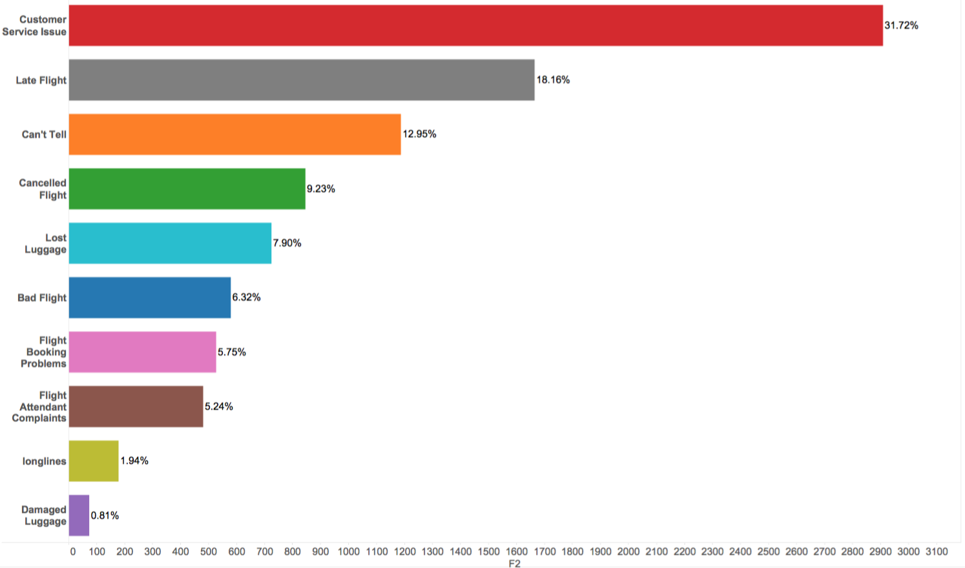
Negative sentiment

Slide 9
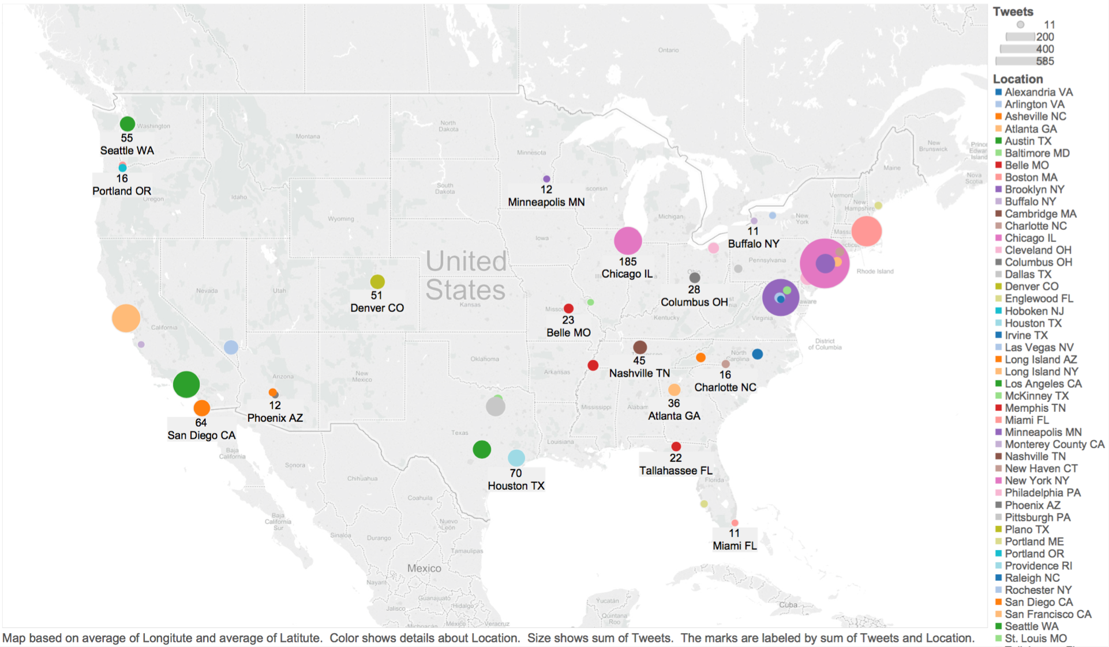
Location Visualization

