Slide 1
Differential Methylation in Primary vs Metastatic Cancer
The Splice Girls
Almas Khan, Denitsa Vasileva, Diana Lin, Nairuz El-azzabi
Notes:
https://github.com/STAT540-UBC/STAT540-UBC.github.io/blob/master/homework/posterRubric2012.pdf

Slide 2
Motivation
Late-stage Head and Neck Squamous Cell Carcinoma (HNSCC):
It is associated with high mortality rates
It can metastasize to the lung and causes HNSCC lung metastases
Lung Squamous Cell carcinoma (LUSC):
It is a type of a primary lung cancer
It is high-treatable
It is frequent in patients with HNSCC
Aim: Identify differentially methylated CpGs between HNSCC lung metastasis and primary LUSC → gain better understanding of epigenetic and genetic differences between the two types → more accurate diagnosis and differentiation
Notes:
https://www.ncbi.nlm.nih.gov/pubmed/20823766
https://clinicalepigeneticsjournal.biomedcentral.com/articles/10.1186/s13148-019-0710-5

Slide 3
Research Question
Are there individual CpG sites/islands with significant differences in methylation level in primary vs metastatic cancer?

Slide 4
About the Dataset
GEO Accession | GSE124052
Method | Infinium MethylationEPIC BeadChip
Values | Raw and normalized Beta values
Participant Profile | 51 males (45 to 80 years old) with either LUSC or HNSCC
Notes:
Noob-normalization source: https://bmcgenomics.biomedcentral.com/articles/10.1186/s12864-016-2819-7

Slide 5
Overview of Workflow
Part 1
Part 2
Part 3
Part 4
Part 5
Part 6
Gather the Data
Quality Control
Data Exploration
Statistical Analysis
Visualizing Results
Pathway Analysis
Wrangle the data
Reshape the data
Filter the data
Combine with metadata
PCA
P-value Histogram
Beta value boxplots
Beta value density plots
Hierarchical clustering
Heatmap
Convert beta values to M values
Limma models
Annotation of CpG sites
Beta value strip plot of differentially methylated genes
Chromosome plot of differentially methylated genes
Annotation of differentially methylated genes using gene ontologies
KEGG Pathway annotation of differentially methylated genes

Slide 6
Quality Control: Principal Component Analysis
 | PC1 | PC2 | PC3 | PC4 | PC5 | PC6 | PC7 | PC8 | PC9 | PC10
Standard deviation | 3.0702 | 2.4583 | 1.94006 | 1.82127 | 1.56238 | 1.44677 | 1.36316 | 1.3169 | 1.24193 | 1.17200
Proportion of Variance | 0.1571 | 0.1007 | 0.06273 | 0.05528 | 0.04068 | 0.03489 | 0.03097 | 0.0289 | 0.02571 | 0.02289
Cumulative Proportion | 0.1571 | 0.2578 | 0.32056 | 0.37584 | 0.41652 | 0.45141 | 0.48238 | 0.5113 | 0.53699 | 0.55988
Notes:
https://towardsdatascience.com/principal-component-analysis-pca-101-using-r-361f4c53a9ff

Slide 7
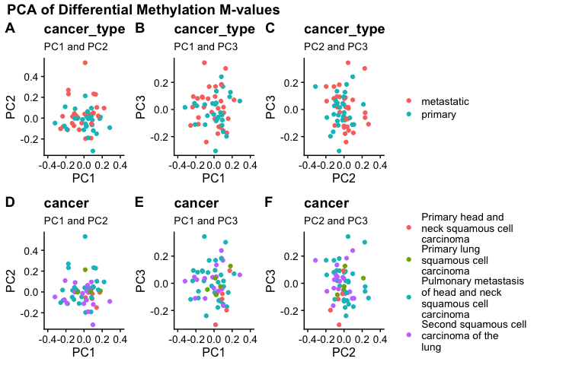
Quality Control: Principal Component Analysis

Slide 8
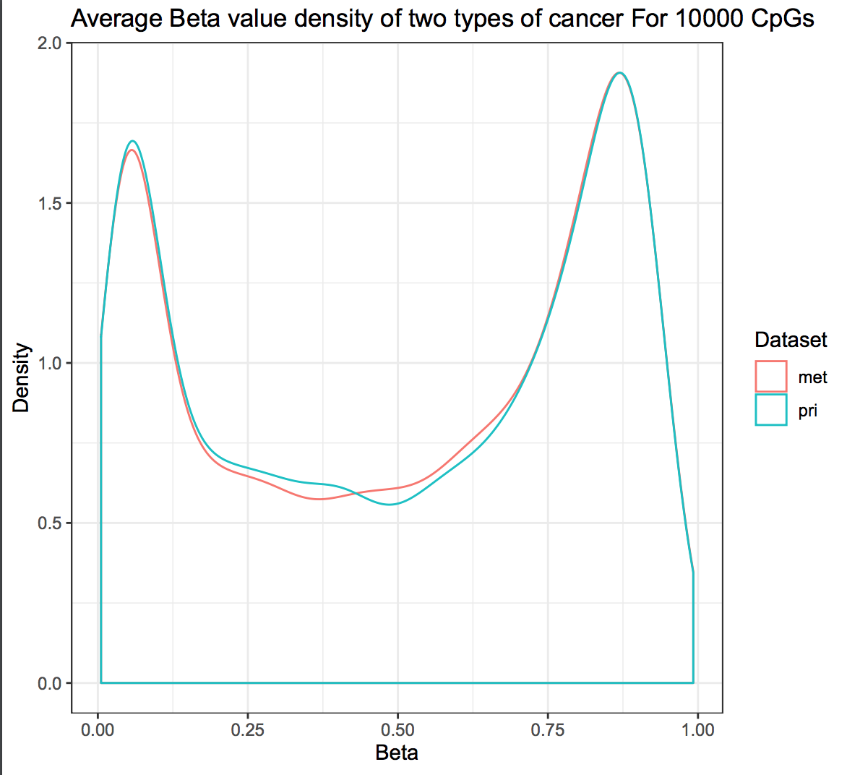
Quality Control: Density Plot of Beta Values
Density Plot of Beta Values Across Primary And Metastatic Cancer

Slide 9
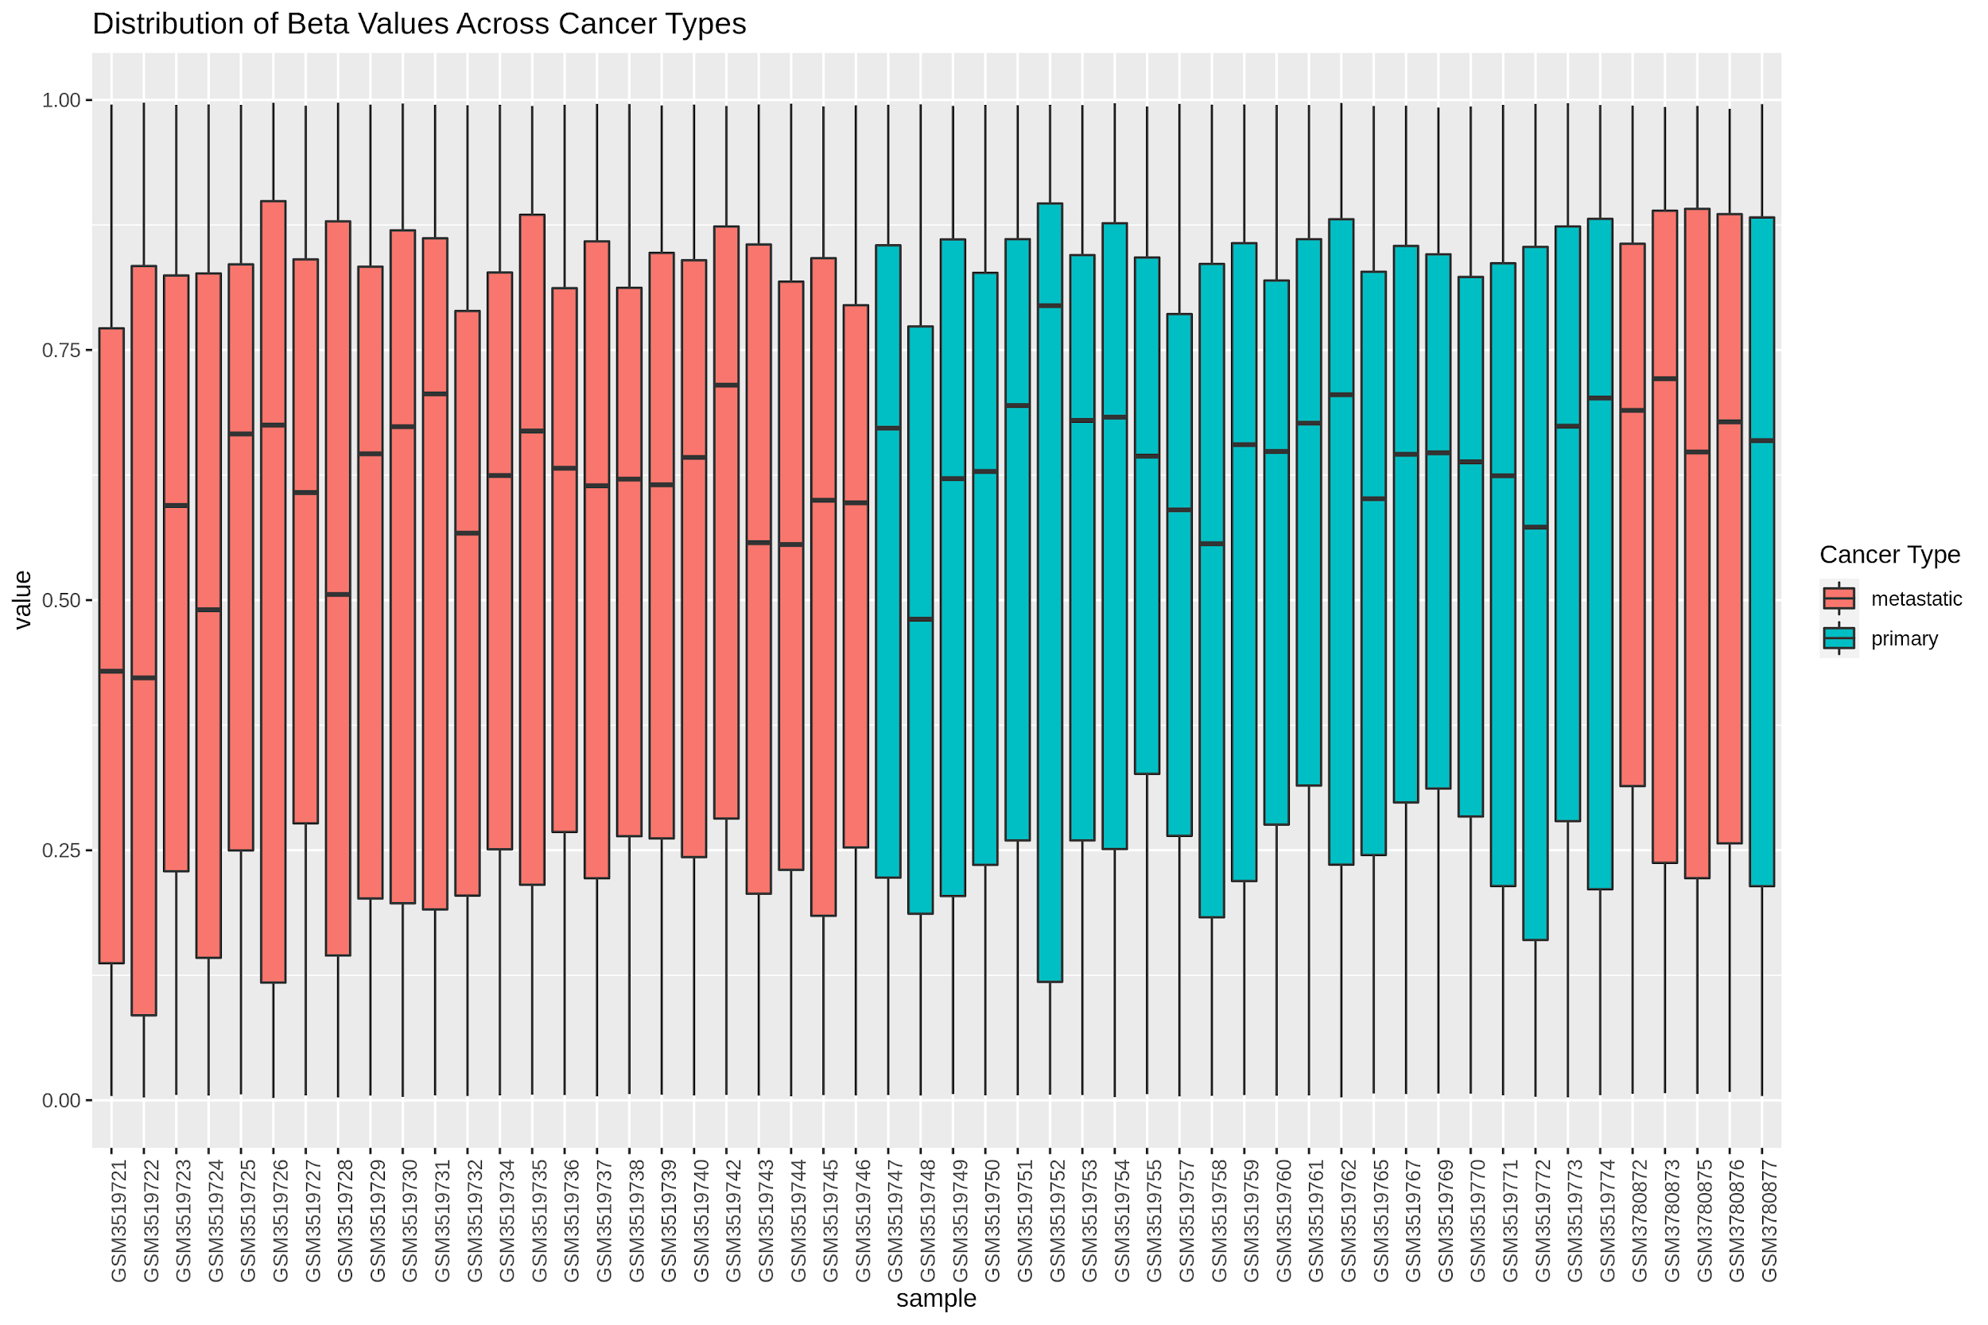
Quality Control: Box Plot Distribution
Beta Value Boxplot Distribution Across Cancer Types

Slide 10
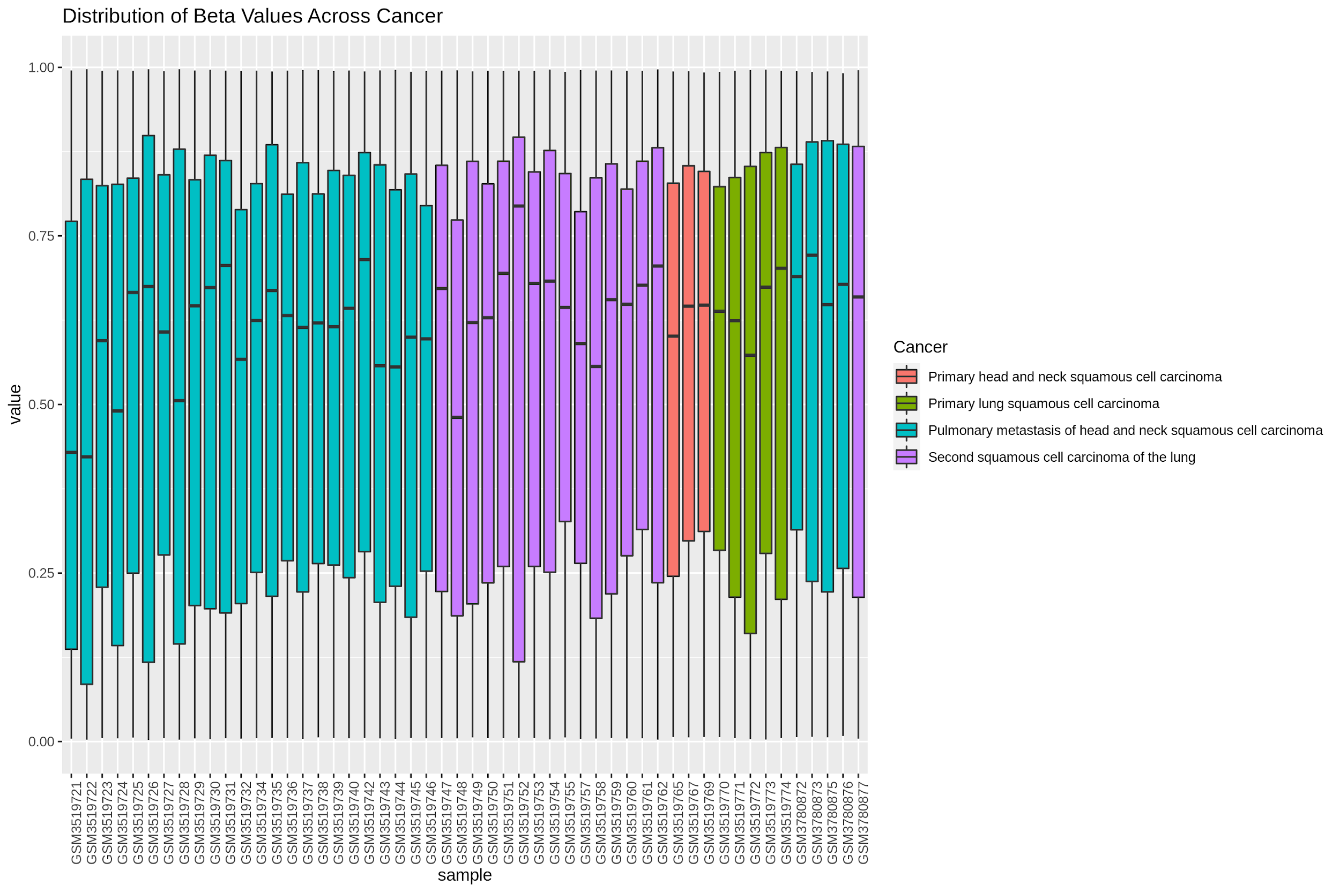
Quality Control: Box Plot Distribution
Beta Value Boxplot Distribution Across The Cancers

Slide 11
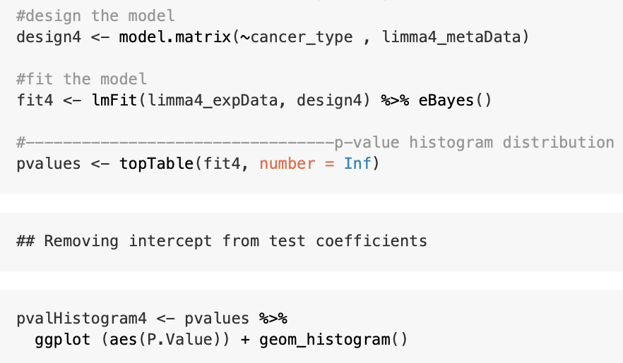
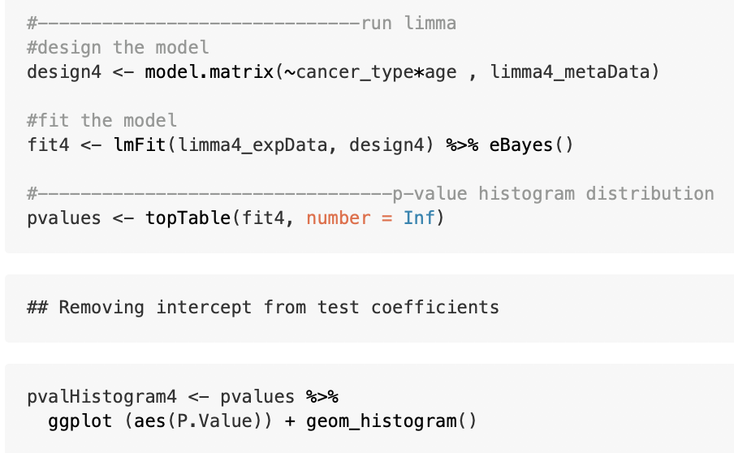
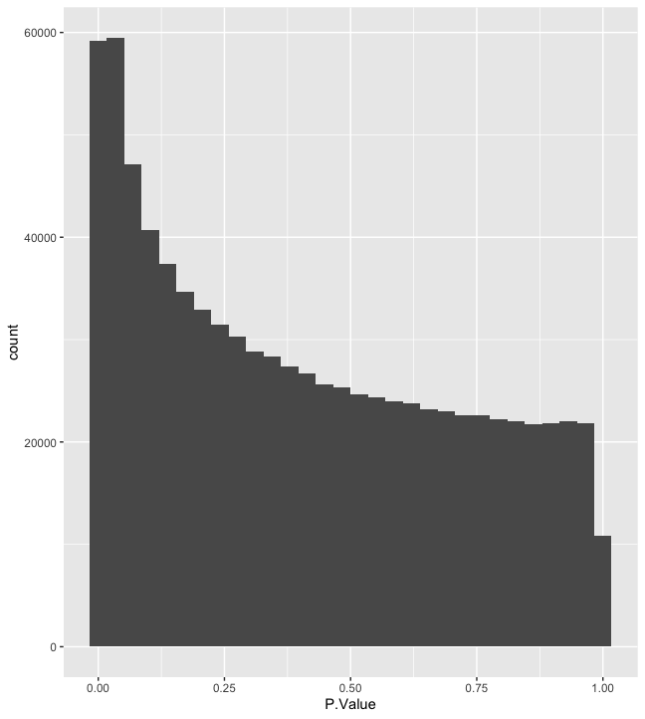
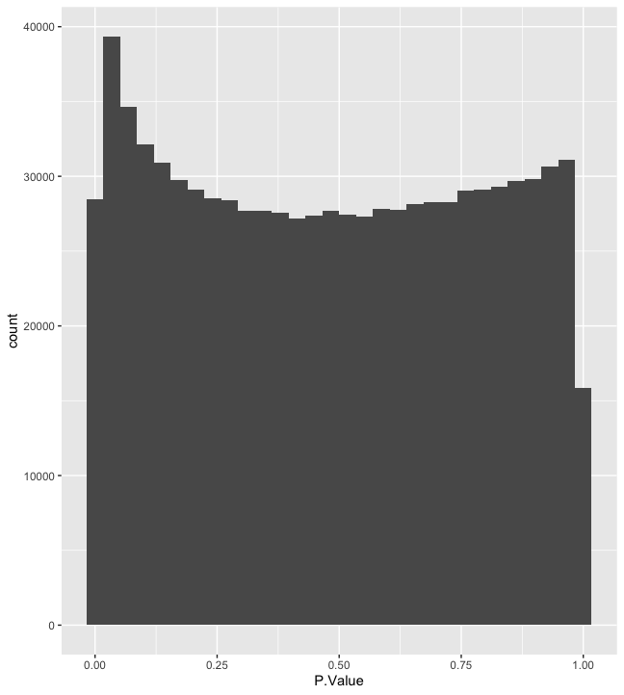
Quality Control: p-value histogram

Slide 12
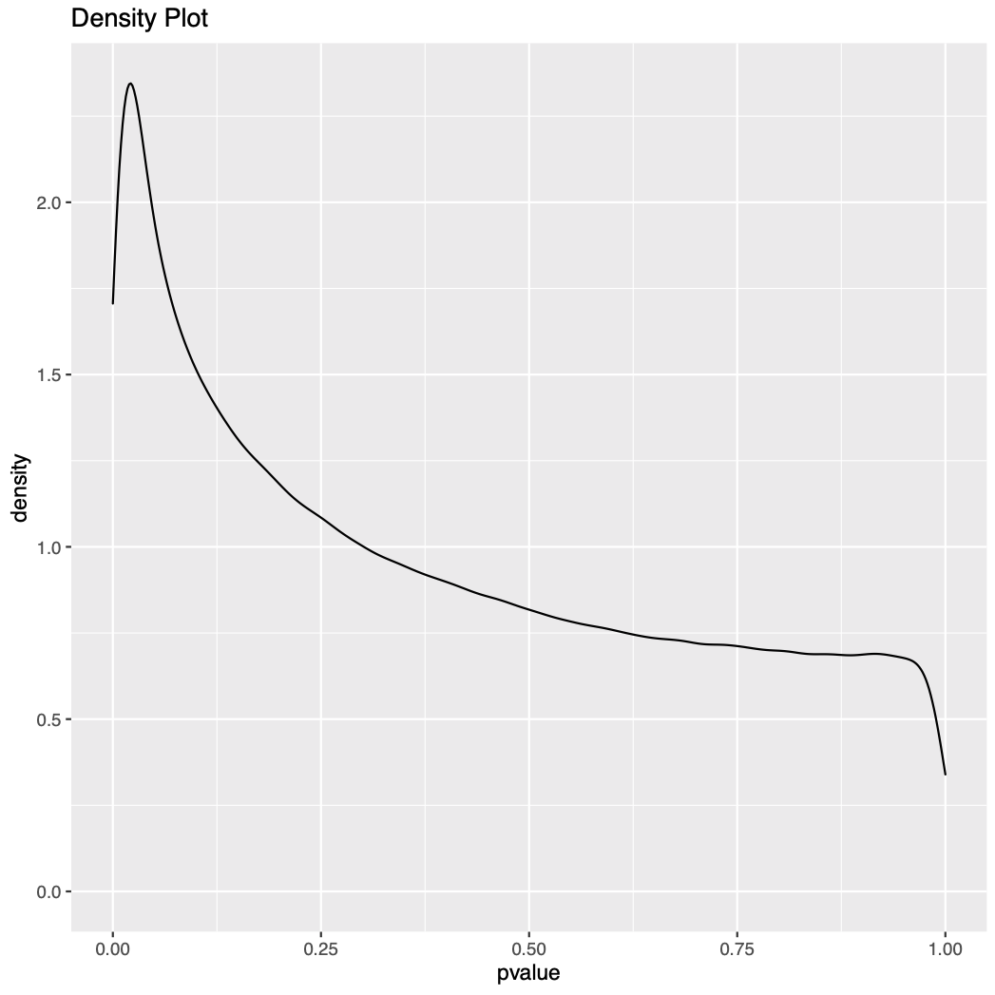
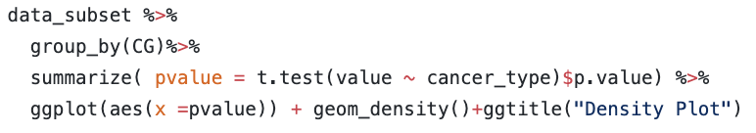
Quality Control
P-value Density Plot

Slide 13
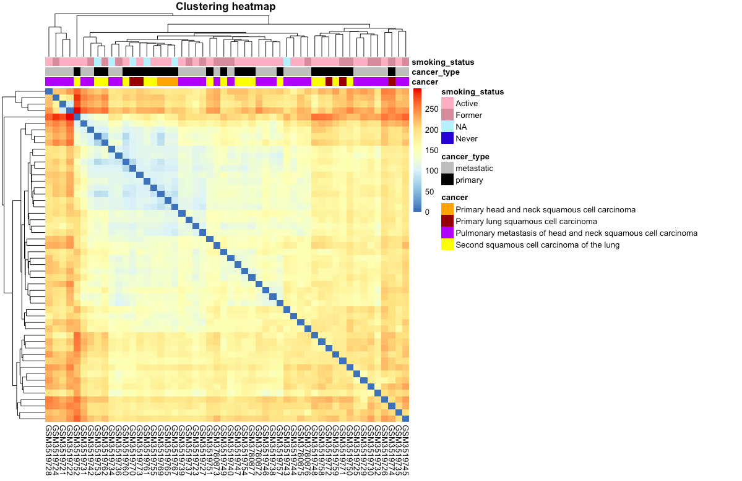
Quality Control: Clustering Heatmap

Slide 14
Statistical Analysis: Methodologies used
Beta-values and M-values: summarize methylation and un-methylation intensities for each probe
Linear regression on M-values: the use of linear regression model to assess differential methylation in the context of multifactorial designed experiment (~cancer_type*Age), run on all probes
Cancer type is primary vs metastatic
P-values: distribution of p-values across all tests to provide good diagnostics
T statistics: hypothesis testing to screen all possible hypotheses and find the ones that are statistically significant

Slide 15
Limma Details
Accounted for age as a covariate due to general effects of age on methylation
Accounted for sex by only using male samples
Final Limma model : Methylation~ Cancer_type+Age+ Age:Cancer_type
Used the default Benjamini-Hochberg multiple test correction methods for the adjusted p values
Could not use where the cancer origin was with cancer_type because we were missing one group (metastatic for lung) which caused problems in limma so decided to leave it out

Slide 16
Top Table-Coefficient of Primary Cancer
Gene | ProbeID | Chr | logFC | T | P value | FDR
TBC1D25 | cg14493612 | X | -10.48 | -4.88 | 1.03e-5 | 0.99
CDC6 | cg21255171 | 17 | -8.29 | -4.72 | 1.79e-5 | 0.99
ISY1-RAB43 | cg10716343 | 3 | 7.99 | 4.65 | 2.29e-5 | 0.99
NA | cg08216425 | 1 | -14.17 | -4.49 | 4.03e-5 | 0.99
CBX5 | cg11713274 | 12 | 13.61 | 4.39 | 5.59e-5 | 0.99
NME7 | cg04788627 | 1 | 9.84 | 4.38 | 5.73e-5 | 0.99
OLFML2A | cg04015541 | 9 | 10.76 | 4.15 | 1.25e-4 | 0.99
CCK | cg27100229 | 3 | 6.82 | 4.14 | 1.27e-4 | 0.99
SIM2 | cg00937982 | 21 | 10.08 | 4.10 | 1.45e-4 | 0.99
SLFN11 | cg18108623 | 17 | 10.71 | 4.00 | 2.02e-4 | 0.99
Notes:
Using the default for adjusted p value → BH method

Slide 17
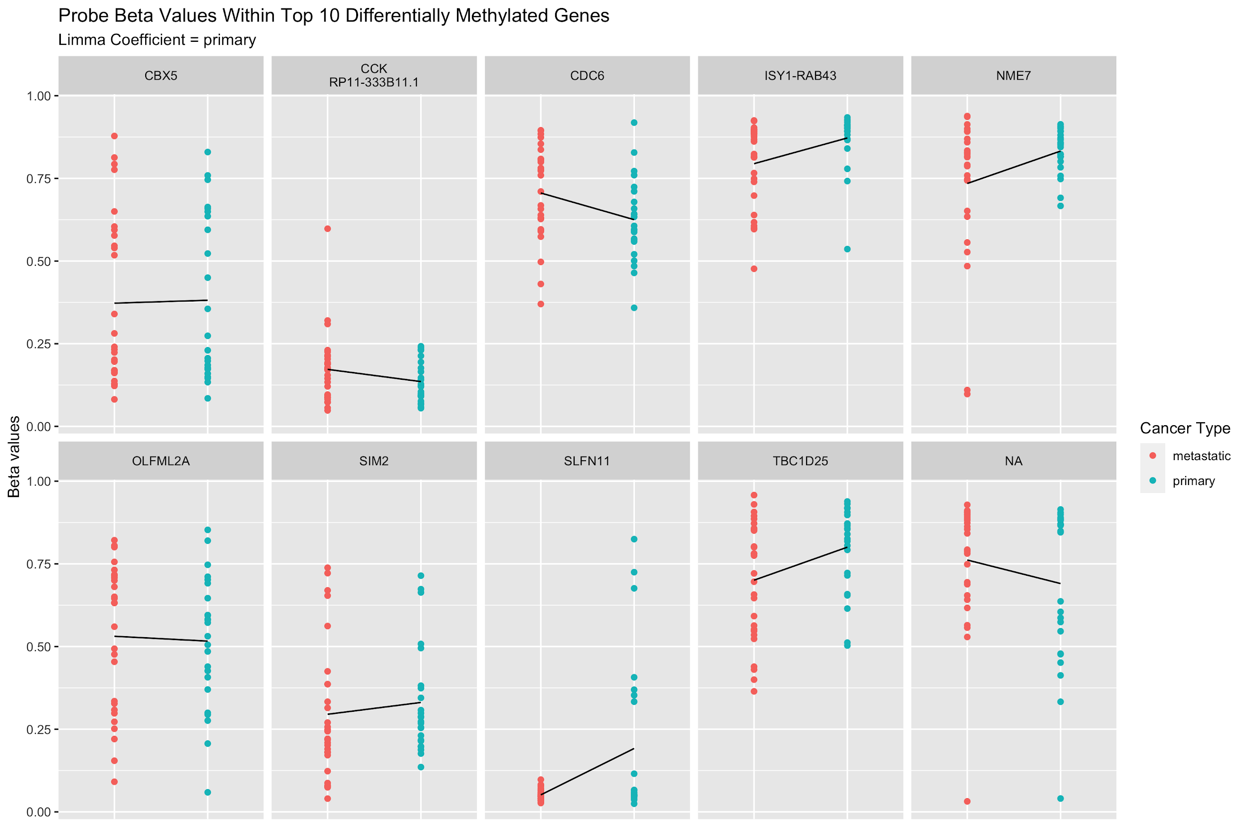
Results: Strip Plot

Slide 18
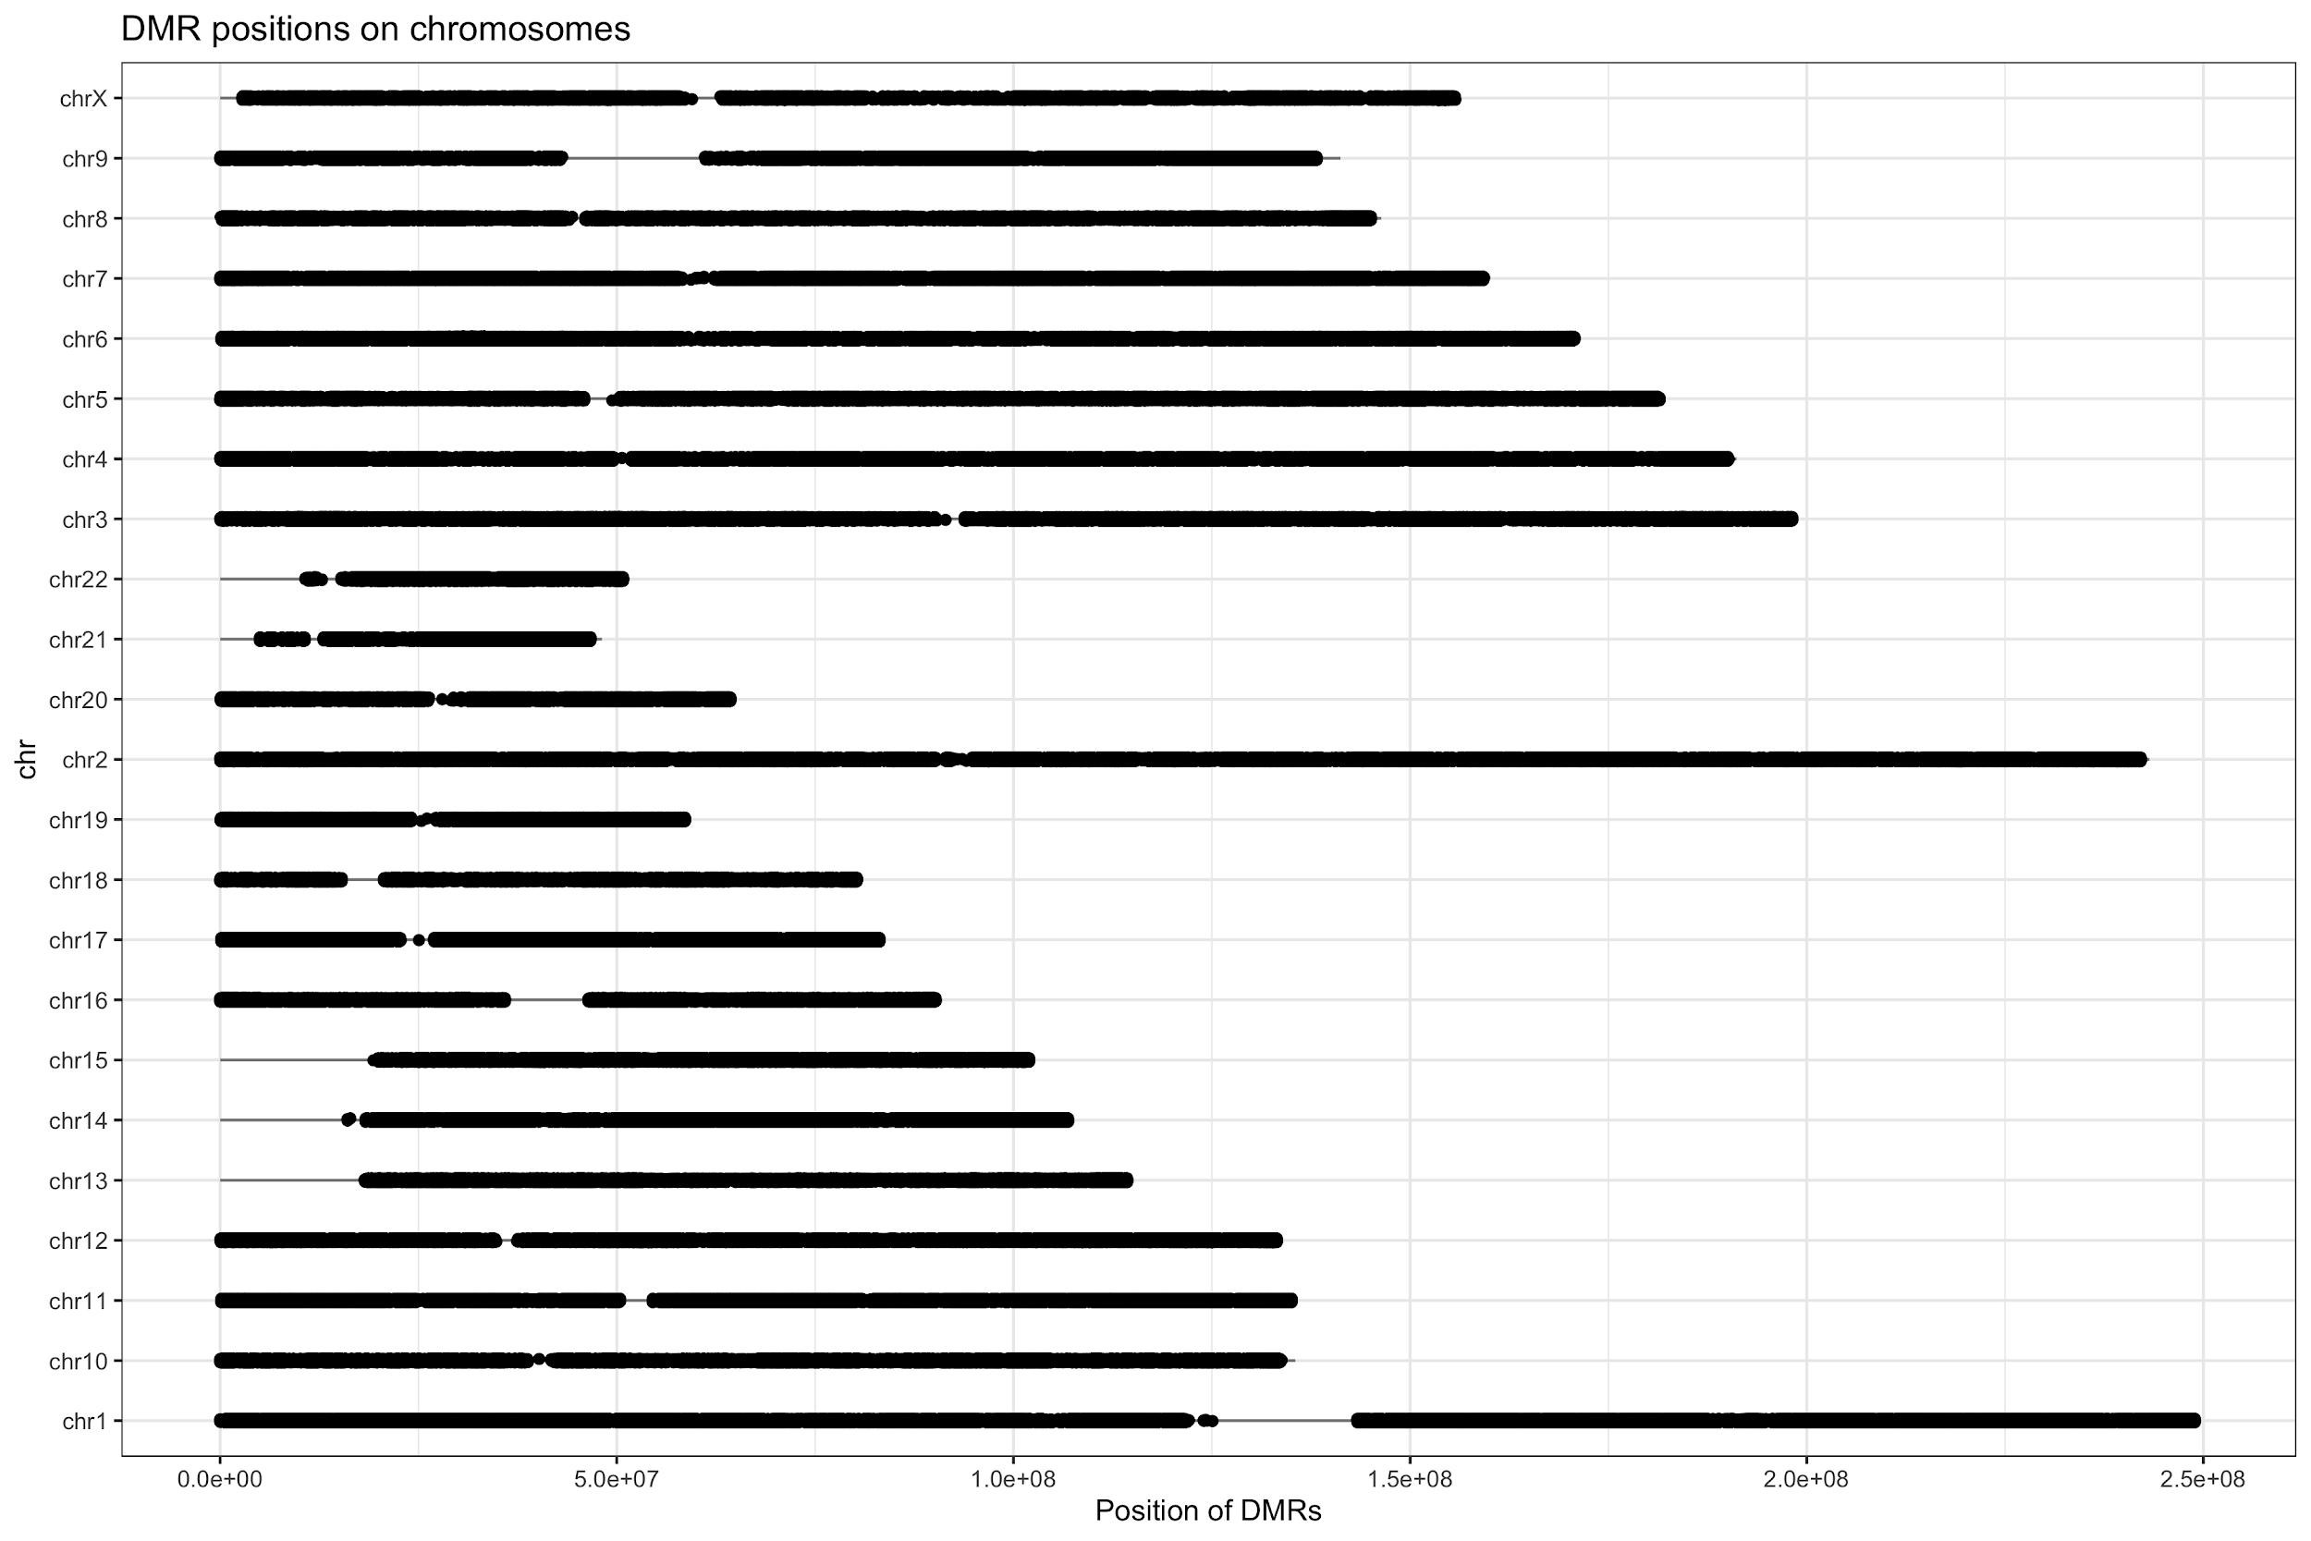
Results: Chromosome Plot

Slide 19
Pathway Analysis: KEGG
Gene Implicated | KEGG ID | Pathways
CBX5 | ko05034 | Alcoholism
CBX5 | ko00310 | Lysine degradation
CBX5 | ko05322 | Systemic lupus erythematosus
CBX5 | ko05202 | Transcriptional misregulation in cancer
CBX5 | ko05203 | Viral carcinogenesis
CCK | ko04974 | Protein digestion and absorption
CDC6 | ko05219 | Bladder cancer
CDC6 | ko05224 | Breast cancer
Notes:
(https://www.ncbi.nlm.nih.gov/pubmed/28815324
https://www.ncbi.nlm.nih.gov/pubmed/27667722

Slide 20
Discussion
Adjusted P values showed no significant genes that are differentially methylated in the primary compared to metastatic
There was no significant differential methylation by age or age:cancer_type interaction
Due to unbalanced design (low number of samples), we decided not to separate the primary cancer into head and neck or lung cancer
Overall sample size was still small so it would be interesting to look at larger numbers of primary lung and metastatic(pulmonary) HNSC

Slide 21
Challenges
Large dataset
Computationally expensive for statistical analysis and for plotting, leading to RStudio crashing and frozen computers
Unbalanced sample sizes
By cancer type : 28 metastatic vs 24 primary
By cancer: 3 primary HNSC vs 3 Primary lung squamous cell carcinoma vs 16 Primary Second Squamous Cell Lung Carcinoma vs 28 Metastatic HNSC
By cancer location: 31 HNSC vs 19 Lung
Inconsistent metadata collection
Some samples were missing information for smoking, e.g. some smokers had # packs per day while others did not
Incompatible R packages
ErmineR caused issues with various versions of Java (even Paul couldn’t figure it out)

Slide 22
Conclusions
We fail to reject the null hypothesis. However, due to the small sample sizes and unbalanced design, we lack sufficient evidence to definitively conclude that there is no differential methylation between primary (HNSC/LUSC) and metastatic cancers (HNSC).
Take Home Messages:
Select datasets with balanced metadata and a larger than enough sample size to maximize statistical power
Select size of datasets based on available computational resources
If given raw data and processed data, use the raw data and do all preprocessing steps (i.e. normalization) yourself to ensure quality analysis
GitHub is great for collaborative high-dimensional biology analyses!

