Slide 1
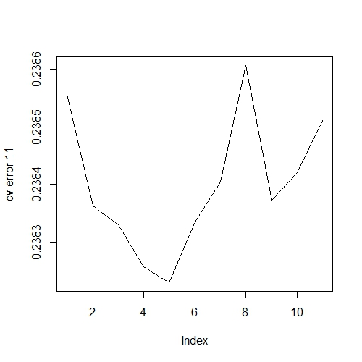
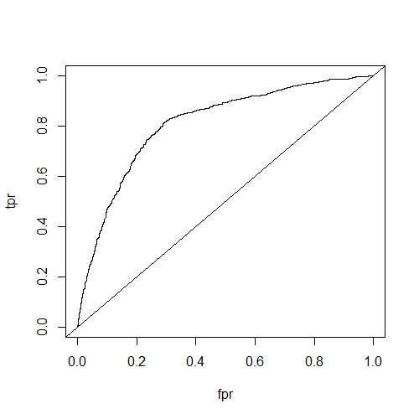
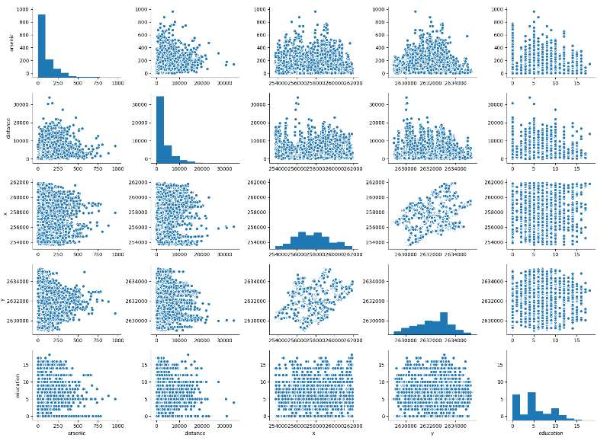
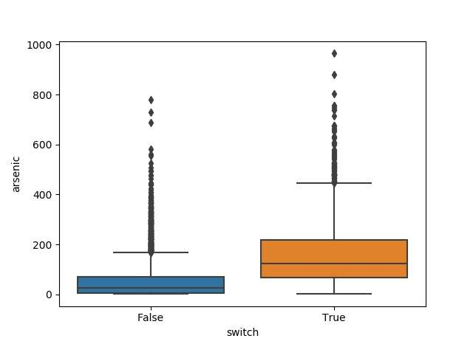
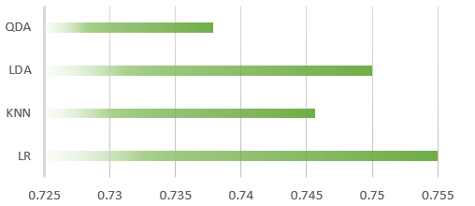
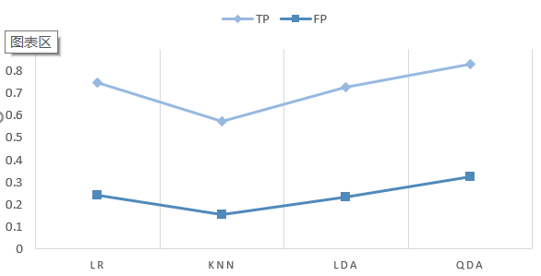
MATH 4432 Mini-Project 1: Statistical Learning Models on Wells Data
Yang Yifeng¹, Deng Yibo¹ and Li Mingxuan² {yyangbf, ydengat, mlibw}@ust.hk
¹: Department of Mathematics, HKUST ²: Department of Computer Science and Engineering, HKUST
1. Introduction
3. Logistic Regression on Wells Dataset
5. Analysis
The data set contains decision of switching unsafe wells for arsenic pollution in Bangladesh. We aim to explore the most influential factors for switching unsafe wells. Models including Logistic regression, LDA, QDA, KNN were employed and the best model was chosen by their error rate.
We fit the model on all the predictors and their interaction. Insignificant terms were dropped for alpha=0.01. We then examined the linearity of our predictors by higher order term. Higher order terms were added for predictors by 10-fold Cross-Validation. Misclassification error and ROC curve were computed to assess the accuracy of the model.
Results from different models are compared mainly based on their error rate and ROC. Among all models, Logistic model achieves the lowest error rate 24% and the highest AUC-70%. The false positive rate is 24.1%, the true positive rate is 74.9%. It worth pointing out that only a few features are kept in the logistic regression model for the sake of simplicity, which comes in the cost of accuracy. For KNN, LDA, QDA, the accuracy is slightly inferior than logistic regression. What’s more, FPR and TPR are inferior than logistic regression. However, the advantage of logistic regression is its simplicity and interpretability.
2. Wells Dataset Analysis
We plot scatter plot using ‘switch’ and each predictor first to see their relation. Pairwise scatterplot between predictors are shown in Figure 1. As shown in Figure 2, ‘arsenic’ seems to be influential in determining ‘switch’ because of the negligible cross-group difference and this is the same with other variables.
6. Conclusion
From the coefficients in the logistic regression model, we can obtain meaningful interpretation. The safety status of wells can significantly influence whether we should switch wells or not. An unsafe well is highly likely to be switched. Moreover, higher concentration of arsenic also suggest switching wells. In addition, the lower the distance between wells and urban area, the higher the chance wells are switched.
chose higher order term
AUC
4. KNN/LDA/QDA on Wells Dataset
All the predictors were first normalized to lie in the similar range. Then KNN, LDA and QDA were employed to predict switching unsafe wells. For KNN, different K-value were also tested to determine the optimal K-value. Notice that KNN achieves the highest accuracy when K=22.
7. References
[1] James G, Witten D, Hastie T, et al. An Introduction to Statistical Learning[M]. Springer New York, 2013.
[2] Hastie T, Tibshirani R, Friedman J. The element of statistical learning[M] . Springer, 2009:192-192.
8. Contribution
Wells Dataset
Algorithm Implementation: Yang
Analysis: Deng, Yang
Poster: Li
pairwise
boxplot
Accuracy across four methods
TP&FP across four methods

