Slide 1
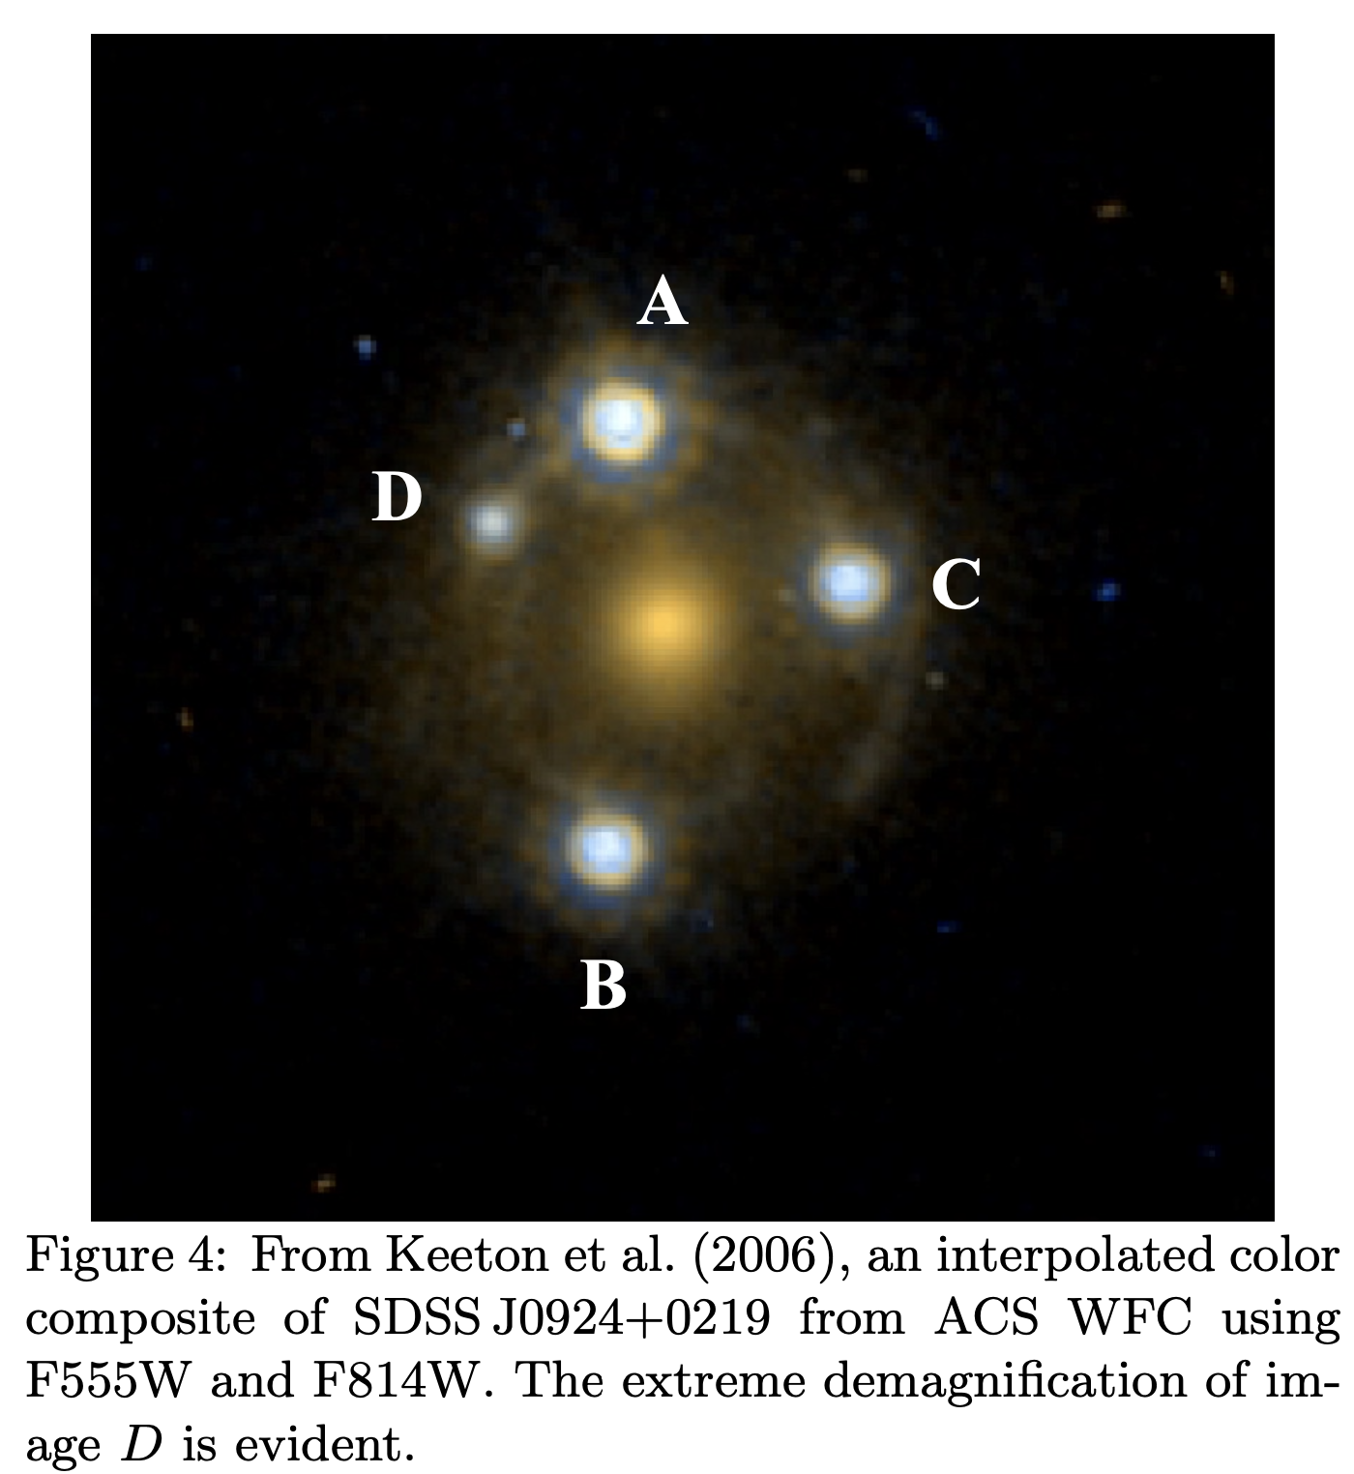
Modeling the microlensing of SDSS-J0924: the “most anomalous quasar”
Daniel A. Yahalomi … Astrostatistics Final Project … April 22, 2021
When a massive galaxy lies between us and a quasar, it can gravitationally lens the quasar producing multiple observed images of the background quasar (either 2 or 4 images).
Multiplicity of the observed images is due to Fermat’s principle:
Light will take paths that correspond to stationary points of the travel time – we observe minima and saddle points.
We expect pairs of minima and saddle points, which are similar in brightness. Images A+D and B+C are pairs.
In SDSS-J0924, image D is fainter than its pair.
An effect called microlensing may be the cause.

Slide 2
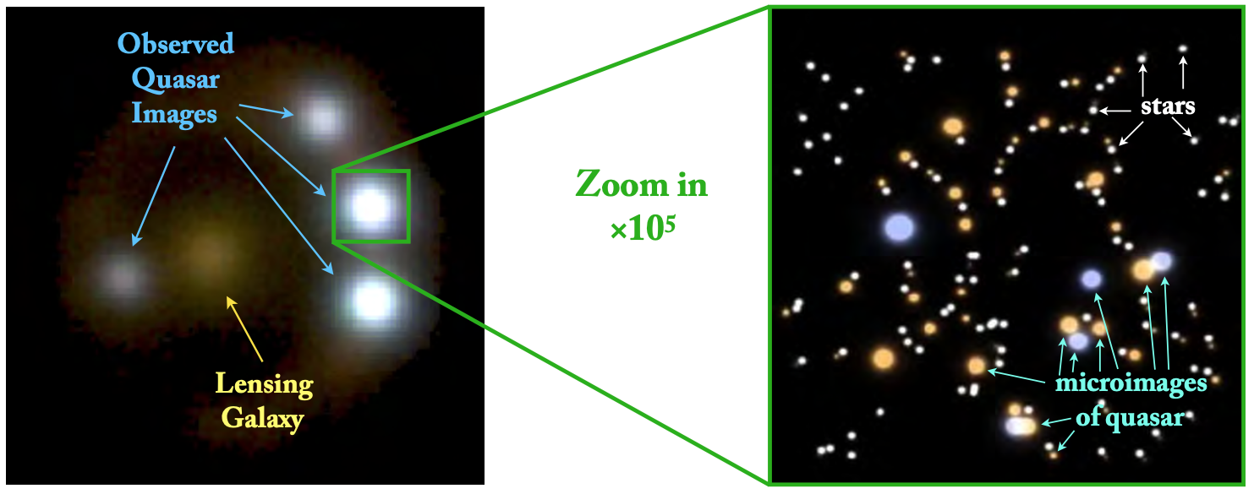
Each of these 4 macro-images is in fact the sum of multiple micro-images of the quasar formed by stars in the lensing galaxy.
As the quasar and lensing galaxy move with respect to each other, the observed brightness of one of these macro-images can vary orders of magnitude on months-years timescale!

Slide 3
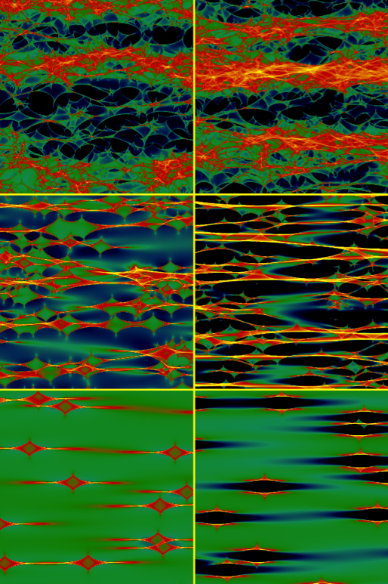
We can determine for a small patch in the lensing galaxy how magnified (or de-magnified) the macro-image would be based on location.
Source: Wambsganss 2002

Slide 4
We can determine for a small patch in the lensing galaxy how magnified (or de-magnified) the macro-image would be based on location.
this is called a microlensing map
these lines are called caustics
caustics are places of extreme micro-magnification that correspond to creation and/or destruction of micro-minima
when caustics are crossed, minima are created, and there are significant increase in the macro-image brightness
Source: Wambsganss 2002

Slide 5
We can determine for a small patch in the lensing galaxy how magnified (or de-magnified) the macro-image would be based on location.
Source: Wambsganss 2002
Source: Wambsganss 2002

Slide 6
In this project, I will investigate the likelihood that image D is in a state with zero micro-minima

Slide 7
We can also produce probability density functions for the micro-magnifications for the case where there are zero micro-minima for image D

Slide 8
When we combine our macro-predictions our observations and our microlensing PDFs we can determine the likelihood for microlensing to account for the flux-ratio anomalies

Slide 9
We find:
Likelihood using all possible number of micro-minima for image D = 0.00397
Likelihood using only 0 micro-minima for image D = 0.00248
This corresponds to a ratio of: 0.62386 or a ~62% probability that image D is in a zero micro-minima state.

Slide 10
We find:
Likelihood using all possible number of micro-minima for image D = 0.00397
Likelihood using only 0 micro-minima for image D = 0.00248
This corresponds to a ratio of: 0.62386 or a ~62% probability that image D is in a zero micro-minima state
We then run a 1000 iteration Monte-Carlo simulation of the probability density functions to get an understanding of the likelihood space:
Following this process:
I shift each PDF for each image such that the amount of area under the curve to the left of the observation is a random number from a uniform distribution between 0 and 1
I multiply the 4 PDFs together for both the zero micro-minima and the any number of micro-minima cases
I determine the likelihood of the resulting product at the observation

Slide 11
We find that in our Monte-Carlo sample that our likelihoods are both more likely than the median likelihood of the distribution. So these are not unreasonable micro-magnifications.

