Slide 1
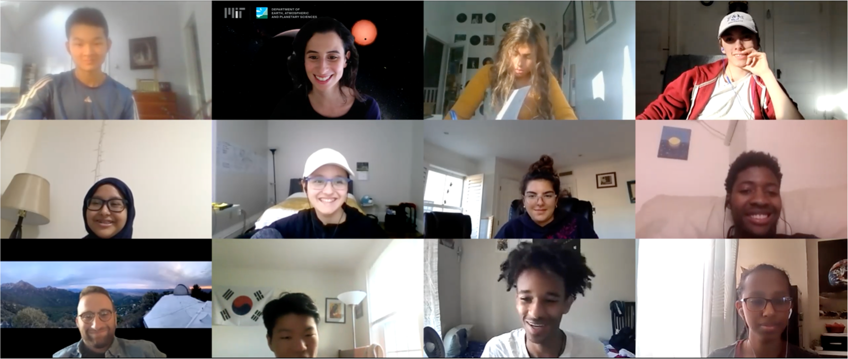
Have you ever wondered about planets, stars, galaxies, or black holes?
Do you want to study our universe with Harvard and MIT scientists?
Join the Harvard-MIT Science Research Mentoring Program (SRMP) and you can!
- Applications open May 10 – May 28
SRMP Details:
September 2021- May 2022.
2-4 students meet 2x week for 2 hours with their mentors.
SRMP students are paid for their work!
No prior research experience required → just interest and curiosity!
…come to the virtual SRMP Symposium 2021
May 21, 2021 from 4:00-6:00 pm
Let our incredible students tell you about their cool research projects!
- Everyone is invited and event is free, but registration is required!
Register for symposium here and apply for next year here
For more information visit: https://projects.iq.harvard.edu/shrimp
Questions? Please email:
Dr. Clara Sousa-Silva (clara.sousa-silva@cfa.harvard.edu)
Mr. Daniel Yahalomi (daniel.yahalomi@columbia.edu)

