Slide 1
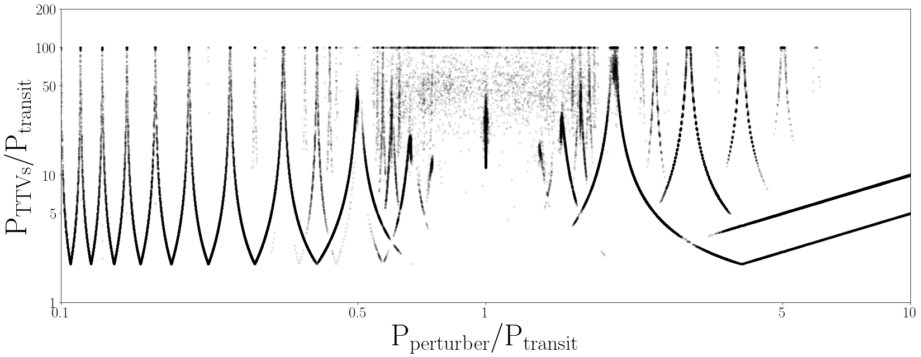
the exoplanet edge:
minimum TTV period from an external perturbing planet
LS peak period of TTVFast simulated n-body planet-planet TTVs
internal perturber
near MMR TTVs
chaotic
region
external perturber
near MMR TTVs
P_{TTV} / P_{Pert} = 1
what causes
this edge?
P_{TTV} / P_{Pert} = 1/2
Nyquist floor
Daniel A. Yahalomi w/ David Kipping, Eric Agol, and David Nesvorny
Columbia AstroFest 2023 | September 22, 2023

Slide 2

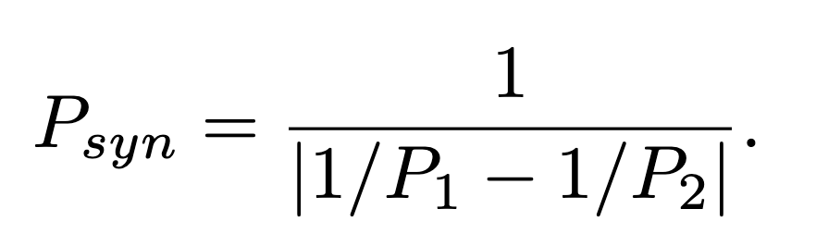
the exoplanet edge:
minimum TTV period from an external perturbing planet
early TTV
late TTV
on-time transit
#3
#4
#2
#5
#1
&
#10
#6
#9
#7
#8
conjunction induced TTV periods:

Slide 3
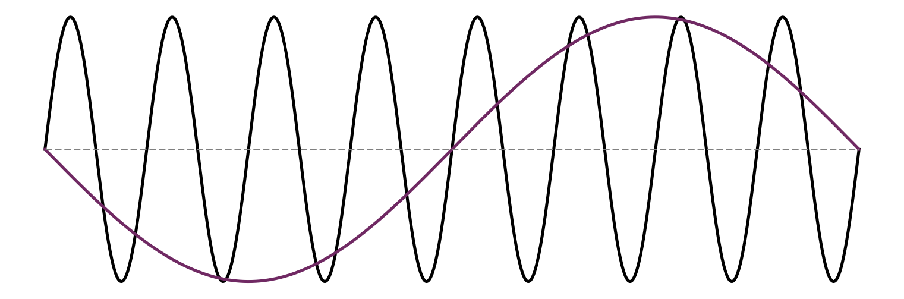
the exoplanet edge:
minimum TTV period from an external perturbing planet
early TTV
late TTV
on-time transit
interior planet TTVs
#3
#8
#4
#2
#7
#9
#10
#5
#1
&
#10
#6
#1
#5
#2
#6
#9
#3
#4
#7
#8
epoch number
conjunction induced TTV periods:
takeaway:
if P_{p} > 2P_{t} , then conjunction TTV signal will be aliased with a period = P_{p .}

