Slide 1
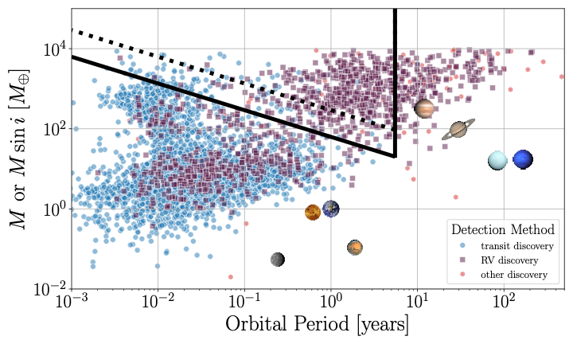
Gaia DR4 baseline = 5.5 years
M_{star} = M_{Sun}
Gaia DR4 recoverable
dist = 50 pc
M_{star} = M_{Sun}/10

