Slide 1
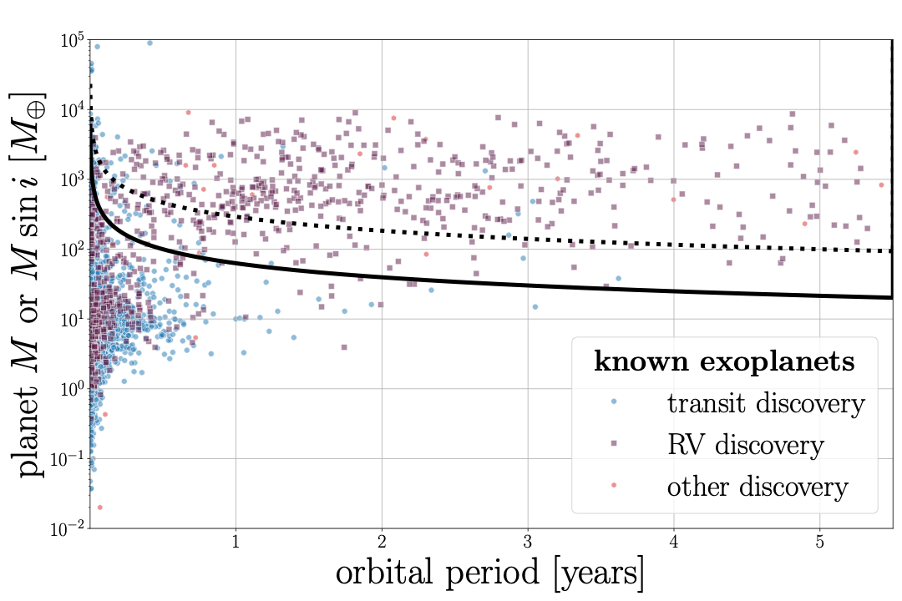
stellar distance = 50 pc
M_{star} = M_{Sun}
Gaia DR4 detectable
M_{star} = M_{Sun}/10

