Slide 1
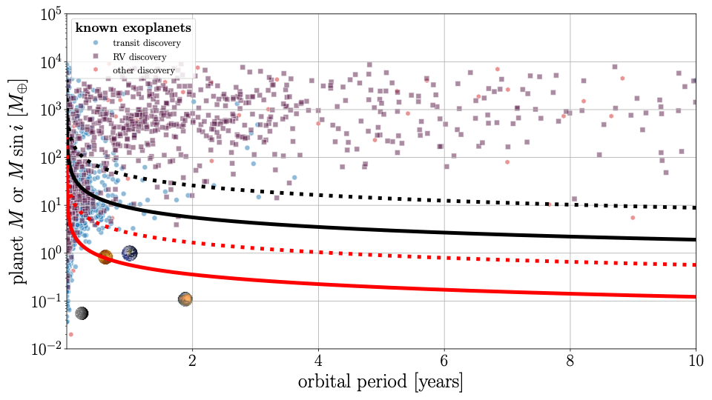
stellar distance = 10 pc
M_{star} = M_{Sun}
Gaia detectable
assuming 138 observations
M_{star} = M_{Sun}/10
M_{star} = M_{Sun}
M_{star} = M_{Sun}/10
Roman detectable
assuming 10 observations

