Slide 1
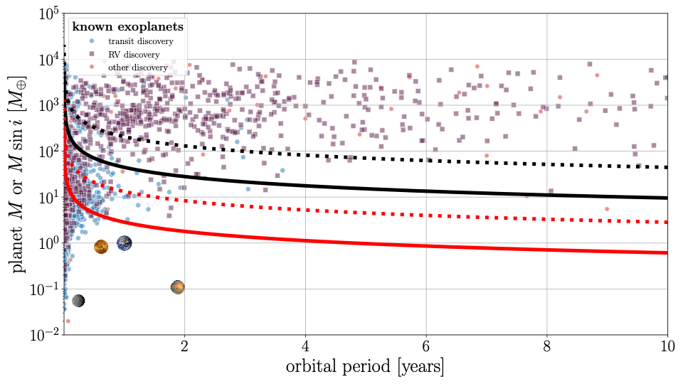
stellar distance = 50 pc
M_{star} = M_{Sun}
Gaia detectable
assuming 138 observations
M_{star} = M_{Sun}/10
M_{star} = M_{Sun}
Roman detectable
M_{star} = M_{Sun}/10
assuming 40 observations

