Slide 1
Cairo Weather Forecast
ML INTERNSHIP PROGRAM · WEATHER FORECAST API & TIME-SERIES EDA
Data acquisition, data preparation and time-series EDA on 1,055 observations (2021 – 2026)
Data collection (Part 1) • Preparation (Part 2) • EDA (Part 3)

Slide 2
Nearly six years of Cairo weather in one ML-ready table
THE DATASET
A free public API, a clean time-series file and ten questions that explain how temperature behaves.
1,055
33
2021 – 2026
22.5 °C
rows
columns
period
mean target
one observation every 2 days
20 API parameters + 12 engineered features, plus the date
2021-01-01 to 2026-10-10
daily average air temperature (NASA POWER T2M)
1
Part 1 · Data collection
2
Part 2 · Preparation (Q1 – Q2)
3
Part 3 · EDA (Q3 – Q10)
NASA POWER daily API, 20 parameters, 6 yearly requests, then sampled every 2 days into a 1,055-row, 33-column table.
Q1: is the series ordered, regular and duplicate-free? Q2: how are missing values and impossible values handled?
Distribution, trend, seasonality, volatility, STL, ACF / PACF, stationarity, correlations, anomaly review.

Slide 3
One free API, one request per year of data
PART 1 · DATA COLLECTION
NASA POWER Daily API — a free public service with historical and near-real-time data, queried at Cairo's coordinates.
ENDPOINT
Free and public
1
GET /api/temporal/daily/point
No paid API key is needed, and the service reaches the newest data (October 2026), so the series runs to the present.
power.larc.nasa.gov
parameters
20 POWER variables (T2M … CLRSKY_SFC_SW_DWN)
20 parameters per request
2
community
RE (Renewable Energy)
This documented limit shaped the design: temperature, humidity, rain, wind, pressure and radiation fit in one call per year.
latitude / longitude
30.0444 / 31.2357 (Cairo)
start / end
one request per year, 2021 → 2026
Built for retries
time-standard
UTC
3
Up to 3 attempts per year with back-off; each raw JSON is cached on disk, and the −999 fill value becomes NaN.
format
JSON

Slide 4
Twenty parameters in six weather families
PART 1 · DATA COLLECTION
Temperature is the prediction target; everything else is a candidate predictor.
5
Temperature
2
Humidity
1
Precipitation
T2M (target) · T2M_MAX · T2M_MIN · dew point · wet bulb
Relative humidity (RH2M) · specific humidity (QV2M)
Bias-corrected precipitation (PRECTOTCORR, mm/day)
8
Wind
1
Pressure
3
Radiation
Speed average / max / min and direction, at 10 m and at 50 m
Surface pressure (PS, kPa)
All-sky shortwave · all-sky longwave · clear-sky shortwave (MJ/m²/day)

Slide 5
From raw JSON to a 1,055-row table
PART 1 · DATA COLLECTION
Five steps turn the API responses into the single CSV used by the whole analysis.
1
2
3
4
5
Download
Clean fill values
Daily table
Sample every 2 days
Add features
6 yearly JSON files (2021 – 2026), cached on disk.
NASA's −999 fill value becomes NaN so it is never read as weather.
2,109 daily records, from Jan 2021 to Oct 2026.
1,055 rows. Alternate days are skipped, not averaged.
+12 columns: calendar, sin/cos day-of-year, wind u/v, ranges.
Why 2-day sampling?
Keeping every day from 2021 to 2026-10-10 would give 2,109 rows; the brief asked for 1,000 – 1,500, so every second day is kept to cover the full period (1,055 rows).

Slide 6
Is the dataset ordered, regularly sampled and free of duplicates?
Q1
QUALITY REPORT
100%
of the 1,054 time steps are exactly 2 days: no gaps, no duplicate dates
Check | Result
Rows × columns | 1,055 × 33
Date range | 2021-01-01 → 2026-10-10
Time step (1,054 intervals) | 2 days, every interval
Duplicate dates | 0
Index | datetime, sorted
WHY THIS PLOT
A summary table suits this check: ordering, spacing and duplicates are counts, not shapes. The ruler below shows what regular sampling looks like.
WHAT THE DATA SAYS
The file holds 1,055 rows × 33 columns from 2021-01-01 to 2026-10-10, sorted by date. Every interval between neighbouring rows is exactly 2 days and no date appears twice, so the series can be indexed by date and treated as a regular time series — which ACF / PACF, STL and lag features all require.
REGULAR SAMPLING
2 days

Slide 7
How should missing values and anomalies be handled?
Q2
108 → 102
missing numeric cells before → after interpolation (gaps of up to 2 steps)
WHY THIS PLOT
A bar chart ranks the columns by missing count at a glance. The physical-range checks are simple counts that should all be zero.
WHAT THE DATA SAYS
Only the three radiation columns have gaps: 36 values each, all in the newest data (2026-08-01 to 2026-10-10). Interpolation fills only gaps of up to 2 steps; the rest stay missing instead of invented. The target is never fabricated: 2026-10-12 returned the fill value (−999) and was excluded. Four physical checks (negative rain, humidity outside 0–100%, negative wind, Tmin above Tmax) all returned 0.
The other 30 columns have no missing values.

Slide 8
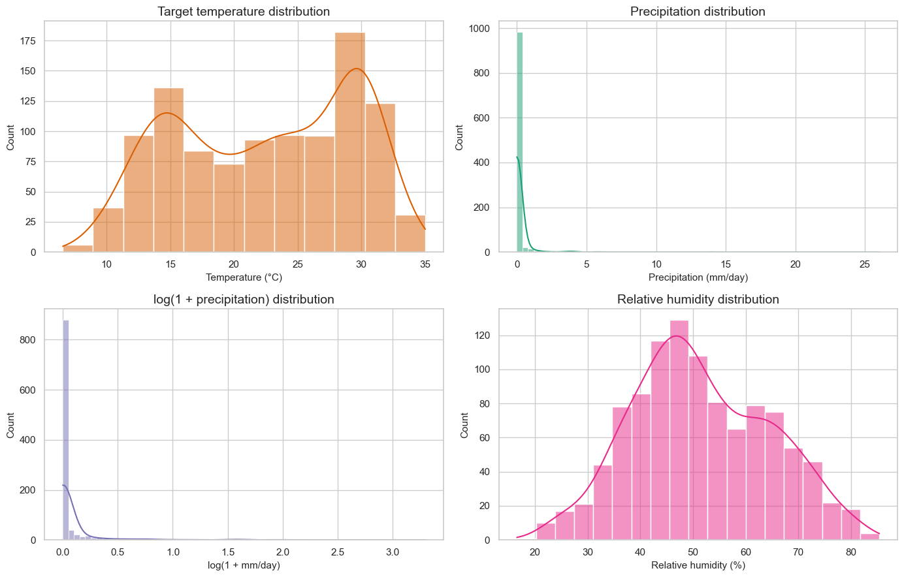
What is the overall distribution of Cairo's temperature?
Q3
22.5 °C
mean temperature (median 23.2, std 6.9, range 6.6 – 35.0 °C)
WHY THIS PLOT
A histogram with a KDE curve shows the shape of one variable. Rainfall also gets a log(1 + x) view because its distribution is extremely skewed.
WHAT THE DATA SAYS
Temperature is bimodal: one peak near 15 °C (winter) and one near 30 °C (summer), so the mean sits in a valley where few observations fall. Rainfall is the opposite: 74% of observations are exactly 0 mm, and just 10 observations hold 52% of all rain (maximum 26 mm). Humidity is roughly symmetric around 51%.

Slide 9
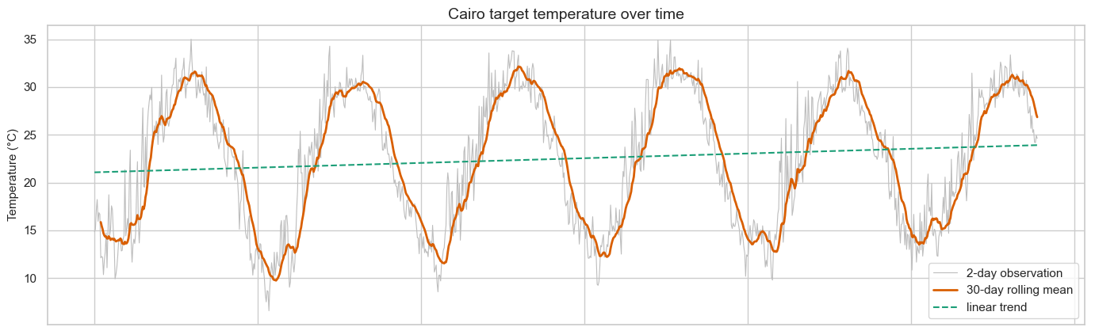
Does Cairo's temperature have a long-term trend?
Q4
WHY THIS PLOT
+0.49 °C/yr
A line plot over time with a 30-day rolling mean (smooths the noise) and a straight-line fit (tests for drift).
slope of the raw series (p = 0.0001), inflated: see the caveat
The rolling mean swings between 9.7 °C and 32.2 °C every year, dwarfing the fitted line. The raw slope is inflated because the series starts in cold January and ends in October, and 2026 lacks its cool Nov–Dec. On full years 2021–2025 the slope is +0.16 °C/yr (p = 0.30); on seasonally adjusted data it is +0.12 ± 0.09 °C/yr.

Slide 10
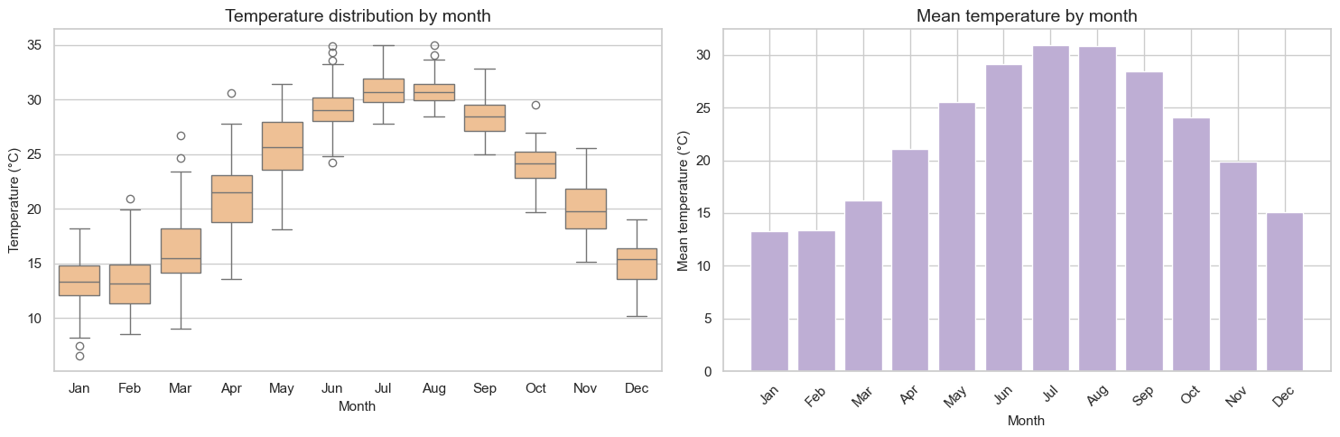
When is Cairo hottest? The monthly and seasonal cycle
Q5
WHY THIS PLOT
30.9 °C
A boxplot per calendar month shows each month's centre and spread across all years; the bar chart adds the monthly mean.
mean temperature in July, the hottest month (January is coldest at 13.3 °C)
A smooth annual hill: July (30.9 °C) and August (30.8 °C) peak, January (13.3 °C) and February (13.4 °C) are lowest, a 17.6 °C gap. Summer is the steadiest season (std 1.8 °C); spring is the most variable (std 5.0 °C) as it climbs from 16.2 °C in March to 25.5 °C in May. This cycle is why the raw series is not a featureless signal.

Slide 11
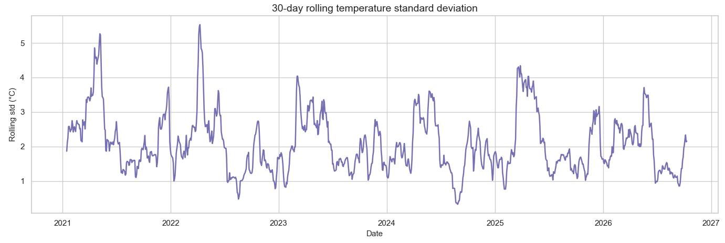
Does local variability change over time?
Q6
WHY THIS PLOT
3.0 °C
A rolling standard deviation (15 observations ≈ 30 days) shows how volatility itself changes over time.
average rolling std in spring, versus 1.7 – 1.9 °C in every other season
Volatility is not constant: it spikes every spring (above 4 °C in March–May of 2021, 2022, 2023 and 2025, peaking at 5.5 °C on 2022-04-10) and is lowest in August (1.3 °C). Part of this is the steep seasonal climb inside each window; the rest is real day-to-day swings. Expect larger forecast errors in spring.

Slide 12
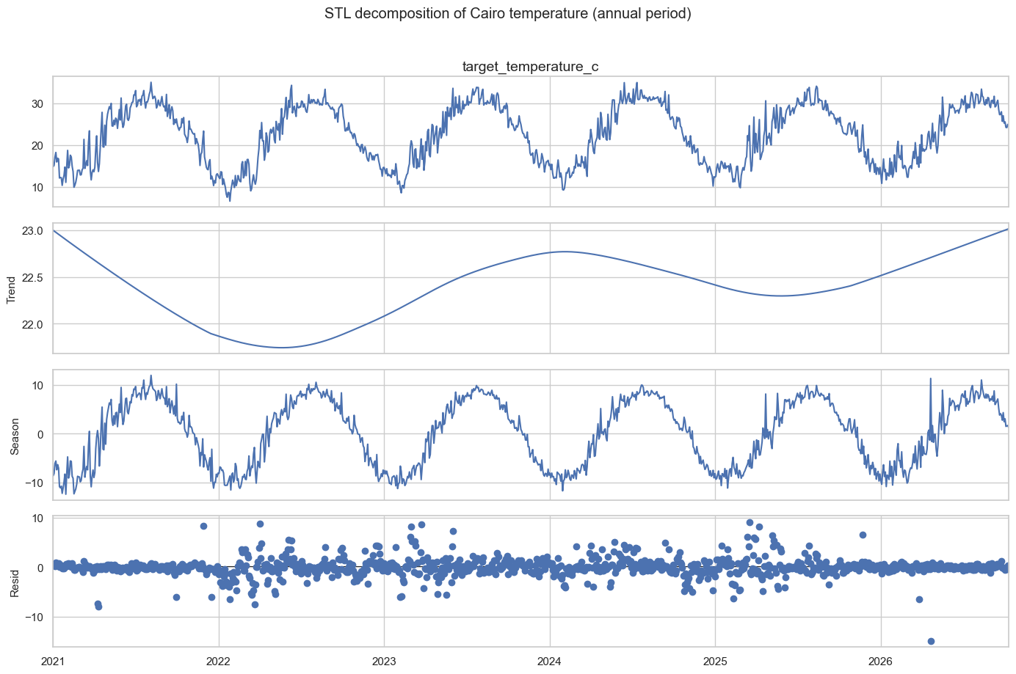
What are the trend, seasonal and residual components?
Q7
92%
of the variance is the seasonal component (trend 0.2%, residual 7%)
WHY THIS PLOT
STL splits a series into trend + seasonal + residual; the robust option stops isolated extremes distorting the seasonal shape. Annual period = 182 observations.
WHAT THE DATA SAYS
Seasonal swings of about ±12 °C explain 44.1 of the series' 48.1 units of variance. The trend only moves between 21.7 and 23.0 °C and is not steadily rising: it falls until mid-2022, climbs to 2024, dips in 2025, then rises again. The residual (std 1.9 °C) is everyday noise; 54% of its largest values fall in March–May.

Slide 13
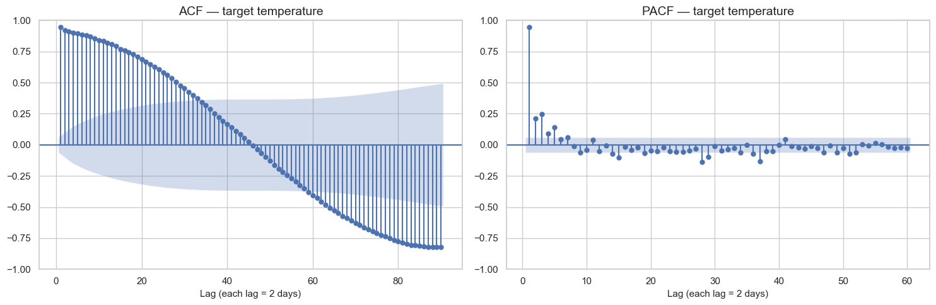
Does temperature depend on previous observations?
Q8
WHY THIS PLOT
0.95
ACF shows the total correlation with each past lag; PACF isolates each lag's direct effect after the shorter lags (1 lag = 2 days).
lag-1 autocorrelation: the next step (2 days ahead) is almost a copy of today
ACF decays slowly, crosses zero at lag 46 (≈ 3 months) and reaches −0.82 at lag 90 (≈ 6 months, the opposite season): the signature of an annual cycle (the plot stops at half a year). PACF has one dominant spike (0.95); lags 2–5 add smaller direct effects (0.09–0.25), so a few recent lags plus seasonal terms carry most of the information.

Slide 14
Is the temperature series stationary?
Q9
AUGMENTED DICKEY-FULLER TEST
p = 0.001
ADF p-value on the raw temperature series (statistic −4.06)
Series | ADF stat | p-value | Verdict
Raw target | −4.06 | 0.0011 | Stationary
First difference | −7.96 | < 0.0001 | Stationary
Seasonal difference (182 obs ≈ 1 year) | −7.53 | < 0.0001 | Stationary
WHY THIS PLOT
A table fits a test result. The ADF null hypothesis is a unit root (non-stationary), so p < 0.05 means the unit root is rejected.
WHAT THE DATA SAYS
All three versions reject the unit root at 5%, so differencing is not needed to remove a stochastic trend. But ADF does not test seasonality, and 92% of the variance is a seasonal cycle: the mean still changes through the year. Safest design: seasonal features (sin / cos of day-of-year) or seasonal differencing, lagged targets, chronological validation.
How to read it
H0: the series has a unit root (non-stationary). The more negative the statistic and the smaller the p-value, the stronger the evidence against H0. 5% threshold.

Slide 15
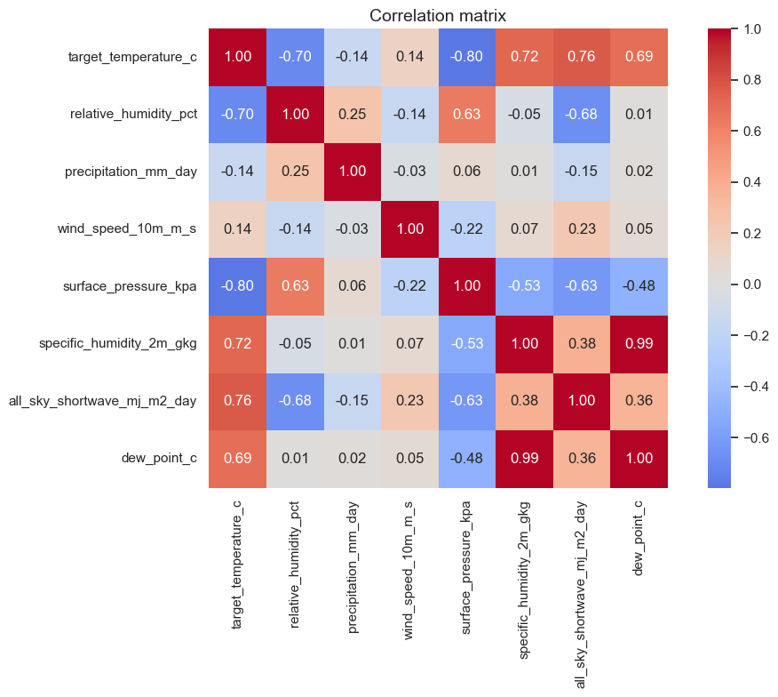
How do other weather variables correlate with temperature?
Q10
−0.80
surface pressure vs. temperature, the strongest correlation of all
WHY THIS PLOT
A correlation heatmap shows every pairwise Pearson r at once, so strong links and redundant variables stand out.
WHAT THE DATA SAYS
Pressure (−0.80), shortwave radiation (+0.76), specific humidity (+0.72), relative humidity (−0.70) and dew point (+0.69) all track temperature, largely because they share the seasonal cycle. Wind (+0.14) and rain (−0.14) are nearly unrelated. Dew point and specific humidity are almost the same variable (r = 0.99). Same-day values are unknown at forecast time, so use lags.

Slide 16
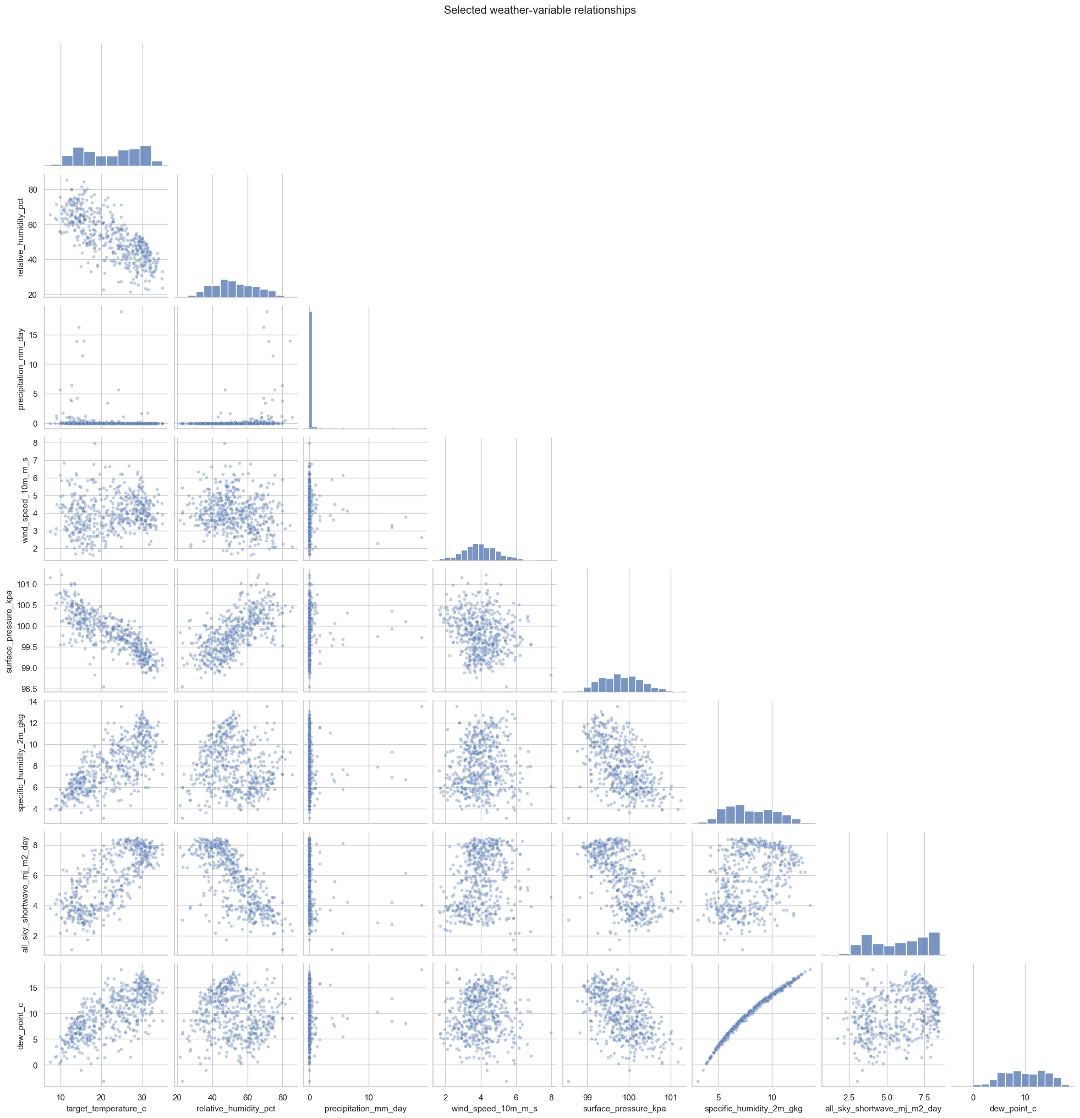
What do those relationships look like in detail?
Q10
0.99
dew point vs. specific humidity: a near-perfect curve, so they are redundant
WHY THIS PLOT
A pair plot adds what one r hides: the shape of each relationship. Read the first column, where temperature is on the x-axis.
WHAT TO LOOK FOR
Temperature falls along a clear downward band against humidity and pressure, and rises against shortwave radiation and dew point. Precipitation is a flat line at 0 with a few spikes, which one correlation number cannot describe. Wind forms a shapeless cloud: no usable linear signal.

Slide 17
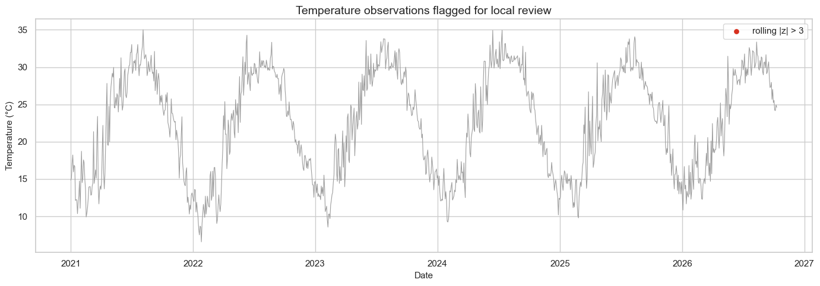
Are any observations anomalous or physically impossible?
Q+
WHY THIS PLOT · SUPPORTING DIAGNOSTIC
0
A line plot with flagged points: each value is compared with its own 15-observation (≈ 30-day) neighbourhood, so normal seasonal swings are not flagged.
observations with |rolling z| > 3, and 0 physical-range violations
No temperature stands out from its local neighbourhood, and every physical check is clean: no negative rainfall, no humidity outside 0–100%, no negative wind speed, no Tmin above Tmax. The data shows no sign of sensor or API errors; its only gaps are the missing radiation values at the end (Q2).

Slide 18
From EDA to a leakage-safe forecasting setup
ML HANDOFF
The findings become design rules: lagged inputs, seasonal features and a split that never looks into the future.
time →
TRAIN · 812 rows (80%)
TEST · 203 rows
2021-01-15 → 2025-06-25
2025-06-27 → 2026-08-05
16
80/20
Aug 5
lagged features
chronological split
last usable row
Target lags at 1, 2 and 7 steps, plus 13 predictors lagged by 1 step. Same-day variables are excluded.
No shuffling: the test set is later in time, so the model is judged on data from its future.
Later rows lack radiation values, so they drop out once lagged features are built.

Slide 19
What Cairo's weather tells us about forecasting temperature
KEY TAKEAWAYS
1
The season is the signal
2
The trend is small and uncertain
92% of temperature variance is the annual cycle: monthly means climb from 13.3 °C in January to 30.9 °C in July.
The raw +0.49 °C/yr slope is inflated by a series that starts in winter and ends in October. Full years 2021–2025: +0.16 °C/yr (p = 0.30).
3
Short memory, volatile springs
4
Design for the season
Lag-1 autocorrelation is 0.95, but spring volatility is 3.0 °C versus 1.7–1.9 °C in other seasons. No anomalies or impossible values.
Use lagged targets, sin / cos day-of-year, lagged predictors and chronological validation. ADF rejects a unit root, but the mean still moves with the season.

