Slide 1
Cairo Weather: Preprocessing
ML INTERNSHIP PROGRAM · TASK 5 · TIME-SERIES PREPROCESSING
Turning the EDA table into a clean, leakage-safe, model-ready 2-day time series
Index alignment • Missing values • Validation & outliers • Features • Chronological split

Slide 2
From 1,055 raw rows to 872 model-ready rows
THE PIPELINE AT A GLANCE
Target: daily mean 2 m air temperature (target_temperature_c). The source is sampled every 2 days, so the native modeling frequency is 2D, not hourly.
1,055
2D
872
21 days
raw rows
native frequency
model-ready rows
hold-out set
2021-01-01 to 2026-10-10
seasonal period = 183 steps (≈ 1 year)
after the 183-step feature warm-up
the last 11 observations, never shuffled
1
2
3
4
5
6
Align
Missing
Validate
Features
Split
Export
regular 2D index, duplicates removed
time interpolation, short gaps only
physical limits and rolling outlier caps
calendar, lags and shifted rolling stats
last 21 days held out, scaler on train
2 CSVs and a JSON audit trail

Slide 3
Is the time index regular and complete?
1
INDEX AUDIT
0
missing timestamps on the 2D grid across all 1,055 observations
Check | Result
Rows before alignment | 1,055
Dominant time step | 2 days
Missing timestamps exposed | 0
Duplicate dates | 0 (1,055 unique dates)
Index frequency | 2D, set explicitly
WHY THIS VISUAL
A summary table suits a structural check, and the ruler shows what a perfectly regular grid looks like.
WHAT THE DATA SAYS
The source was sampled every 2 days on purpose, so 2D is the native frequency: nothing is fabricated into daily rows. Duplicates are dropped, the index is sorted, then re-indexed onto the full 2D grid to expose any missing date. There are none, so the seasonal period is simply 183 steps (≈ 366 days ÷ 2) and every window and lag below counts steps, not days.
REGULAR 2D GRID
2 days

Slide 4
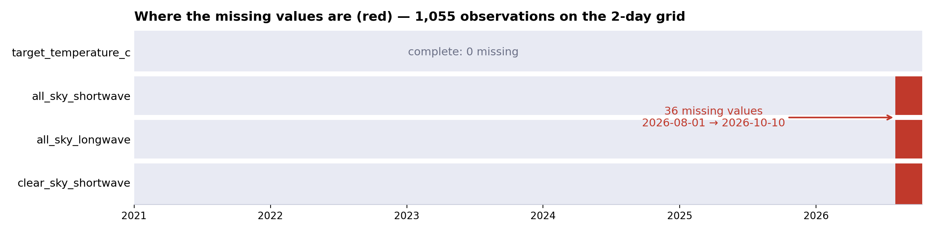
How are missing values handled?
2
WHY THIS VISUAL
36
A missingness strip shows where gaps sit in time: one block at the end is a very different problem from holes scattered through the series.
missing values in each of 3 radiation columns, all at the very end; the target has none
Policy: gaps of up to 2 steps (4 days) inside the series are interpolated by time; a longer target gap would take the value from the same date last year (183 steps), never a forward-fill. The target needed neither. The 36 radiation gaps (2026-08-01 to 2026-10-10) sit at the edge, so limit_area='inside' refuses to extrapolate them; radiation is not a predictor here, so they stay visible.

Slide 5
Are there physically impossible values?
3a
0
impossible values found across the 4 variables that have a hard physical limit
PHYSICAL RULES
Variable | Allowed | Violations
Relative humidity | 0 – 100 % | 0 ✓
Precipitation | ≥ 0 mm/day | 0 ✓
Wind speed, 10 m | ≥ 0 m/s | 0 ✓
Wind speed, 50 m | ≥ 0 m/s | 0 ✓
WHY THIS VISUAL
A rule table fits a pass/fail check: each variable has a hard limit, and the count of violations should be zero.
WHAT THE DATA SAYS
Humidity must stay within 0–100%, and rain and wind speed cannot be negative. Any violation would be set to missing and repaired only by the same short-gap interpolation, never by a flat fill. All four checks returned 0, which agrees with the EDA finding that this NASA POWER extract has no sensor-style errors.
If a rule were broken
value → NaN → time interpolation for gaps of up to 2 steps. No row is ever dropped.

Slide 6
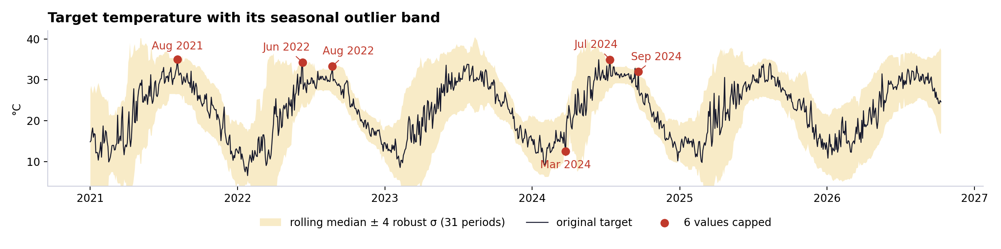
Which target values are outliers, and how are they treated?
3b
WHY THIS VISUAL
6
A rolling median/MAD band follows the season (a fixed threshold would flag normal summer heat). Capping instead of deleting keeps the series continuous for ARIMA.
of 1,055 target values capped; the largest change is 0.93 °C
Each value is compared with a centred 31-step window (≈ 62 days): outside median ± 4 robust σ (1.4826 × MAD) it is capped at the band edge. Five are upper-tail trims of summer peaks (≤ 0.53 °C); one is a cold dip in March 2024 (12.50 → 13.43 °C). None lies within 15 steps of the split, and the original series is kept in its own column for audit.

Slide 7
Which features are safe to use at forecast time?
4
FEATURE FAMILIES
13
forecast-safe features: 4 calendar, 3 lags and 6 rolling statistics
Family | Features | On the 2D grid
Calendar | day-of-year sin / cos, day of week, is weekend | known in advance
Lags | lag 1 · lag 12 · lag 183 | 2 d · ~24 d · ~1 year ago
Rolling mean | windows 4 · 15 · 31 | ≈ 8 · 30 · 62 days
Rolling std | windows 4 · 15 · 31 | local volatility
Leak guard | shift(1) before every rolling window | target never leaks into its own row
WHY THIS VISUAL
A table maps each feature family to what it means on a 2-day grid. The key is that every feature uses only information available before the forecast time.
WHAT THE DATA SAYS
Calendar encodings are known in advance. Lags and rolling statistics use only past values: shift(1) is applied before every rolling window, so the value being predicted never enters its own features. On this grid lag 1 is two days ago, lag 12 about 24 days ago and lag 183 about one year ago.
The sin / cos pair keeps Dec 31 next to Jan 1, which a raw day number would put 364 days apart.

Slide 8
Do the engineered features carry signal?
4b
0.95
correlation of lag 1 (and the 4-step rolling mean) with the target
WHY THIS VISUAL
A sorted bar chart of each feature's correlation with the target ranks them at a glance. Train-only correlations are almost identical, so the test set is not influencing this view.
WHAT THE DATA SAYS
Persistence dominates: lag 1 and the 4-step mean (0.95), then the 15-step mean (0.92) and the one-year lag (0.90). Day-of-year cos (−0.86) and sin (−0.43) carry the season. Rolling std is weakly negative (≈ −0.1), and day of week and is-weekend are essentially zero: weather has no weekly cycle, so they are candidates to drop.

Slide 9
How is the series split and scaled without leakage?
5
WHERE EVERY ROW GOES (1,055 rows on the 2D grid)
time →
Test · 11 rows (1%)
Warm-up · 183 rows (17%)
Train · 861 rows (82%)
2021-01-01 → 2021-12-31
2022-01-02 → 2026-09-18
2026-09-20 → 2026-10-10
lost to the 183-step lag
scaler fitted here only
WHY THIS VISUAL
11 rows
A proportional timeline shows exactly where every row goes: lost to warm-up, used for training, or held out for testing.
in the hold-out: the last 21 calendar days, about 1% of the series
Nothing is shuffled: train 2022-01-02 → 2026-09-18 (861 rows), test 2026-09-20 → 2026-10-10 (11 rows). The MinMax scaler sees only the training target (6.57–34.92 °C); SARIMA keeps original °C and only neural-network inputs are scaled. The 11 test points span just 24.2–28.0 °C, one autumn stretch, so expect noisy scores.

Slide 10
Model-ready data, and what to keep in mind
STEP 6 · WHAT THE PREPROCESSING DELIVERS
1
A clean, regular series
2
Forecast-safe features
1,055 rows on an exact 2-day grid, a complete target, 0 impossible values and 6 mild caps (largest change 0.93 °C).
Calendar encodings, lags 1 / 12 / 183 and shifted rolling statistics. Strongest signals: lag 1 and the 4-step mean (r = 0.95).
3
A leakage-safe split
4
Keep in mind
Last 21 days held out, nothing shuffled, scaler fitted on train only. SARIMA uses original °C; neural networks use scaled input.
The test set is only 11 rows from one season (24.2–28.0 °C), so scores will be noisy. The annual lag costs 183 rows (17%). Day of week and is-weekend carry no signal.
Exported:
cairo_weather_preprocessed_2day.csv (all columns) · cairo_weather_model_ready_2day.csv (872 × 14) · preprocessing_audit.json

