Slide 1
ML INTERNSHIP PROGRAM · TASK 1
Uber Fare Analysis
What actually drives the price of a New York City ride?
An exploratory data analysis of 58,365 NYC Uber trips — choosing the right
chart for each business question, and the story the data tells.
Exploratory Data Analysis • Fare Prediction Project

Slide 2
THE DATASET
58,365 rides. One question: what sets the fare?
Every row is a single NYC Uber trip, with the fare paid alongside pickup time, location, distance,
passenger count, weather, traffic and vehicle condition. Before modeling in Task 2, each variable
was checked against fare using the chart best suited to its data type.
58,365
56,667
$11.35
8
raw trip records
rides after cleaning
average fare
questions explored
collected across 2009–2015
invalid fares & distances removed
median sits lower, at $8.50
one chart type chosen per question
CLEANING APPLIED
Dropped rows missing fare, distance, hour, car condition, weather or traffic data
Removed trips with zero or negative fare and zero or negative distance
Converted hour to integer for grouped time-of-day analysis
2

Slide 3
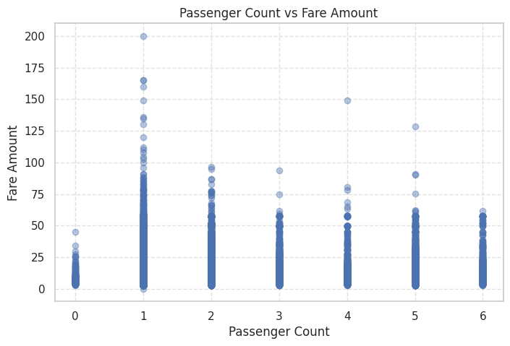
Q1
Does carrying more passengers push the fare up?
0.018
correlation between passenger count and fare — effectively no linear relationship
WHY A SCATTER PLOT
Both passenger_count and fare_amount are numeric, so a scatter plot is the direct way to look for a trend between them.
The points spread out with no visible upward drift as passenger count rises. Uber's flat per-trip pricing — rather than per-passenger pricing — is the likely explanation: a solo rider and a group of five pay for the same trip, not extra seats.
3

Slide 4
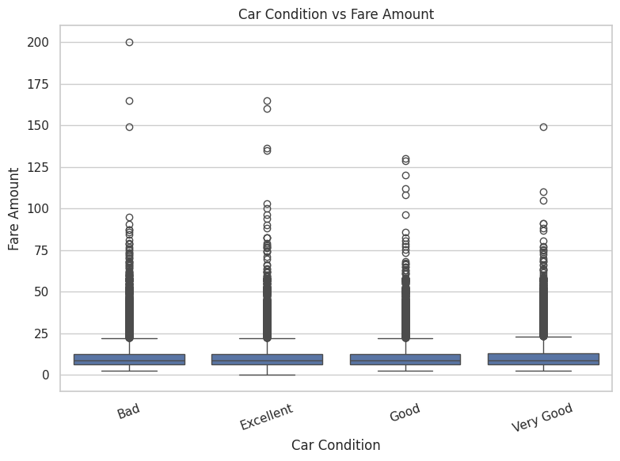
Q2
Does the vehicle's condition change what riders pay?
$8.50
identical median fare across Bad, Good, Very Good and Excellent vehicles
WHY A BOXPLOT
Car_Condition is categorical and fare is numeric, so a boxplot compares the full fare distribution — not just the average — across each condition.
Mean fares vary by barely a dollar ($11.20–$11.51) and every category shares the same $8.50 median. Vehicle condition is a service-quality signal, not a pricing input — fares are set by the trip, not the car.
4

Slide 5
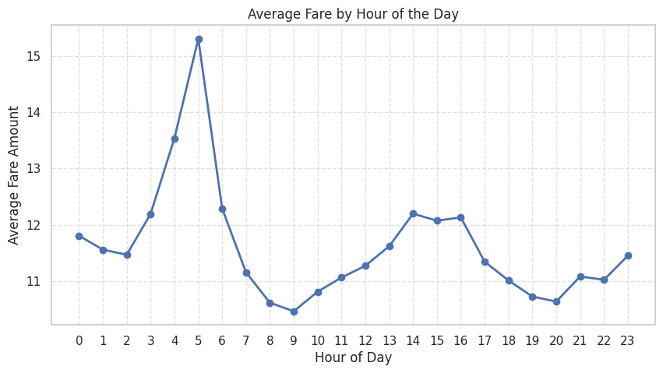
Q3
At what hour of the day are fares typically highest?
5 AM
peak average fare, $15.30 — a small-sample spike, not rush hour
WHY A LINE PLOT
Hour is ordered across a 24-hour cycle, so a line plot is best for tracing how the average fare moves through the day.
The average climbs overnight and peaks near 5 AM, then falls to its lowest point around 8–9 AM ($10.5) before drifting up again. The overnight peak likely reflects fewer but longer late-night trips rather than surge pricing — worth flagging for Task 2, since it hints at a ride-count effect hiding inside the average.
5

Slide 6
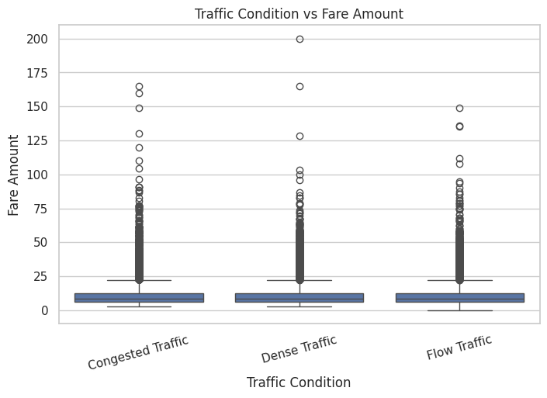
Q4
Does heavier traffic make a trip more expensive?
$0.08
gap in average fare between Congested and Flow traffic — negligible
WHY A BOXPLOT
Traffic_Conditions is categorical and fare is numeric, so a boxplot is used again to compare fare spread across traffic levels.
Congested, Dense and Flow traffic average $11.31–$11.39, and every group shares the same $8.50 median. Fares in this dataset don't carry a time-in-traffic or surge component — a useful boundary to know before modeling.
6

Slide 7
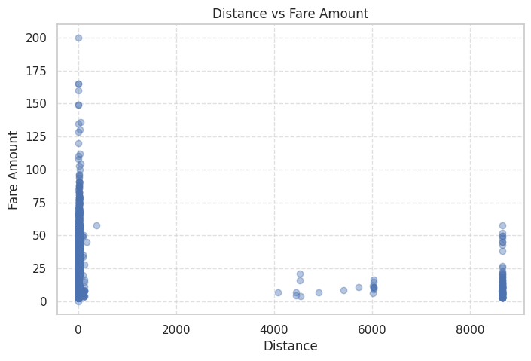
Q5
Is trip distance the strongest predictor of fare?
0.018
correlation between distance and fare — surprisingly weak, not strong
WHY A SCATTER PLOT — AND WHY THIS RESULT MATTERS
Distance and fare are both continuous, so a scatter plot is the natural check for a linear relationship.
Intuition says distance should dominate fare, but the correlation is almost flat. The distance column ranges up to 8,670 km with a mean of 18 km against a 2.2 km median — a handful of extreme outliers are compressing the visible relationship. This is the single most important cleaning flag for Task 2: cap or remove distance outliers before distance can show its true predictive power.
7

Slide 8
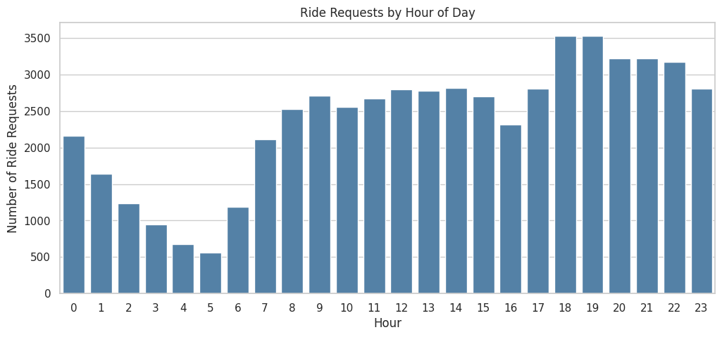
Q6
At what time of day are ride requests most frequent?
7 PM
busiest hour — 3,532 requests, over 6× the 5 AM low of 559
WHY A COUNT PLOT
This question asks about volume, not price, so a count plot of ride frequency per hour is the right tool — a line plot of averages would hide it.
Demand climbs steadily through the day to an early-evening peak around 7 PM, the classic commute pattern, and bottoms out overnight. Read together with Q3, evening rush delivers the most rides but not the highest average fare — volume and price peak at different times.
8

Slide 9
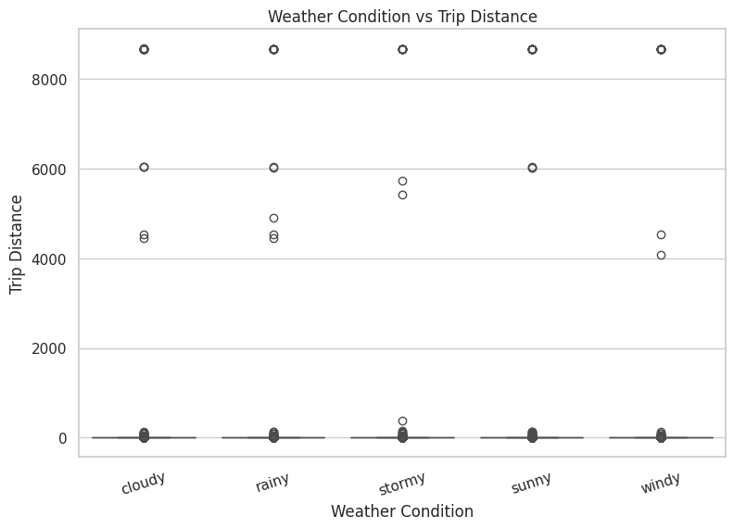
Q7
Does weather change how far people ride?
2.15–2.23
km median trip distance — nearly identical across every weather type
WHY A BOXPLOT
Weather is categorical and distance is numeric, so a boxplot compares distance distributions across conditions.
Mean distance swings widely (cloudy 22.8 km vs. stormy 12.0 km), but the medians barely move and the standard deviations are enormous (267–400 km). That combination is the signature of outliers dragging the mean, not a genuine weather effect — the boxplot's outlier view catches what a bar chart of averages would have overstated.
9

Slide 10
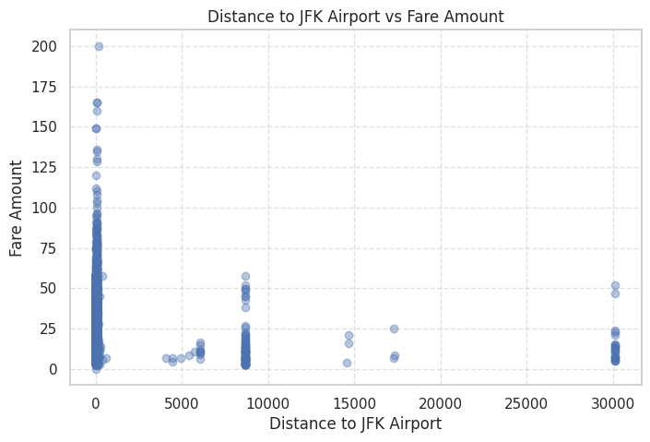
Q8
Are rides starting near an airport more expensive?
0.008
correlation between JFK distance and fare — essentially none
WHY A SCATTER PLOT
Airport distance and fare are both numeric, so a scatter plot is used to check whether shorter airport distance lines up with higher fares.
The cloud of points shows no meaningful pattern — pickups near JFK are not priced differently from pickups far away in this dataset. Combined with the flat trend for EWR (0.014) and LGA (0.011) on the next slide, there's no evidence of airport-zone pricing here.
10

Slide 11
GOING FURTHER
Three follow-up checks, same story
Beyond the eight core questions, a few natural extensions were tested to see whether any of them broke the pattern of weak single-variable relationships.
1
2
3
Weekend vs. weekday
Weather vs. ride volume
Airport distance, compared
$11.36 vs $11.31
11,236 – 11,426
JFK 0.008 · EWR 0.014 · LGA 0.011
Average fare barely moves between weekday and weekend trips, and both share the same $8.50 median. Day-of-week alone is not a fare driver.
Ride counts stay within a tight band across sunny, stormy, rainy, windy and cloudy days. Demand in this dataset doesn't swing with weather.
All three airport-distance correlations with fare round to essentially zero — confirming Q8 wasn't specific to JFK alone.
11

Slide 12
KEY TAKEAWAYS
What this EDA means for Task 2
Hour of day is the strongest pattern found
Passenger count, car condition and traffic show no fare effect
1
2
Ride demand peaks near 7 PM and average fare peaks near 5 AM — two different signals worth engineering as separate features.
All three correlate with fare at ~0.02 or below. They may still support the model indirectly, but not as standalone predictors.
Distance and airport proximity look weak only because of outliers
No single variable explains fare on its own
3
4
Distance ranges up to 8,670 km against a 2.2 km median. Capping or removing these outliers should be the first cleaning step before Task 2's regression model.
The next step is a multivariate model — likely distance (cleaned) plus hour-of-day features — rather than relying on any one column.
Uber Fare Analysis • Task 1 — Exploratory Data Analysis • ML Internship Program
12

