Slide 1
Recent Language Features
Rich Park, Rodrigo Girão Serrão

Slide 2
Dyalog version 18 language features
Dyalog Webinars:
Language Features of version 18.0 in Depth

Slide 3

Dyalog version 18 language features
Dyalog Webinars:
Language Features of version 18.0 in Depth

Slide 4
New Improved
⎕C Case convert
f⍥g Over
f⍤g Atop
≠Y Unique mask
A⍨ Constant
⎕DT Date-time
1200⌶ Format date-time
⎕JSON⍠'HighRank'
⎕JSON⍠'Dialect'
⎕R/⎕S⍠'Regex'
⎕NPUT⍠'NEOL'
⍸Y
X⊂Y
↑[k]Y

Slide 5
Dyalog version 18 language features
Primitive operators
⍤ ⍥ ⍨
Primitive functions
≠ ⍸ ⊂
System functions
⎕C ⎕DT 1200⌶ ⎕JSON ⎕R/⎕S ⎕ATX

Slide 6
Primitive operators
Function composition apl.wiki/Function_composition
Composition | Notation | Monadic | Dyadic
Beside | F∘G | F G ⍵ | ⍺ F G ⍵
Atop | F⍤G | F G ⍵ | F ⍺ G ⍵
Over | F⍥G | F G ⍵ | (G ⍺)F (G ⍵)
Fork | (FGH) | (F ⍵) G (H ⍵) | (⍺ F ⍵)G(⍺ F ⍵)
Behind | F⍛G | (F ⍵) G ⍵ | (F ⍺) G ⍵

Slide 7
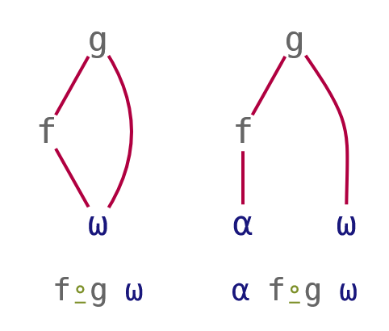
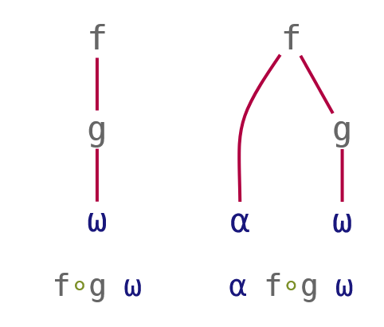
Function composition
Composition | Notation | Monadic | Dyadic
Beside | F∘G | F G ⍵ | ⍺ F G ⍵
Behind | F⍛G | (F ⍵) G ⍵ | (F ⍺) G ⍵
Pre-process right argument
2⊃∘⎕VFI¨ '3 4.2 and 5' '6 7' '12 more'
Pre-process left argument
array ⍴⍛⍴ values

Slide 8
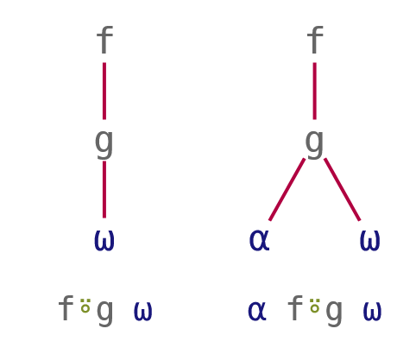
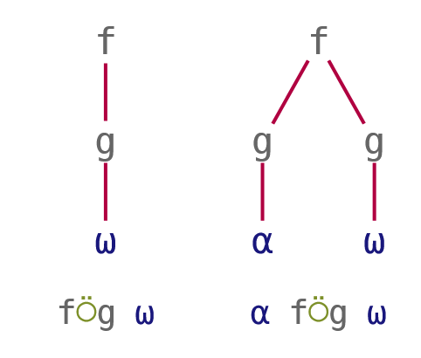
Function composition
Composition | Notation | Monadic | Dyadic
Atop | F⍤G | F G ⍵ | F ⍺ G ⍵
Over | F⍥G | F G ⍵ | (G ⍺)F (G ⍵)
Post-process result
3 4 5 ⌊⍤÷ 7 2 9
Pre-process both arguments
≢⍥,
+/⍥≢

Slide 9
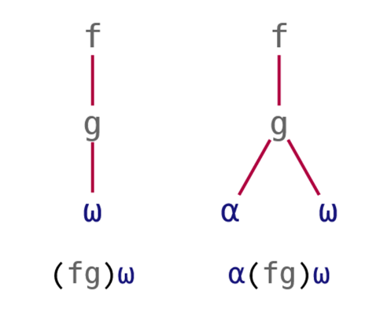
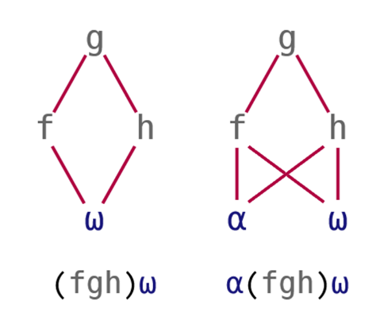
Function composition
Composition | Notation | Monadic | Dyadic
Atop | (FG) | F G ⍵ | F ⍺ G ⍵
Fork | (FGH) | (F⍵)G(H⍵) | (⍺F⍵)G(⍺F⍵)
Post-process result
3 4 5 (⌊÷) 7 2 9
Pre-process both arguments
5 2 3.2 8 (≢⍥, ≡ +/⍥≢) 'ABCD'

Slide 10
Primitive operators
Function composition
Pre-process right argument
2⊃∘⎕VFI¨ '3 4.2 and 5' '6 7' '12 more'
Pre-process left argument
array ⍴⍛⍴ values
Pre-process both arguments
vec1 (≢⍥,≡+/⍥≢) vec2
Post-process result
3 4 5 ⌊⍤÷ 7 2 9
Pre-process separately
x⍉⍛(+.×)∘÷y

Slide 11
Constant A⍨
Lightweight notation
Train {A}×h
At {A}@h

Slide 12
Constant A⍨
Lightweight notation
Train {A}×h A×h
At {A}@h A@h
Constant {A}

Slide 13
Constant A⍨
Lightweight notation
Train {A}×h A×h
At {A}@h A@h
Constant {A} A⍨

Slide 14
Constant A⍨
Lightweight notation
3 5⍴⎕A
ABCDE
FGHIJ
KLMNO
'jk'⍨¨3 5⍴⎕A
┌──┬──┬──┬──┬──┐
│jk│jk│jk│jk│jk│
├──┼──┼──┼──┼──┤
│jk│jk│jk│jk│jk│
├──┼──┼──┼──┼──┤
│jk│jk│jk│jk│jk│
└──┴──┴──┴──┴──┘
'jk'⍴⍨⍴3 5⍴⎕A
jkjkj
kjkjk
jkjkj
'jk'⍴∘⊂⍨⍴3 5⍴⎕A
┌──┬──┬──┬──┬──┐
│jk│jk│jk│jk│jk│
├──┼──┼──┼──┼──┤
│jk│jk│jk│jk│jk│
├──┼──┼──┼──┼──┤
│jk│jk│jk│jk│jk│
└──┴──┴──┴──┴──┘

Slide 15
Constant A⍨
Avoid ugly work-arounds
mask←1 0 0 0 1 0 0 ⋄ data←'AbcdEfg'
'⎕'@{mask}data
⎕bcd⎕fg
(mask/data)←'⎕' ⋄ data
⎕bcd⎕fg

Slide 16
Constant A⍨
Avoid ugly work-arounds
mask←1 0 0 0 1 0 0 ⋄ data←'AbcdEfg'
mask{'⎕'@{⍺}⍵}data
VALUE ERROR
mask{'⎕'@{⍺}⍵}data
∧
mask{'⎕'@(⍺⍨)⍵}data
⎕bcd⎕fg

Slide 17
Exercises
https://is.gd/MXvf9r

