Slide 1
Recent Language Features
Rich Park, Rodrigo Girão Serrão

Slide 2
Dyalog version 18 language features
Dyalog Webinars:
Language Features of version 18.0 in Depth

Slide 3

Dyalog version 18 language features
Dyalog Webinars:
Language Features of version 18.0 in Depth

Slide 4
New Improved
⎕C Case convert
f⍥g Over
f⍤g Atop
≠Y Unique mask
A⍨ Constant
⎕DT Date-time
1200⌶ Format date-time
⎕JSON⍠'HighRank'
⎕JSON⍠'Dialect'
⎕R/⎕S⍠'Regex'
⎕NPUT⍠'NEOL'
⍸Y
X⊂Y
↑[k]Y

Slide 5
Dyalog version 18 language features
Primitive operators
⍤ ⍥ ⍨
Primitive functions
≠ ⍸ ⊂
System functions
⎕C ⎕DT 1200⌶ ⎕JSON ⎕R/⎕S ⎕ATX

Slide 6
Primitive operators
Function composition apl.wiki/Function_composition
Composition | Notation | Monadic | Dyadic
Beside | F∘G | F G ⍵ | ⍺ F G ⍵
Atop | F⍤G | F G ⍵ | F ⍺ G ⍵
Over | F⍥G | F G ⍵ | (G ⍺)F (G ⍵)
Fork | (FGH) | (F ⍵) G (H ⍵) | (⍺ F ⍵)G(⍺ F ⍵)
Behind | F⍛G | (F ⍵) G ⍵ | (F ⍺) G ⍵

Slide 7
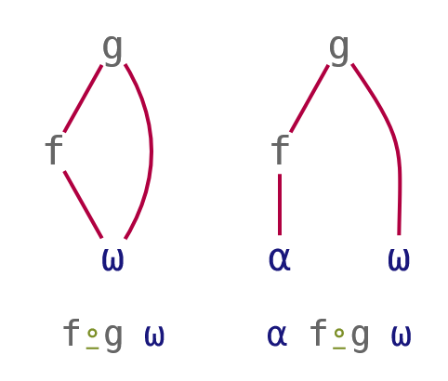
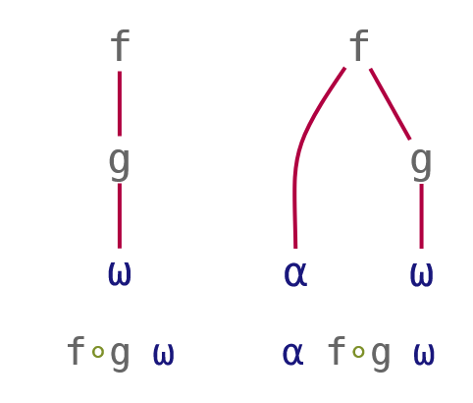
Function composition
Composition | Notation | Monadic | Dyadic
Beside | F∘G | F G ⍵ | ⍺ F G ⍵
Behind | F⍛G | (F ⍵) G ⍵ | (F ⍺) G ⍵
Pre-process right argument
2⊃∘⎕VFI¨ '3 4.2 and 5' '6 7' '12 more'
Pre-process left argument
array ⍴⍛⍴ values

Slide 8
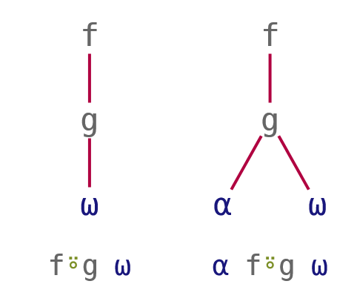
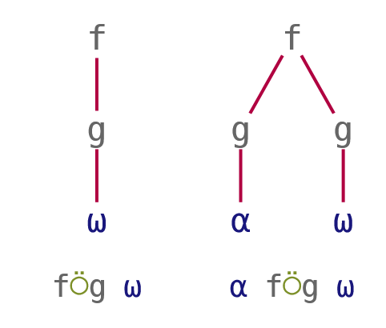
Function composition
Composition | Notation | Monadic | Dyadic
Atop | F⍤G | F G ⍵ | F ⍺ G ⍵
Over | F⍥G | F G ⍵ | (G ⍺)F (G ⍵)
Post-process result
3 4 5 ⌊⍤÷ 7 2 9
Pre-process both arguments
≢⍥,
+/⍥≢

Slide 9
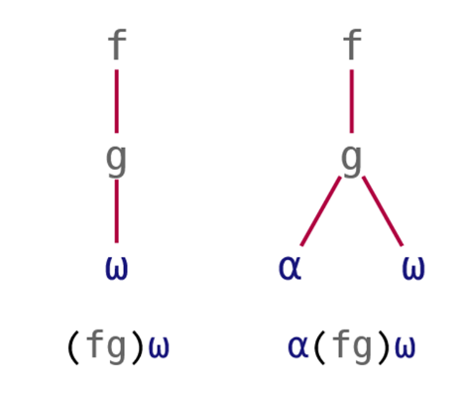
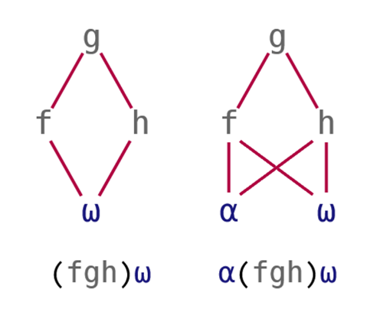
Function composition
Composition | Notation | Monadic | Dyadic
Atop | (FG) | F G ⍵ | F ⍺ G ⍵
Fork | (FGH) | (F⍵)G(H⍵) | (⍺F⍵)G(⍺F⍵)
Post-process result
3 4 5 (⌊÷) 7 2 9
Pre-process both arguments
5 2 3.2 8 (≢⍥, ≡ +/⍥≢) 'ABCD'

Slide 10
Primitive operators
Function composition
Pre-process right argument
2⊃∘⎕VFI¨ '3 4.2 and 5' '6 7' '12 more'
Pre-process left argument
array ⍴⍛⍴ values
Pre-process both arguments
vec1 (≢⍥,≡+/⍥≢) vec2
Post-process result
3 4 5 ⌊⍤÷ 7 2 9
Pre-process separately
x⍉⍛(+.×)∘÷y

Slide 11
Constant A⍨
Lightweight notation
Train {A}×h
At {A}@h

Slide 12
Constant A⍨
Lightweight notation
Train {A}×h A×h
At {A}@h A@h
Constant {A}

Slide 13
Constant A⍨
Lightweight notation
Train {A}×h A×h
At {A}@h A@h
Constant {A} A⍨

Slide 14
Constant A⍨
Lightweight notation
3 5⍴⎕A
ABCDE
FGHIJ
KLMNO
'jk'⍨¨3 5⍴⎕A
┌──┬──┬──┬──┬──┐
│jk│jk│jk│jk│jk│
├──┼──┼──┼──┼──┤
│jk│jk│jk│jk│jk│
├──┼──┼──┼──┼──┤
│jk│jk│jk│jk│jk│
└──┴──┴──┴──┴──┘
'jk'⍴⍨⍴3 5⍴⎕A
jkjkj
kjkjk
jkjkj
'jk'⍴∘⊂⍨⍴3 5⍴⎕A
┌──┬──┬──┬──┬──┐
│jk│jk│jk│jk│jk│
├──┼──┼──┼──┼──┤
│jk│jk│jk│jk│jk│
├──┼──┼──┼──┼──┤
│jk│jk│jk│jk│jk│
└──┴──┴──┴──┴──┘

Slide 15
Constant A⍨
Avoid ugly work-arounds
mask←1 0 0 0 1 0 0 ⋄ data←'AbcdEfg'
'⎕'@{mask}data
⎕bcd⎕fg
(mask/data)←'⎕' ⋄ data
⎕bcd⎕fg

Slide 16
Constant A⍨
Avoid ugly work-arounds
mask←1 0 0 0 1 0 0 ⋄ data←'AbcdEfg'
mask{'⎕'@{⍺}⍵}data
VALUE ERROR
mask{'⎕'@{⍺}⍵}data
∧
mask{'⎕'@(⍺⍨)⍵}data
⎕bcd⎕fg

Slide 17
Exercises
https://is.gd/MXvf9r

Slide 18
System Functions
Unique mask ≠⍵
Where ⍸⍵
Partitioned enclose ⍺⊂⍵

Slide 19
Unique mask ≠⍵ a.k.a. nub-sieve
∪'Mississippi'
Misp
{↑⍵(≠⍵)}'Mississippi'
M i s s i s s i p p i
1 1 1 0 0 0 0 0 1 0 0

Slide 20
Why, though?
≠Y is to ∪Y
as
⍋Y is to Sort Y

Slide 21
⍋Y vs Sort Y
Sort 3 1 4 1 5
1 1 3 4 5
⍋ 3 1 4 1 5
2 4 1 3 5
'Moses'[2 4 1 3 5]
oeMss

Slide 22
≠Y vs ∪Y
∪ 3 1 4 1 5
3 1 4 5
≠ 3 1 4 1 5
1 1 1 0 1
1 1 1 0 1 / 'Moses'
Moss

Slide 23
Where
Now accepts non-negative integers (not just Bool!)

Slide 24
History
price←71 82 81 82 84 59
(75≤price)/price
82 81 82 84
(75≤price)/⍳⍴price
2 3 4 5
1966
1960

Slide 25
History
price←71 82 81 82 84 59
(75≤price)/price
82 81 82 84
(75≤price)/⍳⍴price
2 3 4 5
⍸75≤price
2 3 4 5
2003
2017

Slide 26
Selection
^{Using Where}
⍸

Slide 27
Use case: selection
fruit←'Apple' 'Banana' 'Cherry' 'Date' 'Elderberry'
select←1 1 0 1 0
select/fruit
Apple Banana Date
select/⍳⍴select
1 2 4
⍸select
1 2 4

Slide 28
Use case: selection
fruit←'Apple' 'Banana' 'Cherry' 'Date' 'Elderberry'
select←1 1 0 1 0
select/fruit
Apple Banana Date
fruit[⍸select]
Apple Banana Date

Slide 29
Use case: multi-selection
fruit←'Apple' 'Banana' 'Cherry' 'Date' 'Elderberry'
select←1 2 0 1 0
select/fruit
Apple Banana Banana Date
fruit[⍸select]
DOMAIN ERROR
fruit[⍸select]
∧
1980
17.1

Slide 30
Use case: multi-selection
fruit←'Apple' 'Banana' 'Cherry' 'Date' 'Elderberry'
select←1 2 0 1 0
select/fruit
Apple Banana Banana Date
fruit[⍸select]
Apple Banana Banana Date
18.0

Slide 31
Use case: multi-dimensional selection
spice←'Anise' 'Basil' 'Chili' 'Dill' 'Epazote'
⎕←stuff←↑fruit spice
Apple Banana Cherry Date Elderberry
Anise Basil Chili Dill Epazote
⎕←select←↑select (0 0 0 2 0)
1 2 0 1 0
0 0 0 2 0

Slide 32
Use case: multi-dimensional selection
stuff[⍸select]
Apple Banana Banana Date Dill Dill
select/stuff
RANK ERROR
select/stuff
∧

Slide 33
Representing a set
^{Using Where}
⍸

Slide 34
Use case: Representing a set
all ← 'a' 'b' 'c' 'd' 'e' 'f'
mask ← 1 0 0 1 0 1
indices ← 1 4 6
indices ≡ ⍸ mask
1

Slide 35
Use case: Representing a multi-set
all ← 'a' 'b' 'c' 'd' 'e' 'f'
count ← 1 0 0 3 0 2
indices ← 1 4 4 4 6 6
indices ≡ ⍸ count
1
count ≡ ⍰ indices
1

Slide 36
Use case: Representing a multi-set
all ← 'a' 'b' 'c' 'd' 'e' 'f'
count ← 1 0 0 3 0 2
indices ← 1 4 4 4 6 6
indices ≡ ⍸ count
1
count ≡⍸⍣¯1⊢indices
1

Slide 37
Partitioned enclose ⍺⊂⍵

