Slide 1
TP1: Testing APL Systems
Michael Baas, Morten Kromberg, Stefan Kruger

Slide 2

Goals
Review what we know about existing tools and frameworks for testing
Present some techniques that Dyalog is actually using
Share our collective experience
Discuss requirements for potential future frameworks or tools that Dyalog (or the community) might develop

Slide 3
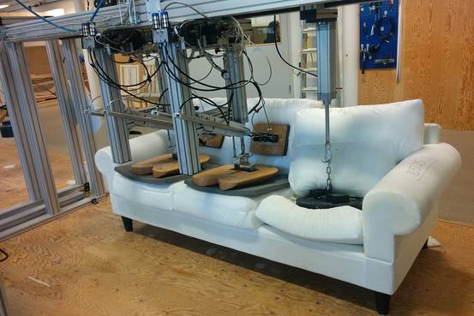

Slide 4
Session 1: Introduction (Morten)
13:30-14:30 (ish, hopefully a bit less)
Define Terminology
Review Some Existing Frameworks & Actual Tests
Exercise 1: Use "Tester" package to write a test

Slide 5
Session 2: DTest (Michael)
14:45-15:45
Basics
Demo
DIY
Bonus: Automation
Bonus: Code Coverage
Exercise: Write a test with DTest for coolStat's "Count" function

Slide 6
Session 3: Automation (Stefan)
16:00-17:00
The case for automation
Testing on the command line
Running tests in Docker
Automation with GitHub Actions
Exercise: Deploy test automation to GitHub

Slide 7
Terminology & Techniques
Types of Testing
Unit
Regression
Integration
Data Driven
Code Coverage
Techniques
Test-driven Development
Mocking (fakes & stubs)
Continuous Integration
GUI Testing (Selenium)

Slide 8
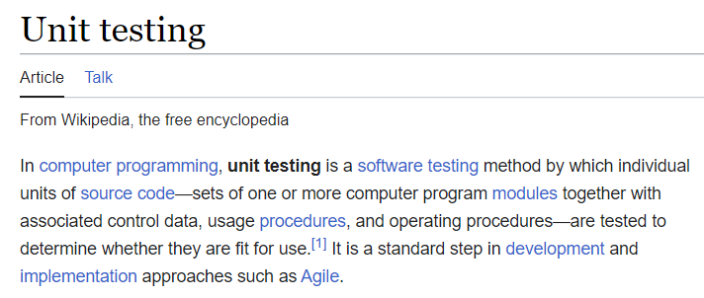
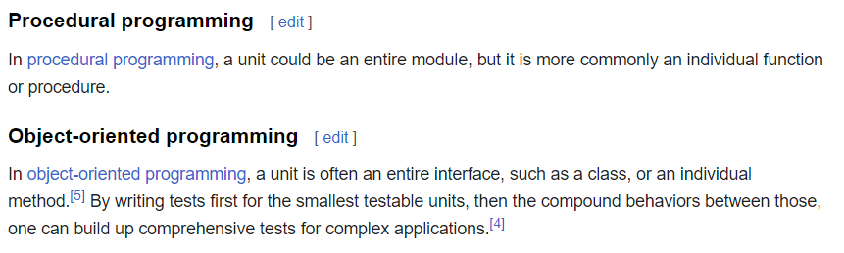
Unit Tests

Slide 9
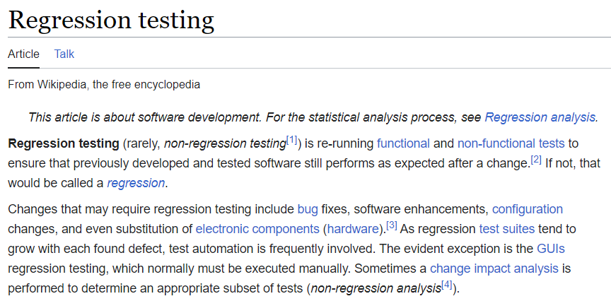

Slide 10
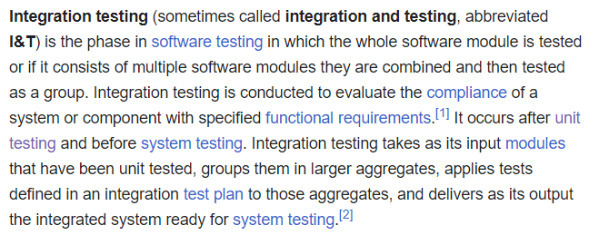

Slide 11
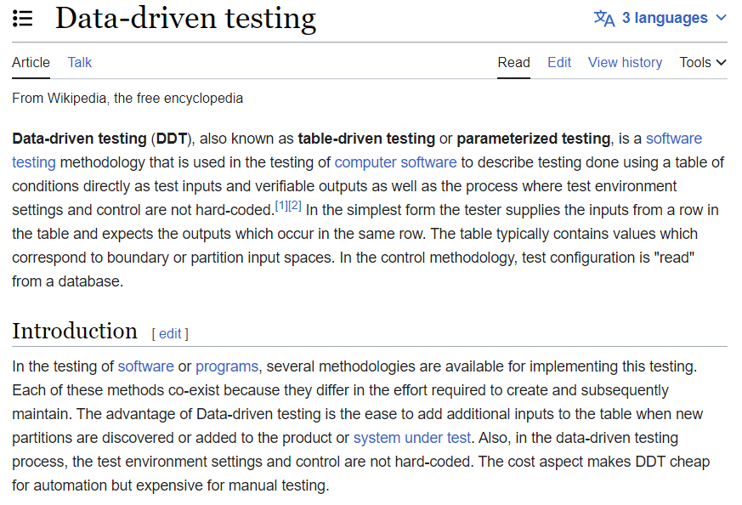

Slide 12
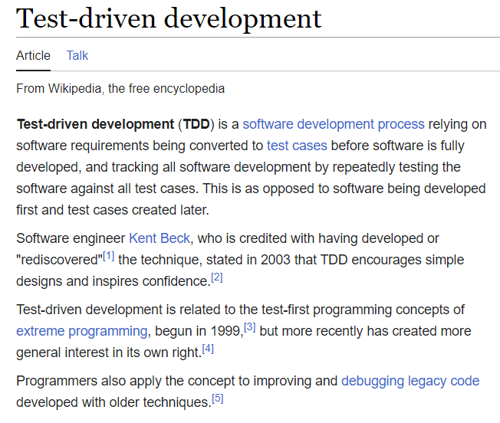

Slide 13
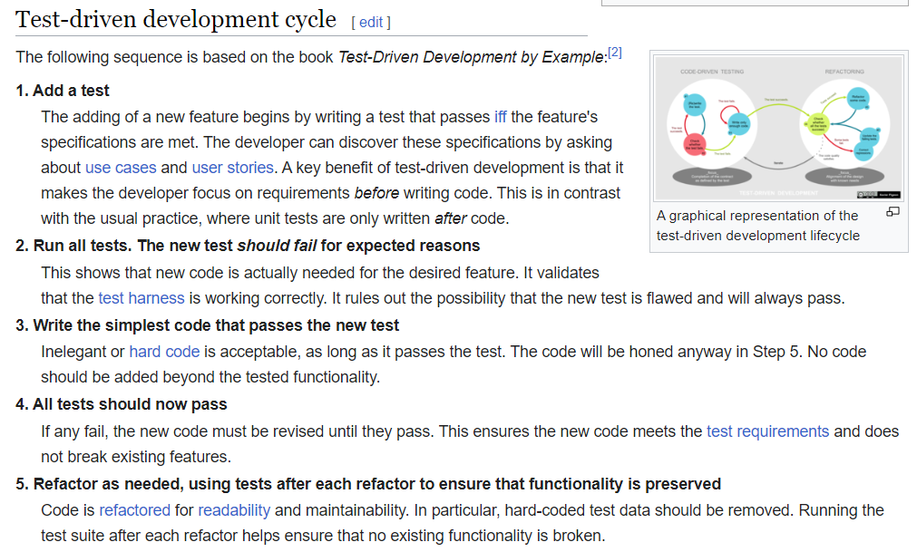

Slide 14
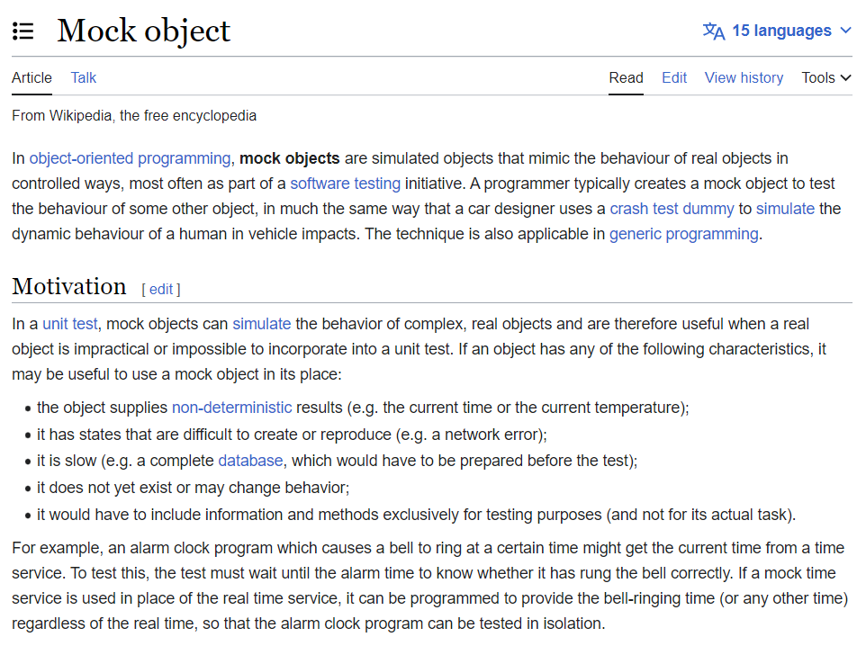

Slide 15
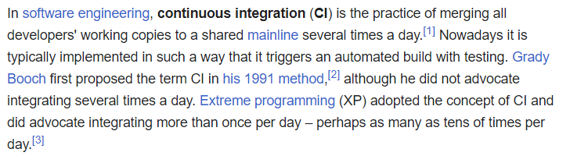

Slide 16
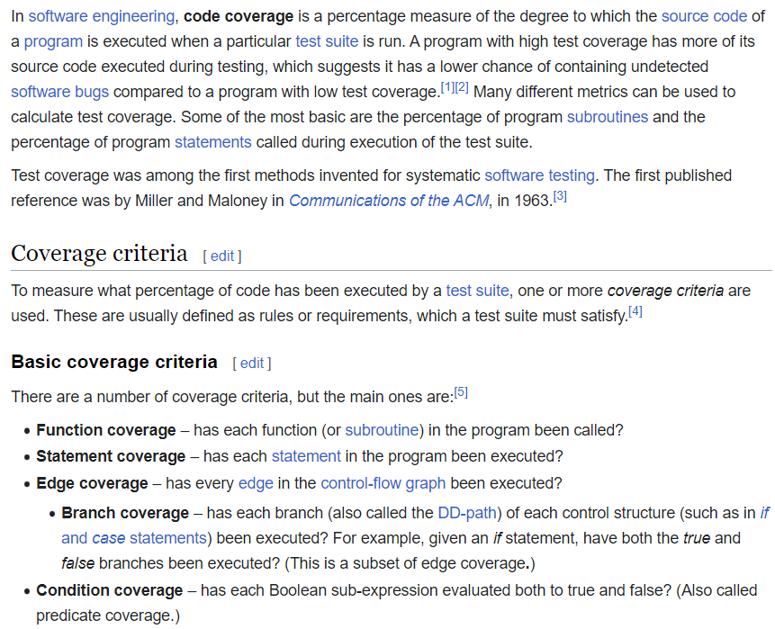
What about primitives with switches "built in"?
x←|÷y Test with y positive, negative and zero? Code coverage is necessary but NOT sufficient.

Slide 17
Test Frameworks for APL
"Unit Test" Frameworks
https://github.com/Gianfrancoalongi/APLUnit
A "classical" Unit Test framework, inspired by non-APL frameworks
https://xpqz.github.io/learnapl/testing.html
A more pragmatic and APL-friendly approach.
Other Test Frameworks
DTest (DyalogTest) – an internal tool used at Dyalog, that is included with Dyalog APL
davin-Tester – A Tatin Package by Davin Church
aplteam-Tester2 – Tatin Package by Kai Jaeger, used to test many of Kai's tools
aplteam-CodeCoverage – Tatin package for measuring code coverage
Do you/we know of others?

Slide 18
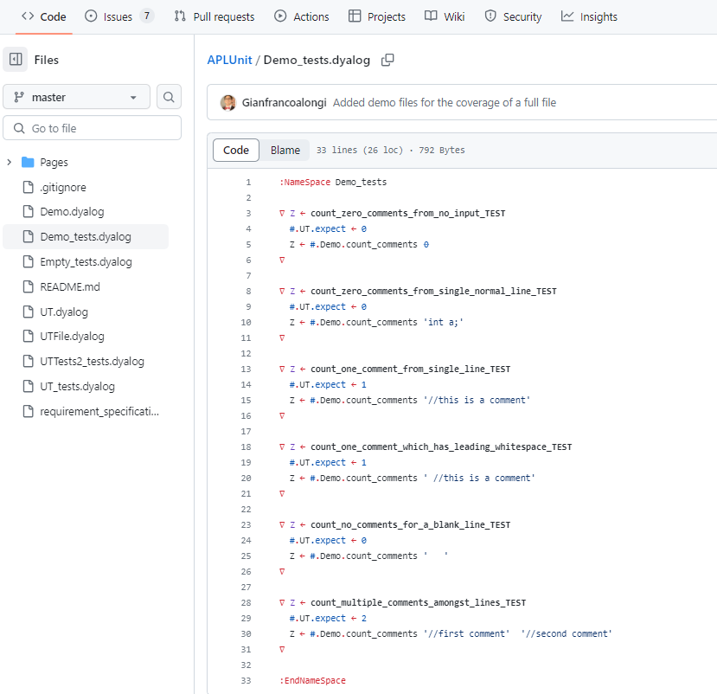
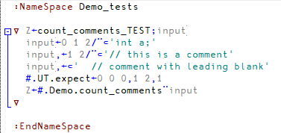
https://github.com/ Gianfrancoalongi/APLUnit

Slide 19
https://xpqz.github.io/ learnapl/testing.html
:Namespace unittest
⎕IO ← 0
run←{
tests ← 'test_.+'⎕S'&'⎕NL ¯3
0=≢tests: 'no tests found'
↑{⍺,('.'/⍨30-≢⍺),⍵⊃'[FAIL]' '[OK]'}⌿↑tests (⍎¨tests,¨⊂' ⍬')
}
:EndNamespace
unittest.test_upper←{'FOO'≡#.upper 'foo'}

Slide 20
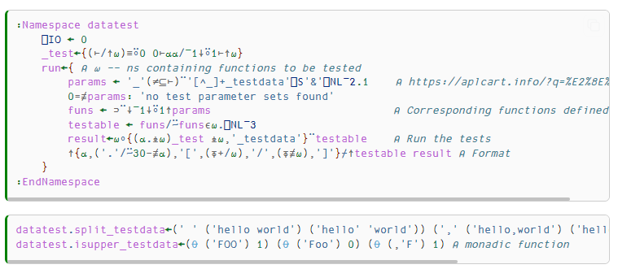
https://xpqz.github.io/learnapl/testing.html … also contains a "framework" for data-driven testing:

Slide 21
Some Recent QA we have written…
Ullu: Testing APL primitives
Kamila's tests
Link Testing
Selenium
(Michael will show some examples based on DTest in the next section)

Slide 22
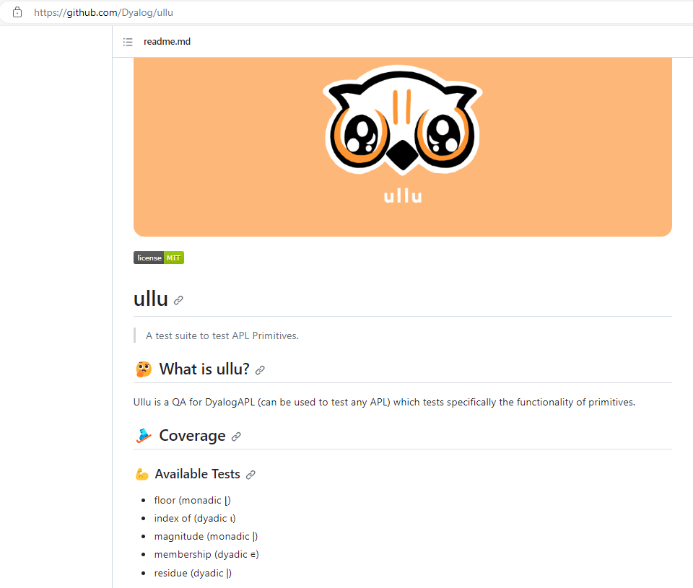

Slide 23
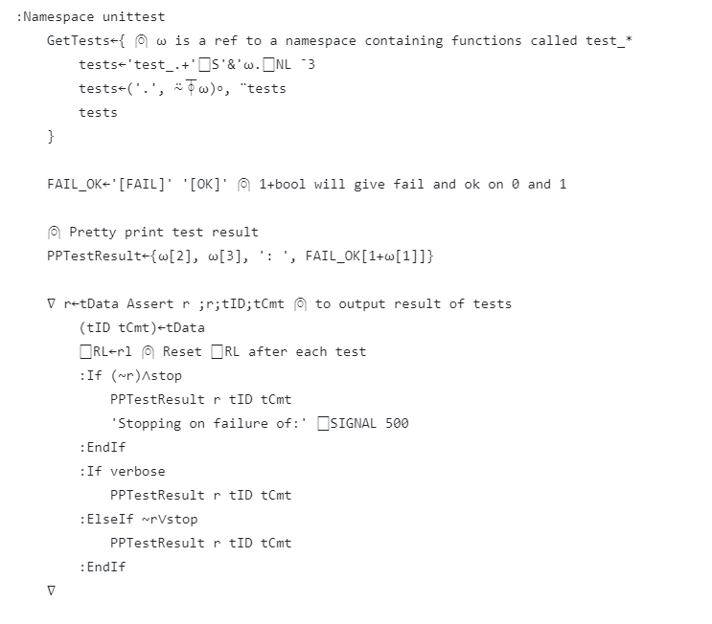
Ullu
Id & Comment

Slide 24
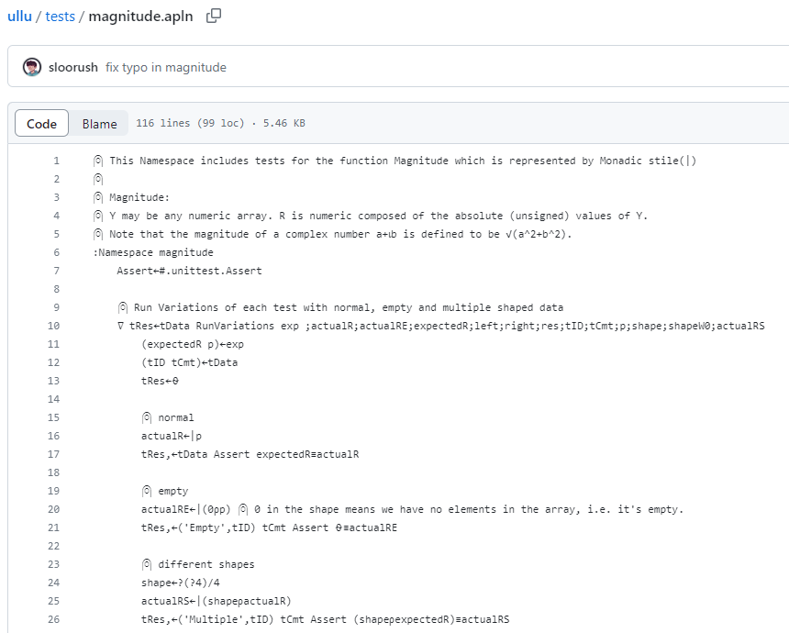

Slide 25
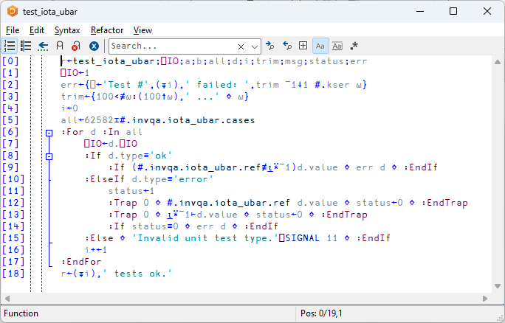
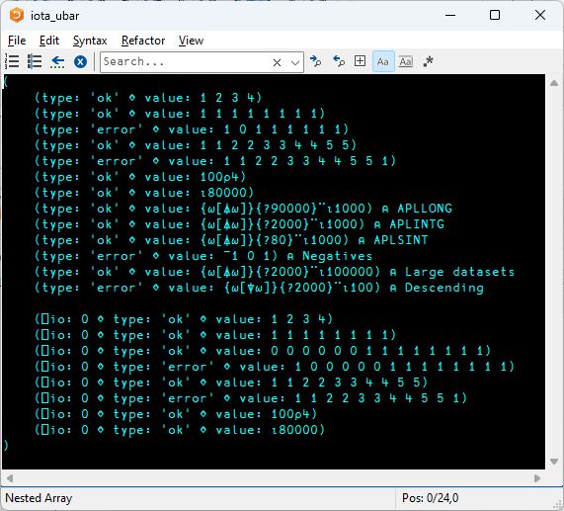

Slide 26
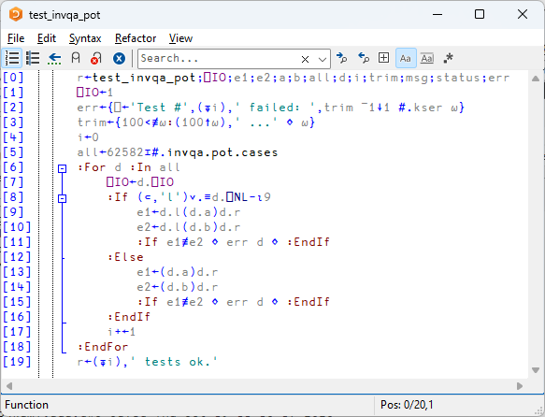
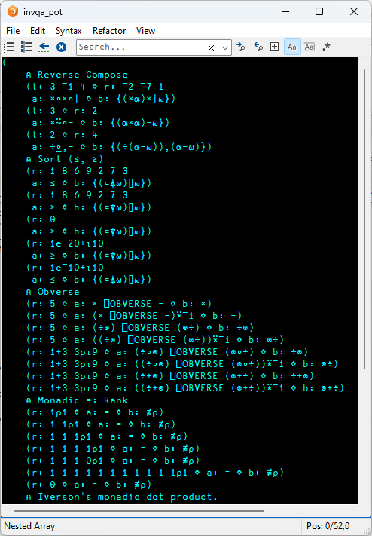

Slide 27

Link Testing

Slide 28
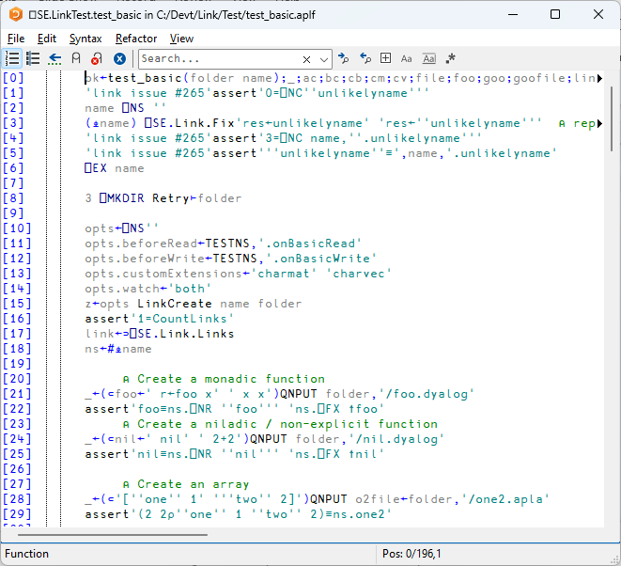
assert 'test'

Slide 29
assert 'test' 'recovery-expression'

Slide 30

Test for expected errors
Expression to run
Text to find in ⎕DM

Slide 31
Mocking
The Link QA needs to test Link's responses to notifications of additions, deletions, and changes to files
File System Watcher cause callbacks to APL from .NET. These are:
Not processed until the end of the current thread time slice (so if QA script keeps running, it may be some time before the callback runs)
Potentially simultaneous: If one takes more than one time slice to process, the next callback may start running before the previous one is completed
This is usually not a problem for the normal use case of editing or moving a small number of files outside APL "by hand"
However, for a QA that makes hundreds or thousands of additions, deletions, moves and copies, it leads to intermittent, unpredictable failures

Slide 32
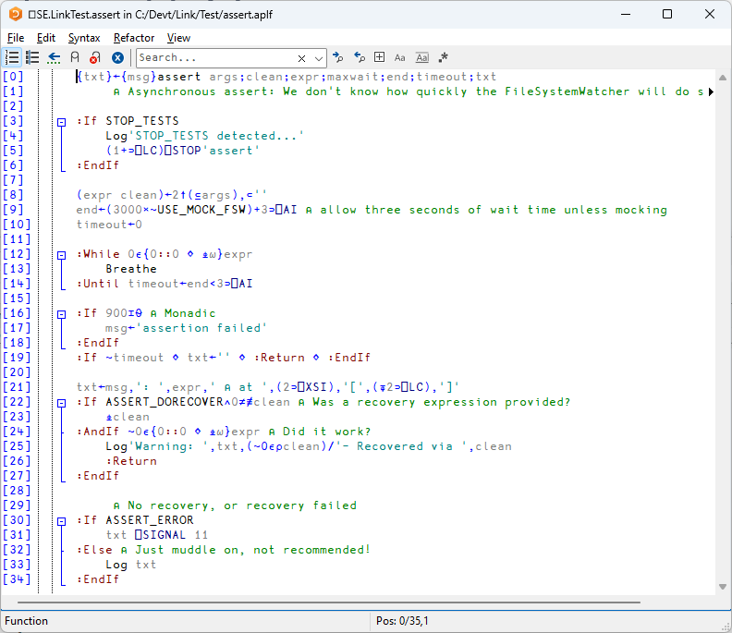
Keep trying until
Event arrives and is processed. Hence the ⍎

Slide 33
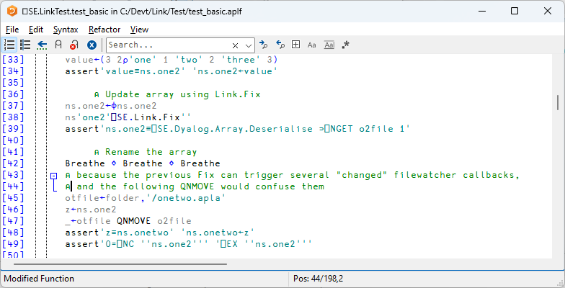
Mocking
This also helped a bit

Slide 34
Mocking
The out-of-order processing meant that delaying was not enough
Create-Update-Delete notifications might not arrive in that order
It was ultimately impossible to get the Link QA to run reliably when using a real File System Watcher
The solution was to "Mock" the FSW by covering all file system operations and call the FSW callback function immediately.
This simulated a "synchronous" FSW and finally made the tests deterministic (after three years of messing about)

Slide 35
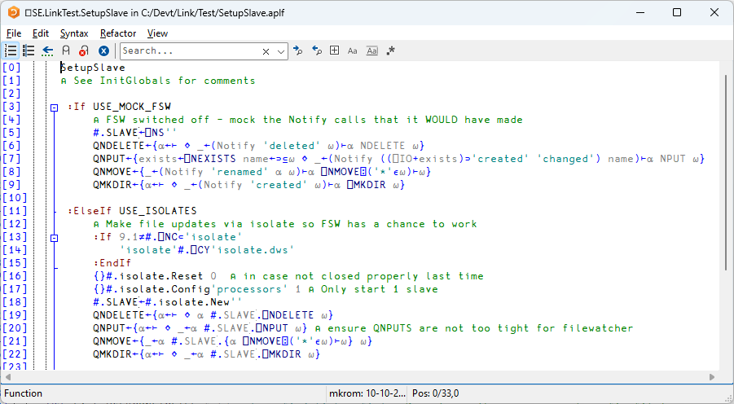
Mocking
Invoke FSW callback explicitly

Slide 36
Asynchronous Effects / GUI Testing
Sometimes, a test will trigger an effect which will take time to materialise
We have seen how Link "assert" waited in a loop
Automated GUI testing will nearly always exhibit this behaviour

Slide 37
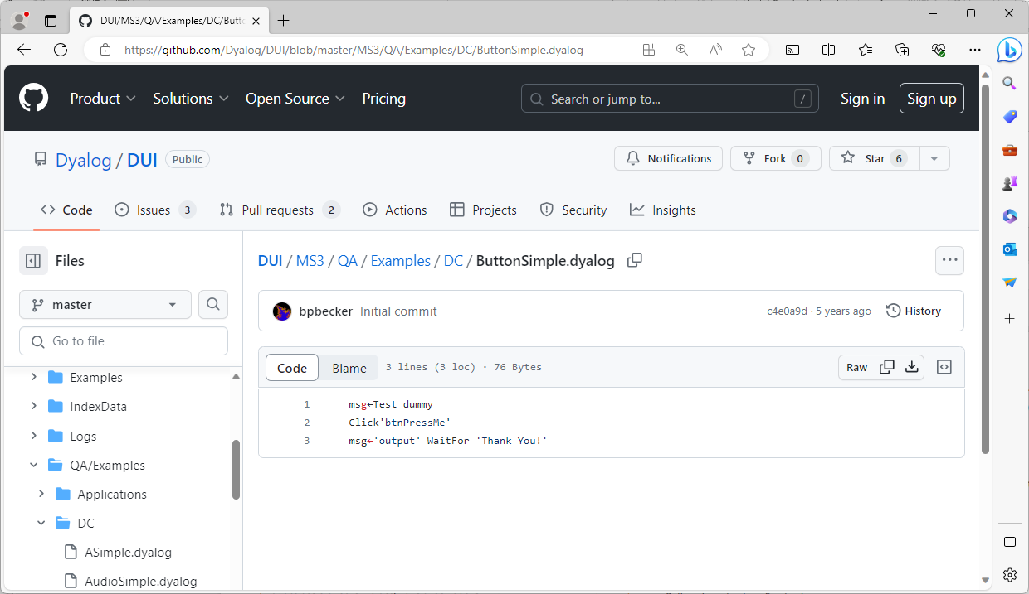
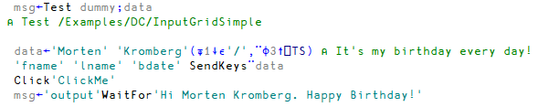

Slide 38
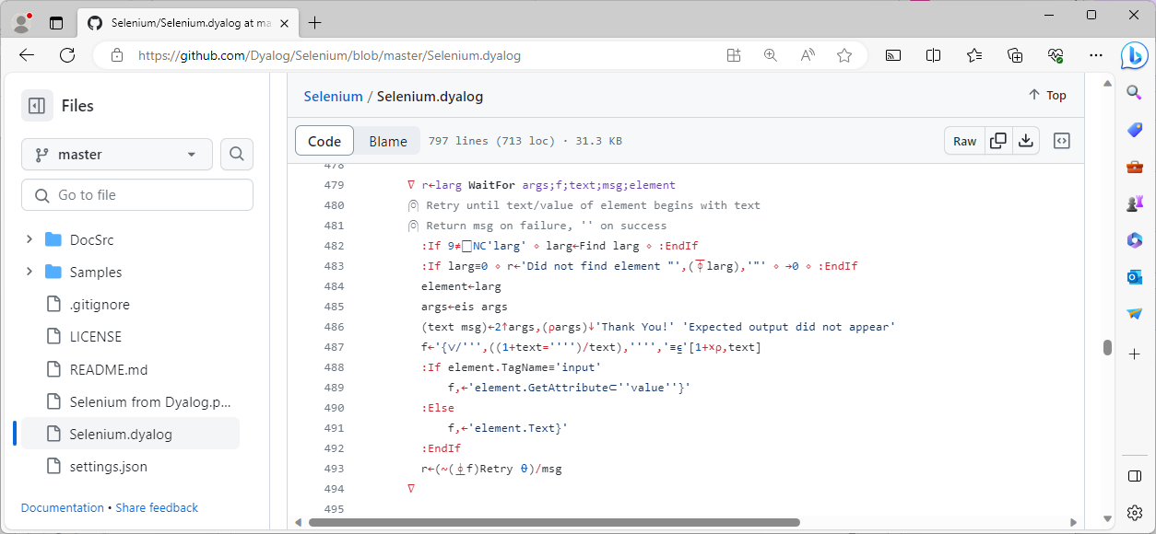

Slide 39
⎕WC – No idea how to test automatically

Slide 40
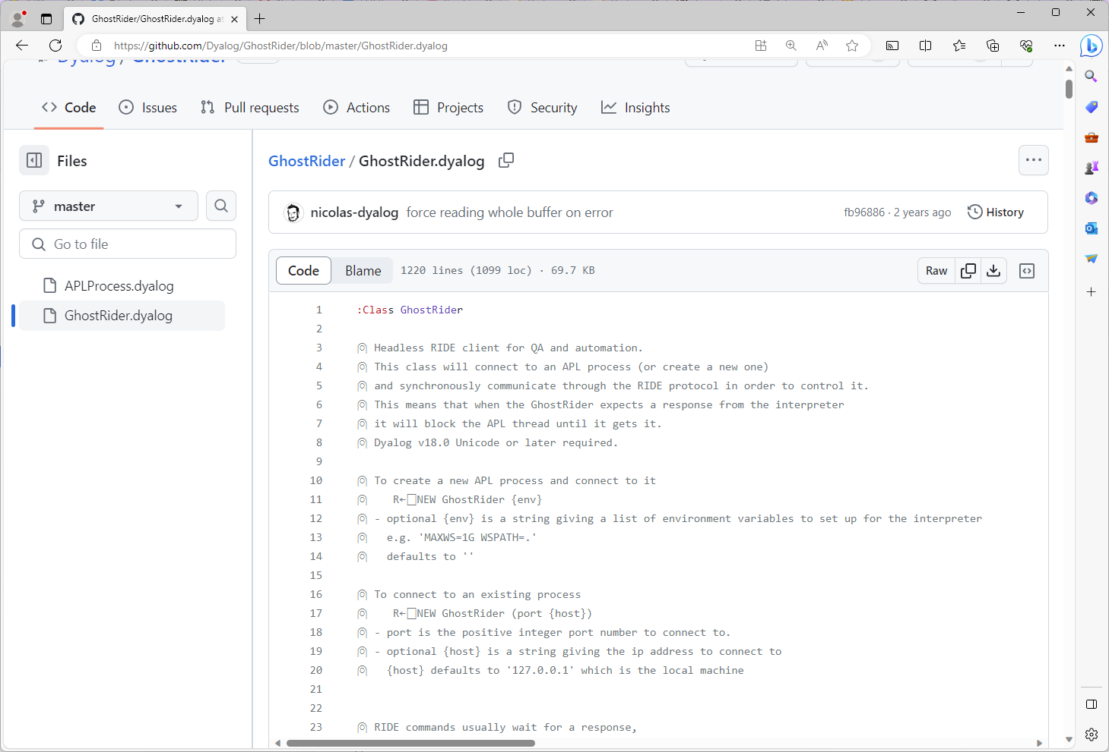
Driving Dyalog IDE

Slide 41
Test Driven Development
Write tests BEFORE fixing the problem or adding the new functionality
… or at least before you make the commits ☺

Slide 42
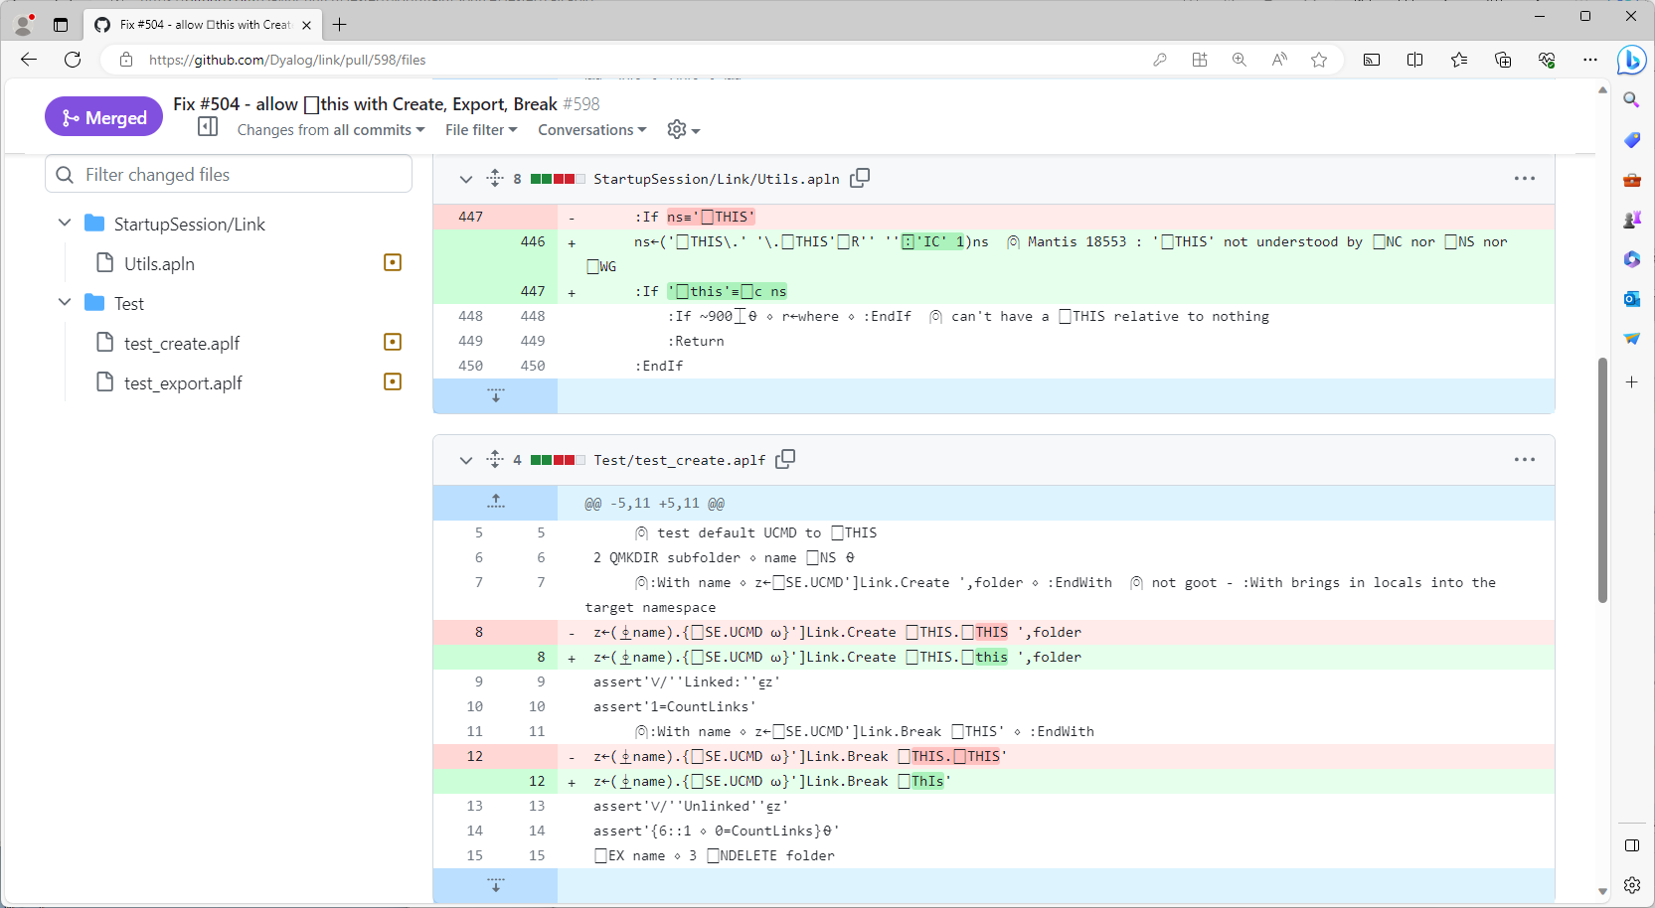

Slide 43
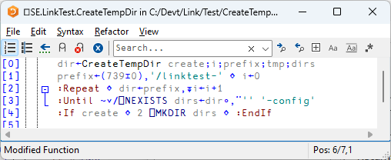
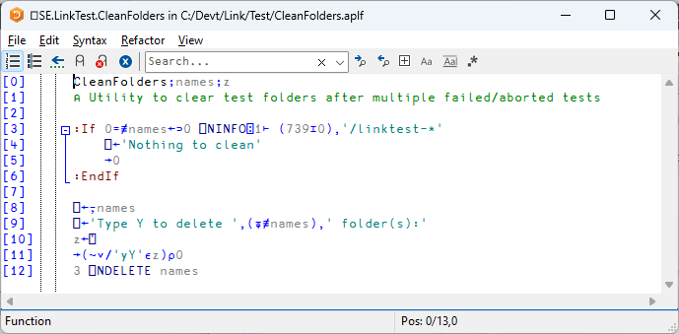
Temp Folders

Slide 44

Observed APL Practices
(Small) Unit Testing is expensive
Data Driven Regression Testing is common
Generating lots of test data in APL is easy
Continuous Integration
APL functions are more like complete modules in other languages
On the rise in APL!

Slide 45
Framework Requirement Spec
Assert
Bool rarg of built-in ≡
How to identify failing test
Async capability?
Expect Specific Error
EN or DM text
Logging levels
Error / Warning
Verbose / Quiet
Stopping behaviour
Record Random Seed
Log/report it on failure
Temporary folder creation
… And cleanup?
Code coverage

Slide 46
Recommendations
Design application to allow
Unit Testing
Mocking
Write tests before coding commit
(more to come)

Slide 47
A couple of Tatin Packages
aplteam-Tester2
Kai Jaeger's own test framework for testing his own tools / packages
davin-Tester
A very simple test framework

Slide 48
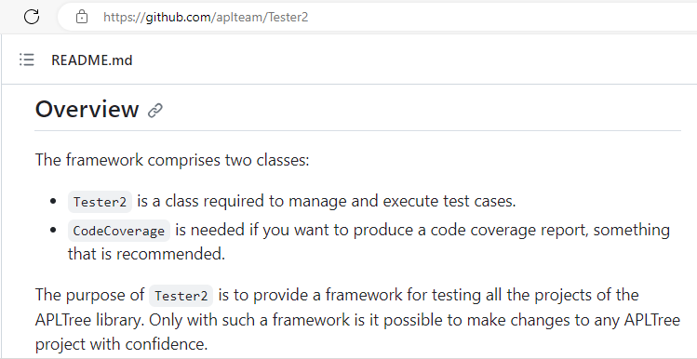
Tester2

Slide 49
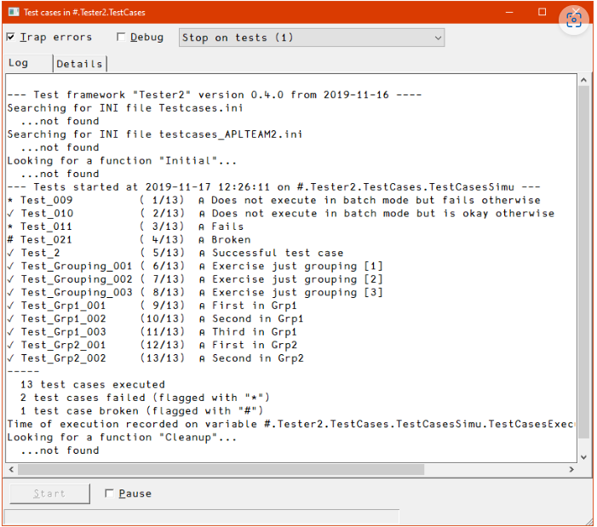
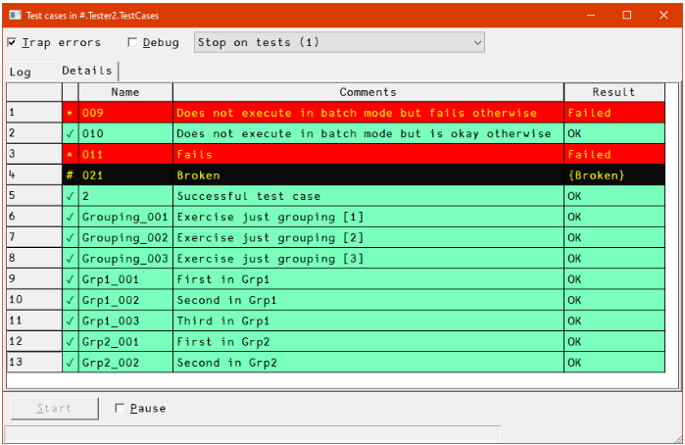

Slide 50
davin-Tester

Slide 51
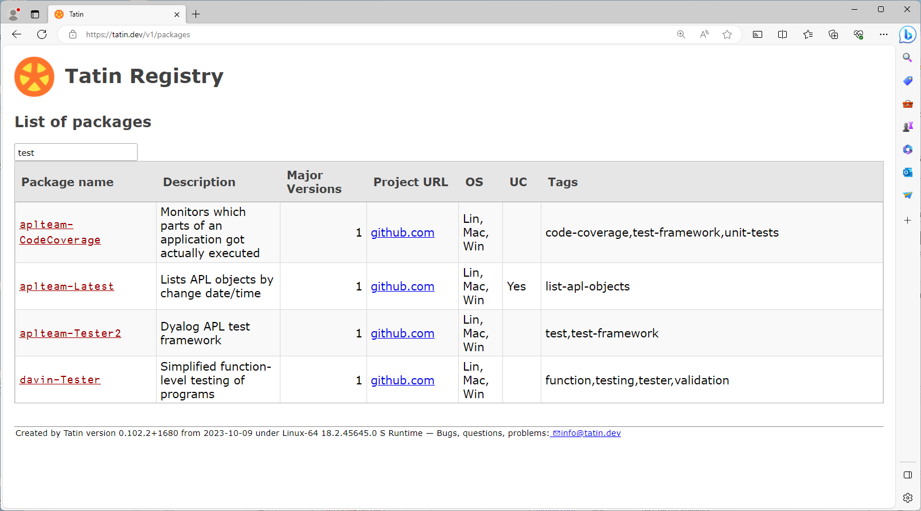

Slide 52
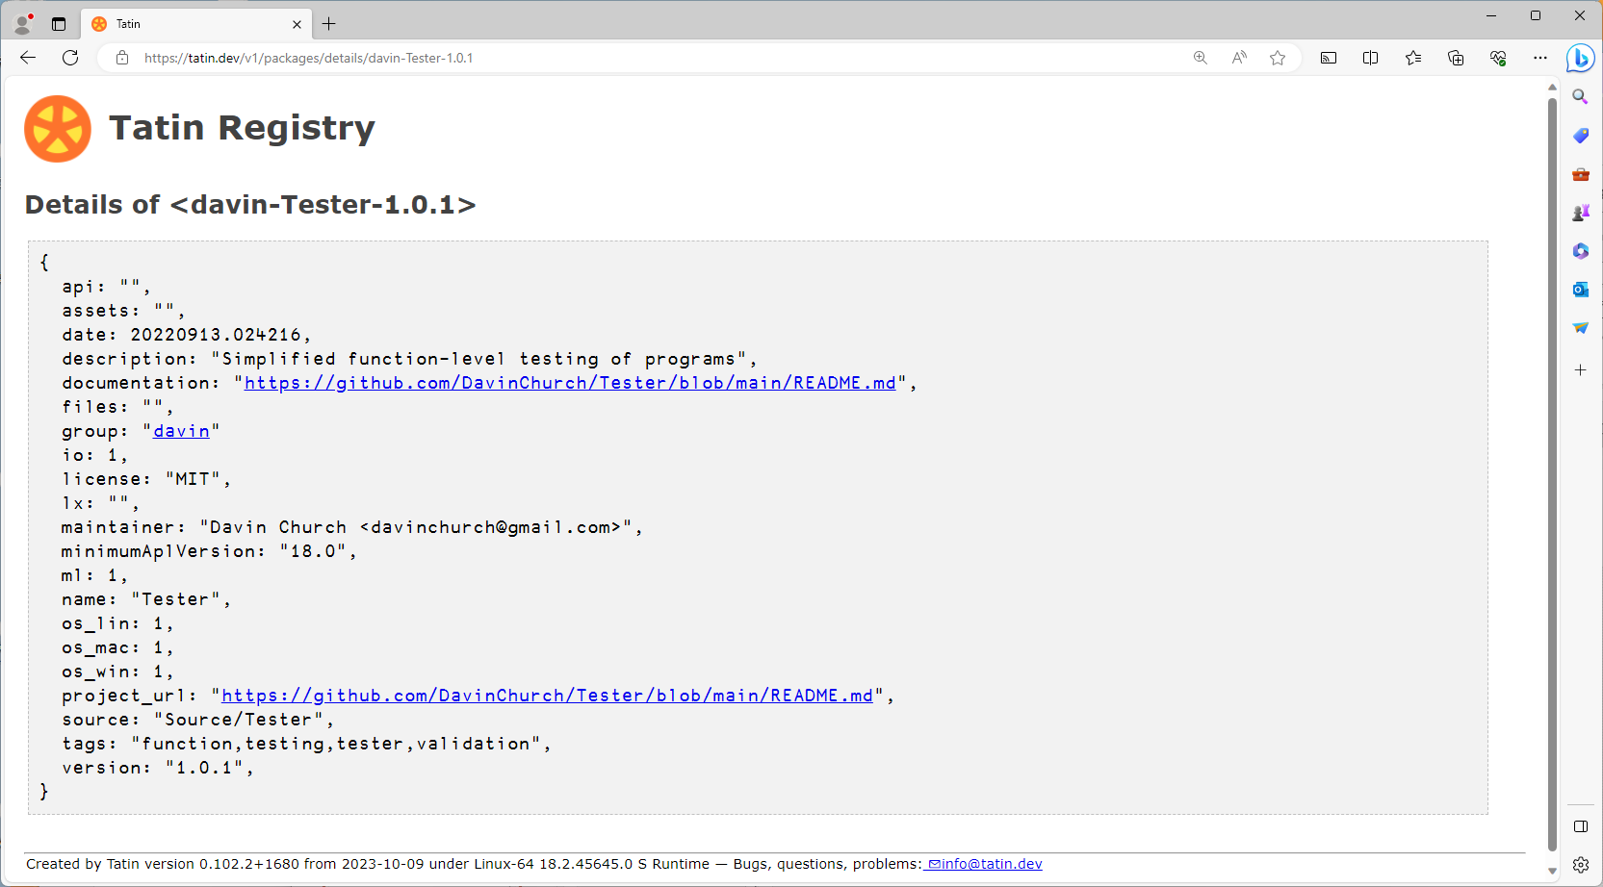

Slide 53
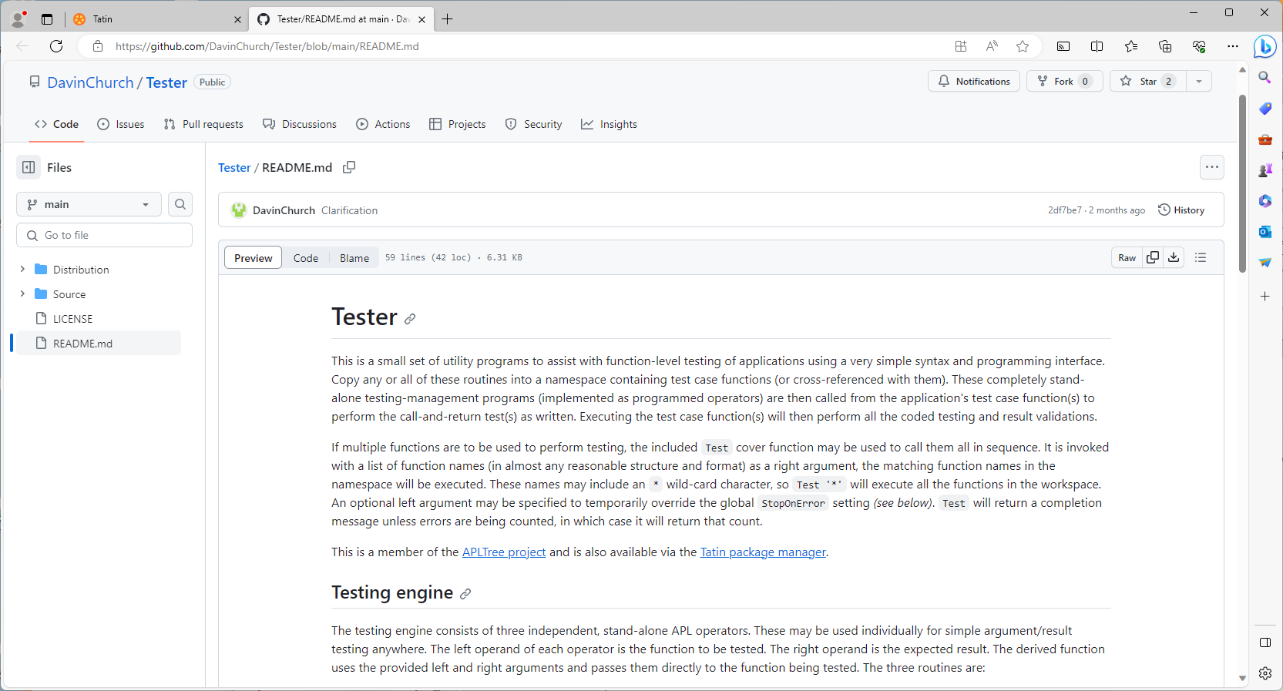

Slide 54
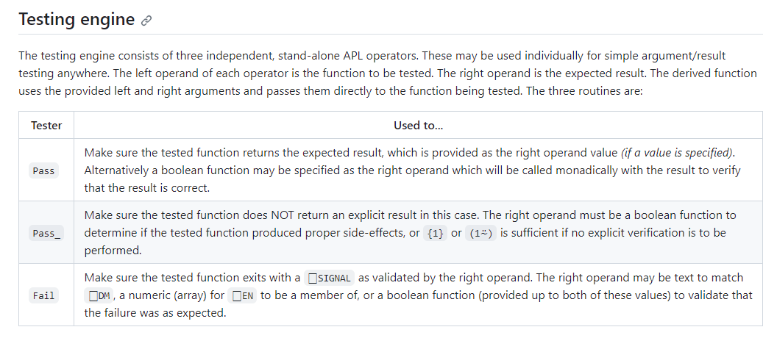

Slide 55
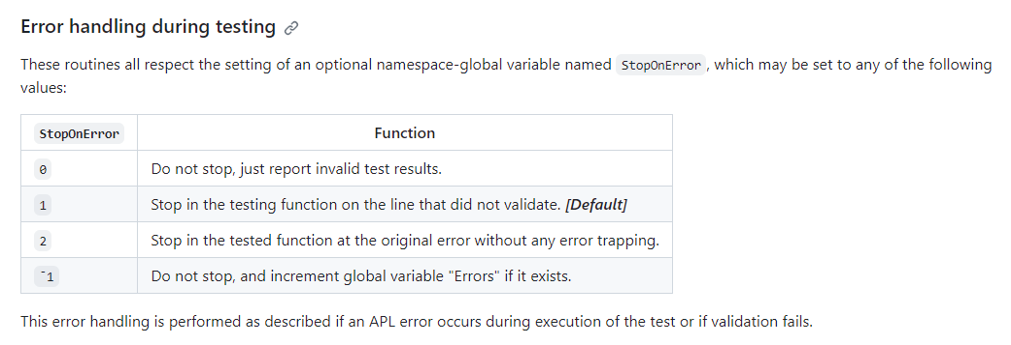

Slide 56
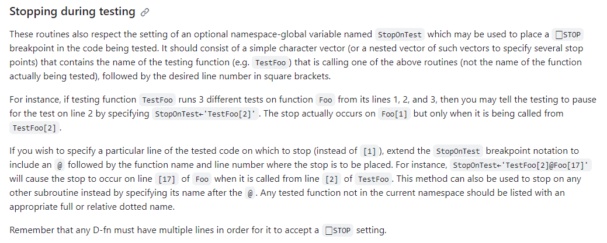

Slide 57
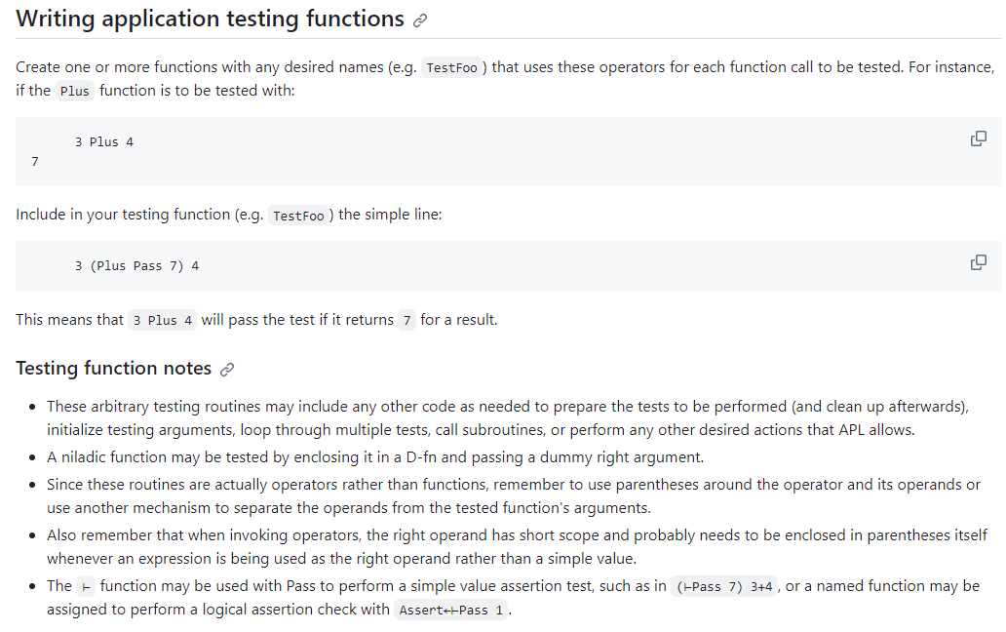

Slide 58
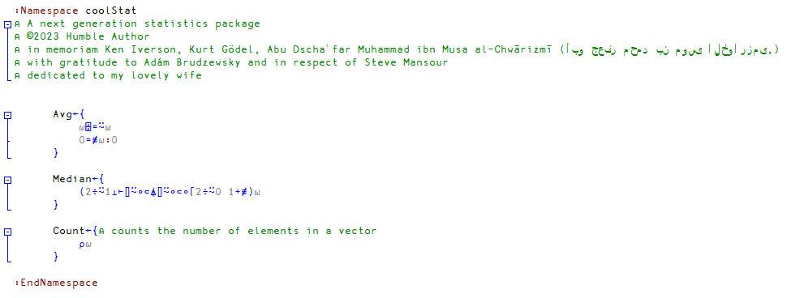
Our Application
https://github.com/Dyalog-Training/DTest/coolStat/src/coolStat.apln

Slide 59
Exercise 1
Write a test for one or more coolStat functions using davin-Tester
… Or use code scraped from https://xpqz.github.io/learnapl/testing.html (or slide #18)
]tatin.loadpackages Tester … or … tester←'https://github.com/DavinChurch/Tester/blob/main/Source/Tester/'
{⎕SE.UCMD 'get ',tester,' ',⍵}¨'Fail.aplo' 'Pass.aplo' 'Pass_.aplo' 'Test.aplf'

