Slide 1
Concurrent Programming in Dyalog
Rich Park, Stefan Kruger

Slide 2
This workshop
An introduction
Some discussion
Some exercises
Not comprehensive

Slide 3
Concurrency & Parallelism
Doing too many things together

Slide 4
Recipe ≈ algorithm
Into one bowl
  Add flour
  Add sugar
  Add salt
Into another bowl
  Add milk
  Add egg
  Add melted butter
Mix wet and dry ingredients
Add butter to hot pan
Add batter to hot pan
Remove pancake from hot pan
Eat

Slide 5
Recipe ≈ algorithm
Add wet, dry separately
  Into another bowl add flour, sugar, salt
  Into another bowl add milk, egg, melted butter
Mix wet and dry ingredients
  Add butter to hot pan
  Mix wet and dry ingredients
Add batter to hot pan
Remove pancake from hot pan
Eat
Notes:
We can do some things simultaneously, but there are dependencies that we have to coordinate

Slide 6
Concurrency vs Parallelism
"Concurrency is about handling asynchronous, non-deterministic events. Parallelism is about using hardware resources to do more computations at the same time."
- some guy

Slide 7
Concurrency vs Parallelism
"Concurrency is about dealing with lots of things at once. Parallelism is about doing lots of things at once."
- Rob Pike, Concurrency is not Parallelism (2012)

Slide 8
Learning Objectives
Understand the difference between green threads and OS threads
Know how to assess performance trade-offs when considering concurrency implementation
Know when threads switch in running Dyalog programs
Know how locking mechanisms can be used to safely manage shared resources in multithreaded programs

Slide 9
When do we want concurrency?
When computations are independent
To hide latency
Protection of modular systems
Notes:
Ask for suggestions from the audience
Hiding latency e.g. when service needs to respond
Protection of modules e.g. independent tabs in a browser

Slide 10
When do we want to implement concurrency?
Never
Notes:
Moore's law – scalability easier with distributed systems

Slide 11
Green Threads
AKA APL Threads
Spawn operator (F&)
Thread management (⎕TID, ⎕TSYNC,⎕TKILL etc.)
Token pool (⎕TALLOC, ⎕TGET, ⎕TPUT etc.)
Thread switching

Slide 12
Green Threads
Run in the same OS process
"time share"
R ← F&arg R is a thread ID
Thread 1
Thread 2
Notes:
Not "co-operative" multi-tasking

Slide 13
Futures and Isolates
Workspace isolate.dws
Execute code in a separate process
Models:
  II (∥)
  IÏ (∥¨)
R ← F II arg R is a "future"
Futures: mysterious "not yet" values
Notes:
Demos:
p←1 0 1 0 0 ⊂ {_←⎕DL 10 ⋄ ⎕A[⍵]}IÏ⍳5
p←{_←⎕DL 10 ⋄ ⎕A[⍵]}IÏ⍳5
p←3⌽{_←⎕DL 10 ⋄ ⎕A[⍵]}IÏ⍳5

Slide 14
Industry Standard
Reverse proxy pattern
Shared state via databases, cache layers, streaming layers

Slide 15
Further Reading
Channels, buses, semaphores, fairness
Coffman conditions, Owicki-Gries, Petri nets
.NET Tasks
nginx, proxies

Slide 16
Overview
Parallelisation Performance
Thread safety

Slide 17
Results of Concurrent Calls
#.⎕CY'isolate'
my_future ← DoThing #.II arg
my_future ⍝ block until ready
result
Notes:
FIXME line spacing

Slide 18
Results of Concurrent Calls
#.⎕CY'isolate'
default ← 'NOT READY YET'
my_future ← DoThing #.II arg
default #.isolate.Values 'my_future'
NOT READY YET
Notes:
FIXME line spacing

Slide 19
Results of Concurrent Calls
tid ← DoThing& arg
r ← ⎕TSYNC tid
VALUE ERROR: No result was provided when the context expected one
Run[2] r←⎕TSYNC tid
∧

Slide 20
Results of Concurrent Calls
r ← ⎕TSYNC DoThing& arg
r ← ⎕TSYNC HttpCommand.Get&¨ urls
Notes:
FIXME HTTP demo

Slide 21
Parallelisation Performance
Demo
Discuss
Try

Slide 22
Parallelisation Performance
Main: DoThing II arg
dyalogrt.exe
startup
send code, arg
Fix code, arg
Execute code
Receive result
Send result

Slide 23
Parallelisation Performance
Collatz step:
{
1=⍵: 1
2|⍵: 1+3×⍵
⍵÷2
}
Notes:
Multiple independent computations

Slide 24
Parallelisation Performance
Collatz step:
{
1=⍵: 1
2|⍵: 1+3×⍵
⍵÷2
}
3 10 5 16 8 4 2 1
4 2 1
5 16 8 4 2 1
6 3 10 5 16 8 4 2 1
Notes:
Multiple independent computations

Slide 25
Parallelisation Performance
]get -u https://github.com/dyalog-training/2026-MA3
#.⎕CY'isolate'
chunks←10 Splits 2 2e6
Collatz 2 2e6
Best Collatz¨chunks
Best ⎕TSYNC Collatz&¨chunks
Best Collatz IÏ chunks
Which expressions are fastest (number 1-4)?
Why?

Slide 26
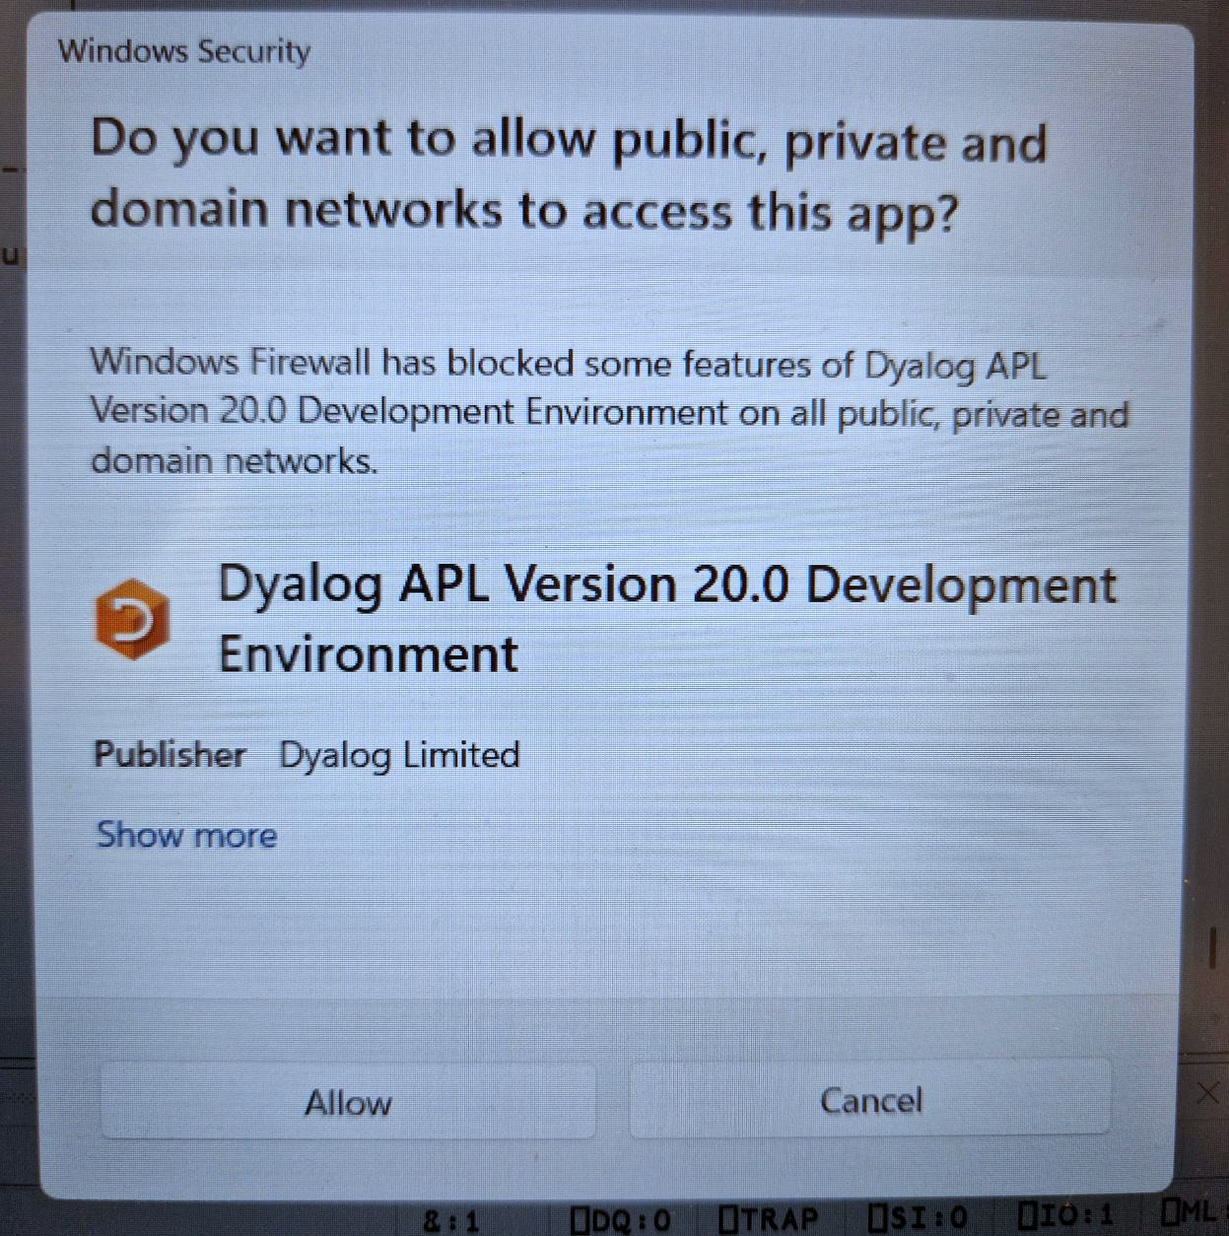
Parallelisation Performance
]get -u https://github.com/dyalog-training/2026-MA3
#.⎕CY'isolate'
chunks←10 Splits 2 2e6
Collatz 2 2e6
Best Collatz¨chunks
Best ⎕TSYNC Collatz&¨chunks
Best Collatz IÏ chunks
Which expressions are fastest (number 1-4)?
Why?
Notes:
Isolates can make Windows popup asking permission
Isolate uses runtime 'terp by default, but configurable

Slide 27
Parallelisation Performance
{Collatz ⍵}_Time 2 2e6
{Best Collatz¨⍵}_Time chunks
{Best ⎕TSYNC Collatz&¨⍵}_Time chunks
{Best Collatz IÏ ⍵}_Time chunks
Use the _Time operator
Try using fewer chunks
Try using more chunks

Slide 28
APL Thread Safety

Slide 29
APL Thread Safety
hardhat by Zach Hainsworth
from Noun Project (CC BY 3.0)

Slide 30
Isolates & Green Threads
Jarvis
request
$$$ compute
Notes:
FIXME maybe hide these, too much info

Slide 31
Isolates & Green Threads
Jarvis
&
&
&
request
request
request
$$$ compute
$$$ compute
$$$ compute

Slide 32
Isolates & Green Threads
Jarvis
&
&
&
request
request
request
$$$ compute
$$$ compute
$$$ compute

Slide 33
Isolates & Green Threads
Jarvis
&
&
request
request
$$$ compute
$$$ compute

Slide 34
Isolates & Green Threads
Jarvis
&
request
$$$ compute

Slide 35
Spawn (&)
Functions may have side effects
  Global variables
  File system
  Network
  External interfaces (DLLs, .NET, etc.)

Slide 36
Shared State
Sections of code that handled shared state are called
critical sections.
[1] sum←+/nums
[2] top←⌈/nums
[3] new←sum top bool
[4] GLOBAL⍪←new
[5] GLOBAL[;3]←~GLOBAL[;3]
[6] r←'sum: ',sum⍕⍛,'top: ',⍕top

Slide 37
:Hold
Block other threads using one or more character "tokens"

Slide 38
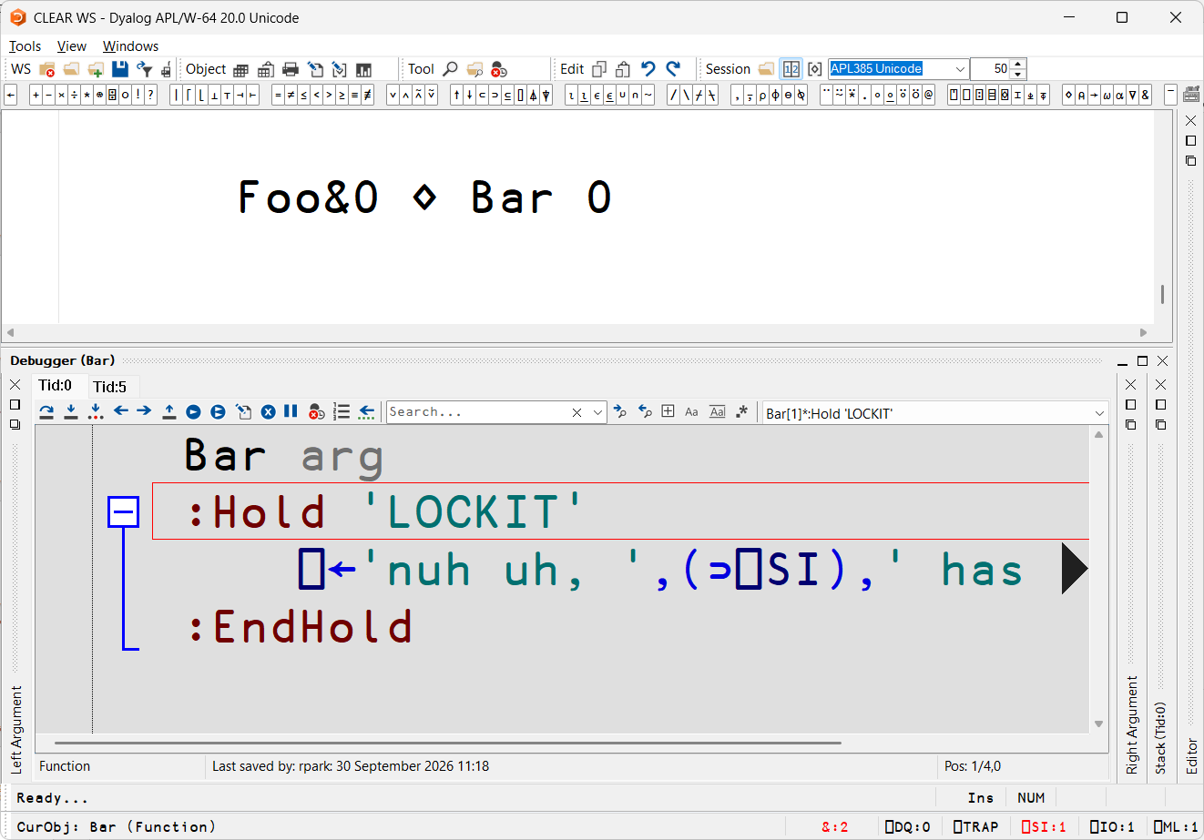
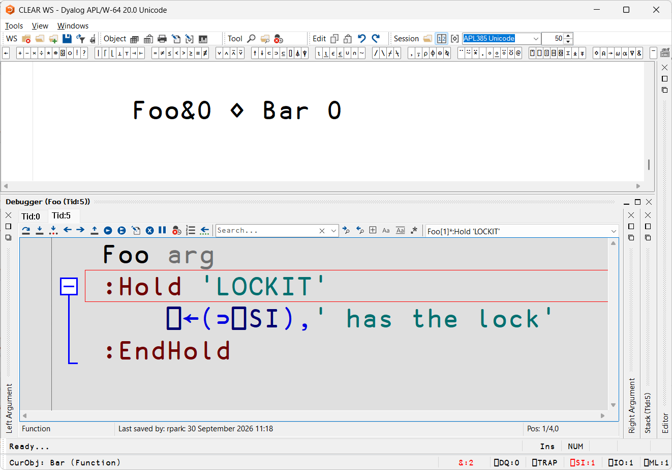

Slide 39
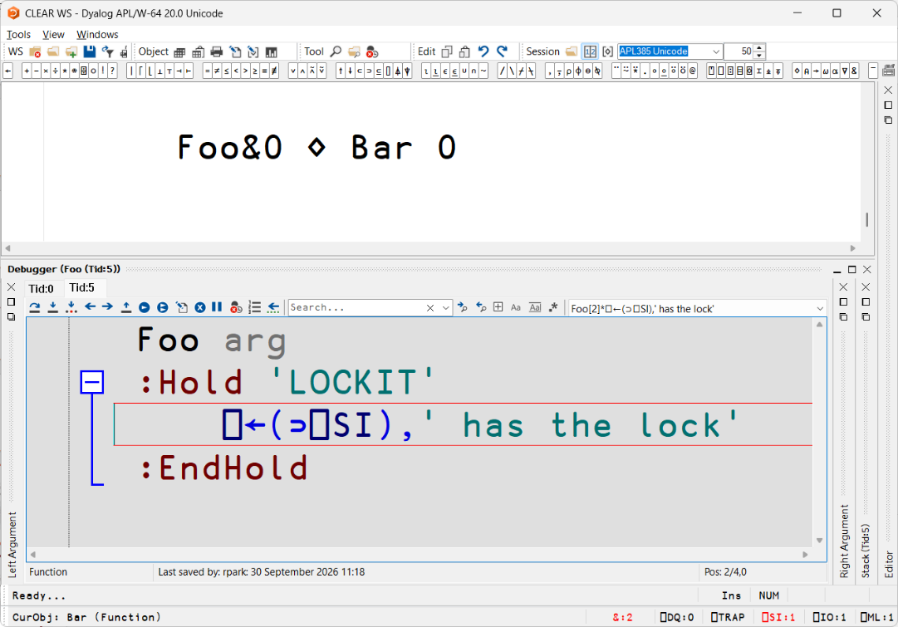

Slide 40
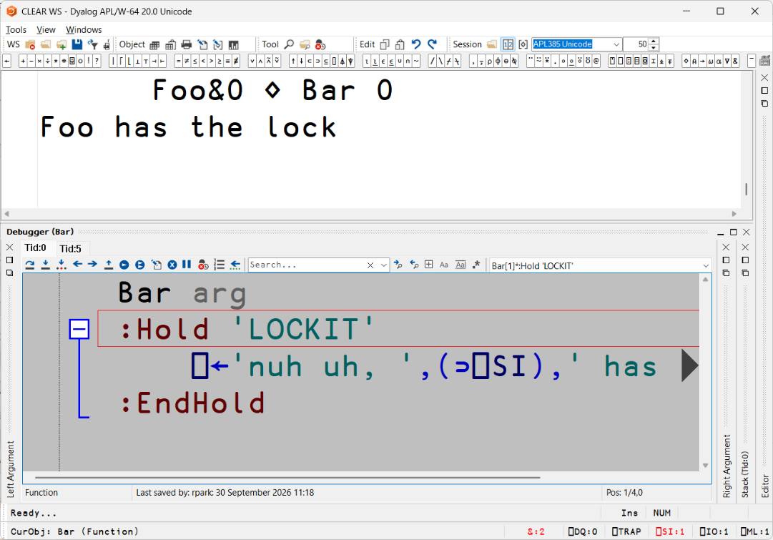


Slide 41
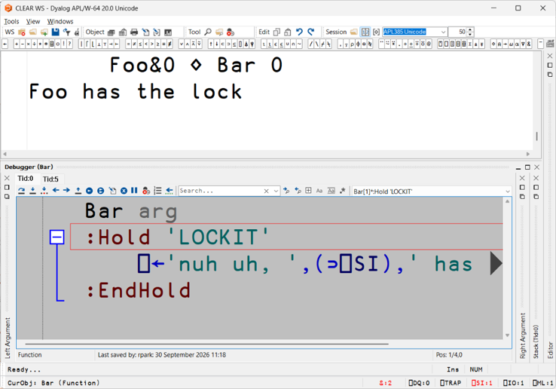
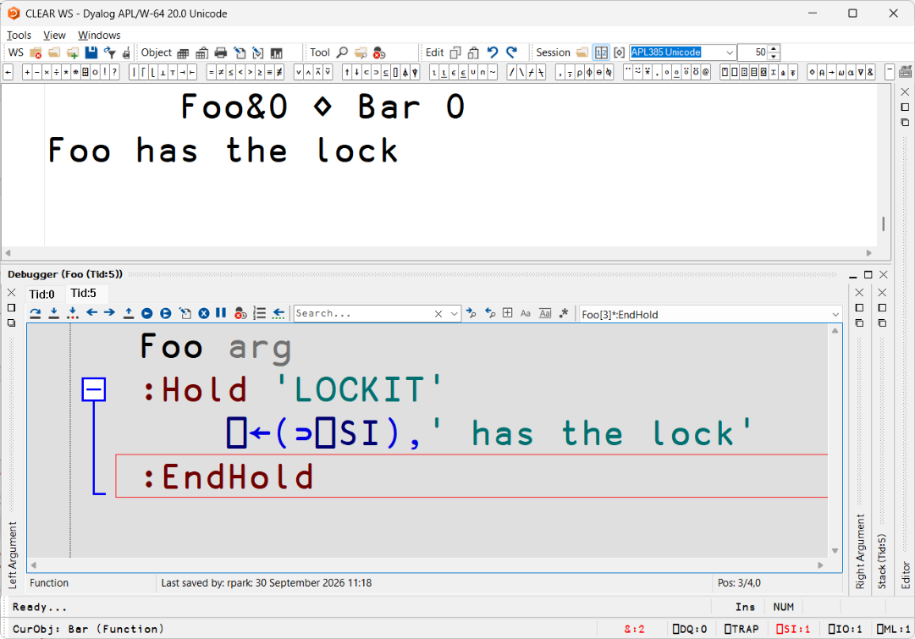

Slide 42
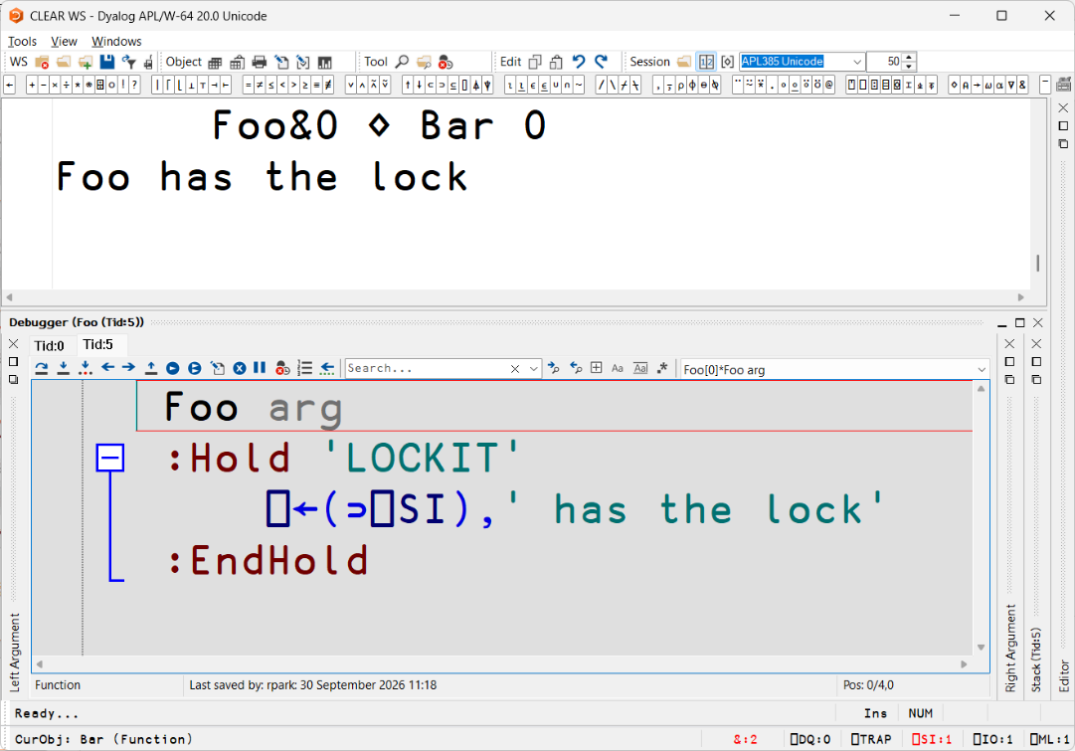

Slide 43
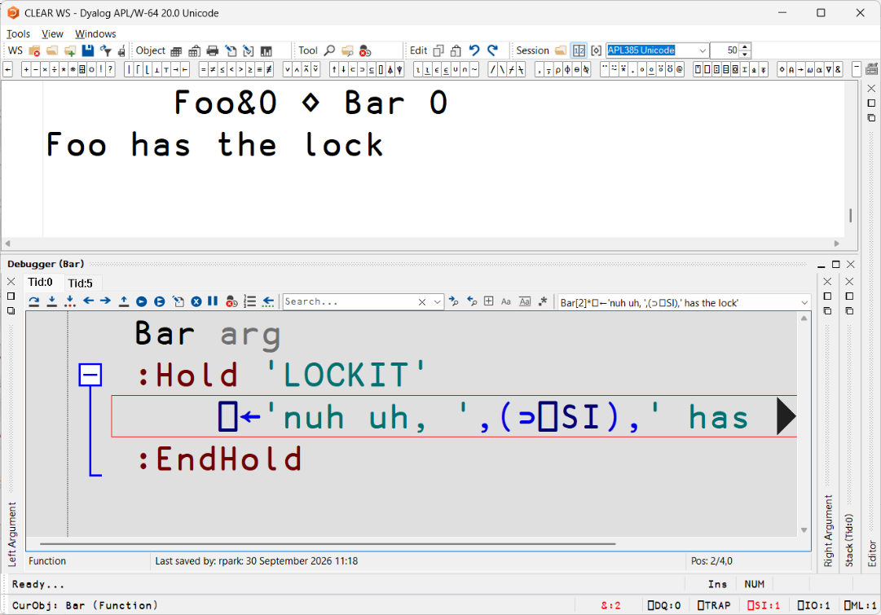


Slide 44
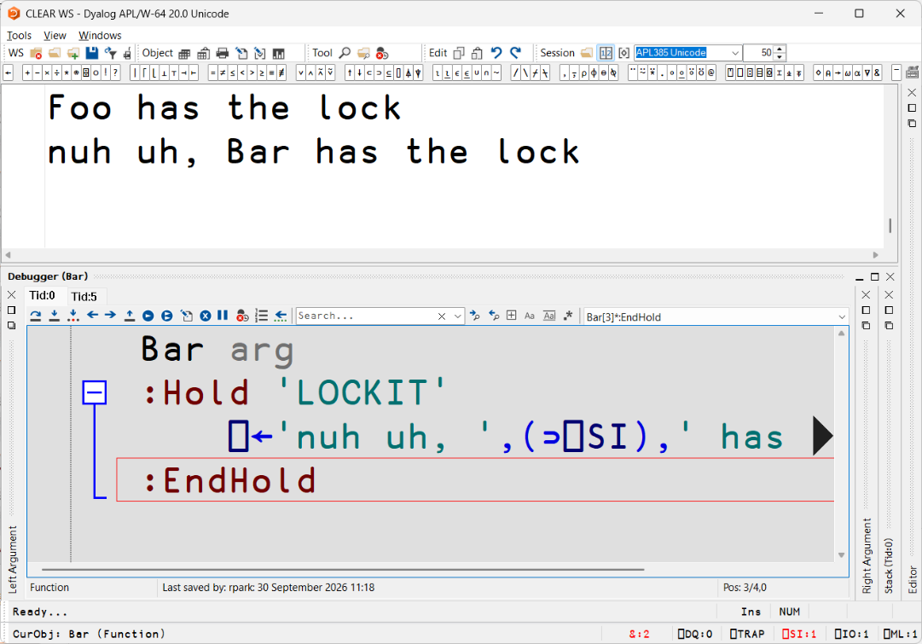

Slide 45
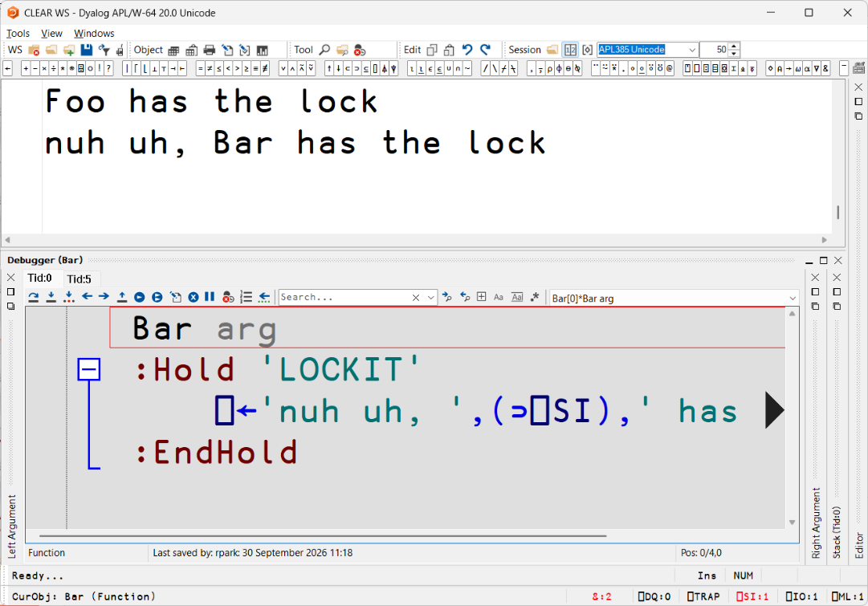

Slide 46
Thread Management
)Holds held tokens
⎕TNUMS running threads
⎕TID this thread
⎕TCNUMS children of this thread
⎕TKILL guess

Slide 47
Thread Switching
Single lines of primitives will not switch threads (inc. ⋄)
Thread switch points include:
between lines of code
on entry to dfn or dop
awaiting completion of an external operation
Search "Dyalog thread switching" online

Slide 48
Shared State & Holds
Risks:
Clobbering ("atomicity violation", lost updates)
Order violation
Deadlock
Livelock
Thread starvation
Notes:
G←0 ⋄ Increment¨4⍴2e5 ⋄ G
G←0 ⋄ ⎕TSYNC Increment&¨4⍴2e5 ⋄ G
2 methods to synchronise access
:Hold
Put on one line

Slide 49
Thread Safety Quiz

Slide 50
Sharing Between Threads
Global variables
External resources
Token pool

Slide 51
Synchronisation Strategies
Atomic Updates
  One-line assignments
  Copy-on-write (snapshot)
Mutual exclusion (mutex) (:Hold)
Various (⎕TPUT/⎕TGET)

Slide 52
Synchronisation Strategies
∇ Update
snapshot←STATE
… modify snapshot
STATE←snapshot
∇
∇ Read
snapshot←STATE
… use snapshot
∇

Slide 53
Synchronisation Strategies
∇ Update
:Hold 'STATE'
snapshot←STATE
… modify snapshot
STATE←snapshot
:EndHold
∇
∇ Read
snapshot←STATE
… use snapshot
∇

Slide 54
Token Pool
⎕TALLOC Reserve token range
⎕TPUT Put token in the pool
⎕TGET Request token from the pool
⎕TPOOL Inspect token pool
⎕TREQ Which tokens requested by thread TID?

Slide 55
Queue
∇ AddJob job
job ⎕TPUT TOK
∇
∇ ProcessQueue arg;job
:While ON
job←⎕TGET TOK
Process job
:EndWhile
∇

Slide 56
:Hold vs ⎕TPOOL
Token releases on exit from :Hold structure
  Even if the thread dies
Token pool has no such guarantees

Slide 57
Word Search
]get -u github.com/dyalog-training/2026-MA3
#.Demos #.Performance #.Seats #.WordSearch
]map WordSearch
#.WordSearch
· ~ CORPUS
· ∇ AddWords Dist ScenarioA Search

Slide 58
Word Search
(WORDS DIST)←''(0 0⍴0)
AddWords 'apple' 'bob' 'cob' 'sample'
4 words added
AddWords 'apple' 'bob' 'cob' 'simple'
1 words added
Search¨'apple' 'cob' 'unknown'
┌──────┬───┬───────────────┐
│sample│bob│Word not found.│
└──────┴───┴───────────────┘

Slide 59
Final Quiz

Slide 60
What's the difference between
F&¨1 2 3
and
F¨&1 2 3
?

Slide 61
Which finishes first, A or B?
r ← ⎕TSYNC HttpCommand.Get&¨url1 url2 url3
r ← HttpCommand.Get¨ url1 url2 url3

Slide 62
Which finishes first, A or B?
r ← ⎕TSYNC (+⌿÷≢)&¨var1 var2 var3
r ← (+⌿÷≢)¨ var1 var2 var3

Slide 63
Why can this result in a VALUE ERROR?
tid ← DoThing& arg
r ← ⎕TSYNC tid

Slide 64
Is this a deadlock?
:Hold 'A' 'B'
:Hold 'B'
⎕←'uh oh'
:EndHold
:EndHold

Slide 65
Feedback
https://feedback.dyalog.com
Notes:
Talk to Neil, Peter, Rich, Aaron about concurrency & multithreading with Dyalog

