Slide 1
Split-C for the New Millennium
Andrew Begel, Phil Buonadonna, David Gay
{abegel,philipb,dgay}@cs.berkeley.edu

Slide 2
Introduction
Berkeley’s new Millennium cluster
  16 2-way Intel 400 Mhz PII SMPs
  Myrinet NICs
Virtual Interface Architecture (VIA) user-level network
Active Messages
Split-C
Project Goals
Implement Active Messages over VIA
Implement and measure Split-C over VIA

Slide 3
VI Architecture
Virtual Address Space
RM
RM
RM
VI Consumer
VI
Send Q
Recv Q
Descriptor
Descriptor
Send Doorbell
Receive Doorbell
Descriptor
Descriptor
Descriptor
Descriptor
Status
Status
Network Interface Controller

Slide 4
Active Messages
Paradigm for message-based communication
  Concept: Overlap communication/computation
Implementation
  Two-phase request/reply pairs
  Endpoints: Processes Connection to a Virtual Network
  Bundles: Collection of process endpoints
Operations
  AM_Map(), AM_Request(), AM_Reply(), AM_Poll()
  Credit based flow-control scheme

Slide 5
AM-VIA Components
VI Queue (VIQ)
  Logical channel for AM message type
  VI & independent Send/Receive Queues
  Independent request credit scheme
  (counter n)
n < k
Data
(2*k)
Data
(2*k +1)
Send
Recv
Dxs
(2*k)
Dxs
(2*k +1)
VI

Slide 6
AM-VIA Components
VI Queue (VIQ)
  Logical channel for AM message type
  VI & independent Send/Receive Queues
  Independent request credit scheme
  (counter n)
MAP Object
  Container for 3 VIQ’s
    Short,Medium,Long
MAP Object

Slide 7
AM-VIA Components
VI Queue (VIQ)
  Logical channel for AM message type
  VI & independent Send/Receive Queues
  Independent request
  credit scheme
  (counter n)
MAP Object
  Container for 3 VIQ’s
    Short,Medium,Long
  Single Registered Memory Region
MAP Object

Slide 8
AM-VIA Integration
Endpoints: Collection of MAP objects
  Virtual network emulated by point-to-point connections
Bundle: Pair of VI Completion Queues
  Send/Receive
Proc A
Proc B
Proc C

Slide 9
AM-VIA Operations
Map
  Allocates VI and registered memory resources and establishes connections.
Send operations
  Copies data into a free send buffer posts descriptor.
Receive operations
  Short/Long messages: copies data and invokes handler
  Medium: invokes handler w/ pointer to data buffer
Polling
  Request/Reply marshalling
    Empties completion queue into Request/Reply FIFO queues
    Process single Request and/or Reply on each iteration
  Recycles send descriptors

Slide 10
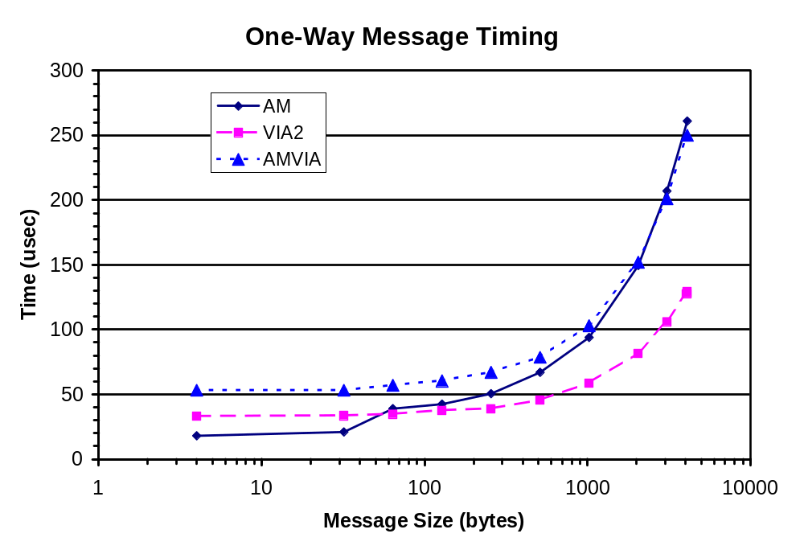

Slide 11
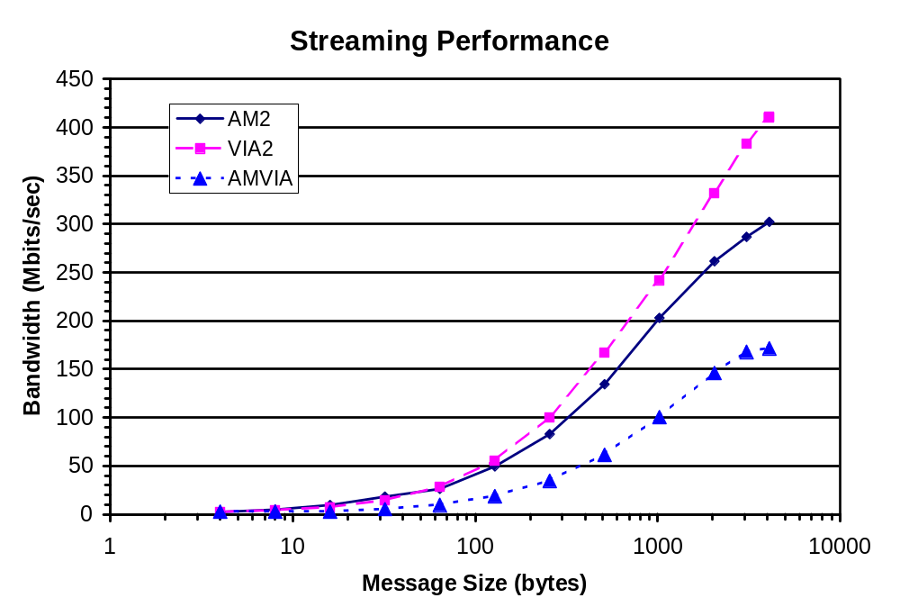

Slide 12
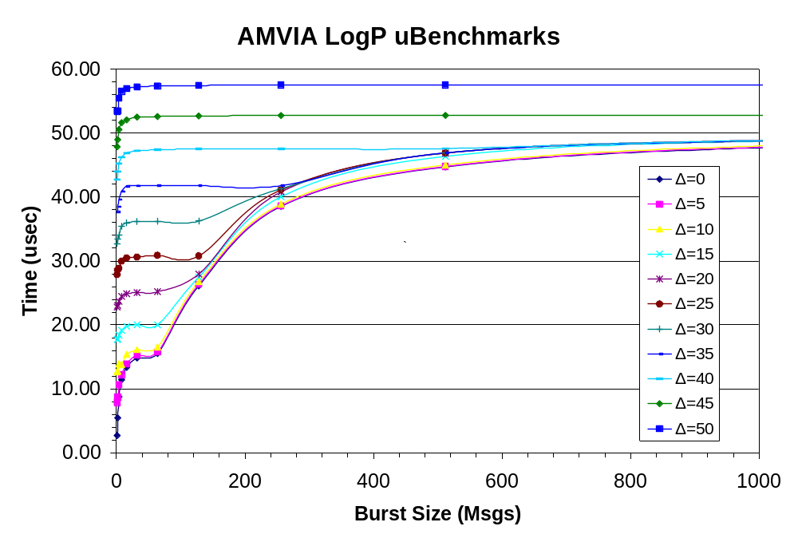

Slide 13
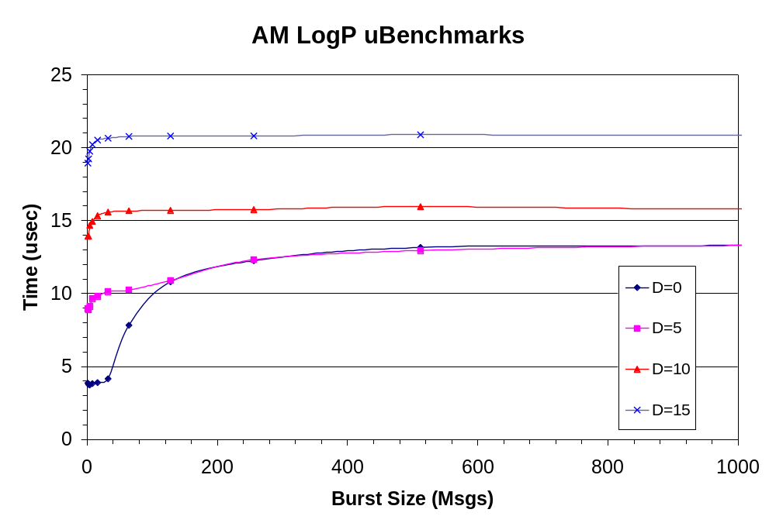

Slide 14
Design Tradeoffs
Logical Channels for Short/Medium/Long messages
  Balances resources (VI’s, buffering) and reliability
  Fine grained credit scheme
  Requires advanced knowledge of reply size.
  Requires request-reply marshalling upon receipt
Data Copying
  Simplest/Robust means to buffer management
  Zero copy on medium receives requires k+1 buffering.
Completion Queue/Bundle
  Straightforward implementation of bundle
  May overflow on high communication volume
  Prevents endpoint migration

Slide 15
Reflections
AMVIA Implementation
  Robust. Works for wide variety of AM applications
  Performance suffers due to subtle architectural differences
VI Architecture shortcomings
  Lack of support for mapping a VI to a user context
  VI Naming complicates IPC on the same host
Active Message shortcomings
  Memory Ownership semantics prevent true zero-copy for medium messages
Both benefit from some direct hardware support
  VIA: Hardware doorbell management
  AM: Distinction of request/reply messages

Slide 16
Split-C
C-based shared address space, parallel language
Distributed memory, explicit global pointers
Split-phase global read/writes:
l := r r :- l
r := l
sync() store_sync()
process
address
Process 0
1
0xdeadbeef
(__)
(oo)
/-------\/
/ | ||
* ||----||
~~ ~~
Process 1

Slide 17
Implementing Split-C
Split-C implemented as a modified gcc compiler
Split-phase reads, writes translated to library calls
  Just need to implement a library
Essential library calls:
    get char sync
    put int + bulk store_sync
    store ...
Four implementations:
  Split-C over AMVIA
  Split-C over reliable VIA
  Split-C over unreliable VIA
  Split-C over shared memory + AMVIA
x

Slide 18
Split-C over AMVIA
Process 0
Process 1
Establish connection between every pair of processes
Simple requests/replies to implement get, put, store, e.g.:
  p0: get(loc, <0x1, 0xbeef>)
  request "get"(1, loc, 0xbeef) p1
  p0 continues program execution
(__)
(oo)
/-------\/
/ | ||
* ||----||
~~ ~~
Process 2
AM connection

Slide 19
Split-C over AMVIA
Process 0
Process 1
Establish connection between every pair of processes
Simple requests/replies to implement get, put, store, e.g.:
  p0: get(loc, <0x1, 0xbeef>)
  request "get"(1, loc, 0xbeef) p1
  p0 continues program execution
  p1: receive request "get"(…)
  reply "getr"(loc, a-cow) p0
(__)
(oo)
/-------\/
/ | ||
* ||----||
~~ ~~
(__)
(oo)
/-------\/
/ | ||
* ||----||
~~ ~~
Process 2
AM connection

Slide 20
Split-C over AMVIA
Process 0
Process 1
Establish connection between every pair of processes
Simple requests/replies to implement get, put, store, e.g.:
  p0: get(loc, <0x1, 0xbeef>)
  request "get"(1, loc, 0xbeef) p1
  p0 continues program execution
  p1: receive request "get"(…)
  reply "getr"(loc, a-cow) p0
  p0: receive reply "getr"(…)
  store cow at loc
(__)
(oo)
/-------\/
/ | ||
* ||----||
~~ ~~
(__)
(oo)
/-------\/
/ | ||
* ||----||
~~ ~~
Process 2
AM connection

Slide 21
Split-C over Reliable VIA
Goal: Reduce send and receive overhead for Split-C operations
Method 1: Specialise AMVIA for Split-C library
  support only short, medium messages
  remove all dynamic dispatch (AM calls, handler dispatch)
  reduce message size
Method 2: Allow reply-free requests (for stores)
  reply to every nth store request, rather than every one
  n = 1/4 of maximum credits

Slide 22
Split-C over Unreliable VIA
Replace request/reply mechanism of Split-C over reliable VIA
Sliding-window + credit-based protocol
Acknowledge processed requests/replies
  reply-free requests handled automatically
Timeouts detected in polling routine (unimplemented)
Ack
Process
Request
99
99
100
100
1
2
3
Stores
Request
Process
Ack
100
101
1
2
3
0
3

Slide 23
Split-C over Shared Memory
How can two processes on the same host communicate?
  Loopback through network
  Multi-Protocol VIA
  Multi-Protocol AM
  Shared Memory Split-C
Each process maps the address space of every other process on the same host into its own.
Heap is allocated with Sys V IPC Shared Memory.
Data segment is mmapped via /proc file system.
Stack is too dynamic to map.
Address Spaces on Host mm4.millennium.berkeley.edu
P1’s view of Process 2
P2’s view of Process 1
Process 1 Local Memory
Process 2 Local Memory
P1’s address space
P2’s address space

Slide 24
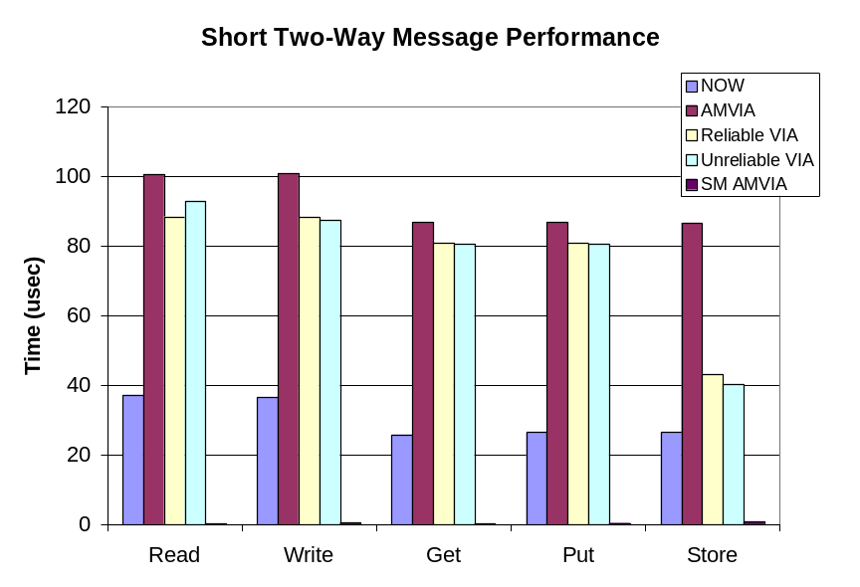
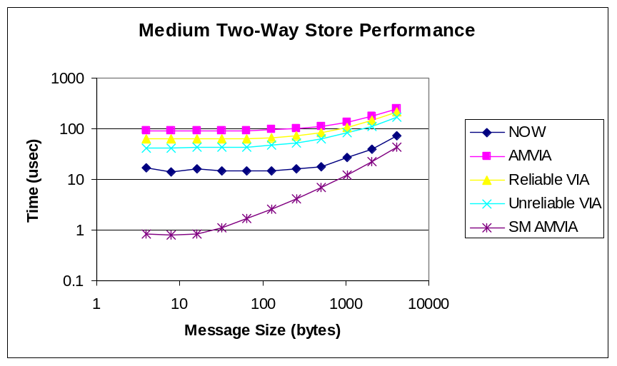
Split-C Microbenchmarks
Split-C Store Performance (Short and Bulk Messages)
(smaller numbers are better)

Slide 25
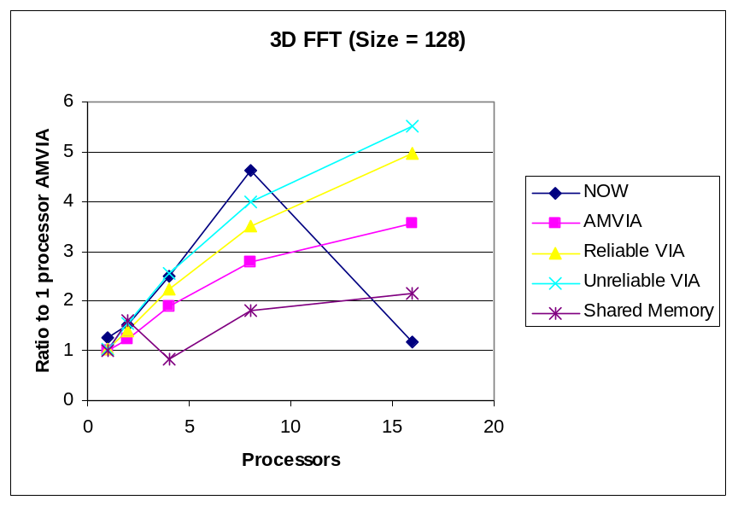
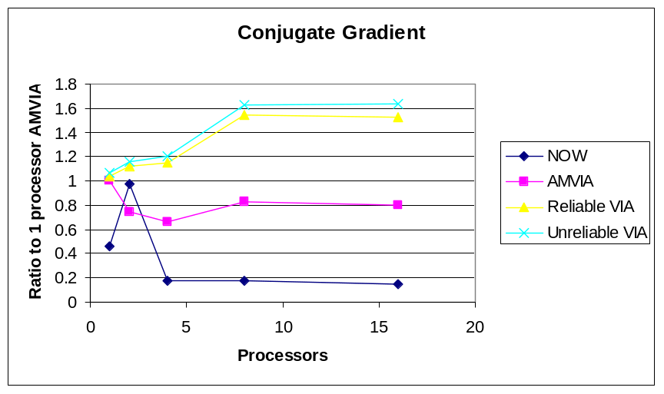
Split-C Application Benchmarks
Figure : Split-C application performance (bigger is better)

Slide 26
Reflections
The specialization of the communications layer for Split-C reduced send and receive overhead.
This overhead reduction appears to correlate with increased application performance and scaling.
Sharing a process’s address space should be much easier than it is in Linux.

Slide 28
AM(v2) Architecture
Components
  Endpoints
reply_hndlr_a()
reply_hndlr_b()
request_hndlr_a()
request_hndlr_b()
...
...
Network

Slide 29
AM(v2) Architecture
Components
  Endpoints
  Virtual Networks
Proc A
Proc B
Proc C

Slide 30
AM(v2) Architecture
Components
  Endpoints
  Virtual Networks
  Bundles
Proc A
Proc B
Proc C

Slide 31
AM(v2) Architecture
Components
  Endpoints
  Virtual Networks
  Bundles
Operations
  Request / Reply
    Short, Med, Long
  Create, Map, Free
  Poll, Wait
Credit based flow control
Proc A
Proc B
Proc C

Slide 32
Active Messages
Split-phase remote procedure calls
  Concept: Overlap communication/computation
Proc A
Proc B
Request
Request Handler
Reply
Reply Handler

