Slide 1

Tools and Analyses for Ambiguous Input Streams
Andrew Begel and Susan L. Graham
University of California, Berkeley
LDTA Workshop - April 3, 2004

Slide 2
Harmonia:
Language-aware Editing
Programming by Voice
  Code dictation
  Voice-based editing commands
Program Transformations
  Transformation actions
  Pattern-matching constructs

Slide 3
Harmonia:
Language-aware Editing
Programming by Voice
  Code dictation
  Voice-based editing commands
Program Transformations
  Transformation actions
  Pattern-matching constructs
Human Speech

Slide 4
Harmonia:
Language-aware Editing
Programming by Voice
  Code dictation
  Voice-based editing commands
Program Transformations
  Transformation actions
  Pattern-matching constructs
Human Speech
Embedded
Languages

Slide 5
Harmonia:
Language-aware Editing
Programming by Voice
  Code dictation
  Voice-based editing commands
Program Transformations
  Transformation actions
  Pattern-matching constructs
Human Speech
Embedded
Languages
Each kind of input stream ambiguity requires new language analyses

Slide 6
Speech Example
for int i equals zero i less than ten i plus plus
for (int i = 0; i < 10; i++ ) {

}

Slide 7
Ambiguities
4 int eye equals 0 aye less then 10 i plus plus
for (int i = 0; i < 10; i++ ) {

}

Slide 8
Ambiguities
ID Spelling?
KW or ID?
KW or #?
4 int eye equals 0 aye less then 10 i plus plus
for (int i = 0; i < 10; i++ ) {

}

Slide 9
Another Utterance
for times ate equals zero two plus equals one

Slide 10
Many Valid Parses!
for times ate equals zero two plus equals one
for (times; ate == 0; to += 1) {

}
4 * 8 = zero; to += won 
fore.times(8).equalsZero(2, plus == 1) 

Slide 11
Embedded Language Example
C and Regexps embedded in Flex
Flex Rule for Identifiers
[_a-zA-Z]([_a-zA-Z0-9])* i++; RETURN_TOKEN(ID);

Slide 12
Embedded Language Example
C and Regexps embedded in Flex
Flex Rule for Identifiers
[_a-zA-Z]([_a-zA-Z0-9])* i++; RETURN_TOKEN(ID);
Why not this interpretation?
[_a-zA-Z]([_a-zA-Z0-9])* i++; RETURN_TOKEN(ID);

Slide 13
Legacy Language Example
Fortran
  DO 57 I = 3,10

Slide 14
Legacy Language Example
Fortran
Do Loop
  DO 57 I = 3,10

Slide 15
Legacy Language Example
Fortran
Do Loop
  DO 57 I = 3,10
  DO 57 I = 3

Slide 16
Legacy Language Example
Fortran
Do Loop
  DO 57 I = 3,10
Assignment
  DO 57 I = 3

Slide 17
Legacy Language Example
Fortran
Do Loop
  DO 57 I = 3,10
Assignment
  DO57I = 3

Slide 18
Legacy Language Example
PL/I
Non-reserved Keywords
  IF IF = THEN
    THEN THEN = ELSE
    ELSE ELSE = END
    END

Slide 19
Legacy Language Example
PL/I
Non-reserved Keywords
  IF IF = THEN
    THEN THEN = ELSE
    ELSE ELSE = END
    END
ID
ID
KW
ID

Slide 20
Input Stream Classification
 | Single Spelling | Multiple Spellings
Single Lexical Category | Unambiguous | Homophone IDs Lexical misspellings
Multiple Lexical Categories | Non-reserved keywords Ambiguous interpretations | Homophones

Slide 21
Input Stream Classification
 | Single Spelling | Multiple Spellings
Single Lexical Category | Unambiguous | Homophone IDs Lexical misspellings
Multiple Lexical Categories | Non-reserved keywords Ambiguous interpretations | Homophones
Embedded Languages Fall in all Four Categories!

Slide 22
GLR Analysis Architecture
for (i = 0; i < 10; i++ ) {

}
Lexer
GLR
Parser
Semantics
FOR
(
I
FOR I

Slide 23
GLR Analysis Architecture
for (i = 0; i < 10; i++ ) {

}
Handles syntactic ambiguities
Lexer
GLR
Parser
Semantics
FOR
(
I
FOR I

Slide 24
Our Contribution:
XGLR Analysis Architecture
for i equals zero ...
Lexer
XGLR
Parser
Semantics
FOR
I
FOR I

Slide 25
Our Contribution:
XGLR Analysis Architecture
for i equals zero ...
Handles input stream ambiguities
Lexer
XGLR
Parser
Semantics
FOR
I
FOR I
4
EYE

Slide 26
LR Parsing
Parse Stack
Input Stream
1
FOR
I
=
0
KW
ID
KW
#
Parse Table
 | ID | KW | #
1 | S2 | S3 | Err
2 | R1 | S4 | Err
3 | S9 | R3 | S7

Slide 27
LR Parsing
Parse Stack
Input Stream
1
FOR
I
=
0
KW
ID
KW
#
Parse Table
 | ID | KW | #
1 | S2 | S3 | Err
2 | R1 | S4 | Err
3 | S9 | R3 | S7

Slide 28
LR Parsing
Parse Stack
Input Stream
1
FOR
3
I
=
0
KW
ID
KW
#
Parse Table
 | ID | KW | #
1 | S2 | S3 | Err
2 | R1 | S4 | Err
3 | S9 | R3 | S7

Slide 29
GLR Parsing
Parse Stack
Input Stream
FOR
I
=
0
KW
ID
KW
#
1
Parse Table
 | ID | KW | #
1 | S2 | S3 R5 | Err
2 | R1 R2 | S4 | Err
3 | S9 | R3 | S7

Slide 30
GLR Parsing
Parse Stack
Input Stream
FOR
I
=
0
KW
ID
KW
#
1
Parse Table
 | ID | KW | #
1 | S2 | S3 R5 | Err
2 | R1 R2 | S4 | Err
3 | S9 | R3 | S7

Slide 31
GLR Parsing
Parse Stack
Input Stream
FOR
I
=
0
2
KW
ID
KW
#
5
1
Parse Table
 | ID | KW | #
1 | S2 | S3 R5 | Err
2 | R1 R2 | S4 | Err
3 | S9 | R3 | S7

Slide 32
GLR Parsing
Parse Stack
Input Stream
I
=
0
2
FOR
4
ID
KW
#
5
KW
1
FOR
3
Parse Table
KW
 | ID | KW | #
1 | S2 | S3 R5 | Err
2 | R1 R2 | S4 | Err
3 | S9 | R3 | S7

Slide 33
XGLR in Action
 | Single Spelling | Multiple Spellings
Single Lexical Category | Not Shown | Example 1
Multiple Lexical Categories | Example 2 | Example 1

Slide 34
Parsing Homophones
23
FOR
BAR

Slide 35
XGLR Extension: Multiple Spellings,
Single and Multiple Lexical Categories
FOUR
FORE
ID
23
FOR
BAR
KW
4
NUM

Slide 36
XGLR Extension: Parsers fork due to input ambiguity
FOUR
23
FORE
ID
23
FOR
BAR
KW
23
4
NUM

Slide 37
Each parser shifts its now unambiguous input
FOUR
23
FORE
26
ID
23
FOR
29
BAR
KW
23
4
35
NUM

Slide 38
The next input is lexed unambiguously
FOUR
23
FORE
26
ID
23
FOR
29
BAR
KW
ID
23
4
35
NUM

Slide 39
ID is only a valid lookahead for two parsers
FOUR
23
FORE
26
49
ID
23
FOR
29
BAR
42
KW
ID
23
4
35
NUM

Slide 40
Parsing Embedded Languages
Example BNF Grammar
Contains Languages L and W
      b_{L} → loop_{L} d_{W} END_{L}
      loop_{L} → LOOP_{L} | ε
      d_{W} → WHILE_{W} NUM_{W} do_{W}
      do_{W} → DO_{W} | ε
L
W

Slide 41
Parsing Embedded Languages
Example BNF Grammar
Contains Languages L and W
      b_{L} → loop_{L} d_{W} END_{L}
      loop_{L} → LOOP_{L} | ε
      d_{W} → WHILE_{W} NUM_{W} do_{W}
      do_{W} → DO_{W} | ε
LOOP WHILE 34 END WHILE 56 DO END
L
W

Slide 42
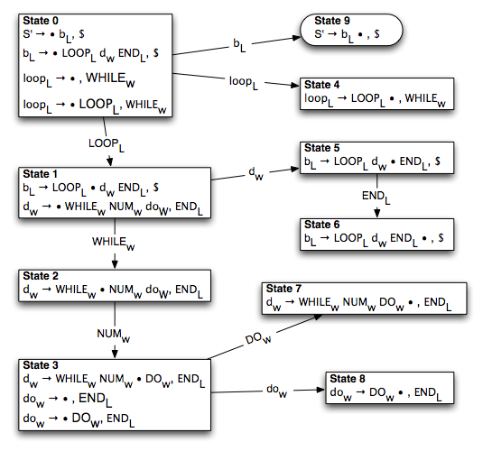

Slide 43
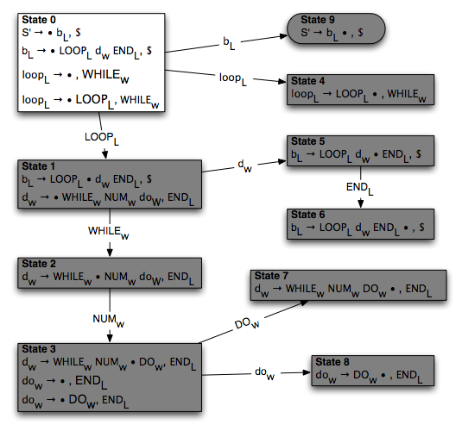

Slide 44
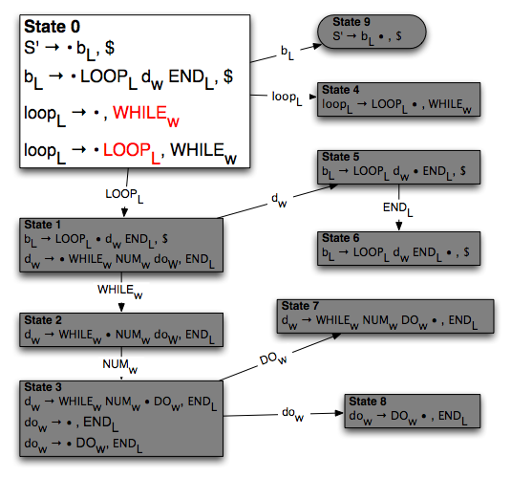

Slide 45
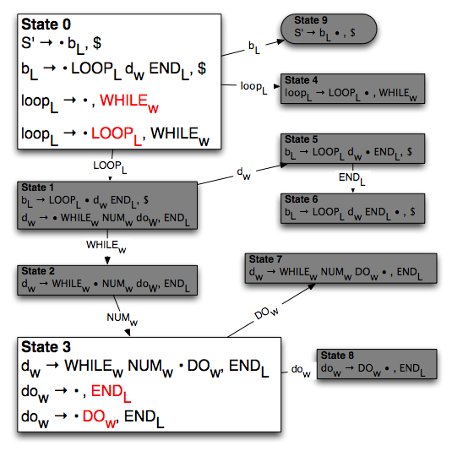

Slide 46
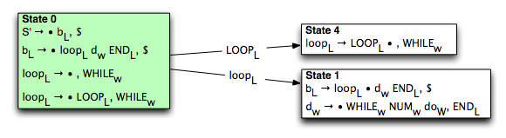
Parsing Embedded Languages
S
0
LOOP
WHILE
34

Slide 47
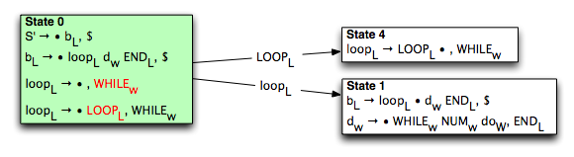
S
0
LOOP
WHILE
34
Current parse state has ambiguous lexical language

Slide 48
L
0
S
LOOP
WHILE
34
W
0
XGLR Extension: Fork parsers, assign one to each
lexical language

Slide 49
L
L
0
LOOP
KW
S
WHILE
34
W
W
0
LOOP
ID
XGLR Extension: Single spelling, Multiple lexical categories
Lex lookahead both in language L and W

Slide 50
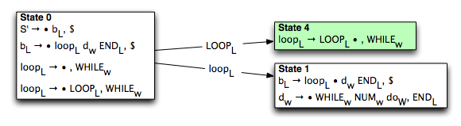
L
L
L
0
LOOP
4
KW
S
WHILE
34
W
W
0
LOOP
ID
Only LOOP_{L} is valid lookahead, and is shifted

Slide 51
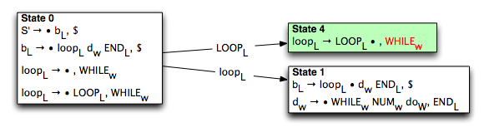
L
L
W
0
LOOP
4
KW
S
WHILE
34
W
W
0
LOOP
ID
XGLR Extension: State 4 has lexer lookaheads
only in language W

Slide 52
L
L
W
W
0
LOOP
4
WHILE
KW
KW
S
34
W
W
0
LOOP
ID
Lex lookahead in language W

Slide 53
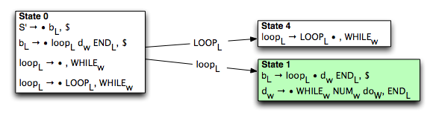
W
1
L
loop
L
L
W
W
0
LOOP
4
WHILE
KW
KW
S
34
W
W
0
LOOP
ID
REDUCE by rule 2 and GOTO state 1

Slide 54
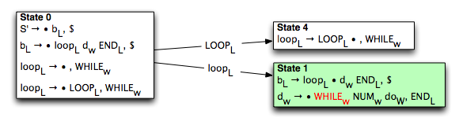
W
W
1
WHILE
L
KW
loop
L
L
W
0
LOOP
4
KW
S
34
W
W
0
LOOP
ID

Slide 55
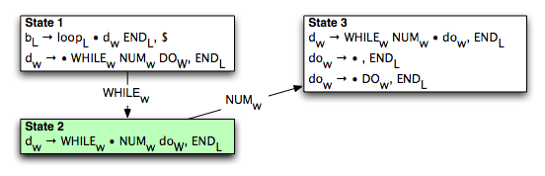
W
W
W
1
WHILE
2
L
KW
loop
L
L
W
0
LOOP
4
KW
S
34
W
W
0
LOOP
ID
Shift into state 2

Slide 56

W
W
W
1
WHILE
2
L
KW
loop
L
L
W
0
LOOP
4
KW
W
S
34
W
W
NUM
0
LOOP
ID
XGLR Extension: Lex lookahead in language W

Slide 57
W
W
W
W
1
WHILE
2
34
L
KW
NUM
loop
L
L
W
0
LOOP
4
KW
S
W
W
0
LOOP
ID

Slide 58
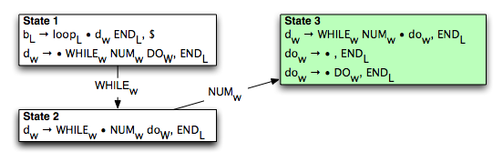
W
W
W
W
W
1
WHILE
2
34
3
L
KW
NUM
loop
L
L
W
0
LOOP
4
KW
S
W
W
0
LOOP
ID
Shift into state 3

Slide 59
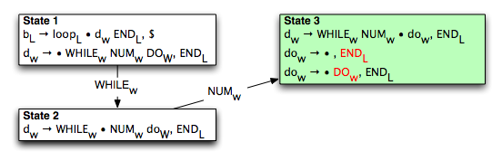
W
W
W
W
W
1
WHILE
2
34
3
L
KW
NUM
loop
L
L
W
0
LOOP
4
KW
S
W
W
0
LOOP
ID
Shift into state 3, which has ambiguous lexical language

Slide 60
W
W
W
W
W
1
WHILE
2
34
3
L
KW
NUM
loop
L
3
L
L
W
0
LOOP
4
KW
S
W
W
0
LOOP
ID
XGLR Extension: Single spelling, Multiple lexical categories
Fork parsers, assign one to each lexical language

Slide 61
GLR Ambiguity Support
Fork parser on shift-reduce conflict
Fork parser on reduce-reduce conflict

Slide 62
XGLR Ambiguity Support
Fork parser on shift-reduce conflict
Fork parser on reduce-reduce conflict

Slide 63
XGLR Ambiguity Support
Fork parser on shift-reduce conflict
Fork parser on reduce-reduce conflict
Fork parsers on ambiguous lexical language
  Single spelling, Multiple lexical categories
Fork parsers on ambiguous lexical lookahead
  Single/Multiple Spellings, Multiple lexical categories
  Shift-shift conflict resolution

Slide 64
XGLR Ambiguities
Many GLR programming language specs have finite, few ambiguities
XGLR language specs also have finite, but slightly more, ambiguities
  Lexical ambiguity due to ambiguous input does result in more ambiguous parse forests

Slide 65
XGLR Ambiguities
Many GLR programming language specs have finite, few ambiguities
XGLR language specs also have finite, but slightly more, ambiguities
  Lexical ambiguity due to ambiguous input does result in more ambiguous parse forests
Ambiguity causes parsers to fork
GLR maintains efficiency by merging parsers when ambiguity is over

Slide 66
Parser Merging
GLR: Parsers merge when in same parse state
8
DO
5
KW
5
57
#
1
DO
3
KW

Slide 67
Parser Merging
GLR: Parsers merge when in same parse state
8
DO
5
57
4
KW
#
5
1
DO
3
57
KW
#

Slide 68
Parser Merging
XGLR: Parsers merge when in same parse state and same lexical state
A
A
W
8
DO
5
KW
A
57
5
#
A
A
A
1
DO
3
KW

Slide 69
Parser Merging
XGLR: Parsers merge when in same parse state and same lexical state
A
A
W
W
8
DO
5
57
KW
#
A
5
A
A
A
A
1
DO
3
57
KW
#

Slide 70
Parser Merging
XGLR: Parsers merge when in same parse state and same lexical state
A
A
W
W
W
8
DO
5
57
4
KW
#
A
5
A
A
A
A
1
DO
3
57
KW
#

Slide 71
Parser Merging
XGLR: Parsers merge when in same parse state and same lexical state
A
A
W
W
A
8
DO
5
57
4
KW
#
A
5
A
A
A
A
1
DO
3
57
KW
#

Slide 72
Parser Merging
XGLR: Parsers merge when in same parse state and same lexical state
A
A
W
W
A
8
DO
5
57
4
KW
#
A
5
A
A
A
A
1
DO
3
57
KW
#

Slide 73
Out of Sync Parsers
XGLR: Parsers merge when in same parse state and same lexical state and same input position
W
8
A
5
DO57I=3
A
1

Slide 74
Out of Sync Parsers
XGLR: Parsers merge when in same parse state and same lexical state and same input position
W
W
8
DO57I
=3
ID
A
5
A
A
1
DO
57I=3
KW

Slide 75
Out of Sync Parsers
XGLR: Parsers merge when in same parse state and same lexical state and same input position
W
W
W
8
DO57I
5
=3
ID
A
5
A
A
A
1
DO
3
57I=3
KW

Slide 76
Out of Sync Parsers
XGLR: Parsers merge when in same parse state and same lexical state and same input position
W
W
W
W
8
DO57I
5
=
3
ID
KW
A
5
A
A
A
A
1
DO
3
57
I=3
KW
ID

Slide 77
Out of Sync Parsers
XGLR: Parsers merge when in same parse state and same lexical state and same input position
W
W
W
W
W
8
DO57I
5
=
6
3
ID
KW
A
5
A
A
A
A
A
1
DO
3
57
4
I=3
KW
ID

Slide 78
Out of Sync Parsers
XGLR: Parsers merge when in same parse state and same lexical state and same input position
W
W
W
W
W
W
8
DO57I
5
=
6
3
ID
KW
#
A
5
A
A
A
A
A
A
1
DO
3
57
4
I
=3
KW
ID
ID

Slide 79
Out of Sync Parsers
XGLR: Parsers merge when in same parse state and same lexical state and same input position
W
W
W
W
W
W
W
8
DO57I
5
=
6
3
9
ID
KW
#
A
5
A
A
A
A
A
A
1
DO
3
57
4
I
=3
KW
ID
ID

Slide 80
Out of Sync Parsers
XGLR: Parsers merge when in same parse state and same lexical state and same input position
W
W
W
W
W
W
W
8
DO57I
5
=
6
3
9
ID
KW
#
A
5
A
A
A
A
A
A
1
DO
3
57
4
I
=3
KW
ID
ID

Slide 81
Implementation
Keep map: lookahead → parser to use when looking for parsers to merge with
Sort parsers by position of lookahead in the input
  Enables pruning of map as parsers move past a particular input location
  Extra memory required is bounded by dynamic separation between first and last parsers

Slide 82
Related Work
GLR Parsing Algorithm
  Tomita [1985]
  Farshi [1991]
  Rekers [1992]
  Johnstone et. al. [2002]
Incremental GLR
  Wagner [1997]
GLR Implementations
(that I heard of before today)
  ASF+SDF [1993]
  Elkhound [2004]
  Bison [2003]
  DParser [2002]
  Aycock and Horspool [1999]
Scannerless Parsing
(or Context-Free Scanning)
  Salomon and Cormack [1989]
  Visser [1997]
  van den Brand [2002]
Ambiguous Input Streams
  Aycock and Horspool [2001]
Embedded Languages
  ASF+SDF [1997]
  Van de Vanter and Boshernitsan
  (CodeProcessor) [2000]

Slide 83
Future Work
Semantic Analysis of Embedded Languages
Automated Semantic Disambiguation

Slide 84
Contributions
Generalized GLR to handle input stream ambiguities
Classified input stream ambiguities into four categories
Implemented XGLR algorithm in Harmonia framework
Constructed combined lexer and parser generator to support embedded languages and lexical ambiguities at each stage of analysis
Enabled analysis of embedded languages, programming by voice, and legacy languages

