Slide 1
Spoken Language Support for Software Development
Andrew Begel
Advisor: Susan L. Graham
Computer Science Division, EECS
University of California, Berkeley
Notes:
Broader research goal in building tools for programmers to improve productivity and
access. Study programmers first and build tools second. and then build analyses to support tools
People spend a lot of time developing software.
There’s a continuing demand for more people.
Make people more productive. b. Enlarge the pool of developers.
1b. Better education and helping people with disabilities
1a. To serve community requires understanding of PL, SE and HCI.

Slide 2
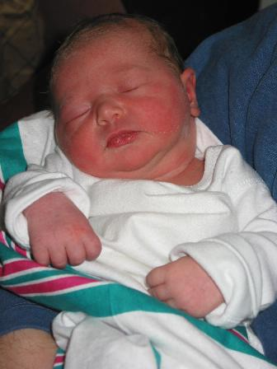
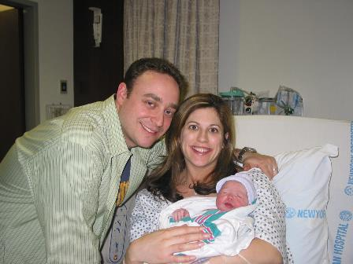
Devon Renee Fuchs - Age 0
Born: 12:01 am March 9, 2004
Weight: 7 lbs 3.5 oz.

Slide 3
Interactive Software Development
Human-Computer
Interaction
Programming
Languages
Human-Centric
Software Tools
Software Engineering
Notes:
i have background in each of these areas, my research lies in the center of all of them.

Slide 4
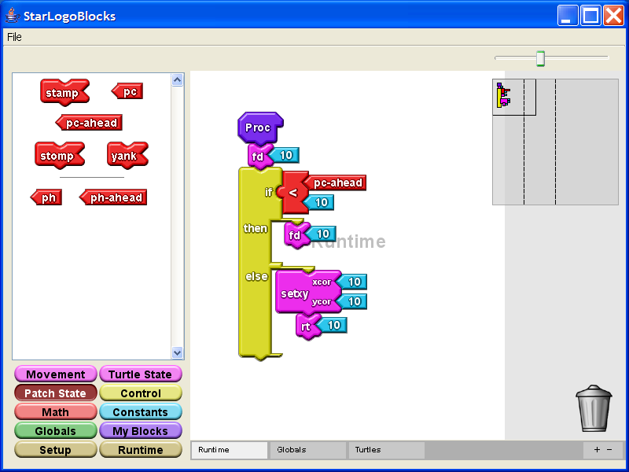
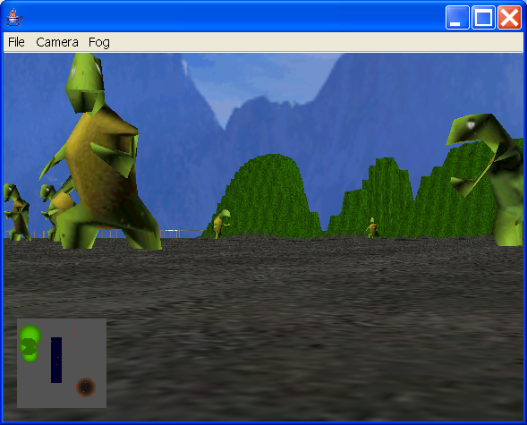
CS Education Projects
StarLogo TNG: Game Construction Kit

Slide 5

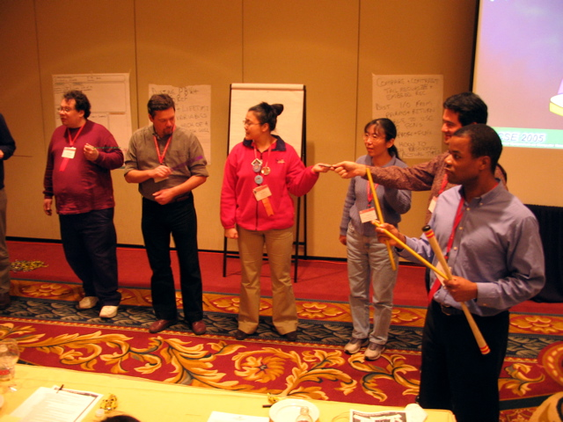
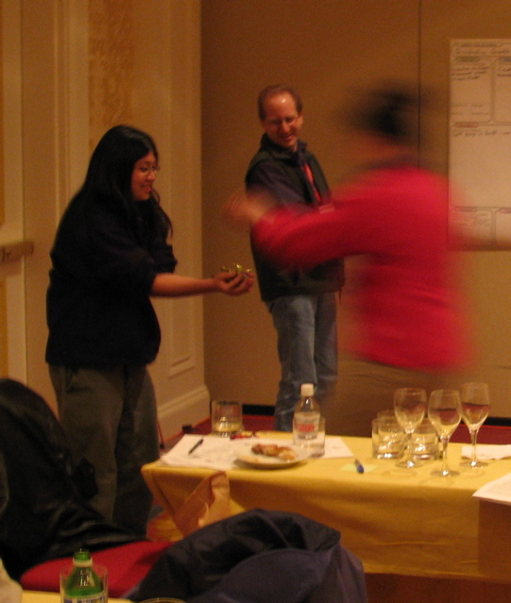
CS Education Projects
inesthetic
earning
ctivities

Slide 6
Motivation
while (counter < limit) {

}
Programmers conventionally use keyboard
  Long hours at keyboard leads to higher risk of RSI
Can speech-based programming be an alternative?
Combines an unambiguous domain (programming) with an inherently ambiguous input modality (speech)
  Great for exploring ambiguity handling in a new context (e.g. [Mankoff 00])
Notes:
Keyboard is unambiguous. Computers lacked processing power to do the work
people are the precious resource. we need to make the computers resolve the ambiguities
for us. not we for them.
addresses ambiguity and RSI. is a playpen to explore ambiguity.
Mankoff Ambiguity mediators, bring amibugity throughout system.

Slide 7
Programming by Voice
while counter is less
than limit do ...
My Goal
  Find out how developers use code verbally. Use this to develop a naturally verbalizable input form.
  Build development environment that supports verbal authoring, navigation, modification.
    Extend conventional compiler analyses to support ambiguities generated by speech.
  Learn how developers can use voice-based programming, and iterate design.
Notes:
rewritre to work with previous slide.
push on technology for ambiguity resolution and see what it’s capable of.
say human-centered again.
methodology slide

Slide 8
Challenges
Programming languages were not designed to be spoken.
Speech is inherently ambiguous. Programming tools were not designed for ambiguity.
Speech tools are poorly suited for programming tasks.
Programmers are not used to verbal software development.
Notes:
Not the best way to do things, but too hard to change, so instead we’ll modify the input to the programming language to make it easier for people.
i made progress on each of these. none of these is done yet.

Slide 9
Talk Outline
Introduction and Motivation
Programming by Voice
Program Analyses for Ambiguous Inputs
Program Navigation and Editing
Conclusion
Notes:
target 5 minutes

Slide 10
Programming by Voice
for (int i = 0; i < 10; i++ ) {
▌
}

Slide 11
Current Tools are Awkward!
VoiceCode
[Desilets 2004]
for loop … after left paren … declare india of type integer … assign zero … after semi … recall one … less than ten … after semi … recall one … increment … after left brace
1
for (▌ ; ; ) {
}
2
3
4
Notes:
Existing tools badly adapt VR to programming
(No compiler technology)
More explicitly list out loud what the awkwardness is.
Requires users to spell identifiers
VR finds small words hard to understand.
prescriptive way to enter the program
once code is in editor, it can no longer be edited by template.
code entry is over-stylized
no solution for nav and editing

Slide 12
Current Tools are Awkward!
VoiceCode
[Desilets 2004]
for loop … after left paren … declare india of type integer … assign zero … after semi … recall one … less than ten … after semi … recall one … increment … after left brace
1
i
for (int i = 0;▌ ; ) {
}
2
3
4
Notes:
More explicitly list out loud what the awkwardness is.

Slide 13
Current Tools are Awkward!
VoiceCode
[Desilets 2004]
for loop … after left paren … declare india of type integer … assign zero … after semi … recall one … less than ten … after semi … recall one … increment … after left brace
1
i
for (int i = 0; i < 10;▌ ) {
}
2
3
4
Notes:
More explicitly list out loud what the awkwardness is.

Slide 14
Current Tools are Awkward!
VoiceCode
[Desilets 2004]
for loop … after left paren … declare india of type integer … assign zero … after semi … recall one … less than ten … after semi … recall one … increment … after left brace
1
i
for (int i = 0; i < 10; i++ ) {
▌
}
2
3
4
Notes:
More explicitly list out loud what the awkwardness is.
explain that template disappears and explain what it is (behind the scenes)

Slide 15
Programming by Voice Related Work
Multiple
Tasks
Begel ‘05
Arnold ‘00
Snell ‘00
Desilets ‘01 ‘04
Price ‘00 ‘02
Authoring
Only
Gray ‘03
Computer-Centric
Human-Centric
Notes:
My goal is to create a solution that is both complete and human-centric
complete in that it enables authoring, navigation, and editing.
Human centric in that the machine adapts to the programmer.
Everyone knows this is important work
but no one has accomplished it yet. My work
goes the farthest

Slide 16
How do Programmers Speak Code?
10 programmers read Java code out loud
Most programmers spoke the same way
But, there were some interesting differences...

Slide 17
How do Programmers Speak Code?
Awkwardness by Design (Structural)
(int)foo
(3 + 5) * 7
Notes:
“Think about how to say this”

Slide 18
How do Programmers Speak Code?
Individual Inconsistency
System.out.println vs.
System out println
bar sub i vs.
bar of i vs.
i from bar

Slide 19
How do Programmers Speak Code?
Native English speakers vs.
non-native speakers (Pronunciation)
tur vs. t u r
println
array[i++] vs. array[i]++

Slide 20
A More Natural Way to Code
for int i equals zero i less than ten i plus plus
for (int i = 0; i < 10; i++ ) {
▌
}
Notes:
Didn’t have to verbalize parens, semicolons, etc.

Slide 21
Too Many Ambiguities
for int i equals zero i less than ten i plus plus
Spelling of ID?
KW or ID?
KW or #?
4 int eye equals 0 aye less then ten i plus plus
for (int i = 0; i < 10; i++ ) {
▌
}
Notes:
A human could eyeball this.

Slide 22
Sometimes It’s Non-Obvious
for times equals 8 file 2 load times equals one
for (times = 8; file(2, load); times == one) {
▌
}
fore *= 8; file.tooLode.times = won ▌
4; times = ate(file).to(load).equals(1) ▌

Slide 23
Design Tradeoffs
Command
Language
Natural
Language
Programming
by Voice
Easy to analyze,
but prescriptive
Flexible,
but ambiguous

Slide 24
Spoken Java
Semantically identical to Java
Syntactically easier to say than Java
  Methodology generalizable to any computer language
  All punctuation has English equivalents
    Open Brace, End For Loop
  Most punctuation is optional
  Provide verbalization for all abbreviations
  Relaxed phrasing for better fit with English
    (int)foo ⬄ “cast foo to integer”
    foo = 6 ⬄ “set foo to 6”
    foo[i]++ ⬄ “increment the ith element of array foo”

Slide 25
SPEED: Speech Editor
Build an editor that supports naturally verbalized programs
  SPEED: SPEech EDitor
    Based on IBM ViaVoice, Eclipse IDE, Harmonia
  Spoken Java Language for Composition
  Spoken Command Language for Navigation, Editing, Template instantiation, Refactorings, Search
  Audible and visual feedback
    Similar to JavaSpeak [Smith 2000]

Slide 26
Talk Outline
Introduction and Motivation
Programming by Voice
Program Analyses for Ambiguous Inputs
Program Navigation and Editing
Conclusion
Notes:
Spoken input requires new compiler analyses
Existing analyses are not built for ambiguity
Target 25 minutes.

Slide 27
Traditional Compiler Analyses
for (i = 0; i < 10; i++ ) {

}
Programming languages are designed to be unambiguous
Lexical
Analysis
Parsing
Semantic
Analysis
For Loop
i | LocalVar | int
FOR
I
FOR
Assign Expr
I
=
0

Slide 28
Ambiguity-Aware Analyses
for i equals zero ...
Handles input stream, syntactic and semantic ambiguities
Lexical
Analysis
Ambiguous
Parsing
Semantic
Ambiguity
Resolution
Ambig Stmt

i | LocalVar | int
foureye | LocalVar | ?
FOR
I
For Loop
Assign Expr
4
EYE
FOUREYE
=
0

FOR
Assign Expr
I
=
0
Notes:
Insight here is to generalize GLR algorithm for lexical ambiguities
totally changes the algorithm.

Slide 29

Scan Input Stream
Homophone
Dictionary
Lexical
Analysis
Commercial
Speech
Recognizer
Notes:
Training the speech recognizer. HMM.

Slide 30
Homophones Cause Ambiguities
4
for
i
equals
fore
eye
four
aye
Concatenated words cause them too
for i equals
foreeye equals
foriequals
4 i equals
fore ayeequals
foureyeequals
Notes:
// Edit me

Slide 31
Ambiguity-Aware Analyses
for i equals zero ...
Lexical
Analysis
XGLR
Ambiguous
Parsing
Semantic
Ambiguity
Resolution
Ambig Stmt

i | LocalVar | int
foureye | LocalVar | ?
FOR
I
For Loop
Assign Expr
4
EYE
FOUREYE
=
0

FOR
Assign Expr
I
=
0

Slide 32
GLR Parsing [ Tomita 85 ]
Expr
Expr
IF
IF
FOO
ELSE
BAR
KW
KW
ID
KW
ID
Notes:
Expr is previously parsed. Incremental setting you’re not updating everything.
Dangling else problem.

Slide 33
GLR Parsing [ Tomita 85 ]
Expr
Expr
IF
IF
FOO
ELSE
BAR
KW
KW
ID
KW
ID

Slide 34
GLR Parsing [ Tomita 85 ]
Expr
Expr
IF
IF
FOO
ELSE
BAR
KW
KW
ID
KW
ID

Slide 35
GLR Parsing [ Tomita 85 ]
Expr
Expr
IF
IF
FOO
ELSE
BAR
KW
KW
ID
KW
ID

Slide 36
GLR Parsing [ Tomita 85 ]
Expr
Expr
IF
IF
FOO
ELSE
BAR
KW
KW
ID
KW
ID

Slide 37
GLR Parsing [ Tomita 85 ]
Expr
Expr
IF
IF
FOO
ELSE
BAR
KW
KW
ID
KW
ID

Slide 38
GLR Parsing [ Tomita 85 ]
Expr
Expr
IF
IF
FOO
KW
KW
ID
Expr
Expr
IF
IF
FOO
ELSE
BAR
KW
KW
ID
KW
ID
Notes:
Why fork? - 1. There actually are two possible parses
2. Need more lookahead to figure out which parse is right.
3. Need semantics to determine which parse is right.

Slide 39
GLR Parsing [ Tomita 85 ]
Expr
Expr
IF
IF
FOO
KW
KW
ID
Stmt
Expr
Expr
IF
IF
FOO
ELSE
BAR
KW
KW
ID
KW
ID
Notes:
Why fork? - 1. There actually are two possible parses
2. Need more lookahead to figure out which parse is right.
3. Need semantics to determine which parse is right.
change Expr to Stmt.

Slide 40
GLR Parsing [ Tomita 85 ]
Expr
Expr
IF
IF
FOO
ELSE
KW
KW
ID
KW
Stmt
Expr
Expr
IF
IF
FOO
ELSE
BAR
KW
KW
ID
KW
ID

Slide 41
GLR Parsing [ Tomita 85 ]
Expr
Expr
IF
IF
FOO
ELSE
BAR
KW
KW
ID
KW
ID
Stmt
Expr
Expr
IF
IF
FOO
ELSE
BAR
KW
KW
ID
KW
ID

Slide 42
GLR Parsing [ Tomita 85 ]
Stmt
Expr
Expr
IF
IF
FOO
ELSE
BAR
KW
KW
ID
KW
ID
Stmt
Expr
Expr
IF
IF
FOO
ELSE
BAR
KW
KW
ID
KW
ID

Slide 43
GLR Parsing [ Tomita 85 ]
Stmt
Stmt
Expr
Expr
IF
IF
FOO
ELSE
BAR
KW
KW
ID
KW
ID
Stmt
Expr
Expr
IF
IF
FOO
ELSE
BAR
KW
KW
ID
KW
ID

Slide 44
GLR Parsing [ Tomita 85 ]
Stmt
Stmt
Expr
Expr
IF
IF
FOO
ELSE
BAR
KW
KW
ID
KW
ID
Stmt
Stmt
Expr
Expr
IF
IF
FOO
ELSE
BAR
KW
KW
ID
KW
ID
Notes:
Yield is identical. We do structural sharing so we don’t use up too much space.

Slide 45
GLR Ambiguity Support
Fork when there is more than one possible interpretation (tree)

Slide 46
XGLR Ambiguity Support
Fork when there is more than one possible interpretation (tree)
Fork when the lexical input is ambiguous
Notes:
forces a lot of changes to algorithm.
No longer true that all parses have the same yield.

Slide 47
XGLR Parsing [ Begel 04 ]
IF
FIFTY
FIVE
<
X
Notes:
state contributions now. so that everyone is aware of what’s coming up.

Slide 48
XGLR Parsing [ Begel 04 ]
IF
FIFTY
FIVE
<
X
KW

Slide 49
XGLR Parsing [ Begel 04 ]
IF
FIFTY
FIVE
<
X
KW

Slide 50
XGLR Parsing [ Begel 04 ]
55
<
X
#
50
5
<
X
#
#
50
FIVE
<
X
#
ID
FIFTY
5
<
X
ID
#
IF
FIFTY
FIVE
<
X
KW
ID
ID

Slide 51
XGLR Parsing [ Begel 04 ]
IF
55
<
X
KW
#
IF
50
5
<
X
KW
#
#
IF
50
FIVE
<
X
KW
#
ID
IF
FIFTY
5
<
X
KW
ID
#
IF
FIFTY
FIVE
<
X
KW
ID
ID

Slide 52
XGLR Parsing [ Begel 04 ]
IF
FIFTY
.
KW
ID
IF
FIFTY
.
KW
ID
IF
FIFTY
(
KW
ID
IF
FIFTY
(
KW
ID
IF
55
<
X
KW
#
IF
50
5
<
X
KW
#
#
IF
50
FIVE
<
X
KW
#
ID
IF
FIFTY
5
<
X
KW
ID
#
IF
FIFTY
FIVE
<
X
KW
ID
ID

Slide 53
XGLR Parsing [ Begel 04 ]
IF
FIFTY
.
5
<
X
KW
ID
#
IF
FIFTY
.
FIVE
<
X
KW
ID
ID
IF
FIFTY
(
5
<
X
KW
ID
#
IF
FIFTY
(
FIVE
<
X
KW
ID
ID
IF
55
<
X
KW
#
Op
IF
50
5
<
X
KW
#
#
IF
50
FIVE
<
X
KW
#
ID
IF
FIFTY
5
<
X
KW
ID
#
IF
FIFTY
FIVE
<
X
KW
ID
ID

Slide 54
XGLR Parsing [ Begel 04 ]
IF
FIFTY
.
5
<
X
KW
ID
#
IF
FIFTY
.
FIVE
<
X
KW
ID
ID
IF
FIFTY
(
5
<
X
KW
ID
#
IF
FIFTY
(
FIVE
<
X
KW
ID
ID
IF
55
<
X
KW
#
Op
IF
50
5
<
X
KW
#
#
IF
50
FIVE
<
X
KW
#
ID
IF
FIFTY
5
<
X
KW
ID
#
IF
FIFTY
FIVE
<
X
KW
ID
ID

Slide 55
XGLR Parsing [ Begel 04 ]
IF
FIFTY
.
5
<
X
KW
ID
#
IF
FIFTY
.
FIVE
<
X
KW
ID
ID
IF
FIFTY
(
5
<
X
KW
ID
#
IF
FIFTY
(
FIVE
<
X
KW
ID
ID
IF
55
<
X
KW
#
Op
IF
50
5
<
X
KW
#
#
IF
50
FIVE
<
X
KW
#
ID
IF
FIFTY
5
<
X
KW
ID
#
IF
FIFTY
FIVE
<
X
KW
ID
ID

Slide 56
XGLR Parsing [ Begel 04 ]
IF
FIFTY
.
FIVE
<
X
KW
ID
ID
IF
FIFTY
(
5
<
X
KW
ID
#
IF
FIFTY
(
FIVE
<
X
KW
ID
ID
IF
55
<
X
KW
#
Op

Slide 57
XGLR Parsing [ Begel 04 ]
IF
FIFTY
(
5
)
<
X
KW
ID
#
IF
FIFTY
(
FIVE
)
<
X
KW
ID
ID
IF
FIFTY
.
FIVE
.
<
X
KW
ID
ID
IF
FIFTY
.
FIVE
(
<
X
KW
ID
ID
IF
FIFTY
(
FIVE
.
<
X
KW
ID
ID
IF
FIFTY
(
FIVE
(
<
X
KW
ID
ID
IF
FIFTY
.
FIVE
<
X
KW
ID
ID
IF
FIFTY
(
5
<
X
KW
ID
#
IF
FIFTY
(
FIVE
<
X
KW
ID
ID
IF
55
<
X
KW
#
Op

Slide 58
XGLR Parsing [ Begel 04 ]
IF
FIFTY
(
5
)
<
X
KW
ID
#
Op
IF
FIFTY
(
FIVE
)
<
X
KW
ID
ID
Op
IF
FIFTY
.
FIVE
.
<
X
KW
ID
ID
Op
IF
FIFTY
.
FIVE
(
<
X
KW
ID
ID
Op
IF
FIFTY
(
FIVE
.
<
X
KW
ID
ID
Op
IF
FIFTY
(
FIVE
(
<
X
KW
ID
ID
Op
IF
FIFTY
.
FIVE
<
X
KW
ID
ID
Op
IF
FIFTY
(
5
<
X
KW
ID
#
Op
IF
FIFTY
(
FIVE
<
X
KW
ID
ID
Op
IF
55
<
X
KW
#
Op
ID

Slide 59
XGLR Parsing [ Begel 04 ]
IF
FIFTY
(
5
)
<
X
KW
ID
#
Op
IF
FIFTY
(
FIVE
)
<
X
KW
ID
ID
Op
IF
FIFTY
.
FIVE
.
<
X
KW
ID
ID
Op
IF
FIFTY
.
FIVE
(
<
X
KW
ID
ID
Op
IF
FIFTY
(
FIVE
.
<
X
KW
ID
ID
Op
IF
FIFTY
(
FIVE
(
<
X
KW
ID
ID
Op
IF
FIFTY
.
FIVE
<
X
KW
ID
ID
Op
IF
FIFTY
(
5
<
X
KW
ID
#
Op
IF
FIFTY
(
FIVE
<
X
KW
ID
ID
Op
IF
55
<
X
KW
#
Op
ID

Slide 60
XGLR Parsing [ Begel 04 ]
IF
FIFTY
(
5
)
<
X
KW
ID
#
Op
IF
FIFTY
(
FIVE
)
<
X
KW
ID
ID
Op
IF
FIFTY
.
FIVE
<
X
KW
ID
ID
Op
IF
FIFTY
(
5
<
X
KW
ID
#
Op
IF
FIFTY
(
FIVE
<
X
KW
ID
ID
Op
IF
55
<
X
KW
#
Op
ID

Slide 61
XGLR Parsing [ Begel 04 ]
IF
FIFTY
(
5
)
<
X
KW
ID
#
Op
ID
IF
FIFTY
(
FIVE
)
<
X
KW
ID
ID
Op
ID
IF
FIFTY
.
FIVE
<
X
KW
ID
ID
Op
ID
IF
FIFTY
(
5
<
X
KW
ID
#
Op
ID
IF
FIFTY
(
FIVE
<
X
KW
ID
ID
Op
ID
IF
55
<
X
KW
#
Op
ID

Slide 62
XGLR Parsing [ Begel 04 ]
IF
FIFTY
(
5
)
<
X
KW
ID
#
Op
ID
IF
FIFTY
(
FIVE
)
<
X
KW
ID
ID
Op
ID
IF
FIFTY
.
FIVE
<
X
KW
ID
ID
Op
ID
IF
FIFTY
(
5
<
X
KW
ID
#
Op
ID
IF
FIFTY
(
FIVE
<
X
KW
ID
ID
Op
ID
IF
55
<
X
KW
#
Op
ID

Slide 63
XGLR Parsing [ Begel 04 ]
IF
FIFTY
(
5
)
<
X
KW
ID
#
Op
ID
IF
FIFTY
(
FIVE
)
<
X
KW
ID
ID
Op
ID
IF
FIFTY
.
FIVE
<
X
KW
ID
ID
Op
ID
IF
FIFTY
(
5
<
X
KW
ID
#
Op
ID
IF
FIFTY
(
FIVE
<
X
KW
ID
ID
Op
ID
IF
55
<
X
KW
#
Op
ID

Slide 64
XGLR Parsing [ Begel 04 ]
IF
FIFTY
(
5
)
<
X
KW
ID
#
Op
ID
IF
FIFTY
(
FIVE
)
<
X
KW
ID
ID
Op
ID
IF
FIFTY
.
FIVE
<
X
KW
ID
ID
Op
ID
IF
FIFTY
(
5
<
X
KW
ID
#
Op
ID
IF
FIFTY
(
FIVE
<
X
KW
ID
ID
Op
ID
Expr
IF
55
<
X
KW
#
Op
ID

Slide 65
XGLR Parsing [ Begel 04 ]
Expr
FuncCall
IF
FIFTY
(
5
)
<
X
KW
ID
#
Op
ID
Expr
FuncCall
IF
FIFTY
(
FIVE
)
<
X
KW
ID
ID
Op
ID
Expr
Expr
IF
FIFTY
.
FIVE
<
X
KW
ID
ID
Op
ID
IF
FIFTY
(
5
<
X
KW
ID
#
Op
ID
IF
FIFTY
(
FIVE
<
X
KW
ID
ID
Op
ID
Expr
IF
55
<
X
KW
#
Op
ID
Notes:
Describe what semantic analysis will do for you here.
Syntactically well formed but only valid in certain cases.

Slide 66
XGLR Summary
Generalized traditional GLR algorithm
Many algorithm and engineering challenges
  New combined lexer and parser generator
  Preserve subtree sharing when parses have different yields
  Preserve efficiency when parses get out of sync
    Determine parse position w.r.t. ambiguous input
  The devil is in the details [Begel 04]

Slide 67
GLR Parsing Genealogy
Scannerless
Visser
1997
van den Brand
2002
Tomita
1985
Farshi
1991
Rekers
1992
Wagner
1997
Begel
2004
Input Stream
Ambiguities
Incremental
Johnstone et. al.
2002

Slide 68
Ambiguity-Aware Analyses
for i equals zero ...
Lexical
Analysis
XGLR
Ambiguous
Parsing
Semantic
Ambiguity
Resolution
Ambig Stmt

i | LocalVar | int
foureye | LocalVar | ?
FOR
I
For Loop
Assign Expr
4
EYE
FOUREYE
=
0

FOR
Assign Expr
I
=
0
Notes:
37 minutes in practice.
40 minutes in practice
Please be here at 35 minutes.

Slide 69
Disambiguation Example
class Loader {
public void load() {
String filetoload = null;
InputStream stream = getStream();
...
▌
}
}
file to load equals stream dot read string
filetoload = stream.readString();
Notes:
Say you don’t need to understand code (just defining a string named file to load and setting its value)
This is a Java example.
Verbally switch argument into how to do the analysis.

Slide 70
Many Interpretations
file.toload
file(to, load)
filetoload()
(file, 2, load)
file(to.lode)
filetoload
file.to(load)
file(to(lode))
file.to.load
file(toload)
file(2, load)
Notes:
Just a small number of the possibilities

Slide 71
Incremental Semantics
What does this name mean?
What names are visible at this program point?
  Or, What can I say here?
Visibility Graph [Garrison 1987]
  Language independent data structure for scopes, names and bindings
  Designed Visibility Graph algorithms for incremental update and name propagation
  Used for type checking, too
Doesn’t <insert favorite IDE here> do this?
Notes:
Lied about concatenation. It’s really done in name lookup to avoid ambiguities

Slide 72
Program Context Can Help
class Loader {
public void load() {
String filetoload = null;
InputStream stream = getStream();
...
▌
}
}
class Loader
scope
[ load, Method, ()  void ]
[ filetoload, LocalVar, String ]
[ stream, LocalVar, InputStream ]
method load
scope

Slide 73
Program Context Can Help
class Loader {
public void load() {
String filetoload = null;
InputStream stream = getStream();
...
▌
}
}
class Loader
scope
[ load, Method, ()  void ]
[ filetoload, LocalVar, String ]
[ stream, LocalVar, InputStream ]
method load
scope
[ load, Method, ()  void ]
Notes:
Name propagation moves data around the tree so that lookups are super-fast.

Slide 74
Semantic Disambiguation
class Loader
scope
[ load, Method, ()  void ]
[ filetoload, LocalVar, String ]
[ stream, LocalVar, InputStream ]
method load
scope
[ load, Method, ()  void ]
file.toload
file(to, load)
filetoload()
(file, 2, load)
file(to.lode)
filetoload
file(to(lode))
file.to(load)
file(toload)
file.to.load
file(2, load)
Notes:
Lookups need to be super fast when you are doing a lot of them for disambiguation

Slide 75
Semantic Disambiguation
class Loader
scope
[ load, Method, ()  void ]
[ filetoload, LocalVar, String ]
[ stream, LocalVar, InputStream ]
method load
scope
[ load, Method, ()  void ]
Is “file” a visible variable name?
file.toload
file(to, load)
filetoload()
(file, 2, load)
file(to.lode)
filetoload
file(to(lode))
file.to(load)
file(toload)
file.to.load
file(2, load)

Slide 76
Semantic Disambiguation
class Loader
scope
[ load, Method, ()  void ]
[ filetoload, LocalVar, String ]
[ stream, LocalVar, InputStream ]
method load
scope
[ load, Method, ()  void ]
Is “file” a visible method name?
file(to, load)
filetoload()
file(to.lode)
filetoload
file(to(lode))
file(toload)
file(2, load)

Slide 77
Semantic Disambiguation
class Loader
scope
[ load, Method, ()  void ]
[ filetoload, LocalVar, String ]
[ stream, LocalVar, InputStream ]
method load
scope
[ load, Method, ()  void ]
Is “filetoload” a visible method name?
filetoload()
filetoload
Notes:
These queries may look simple in this example, but they can be as complicated as the program itself.

Slide 78
Manual Disambiguation
Some ambiguities cannot (and should not) be automatically resolved:
print(“line”) vs. println()
if (pred1) then if (pred2) then foo() else bar()
If ambiguities remain, ask the user how to resolve them. (e.g. [Mankoff 00])
if
if
if
if
bar()
foo()
bar()
foo()

Slide 79
Talk Outline
Introduction and Motivation
Programming by Voice
Program Analyses for Ambiguous Inputs
Program Navigation and Editing
Conclusion
Notes:
45 minutes.

Slide 80
Study - Navigation by Speech
Eight navigation tasks with commercial VR tools
Search through text (w/o Find dialog), e.g.
Find the sentence where Romeo cries out about his fate after killing Tybalt.
Metrics
Time to scroll to right page
Number of commands
Number of recognition errors
Number of system mistakes
Results
Cognitive load is too high - too many commands, misestimation errors
Voice recognition induces too much delay/errors for accurate control

Slide 81
SPEED Navigation
2
class Loader {
public void load() {
String filetoload = null;
InputStream stream = getStream();
filetoload = “file.txt”;
▌
}
public void save() {
...
}
}
class MenuLoader extends Loader {
...
}
Phonetics-based subtoken search
1
3
4
5
6
find lode
Notes:
Punctuation-independent
say editing out loud at end of navgiation.

Slide 82
SPEED Navigation
class Loader {
public void load() {
String filetoload = null;
InputStream stream = getStream();
filetoload = “file.txt”; ▌
}
public void save() {
...
}
}
class MenuLoader extends Loader {
...
}
Phonetics-based subtoken search
Context-Sensitive Mouse Grid [Begel]
  Related Work: Tree Hierarchy Navigation [Smith 2004]
Notes:
Punctuation-independent

Slide 83
SPEED Navigation
1
class Loader {
public void load() {
String filetoload = null;
InputStream stream = getStream();
filetoload = “file.txt”;
▌
}
public void save() {
...
}
}
class MenuLoader extends Loader {
...
}
Phonetics-based subtoken search
Context-Sensitive Mouse Grid [Begel]
  Related Work: Tree Hierarchy Navigation [Smith 2004]
2
Notes:
Punctuation-independent

Slide 84
SPEED Navigation
class Loader {
public void load() {
String filetoload = null;
InputStream stream = getStream();
filetoload = “file.txt”;
▌
}
public void save() {
...
}
}
class MenuLoader extends Loader {
...
}
1
Phonetics-based subtoken search
Context-Sensitive Mouse Grid [Begel]
  Related Work: Tree Hierarchy Navigation [Smith 2004]
  1
2
Notes:
Punctuation-independent

Slide 85
SPEED Navigation
class Loader {
public void load() {
String filetoload = null;
InputStream stream = getStream();
filetoload = “file.txt”;
▌
}
public void save() {
...
}
}
class MenuLoader extends Loader {
...
}
Phonetics-based subtoken search
Context-Sensitive Mouse Grid [Begel]
  Related Work: Tree Hierarchy Navigation [Smith 2004]
  1 1
1
2
3
4
Notes:
Punctuation-independent

Slide 86
SPEED Navigation
class Loader {
public void load() {
String filetoload = null;
InputStream stream = getStream();
filetoload = “file.txt”;
▌
}
public void save() {
...
}
}
class MenuLoader extends Loader {
...
}
Phonetics-based subtoken search
Context-Sensitive Mouse Grid [Begel]
  Related Work: Tree Hierarchy Navigation [Smith 2004]
  1 1 3 select
Notes:
Punctuation-independent

Slide 87
SPEED Editing
class Loader {
public void load() {
String filetoload = null;
InputStream stream = getStream();
filetoload = “file.txt”;
▌
}
public void save() {
...
}
}
class MenuLoader extends Loader {
...
}
Phonetics-based subtoken search
Context-Sensitive Mouse Grid [Begel]
  Related Work: Tree Hierarchy Navigation [Smith 2004]
  edit
filetoload equals quote file.txt quote
Notes:
Punctuation-independent

Slide 88
SPEED Editing
class Loader {
public void load() {
String filetoload = null;
InputStream stream = getStream();
filetoload = “file.txt”;
▌
}
public void save() {
...
}
}
class MenuLoader extends Loader {
...
}
Phonetics-based subtoken search
Context-Sensitive Mouse Grid [Begel]
  Related Work: Tree Hierarchy Navigation [Smith 2004]
  edit
file to load equals stream dot read string
Notes:
Punctuation-independent

Slide 89
SPEED Editing
class Loader {
public void load() {
String filetoload = null;
InputStream stream = getStream();
filetoload = stream.readString();
▌
}
public void save() {
...
}
}
class MenuLoader extends Loader {
...
}
Phonetics-based subtoken search
Context-Sensitive Mouse Grid [Begel]
  Related Work: Tree Hierarchy Navigation [Smith 2004]
  put it back
file to load equals stream dot read string
Notes:
Punctuation-independent

Slide 90
Study - Compare with VoiceCode
Goal: Understand how SPEED can be used by experts and compare it with VoiceCode
Train expert Java programmers on SPEED and VoiceCode
Author new code
  Build a Linked List data structure with associated algorithms
Modify existing code
  Change abstraction representation and update algorithms
Notes:
Say this is for expert java programmers.
Rephrase system understanding (everything else is about the person, but this is about the system).
Find some terminology from AI systems evaluations (false positive rate etc)

Slide 91
Metrics
User Metrics
  Speed
  Vocabulary mistakes, Forgotten vocabulary
  Grammatical mistakes, Grammatical substitutions
SPEED Metrics
  Word tokenization errors
  Disambiguation errors
  Irresolvable ambiguities

Slide 92
Talk Outline
Introduction and Motivation
Programming by Voice
Program Analyses for Ambiguous Inputs
Program Navigation and Editing
Conclusion
Notes:
48 minutes.

Slide 93
Contributions
A study of programmers to understand and design a naturally verbalizable input for programming
An interactive editor designed for spoken interaction
The use of syntax and semantics of programming for disambiguation
  Enhanced lexical, syntactic, semantic analyses for support of verbal ambiguities
Evaluation of design and tools by studying programmers using voice for software development

Slide 94
Future of Programming by Voice
Improve automation of semantic disambiguation
  Use ideas from NLP, Machine Learning
Early pruning of ambiguities using analysis feedback
Learn individual’s programming style
Support higher-level linguistic programming
  Paraphrasing
Design spoken variants of formal languages
  Scripting (PL, OS), Design (HCI), Command (Robotics), Domain-specific languages (SQL)
Use programming by voice as platform for studies of program comprehension and expression
Study novice programmers to see if using voice can make learning to program easier

Slide 95
Future Research Directions
Data mining the program edit history
  Synthesizing high-level schemas (Machine Learning)
Commenting by voice
  Easier input (HCI)
  More frequent (SoftEng)
  Higher quality (SoftEng)
  More maintainable (NLP)
Visualizing effects of compilation and optimization
  Program visualization (HCI)

Slide 96
Any Questions?
Andrew Begel: abegel@cs.berkeley.edu

