Slide 1
USAGE AND PERCEPTIONS OF AGILE SOFTWARE DEVELOPMENT IN AN INDUSTRIAL CONTEXT
Andrew Begel, Nachiappan Nagappan
Microsoft Research
ESEM 2007
September 21, 2007

Slide 2
Agile Development is Spreading
Variety of Agile methodologies
  Scrum, Extreme Programming, Crystal, others
Research Questions
  How is Agile practiced at Microsoft?
    i.e. What do they do?
  How do engineers feel about it?
    i.e. Do they like it?
This will be a data-heavy talk.

Slide 3
What did we do?
Survey-based study
  Anonymous survey sent to 2821 engineers at Microsoft
    10% random sampling of all developers, testers, program managers at Microsoft in October 2006
  487 valid responses
    18% developers, 18% testers, 10% program managers
  Important topic to Microsoft engineers
  We offered raffle for one $250 MP3 player

Slide 4
Respondent Demographics
Average 9.20 years of professional experience
  SD: 7.06 years
Average 2.4 years in current product team
  SD: 2.5 years

Slide 5
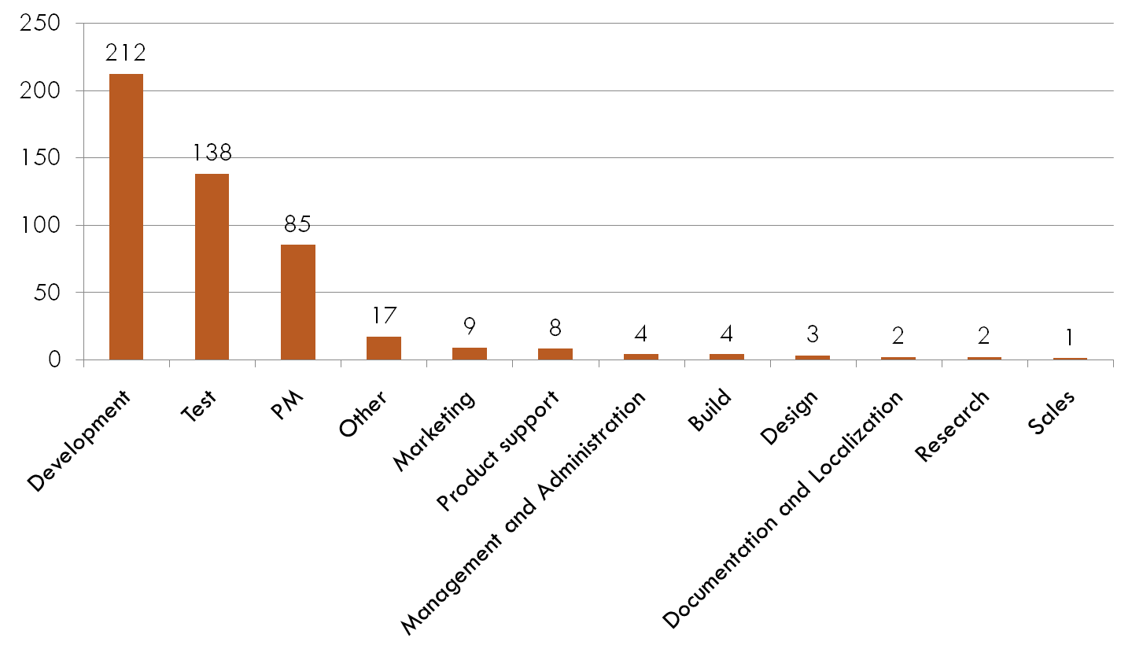
Respondent Job Area

Slide 6
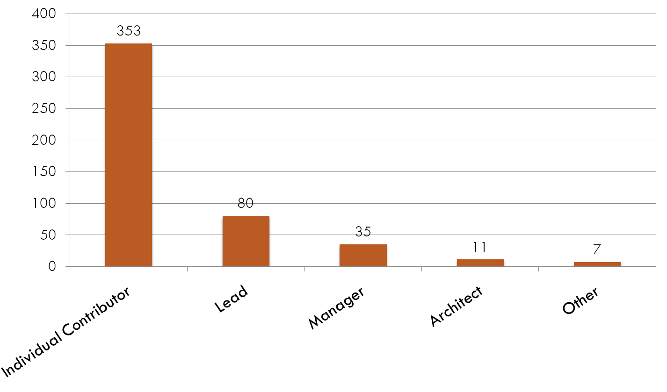
Respondent Job Role

Slide 7
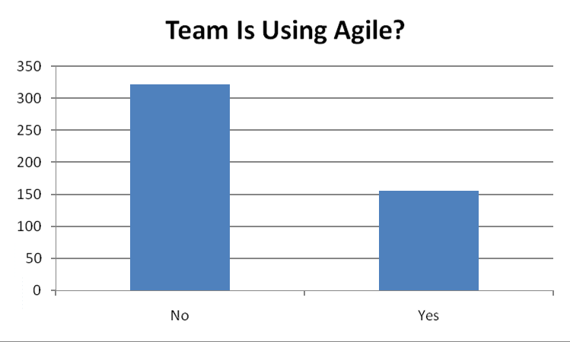
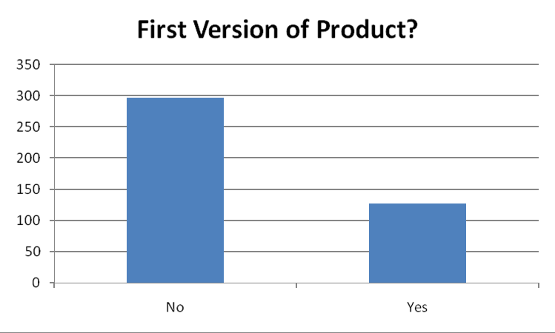
Who uses Agile?
59.6% of Agile users work on legacy (not v1) code
32% of respondents say their team uses Agile development methodologies

Slide 8
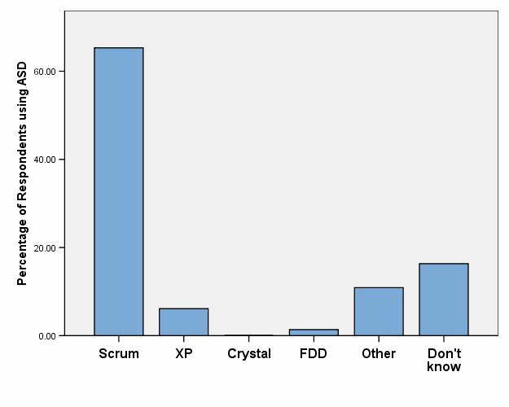
Agile Methodology

Slide 9
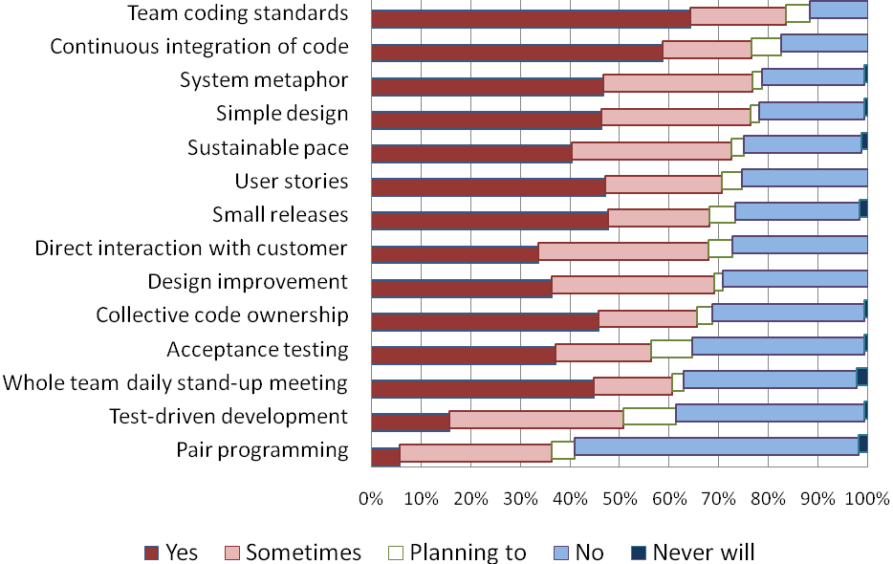
Agile Practice Penetration

Slide 10
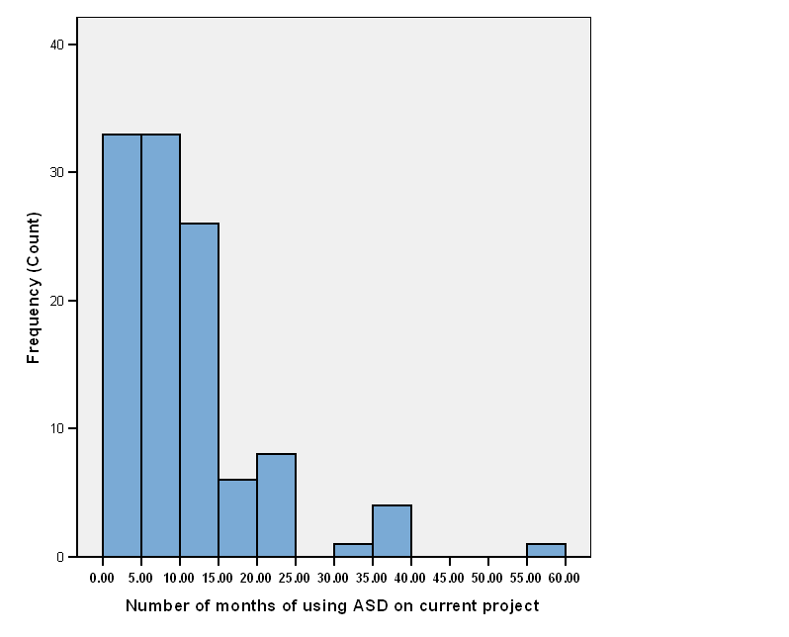
Length of Time Using Agile

Slide 11
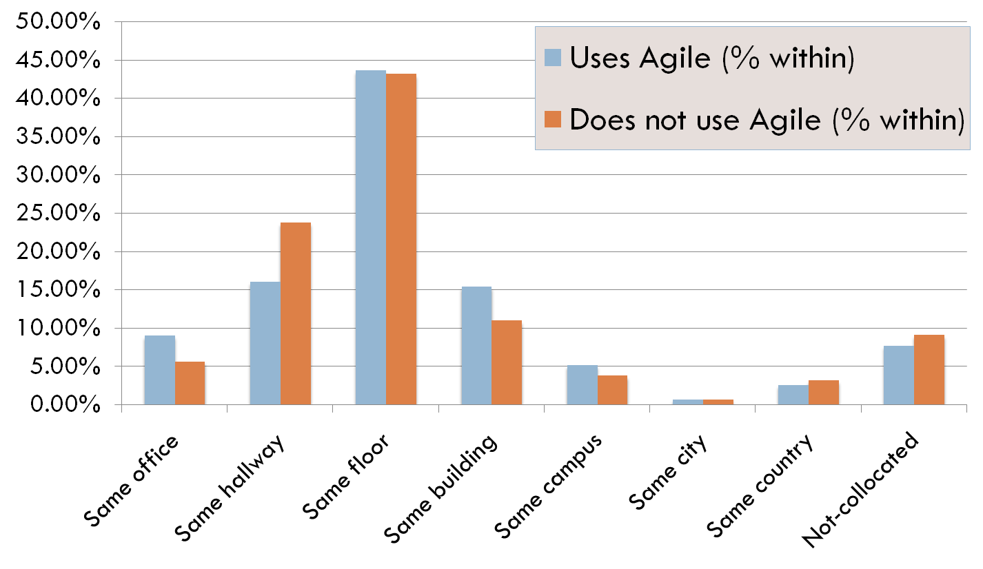
Team Collocation
84% of respondents in Agile teams are collocated within the same building

Slide 12
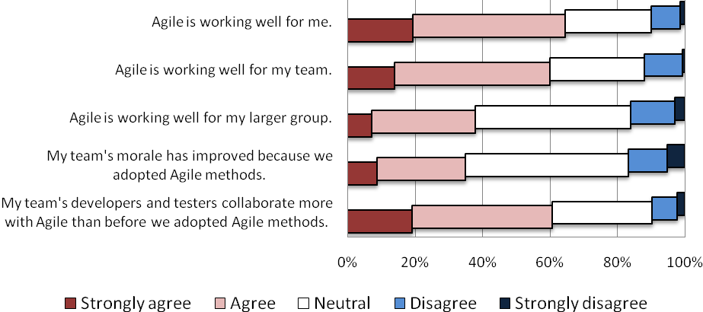
Engineering Teams Like Agile

Slide 13
Qualitative Methodology
Open Coding via Card Sort
  Print all long answer responses (for each survey question) on index cards
  Sort them into piles on a table, by theme
  Move cards between piles until settled
    Each answer can be in only one pile
  Piles labeled by theme of answers within
  2 researchers working together
  2-3 hours per card sort

Slide 14
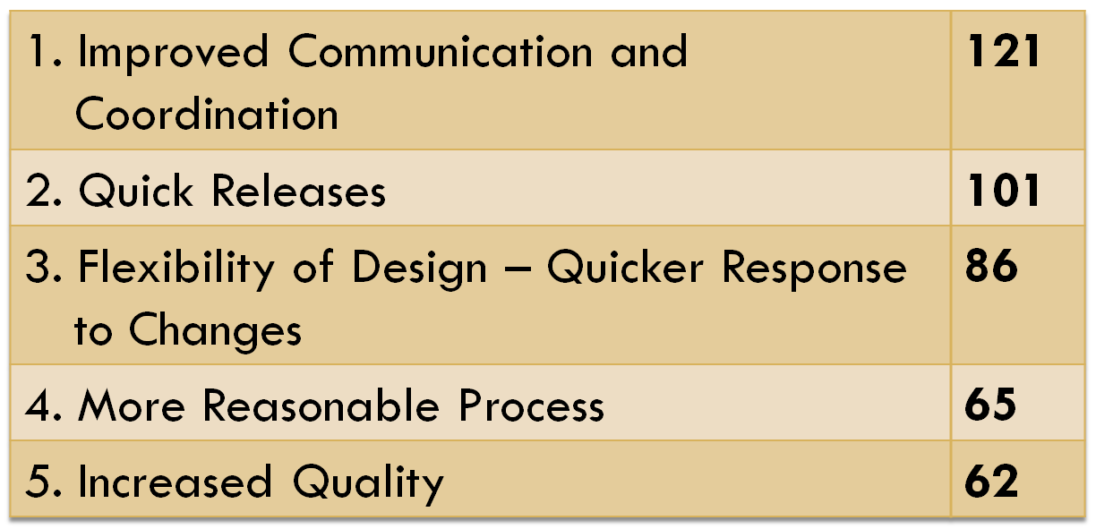
Perceived Benefits from Agile
“Team members are aware of what each of the others is working on.”
The process supports “real-time tracking of progress and ability to adjust future forecasts based on real data.”
“…ongoing refactoring leads to higher code reuse and better quality.”
“When you integrate early and often, the product can be tested early and often, too.”
You don’t have to commit prematurely (for example, to design decisions).”
687 comments, 44 themes

Slide 15
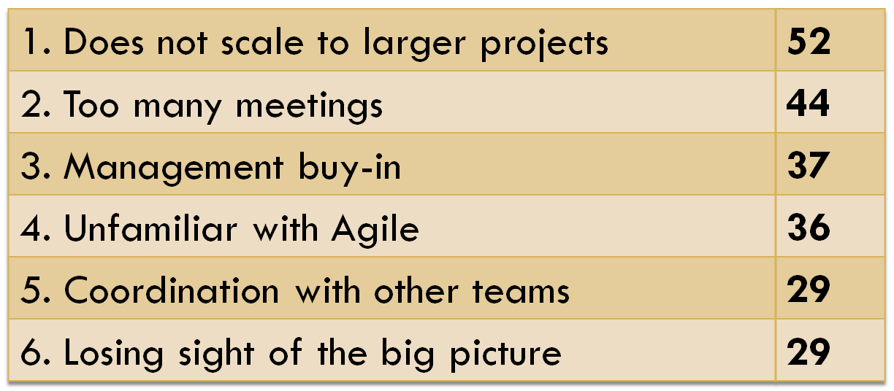
Perceived Problems from Agile
“Interaction with non-Agile teams is hard because they don’t understand that you can guarantee that all the sprint items will be completed because the prioritization meeting involves very loose time estimates.”
Agile “works for small co-located teams, but not for complex large projects.”
The “focus is on today’s work” more “than what the feature team is trying to achieve.”
“The pressure to daily report percentage of progress was uncomfortable, especially when I had to report progress (or call an item ‘done’) without actually testing in integrated fashion.”
“Upper management still tries to get specific dates for specific deliverables.”
Agile development “is simple, but requires a lot of discipline from the team.”
565 comments, 58 themes

Slide 16
Open Questions
How do you scale Agile to large (500-5000 person) teams?
How do you best coordinate Agile and non-Agile teams?
  Recently finished study on software team coordination at MS (in submission).
What are the best software metrics for discerning Agile (vs. non-Agile) process effects on teams’ artifacts?
How can we fix actual and perceived problems uncovered in ethnographic investigations of Agile software development teams?

Slide 17
Conclusions
1/3 of respondents (spread across divisions) report their team uses Agile methodologies.
  They mainly use Scrum.
  Used for many legacy products.
  Test-driven development and pair programming are not very common.
  Agile usage does not appear to affect team collocation.
MS engineers who have used Agile like it for their local team, but not necessarily for their organization.
  They worry about scale, overhead, and management buy-in.

Slide 18
Questions?
Andrew Begel (andrew.begel@microsoft.com)
HIP – Human Interactions in Programming
http://research.microsoft.com/hip
Nachiappan Nagappan (nachin@microsoft.com)
ESM – Empirical Software Engineering and Measurement
http://research.microsoft.com/esm

