Slide 1
Cognitive Perspectives on the Role of Naming in Computer Programs
Ben Liblit
University of Wisconsin, Madison
liblit@cs.wisc.edu
Andrew Begel
Microsoft Research, Redmond
andrew.begel@microsoft.com
Eve Sweetser
University of California, Berkeley
sweetser@berkeley.edu
Notes:
Broader research goal in building tools for programmers to improve productivity and
access. Study programmers first and build tools second. and then build analyses to support tools
People spend a lot of time developing software.
There’s a continuing demand for more people.
Make people more productive. b. Enlarge the pool of developers.
1b. Better education and helping people with disabilities
1a. To serve community requires understanding of PL, SE and HCI.

Slide 2
Naming in Programs
Symbolic names are most meaningful to humans
  Computers care only about matching names with same spelling
We explore the linguistics of names used in code
        Morphology
        Grammar
        Metaphor
        Deixis & Anaphora
        Polysemy & Homonymy

Slide 3
Morphemes
C/C++: Underscore separates morphemes
gnome_druid_get_type gnome_druid_new
gnome_druid_append_page gnome_druid_prepend_page
gnome_druid_insert_page gnome_druid_set_show_finish
gnome_druid_set_page gnome_druid_set_show_help
gnome_druid_set_buttons_sensitive
C++/Java: Intercapped (Camel Case) Morphemes
gnomeDruidGetType gnomeDruidNew
gnomeDruidAppendPage gnomeDruidPrependPage
gnomeDruidInsertPage gnomeDruidSetShowFinish
gnomeDruidSetPage gnomeDruidSetShowHelp
gnomeDruidSetButtonsSensitive
C#: Intercapped, initial caps morphemes
GnomeDruidGetType GnomeDruidNew
GnomeDruidAppendPage GnomeDruidPrependPage
GnomeDruidInsertPage GnomeDruidSetShowFinish
GnomeDruidSetPage GnomeDruidSetShowHelp
GnomeDruidSetButtonsSensitive

Slide 4
Morphemes: Highlighted namespaces
C/C++
gnome_druid_get_type gnome_druid_new
gnome_druid_append_page gnome_druid_prepend_page
gnome_druid_insert_page gnome_druid_set_show_finish
gnome_druid_set_page gnome_druid_set_show_help
gnome_druid_set_buttons_sensitive
C++/Java
gnomeDruidGetType gnomeDruidNew
gnomeDruidAppendPage gnomeDruidPrependPage
gnomeDruidInsertPage gnomeDruidSetShowFinish
gnomeDruidSetPage gnomeDruidSetShowHelp
gnomeDruidSetButtonsSensitive
C#
GnomeDruidGetType GnomeDruidNew
GnomeDruidAppendPage GnomeDruidPrependPage
GnomeDruidInsertPage GnomeDruidSetShowFinish
GnomeDruidSetPage GnomeDruidSetShowHelp
GnomeDruidSetButtonsSensitive

Slide 5
Morpheme Length
distance_between_abscissae = first_abscissa - second_abscissa;
distance_between_ordinates = first_ordinate - second_ordinate;
cartesian_distance = square_root(
distance_between_abscissae * distance_between_abscissae
+ distance_between_ordinates * distance_between_ordinates
);
OR
dx = x1 – x2;
dy = y1 – y2;
dist = sqrt(dx * dx + dy * dy);

Slide 6
Name length pressure
Names are often concatenated.
Long names don’t fit on screen.
Mathematical abstractions are understandable.
Overuse of abbreviations can make code hard to understand.
Name length proportional to visibility and use frequency?

Slide 7
How Long Are Names in the Wild?
Java 1.3 libraries
  572,842 LOC
  83,750 names
  48,332 are local variables or parameters
    Avg. 4.7 chars, 1.3 subwords
  17,575 are public method names
    Avg. 12.1 chars, 2.4 subwords

Slide 8
Is Name Length ∝ Visibility?
Gnumeric, open-source spreadsheet, C code
  116,820 LOC
  22,740 names
  18,224 are local variables or parameters
    Avg. 4.7 chars, 1.2 subwords
  2,283 are file-scope function names
    Avg. 18.9 chars, 3.3 subwords
  1,358 are global scope function names
    Ave. 20.5 chars, 3.6 subwords
Many long function names contain common prefixes (indicating namespace)

Slide 9
What if we look at BIG software?
Windows 2003 Server, C/C++ code
  40 MLOC
  7,142,247 names
  3,449,263 are local variables or parameters
    Avg. 7.5 chars, 1.9 subwords
  859,121 are global function names
    Avg. 15.8 chars, 3.3 subwords
  3,692,984 are global scope names (functions and types)
    Ave. 17.2 chars, 3.0 subwords
Many names use Hungarian notation (I, i, pv, ppv, dw) inflating word count by one
Missed counting subwords with no typographic distinction at boundaries between words

Slide 10
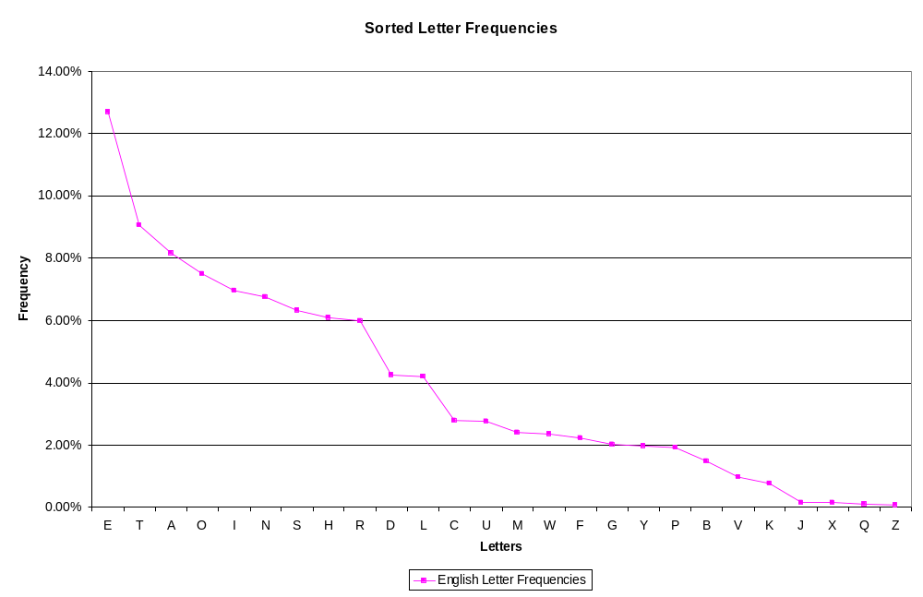
Just for fun: Monogram Freq. Analysis

Slide 11
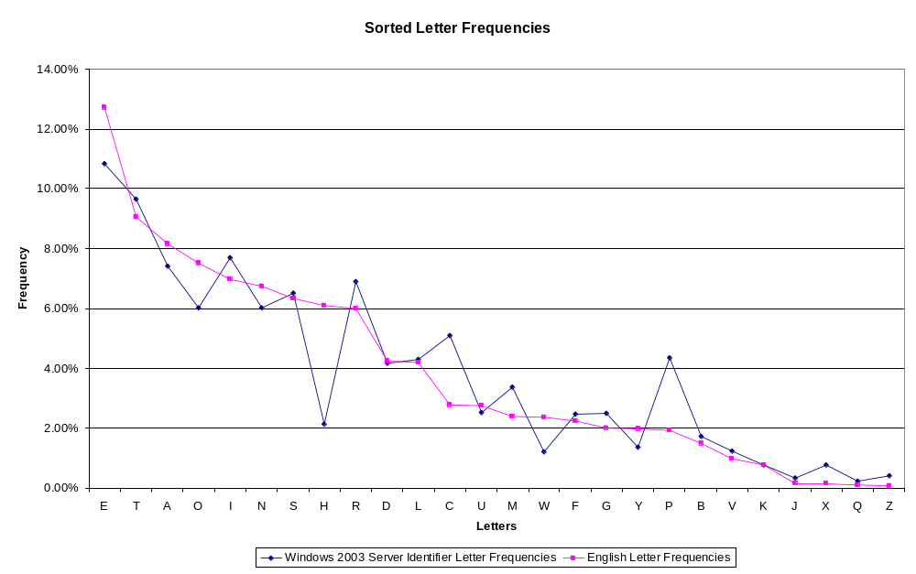
Just for fun: Monogram Freq. Analysis

Slide 12
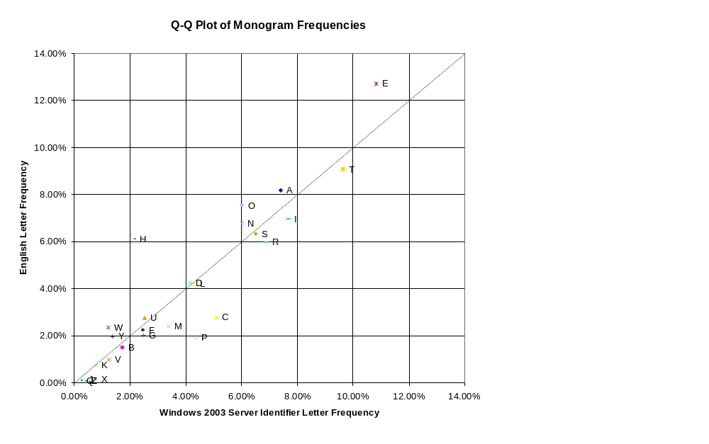
Q-Q Plot: English vs. C/C++ Code

Slide 13
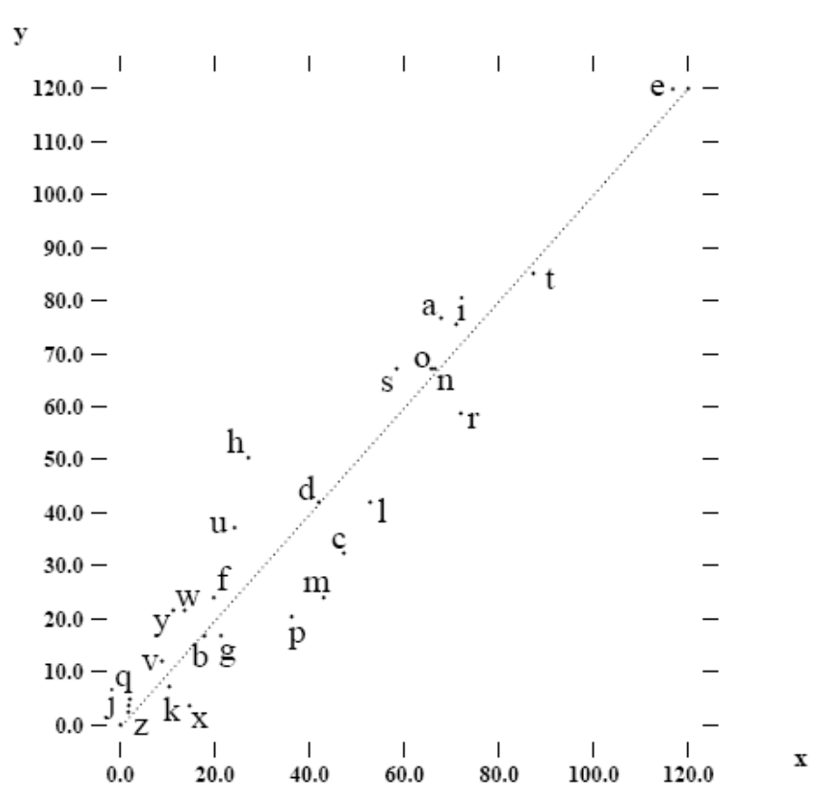
Q-Q Plot: English vs. C/C++ Code
Windows 2003 Server
C/C++ Code
Open Source C/C++ Code
[Caprile and Tonella 99]

Slide 14
Names have structure
Grammatical phrases grouped by metaphor
Noun phrases – Data are things
  top_bands, bottom_bands, right_bands
  floating_children, client_rect
  elementAt, firstElement, indexOf
Verb statements – True/False Data are Factual Assertions
  floating_items_allowed (omitting ‘are’)
Verb phrases – Methods are Actions
  add, addAll, addElement, copyInto, removeElement

Slide 15
Prepositions are valence cues
indexOf, elementAt
Not so obvious in C/C++/C#/Java
  rosterArray.insertElementAt(newHire, position)
Pulled out into separate words in Smalltalk
  rosterArray at: position put: newHire
  (Similar to how you could say it out loud)
Initial open valence slot for subject of verb phrase
  At end in subject-last languages?
  Possessive reading handy
    Roster Array’s first element: rosterArray.firstElement()

Slide 16
Reference Metaphors
Objects are containers
  Enclose attributes
  Often depicted as boxes
Pointers are paths
  C/C++: pComp->pProc->IsPublic()
  C#/Java: dock.container.widget.position.width
  “Follow” pointers, “traverse” pointers, “fall off the end” of a pointer chain

Slide 17
Deixis and Anaphora
Deixis: Reference of objects in different places
  Outside Vector: rosterVector.lastElement()
  Inside Vector: this.lastElement() or lastElement()
Anaphora: Reference of objects after introduction
  AOP: “Before the execution of this method”
  Shell: $?, ERRORLEVEL
  Fairly rare in programming languages

Slide 18
Method Overloading
Polysemy: words with shared etymology having different meanings
  ArrayList.add(int index, Object element)
  ArrayList.add(Object o)
Operator overloading: Symbolic polysemy
  sum(q, product(r, s)) vs. q + r * s
  Overloading can be arbitrary and devoid of real meaning
  Operators may not do what you expect. May need understanding of how they are implemented
Homonyms: Same symbol, different sense/meaning
  x << 4 vs. stdout << “Hello World!”

Slide 19
Questions to Ponder
How do linguistic conventions affect programmers’ cognitive burden?
How can we employ a larger variety of linguistic features in programming languages?
  Anthropomorphism
  Analogical reasoning
  Double negative detection/elimination

Slide 20
Any Questions?
Andrew Begel: andrew.begel@microsoft.com

