Slide 1

An Assessment of a Speech-Based Programming Environment
Andrew Begel
Microsoft Research (formerly UC Berkeley)
andrew.begel@microsoft.com
Notes:
Broader research goal in building tools for programmers to improve productivity and
access. Study programmers first and build tools second. and then build analyses to support tools
People spend a lot of time developing software.
There’s a continuing demand for more people.
Make people more productive. b. Enlarge the pool of developers.
1b. Better education and helping people with disabilities
1a. To serve community requires understanding of PL, SE and HCI.

Slide 2
The Big Questions
Can people learn to program by speaking?
(if they already know how to program)
What is easy and what is hard?
What are the problems and how might they be resolved?

Slide 3

The Story Until Now
Speech-based programming can be an alternative to typing/mousing
Spoken programs differ from written programs [Begel & Graham, VL/HCC ‘05]
  Lexical, syntactic, semantic and prosodic ambiguities
Programming language analyses can be enhanced to resolve ambiguities [Begel and Graham, LDTA ’04]
while counter is less
than limit do ...

Slide 4
Study – SPEech EDitor Usability
Goal: Understand how SPEED can be used by expert programmers
Hypothesis: SPEED is learnable and usable for standard programming tasks
Train 5 expert Java programmers on SPEED (20 minutes)
Create and modify code (30 minutes)
  Build a Linked List data structure with associated algorithms
3 programmers used commercial speech recognizer
2 programmers used human speech recognizer
Notes:
Say this is for expert java programmers.
Rephrase system understanding (everything else is about the person, but this is about the system).
Find some terminology from AI systems evaluations (false positive rate etc)

Slide 5
Video

Slide 6
Metrics
Number of Commands/Dictations Uttered vs. Recognized
Number of Correctly Interpreted Recognition Events
Features Used
  Code Templates, Dictation, Navigation, Editing, Fixing Mistakes
Quantity and Kinds of Mistakes
  Speech Recognition, SPEED, User

Slide 7
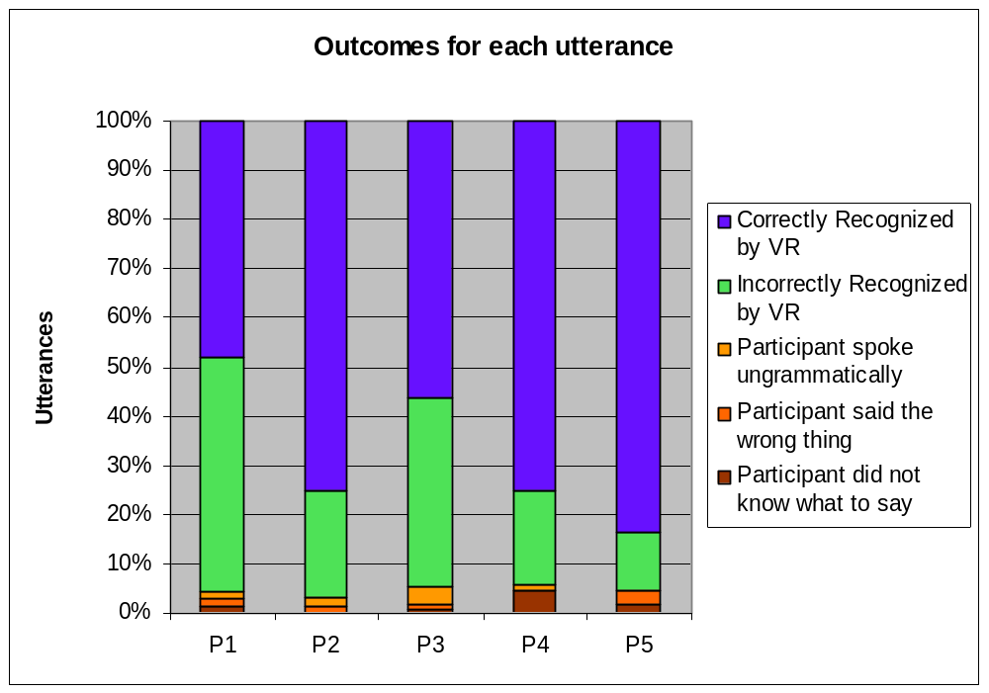

Slide 8
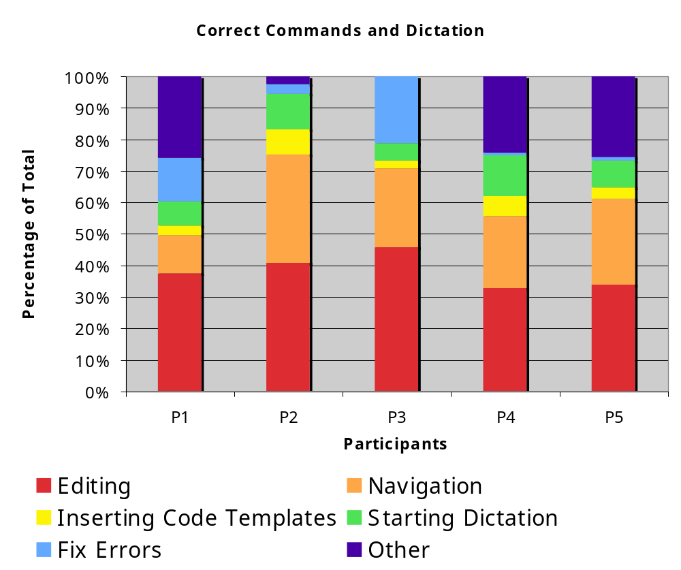

Slide 9
Summary of Results
Commands were easy to learn and remember.
  Very few user mistakes
Most commands spoken for editing.
  GOMS analysis predicts speech will be slower unless you can get a lot of text for each utterance.
  Code templates provide “most bang for your buck”.
Speakers were apprehensive about speaking code instead of describing it via code templates.

Slide 10
Conclusions
SPEED is learnable in a short amount of time
Programming-by-voice is slower than typing
  Programmers would not want to use it until they had to
Programmers believed they would be efficient enough using SPEED to remain in software engineering jobs

Slide 11
Any Questions?
Andrew Begel: andrew.begel@microsoft.com

Slide 12
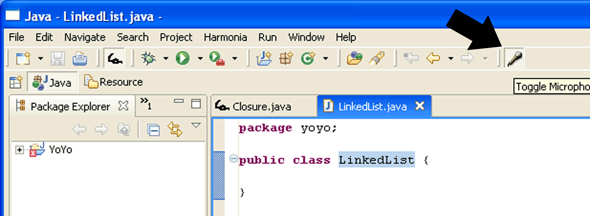
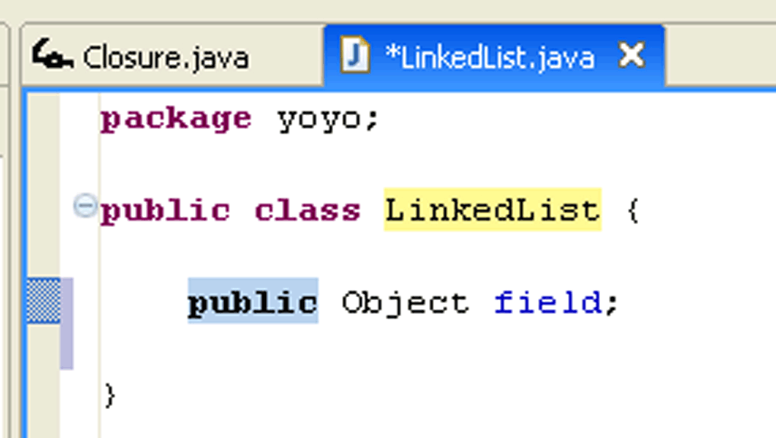
Speech Editing Model
Toggle
Microphone
Code Template
Insertion
(insert field)

Slide 13
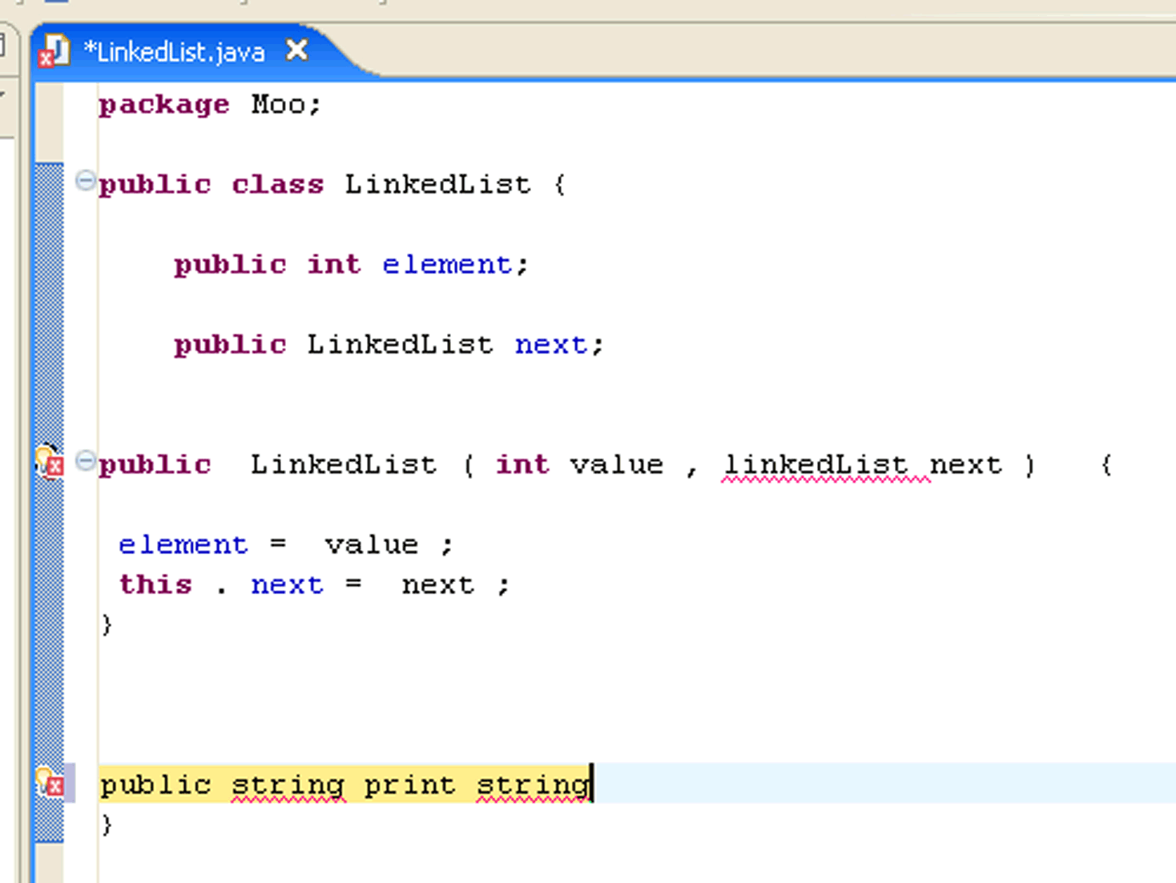
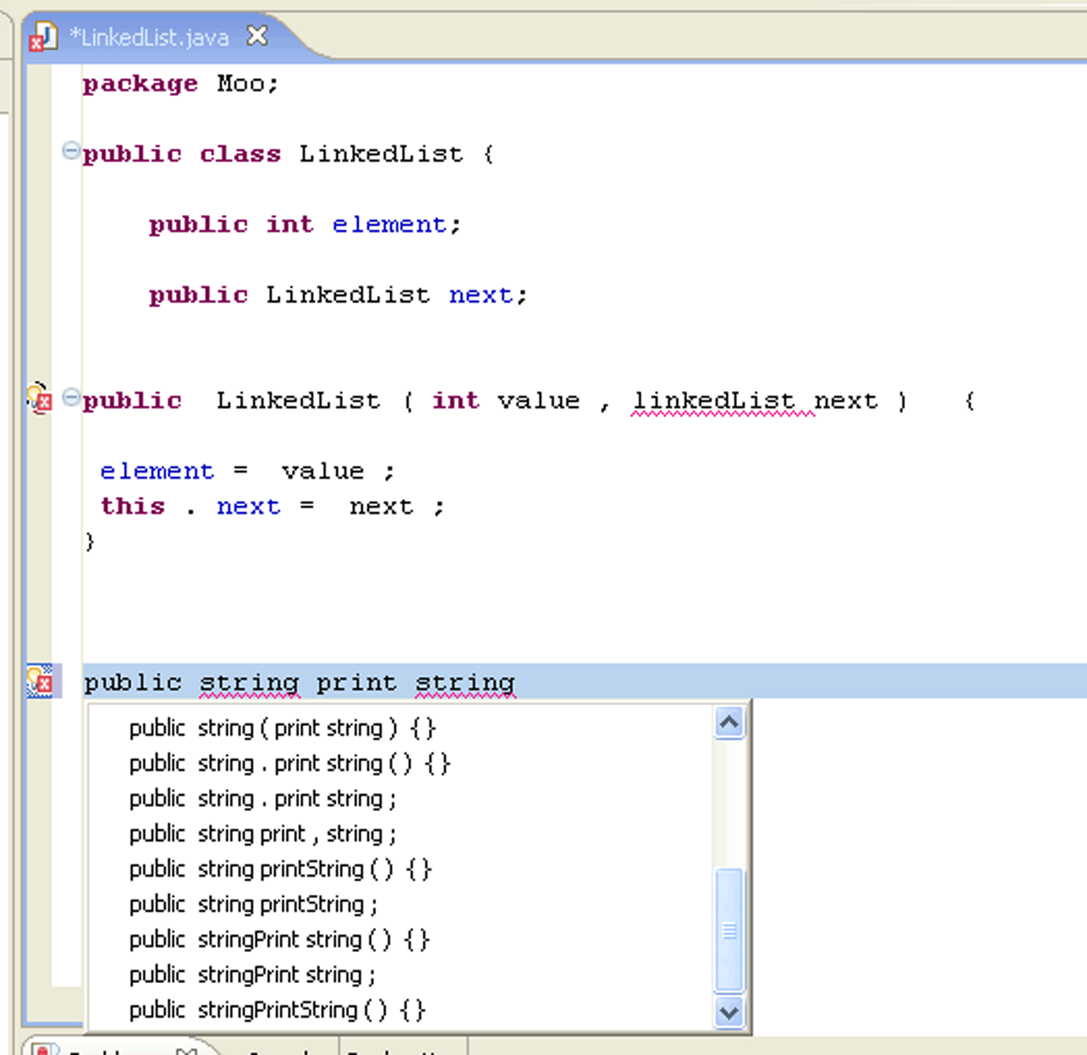
Spoken Java Editing Model
1. Speak Code
2. Choose From
Alternatives

Slide 14
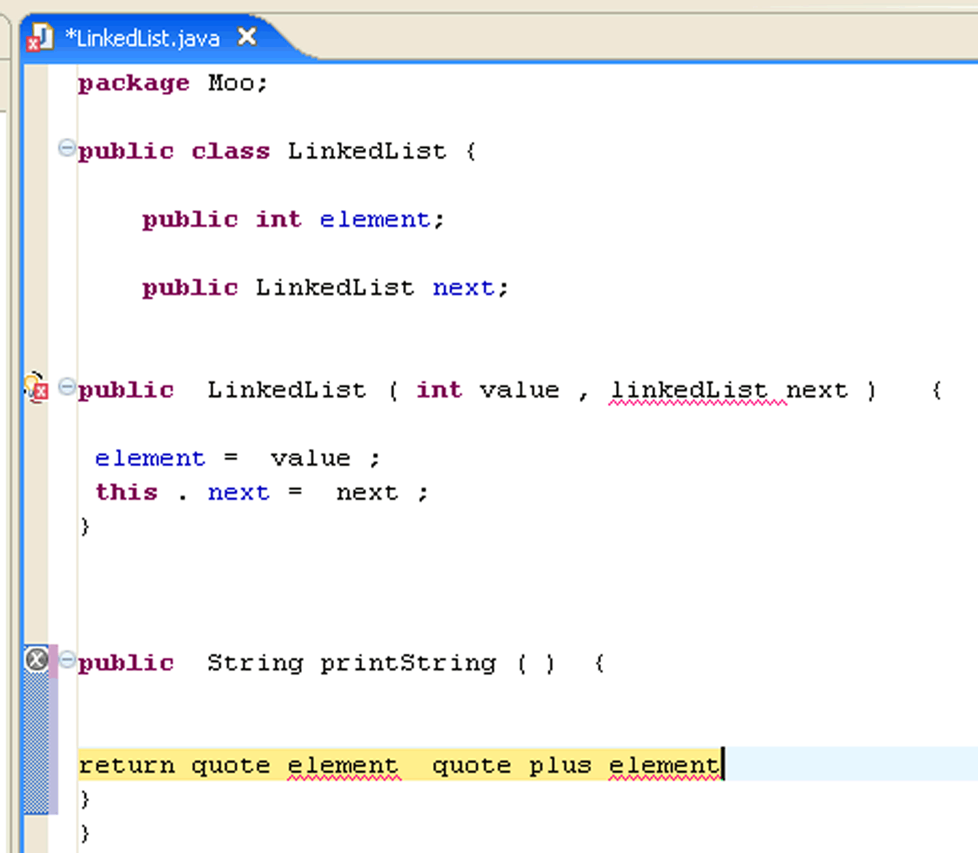
Speech Editing Model

Slide 15
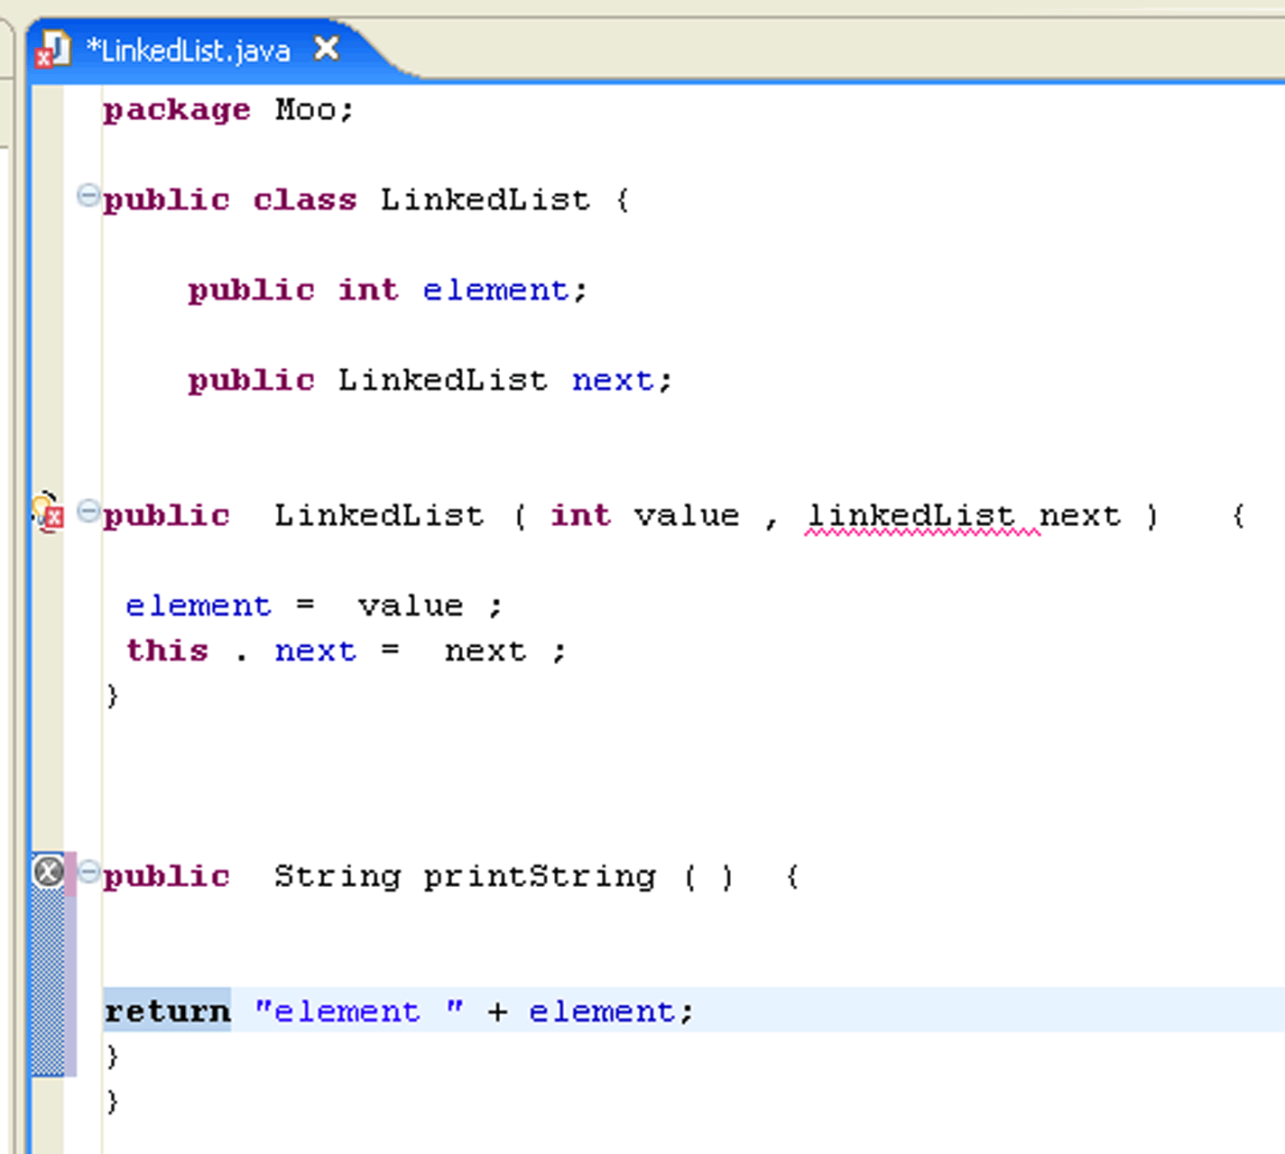
Speech Editing Model

Slide 16
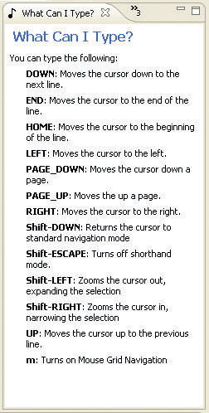
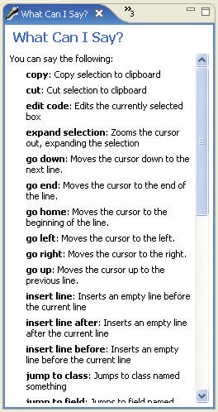
What Can I Type/Say?

