Slide 1
BPF+
Exploiting Global Data-flow Optimization in a Packet Filter Architecture
Andrew Begel, Steven McCanne, Susan L. Graham
University of California, Berkeley
with acknowledgments to Van Jacobson

Slide 2
The Big Picture
With BPF+, we can express packet filters in a high-level language and compile them into efficient code.

Slide 3
The Packet Filter
Definition: A tool for selecting packets from a packet stream using a programmable selection criterion.
Example: tcp and source net 128.32/16 and destination host web.mit.edu and port 80

Slide 4
Domain-Specific Optimization
Tune traditional compiler optimizations for the application of packet filtering.
Affords simpler analyses and much more effective optimization.
  Packet filters are DAGs
  Engenders linear-time algorithms
Combine with Just-In-Time (JIT) assembly.

Slide 5
Comparison of C Optimizer to BPF+ Optimizer
2500
BPF+ Linear
BPF+ Hash
Optimized C
2000
1500
Filter Time (ns)
1000
500
0
5
10
15
20
25
30
Number of Table Entries

Slide 6
Related Work
Virtual Machine Models:
  CMU/Stanford Packet Filter: MRA87
  BPF: Berkeley Packet Filter: MJ93
    tcpdump and libpcap
  MPF: YBMEM94
Exploit Filter Structure:
  PathFinder: BGPP94
  DPF: EK96
  Multi-dimensional Range Matching: LS98
  Grid of Tries: SVSW98
High-Level Approach:
  LR Parsing: JC96

Slide 7
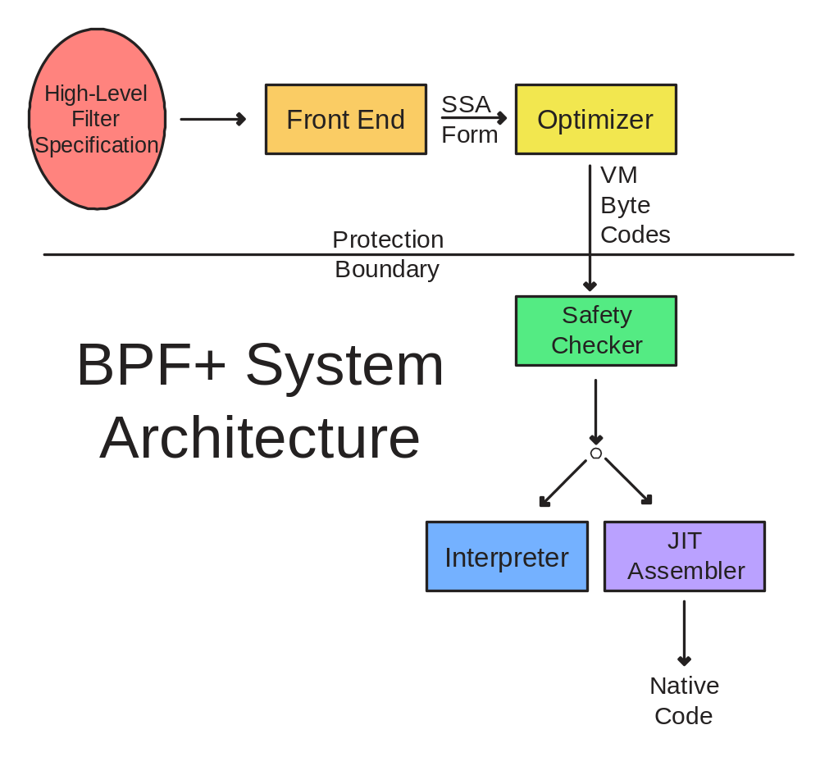

Slide 8
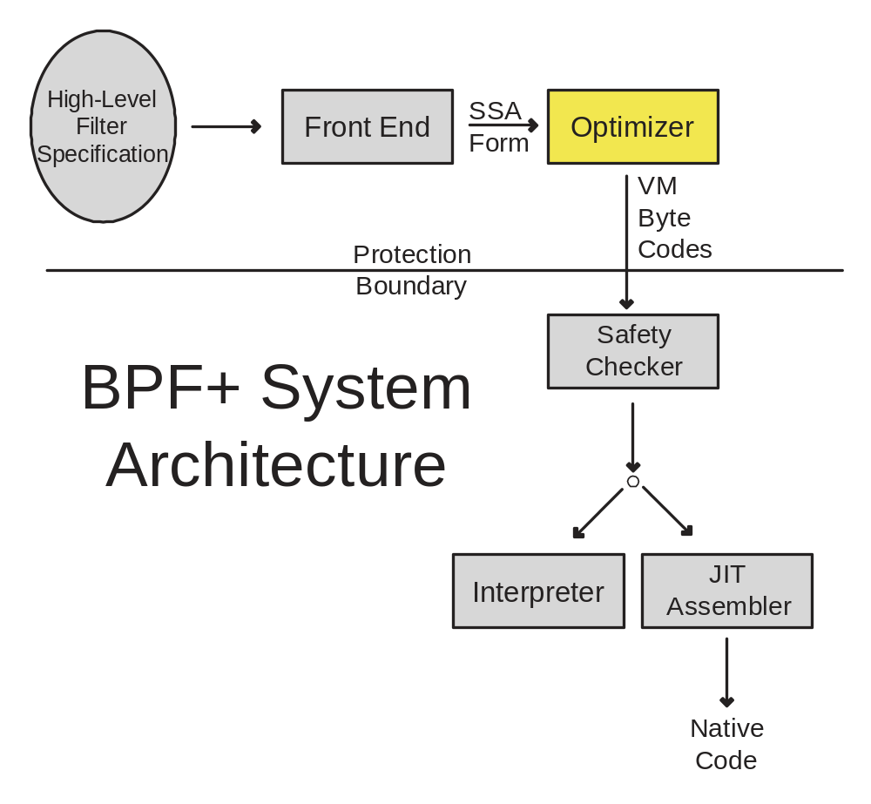

Slide 9
Compiler Optimizations
Leverage modern compiler technology
Powerful intermediate form
  Static Single Assignment (SSA)
Three key optimizations
  Redundant Predicate Elimination
  Partial Redundancy Elimination
  Lookup Table Encapsulation

Slide 10
Redundant Predicate Elimination
Packet header parsing leads to many redundant predicates.
Unlike traditional optimizations, detect redundant edges rather than redundant computation.
Packet filter control flow graphs are edge-rich.

Slide 11
(src host UCB and dest host MIT) or
(src host MIT and dest host UCB)
All packets between UCB and MIT

Slide 12
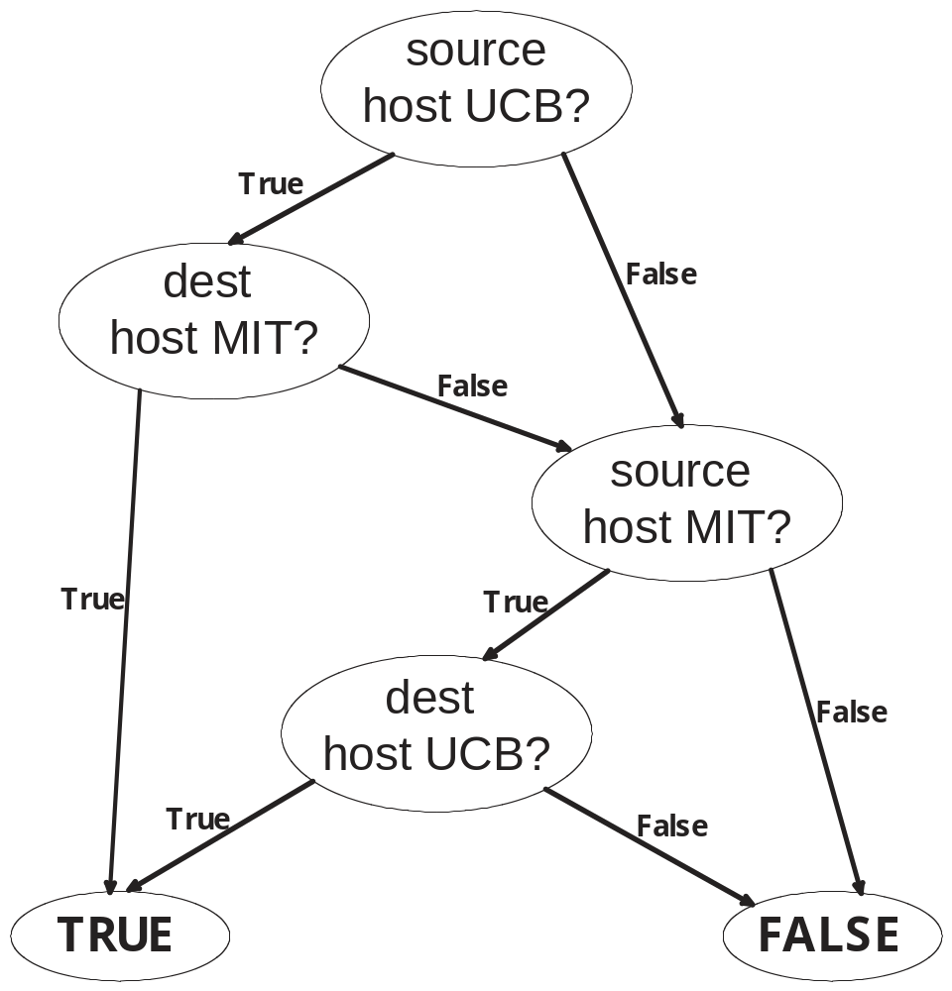

Slide 13
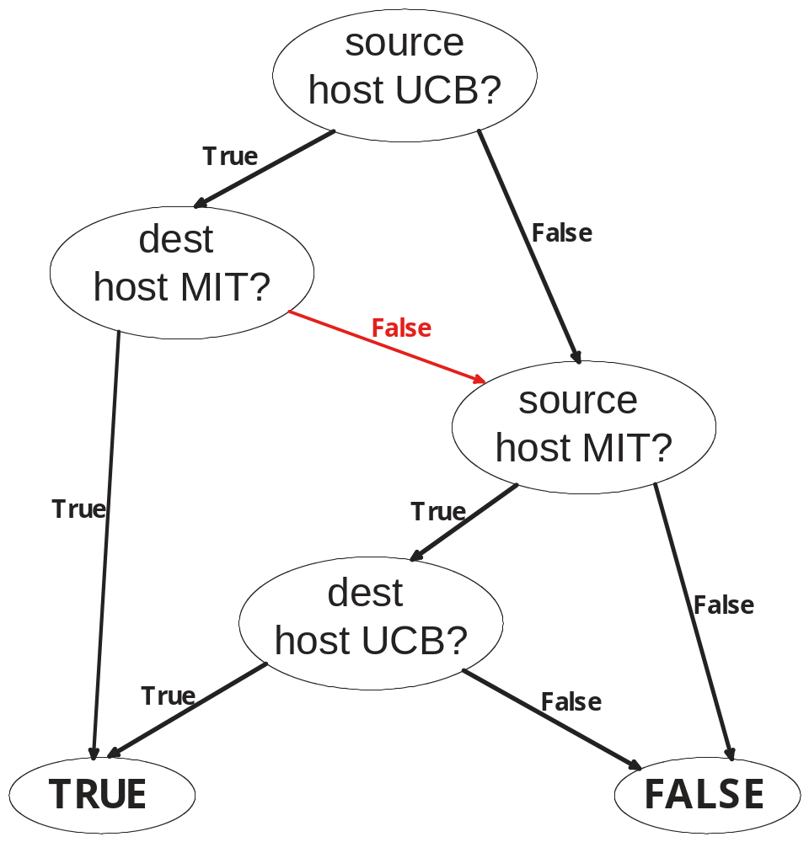

Slide 14
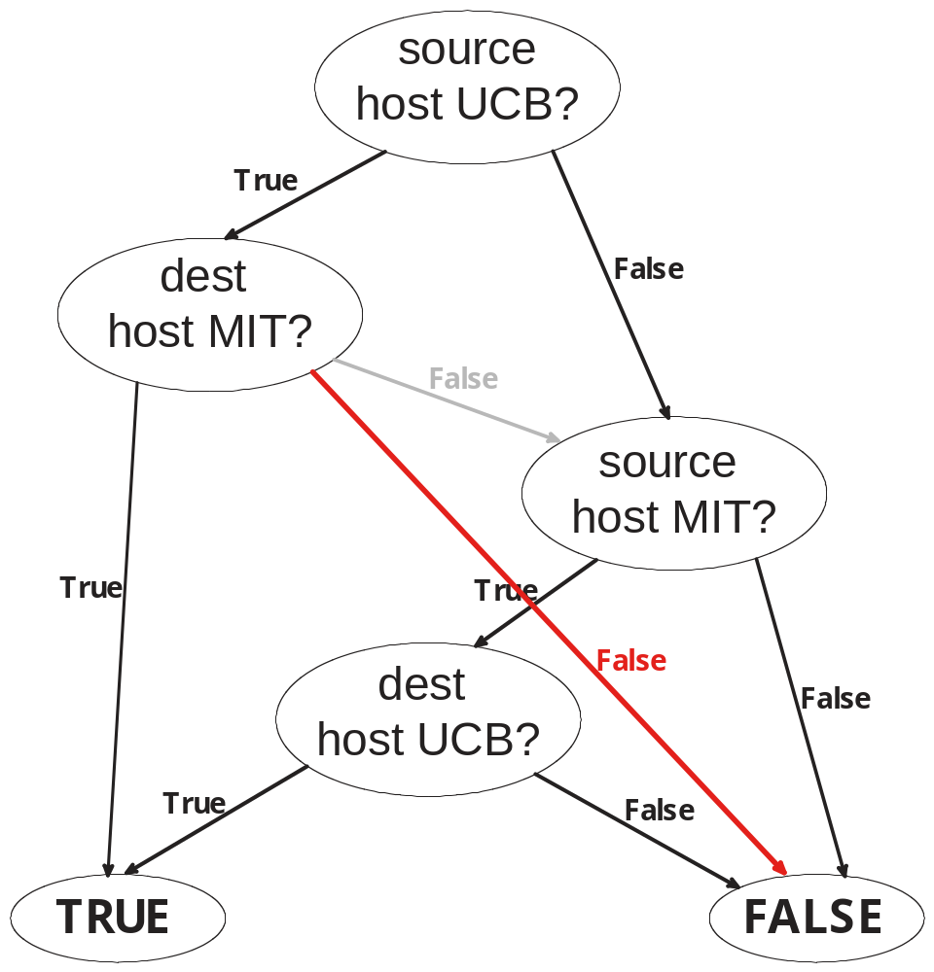

Slide 15
Partial Redundancy Elimination
Packet header parsing also leads to much redundant computation.

Slide 16
src host UCB or src host MIT
All packets that come from
either UCB or MIT

Slide 17
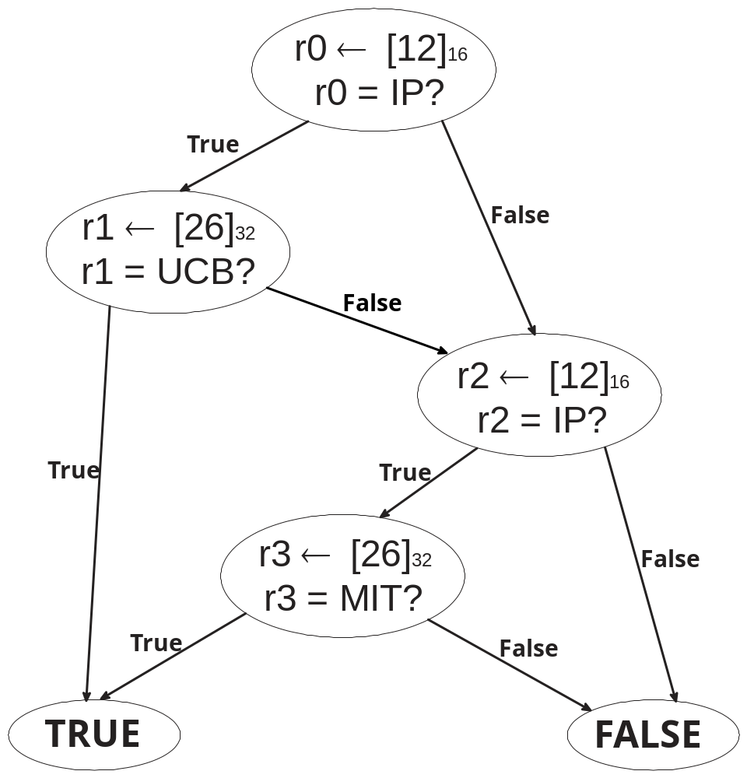

Slide 18
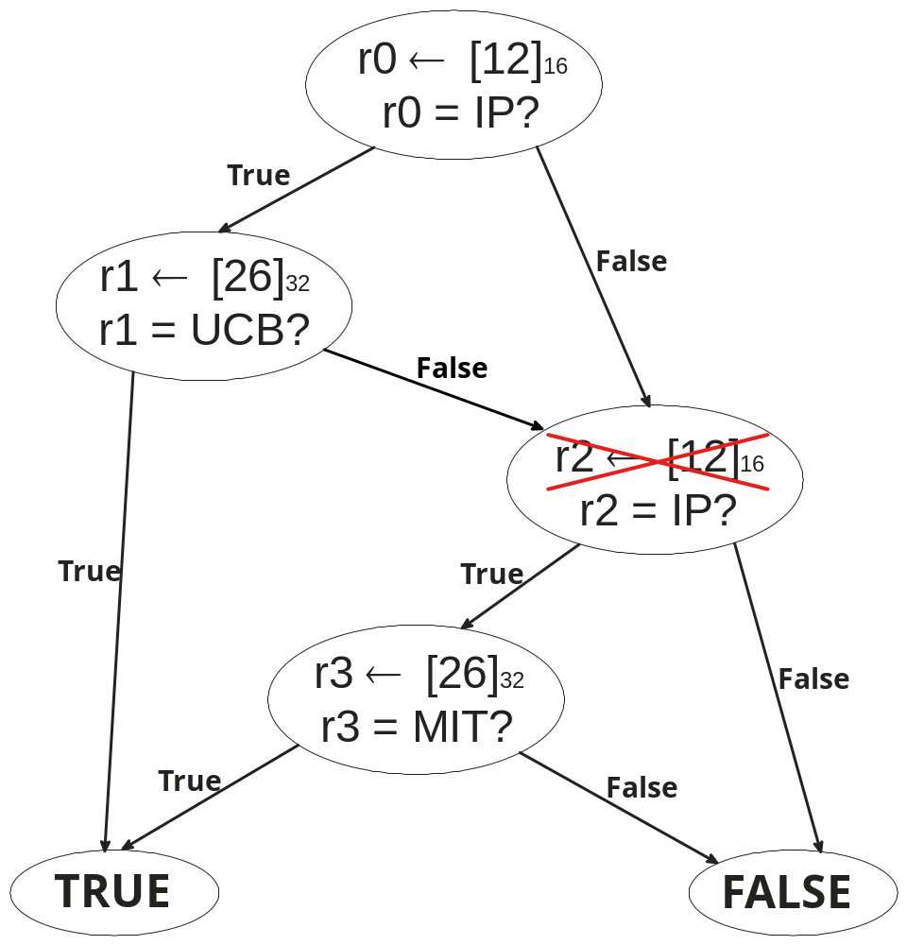

Slide 19
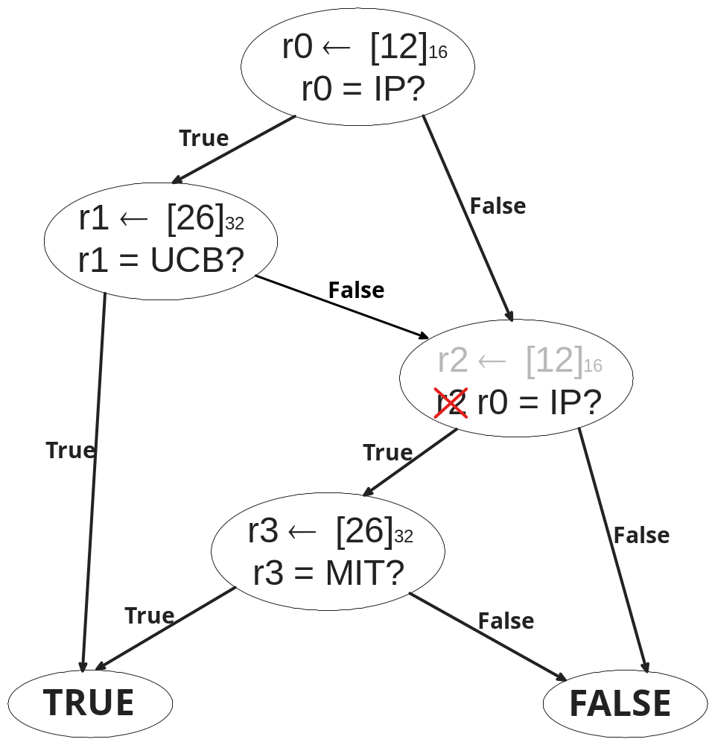

Slide 20
Putting Them Both Together
Combining partial redundancy elimination with redundant predicate elimination is much more effective than using either alone.
(6 steps later...)

Slide 21
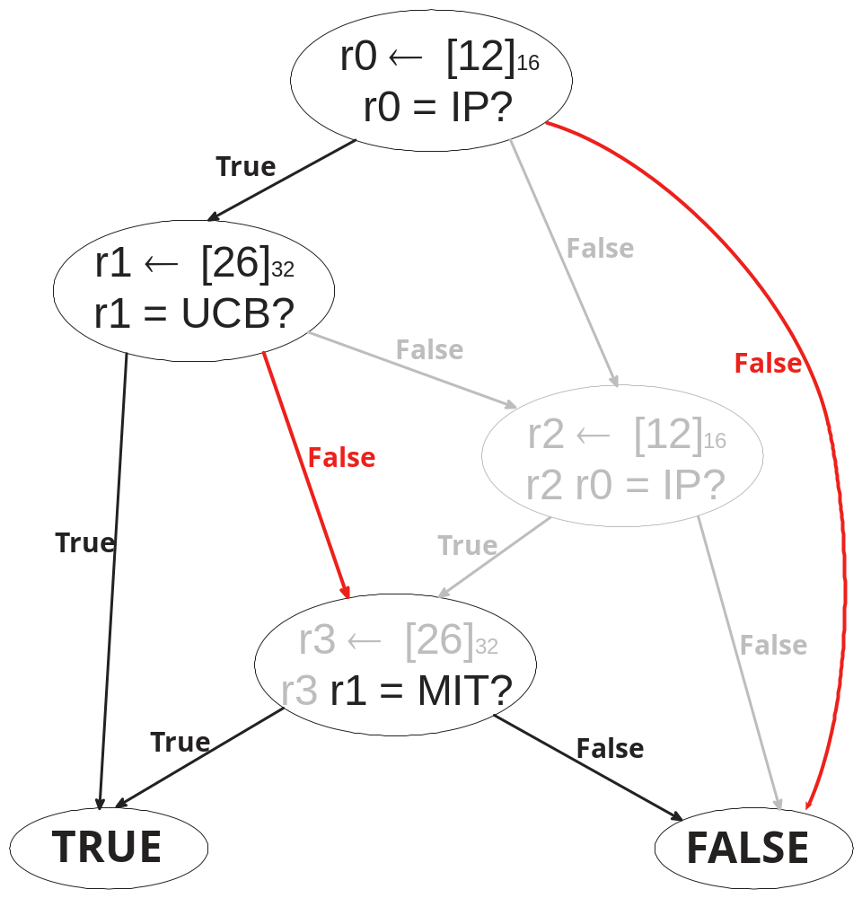

Slide 22
Lookup Table Encapsulation
After early optimizations, many predicates reduced to simple field comparisons.
Use analysis to discover opportunities for moving into lookup tables.
Implementation may use linear search, binary search, hash lookup or any combination of the three.

Slide 23
src host UCB or src host MIT or src host CMU
All packets that come from
UCB, MIT or CMU

Slide 24
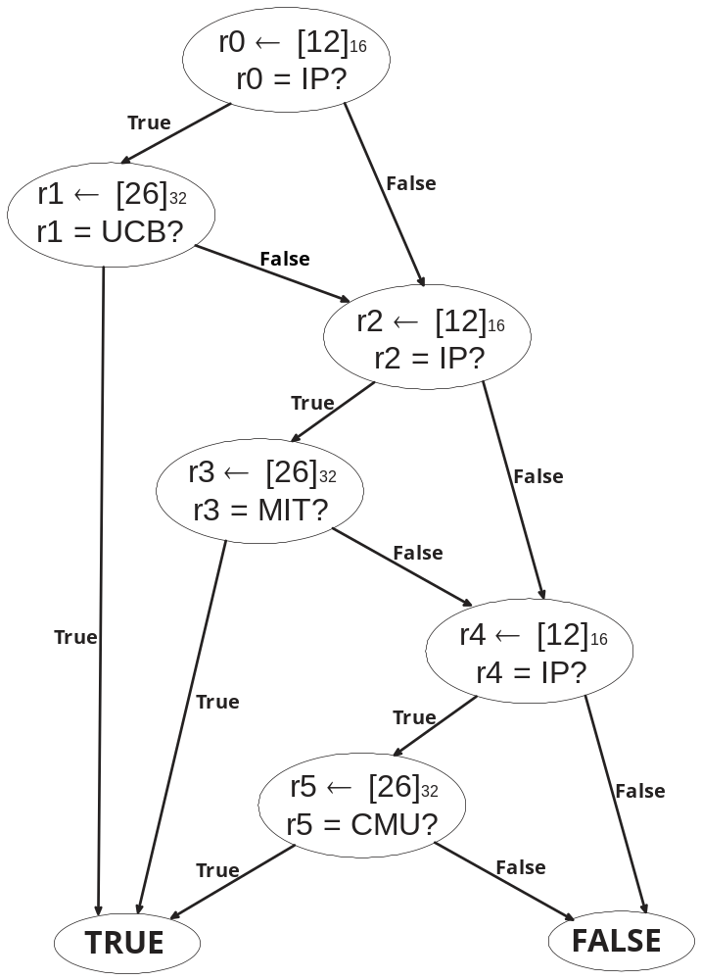

Slide 25
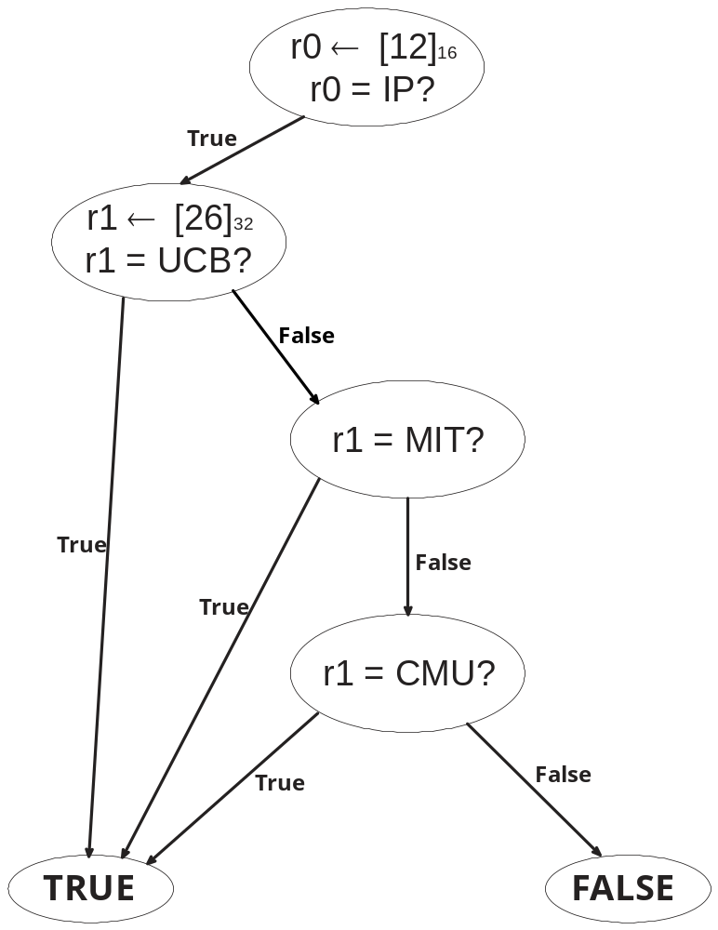

Slide 26
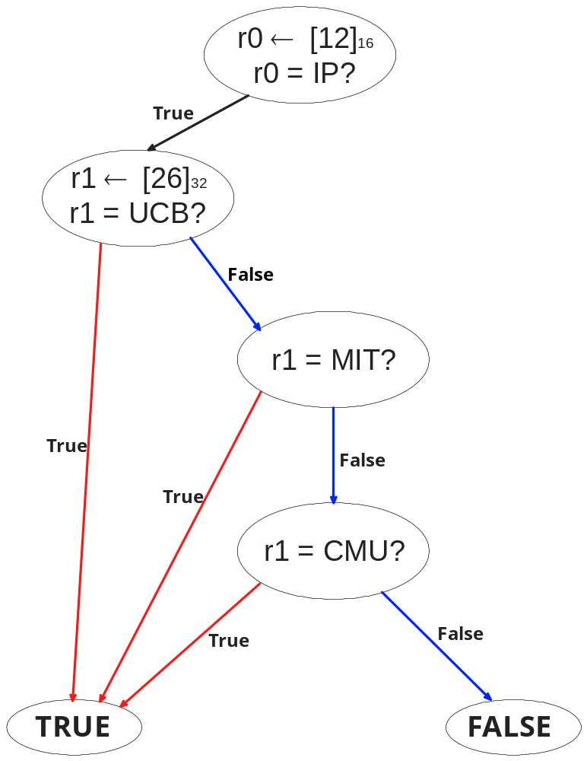

Slide 27
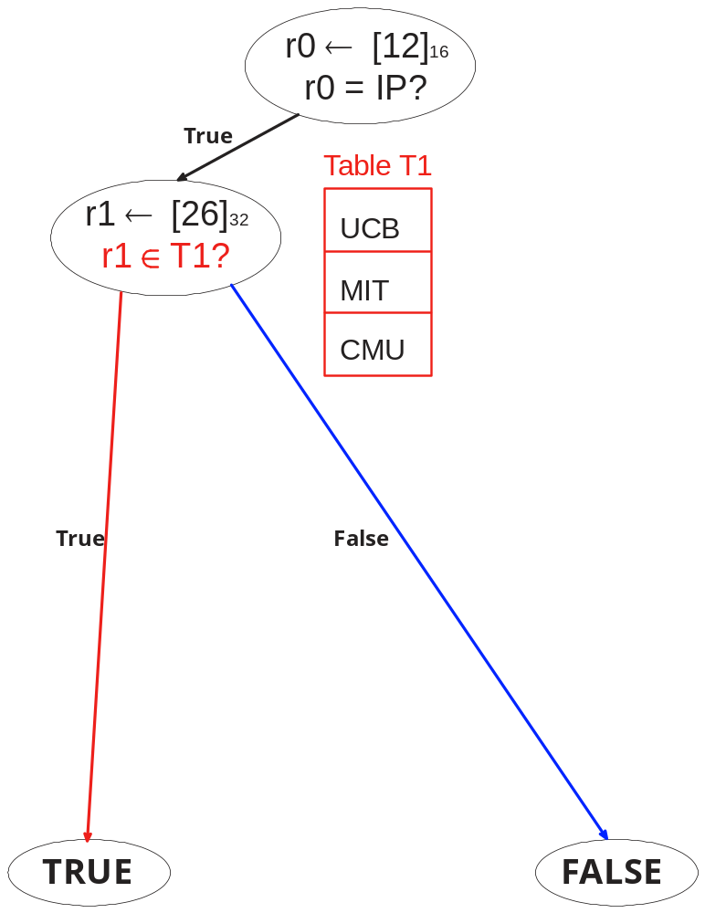

Slide 28
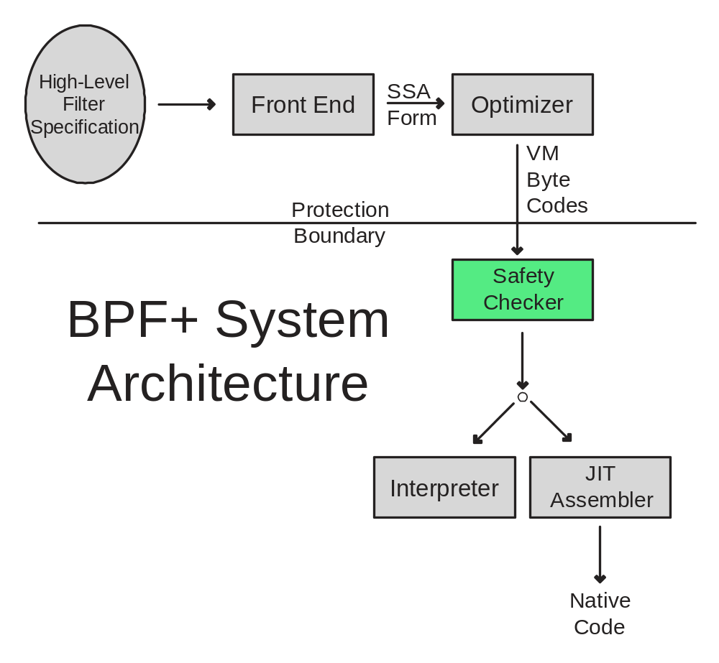

Slide 29
Filter Safety Must Be Verified
All bytecodes are valid.
Jump targets are valid.
No loops.
All paths terminate with a return instruction.
No out-of-bounds reads or writes.

Slide 30
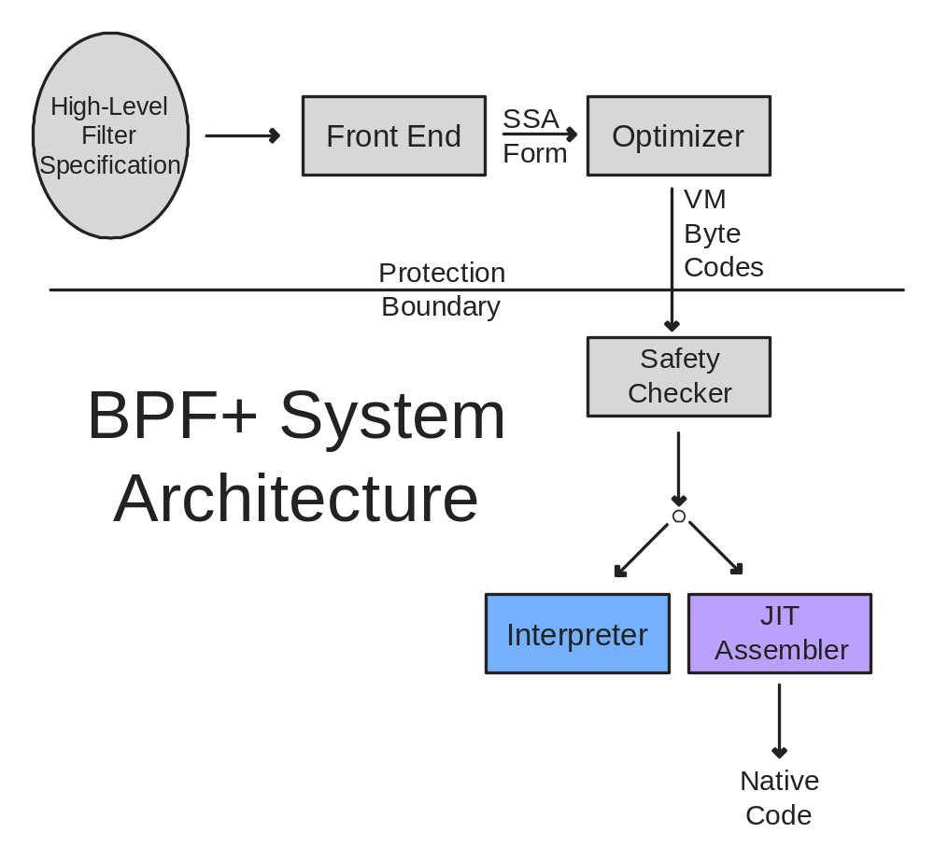

Slide 31
Performance Tests
Two types of predicate expressions
  Dependent (src host (UCB or MIT or CMU)
  Independent (i.e. TCP, Port 80, dest host UCB)
Run on Ultra 10 300 MHz UltraSPARC IIi
Four ways to run a filter
  Unoptimized, Interpreted
  Optimized, Interpreted
  Unoptimized, JIT Assembled
  Optimized, JIT Assembled

Slide 32
Comparison of Linear Search to Hash Lookup
500
450
400
350
Filter Time (ns)
300
250
200
150
BPF+ Linear
BPF+ Hash Table
100
5
10
15
20
25
30
Number of Dependent Table Entries

Slide 33
Effects of Optimization and JIT Assembly
1
2
0
0
0
U
n
o
p
t
i
m
i
z
e
d
I
n
t
e
r
p
r
e
t
e
d
O
p
t
i
m
i
z
e
d
I
n
t
e
r
p
r
e
t
e
d
U
n
o
p
t
i
m
i
z
e
d
A
s
s
e
m
b
l
e
d
1
0
0
0
0
O
p
t
i
m
i
z
e
d
A
s
s
e
m
b
l
e
d
8
0
0
0
60
0
0
Filter Time (ns)
4
0
0
0
2
0
0
0
0
1
2
3
4
5
6
7
8
9
1
0
1
5
2
0
3
0
N
u
m
b
e
r
o
f
D
e
p
e
n
d
e
n
t
T
a
b
l
e
E
n
t
r
i
e
s

Slide 34
Effects of Optimization and JIT Assembly (log scale)
10000
Filter Time (ns) (log scale)
1000
Unoptimized Interpreted
Optimized Interpreted
Unoptimized Assembled
Optimized Assembled
100
5
10
15
20
25
30
Number of Dependent Table Entries

Slide 35
Effects of Optimization and JIT Assembly
on Independent Predicates (log scale)
4000
2000
1000
700
Filter Time (ns) (log scale)
500
400
300
200
Unoptimized Interpreted
Optimized Interpreted
Unoptimized Assembled
Optimized Assembled
100
1
2
3
4
5
Number of Independent Predicates

Slide 36
Future Work
More efficient table lookup representations (LS98, SVSW98)
Better support for packet classification
Loops
  Proof-Carrying Code, Necula 96
Intrusion detection
  Online Updates

Slide 37
Conclusions
Packet filters can be specified at a high-level and be efficiently executed.
Key idea: Tune familiar global data-flow compiler analyses and optimizations for packet filtering.

