Slide 1
Cataract

Slide 2
Introduction

Slide 3
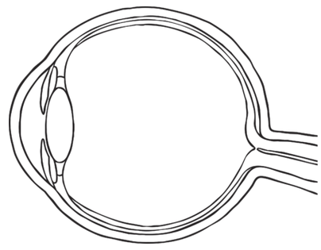
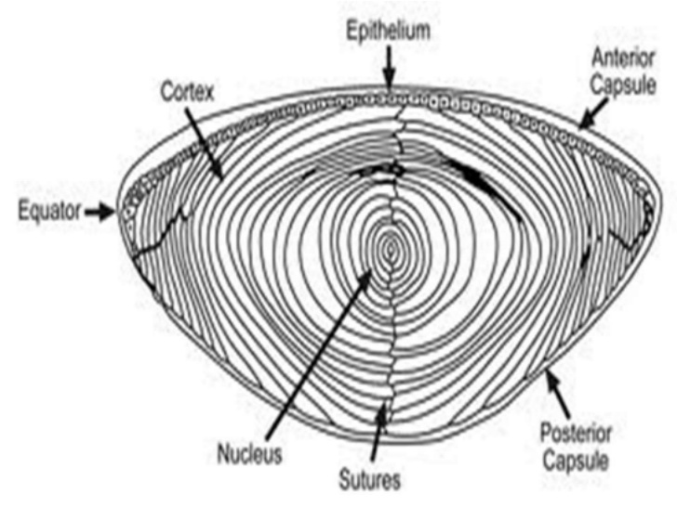
Eye and Lens
Lens is located in front of eye. Focuses light on back of eye.
To focus, we change the curvature of the lens (more or less spherical)
Three parts: capsule (outer elastic layer of cells), epithelium (cells that divide to produce fiber cells), fiber cells (clear, organelle-free cells)

Slide 4
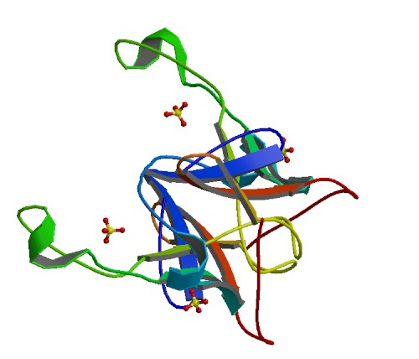
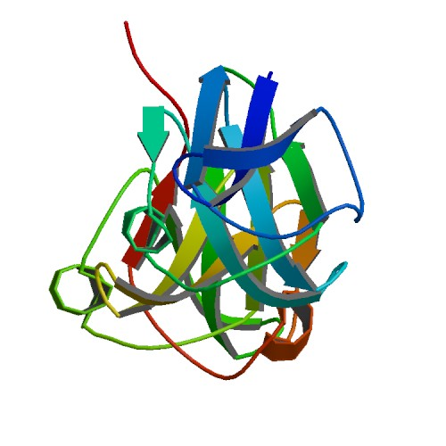
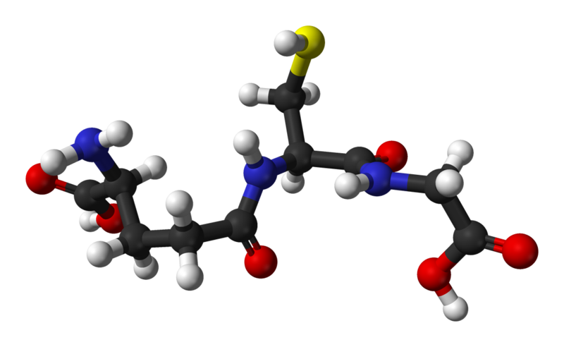
Fiber Cells and Crystallin
Fiber cells' protein: 90% crystallin
Three types:
α-crystallin: Structural protein and "chaperone" (binds to proteins to stabilize and prevent aggregation, but doesn't refold them). Two units: αA, αB
Encoded by CRYAA, CRYAB genes
β- and γ-crystallin: Structural protein, but otherwise no significant function
Encoded by CRYB*, CRYG* genes
Fiber cells are organelle-free; proteins are permanent.
Glutathione (GSH): Anti-oxidant, prevents oxidation of the crystallins.
Encoded by GSTM1, GSTT1 genes
Notes:
CRYBA1 CRYBA4 CRYBA4 CRYBB1 CRYBB2 CRYBB3 CRYBB3 CRYGA CRYGB

Slide 5
Cataract
Cataract is opacification of the lens; when the lens becomes cloudy and blocks vision
Opaque areas are aggregates of desolubilized crystallin proteins

Slide 6
Methods

Slide 7
Results

