Slide 1
Age-Related Cataract

Slide 2
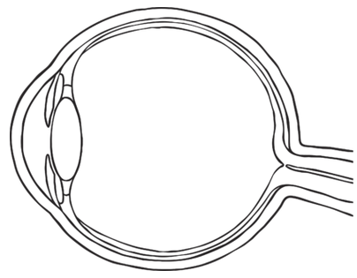
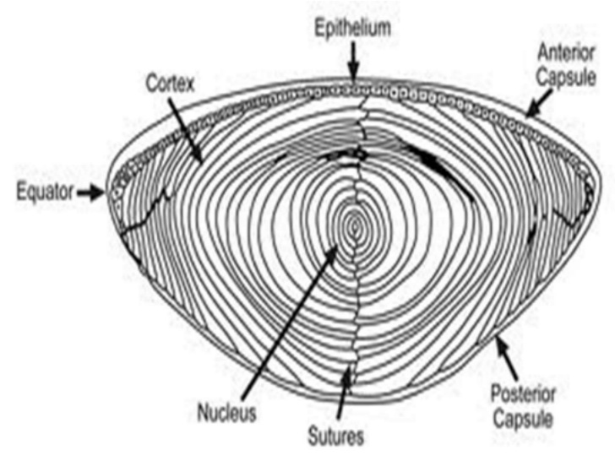
Eye and Lens
Lens is located in front of eye. Focuses light on back of eye.
To focus, we change the curvature of the lens (more or less spherical)
Three parts: capsule (outer elastic layer of cells), epithelium (cells that divide to produce fiber cells), fiber cells (clear, organelle-free cells)

Slide 3
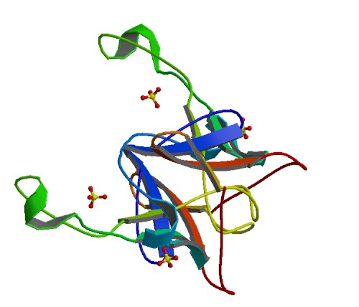
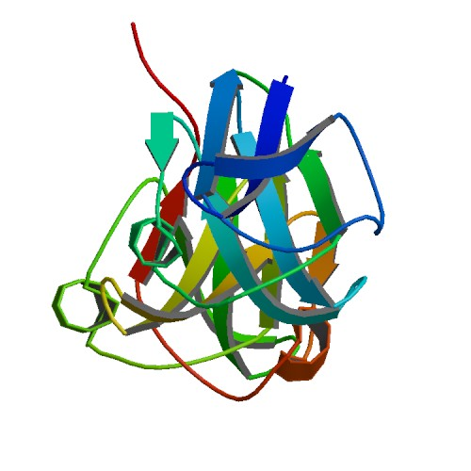
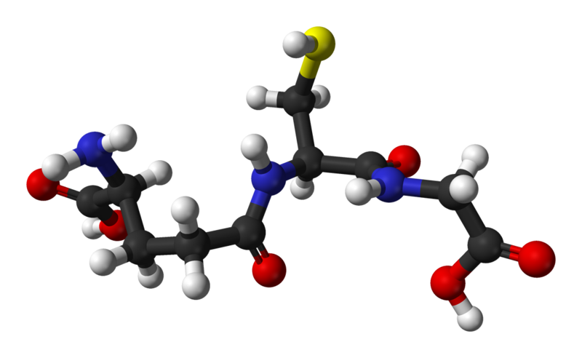
Fiber Cells and Crystallin
Fiber cells' protein: 90% crystallin
Three types:
α-crystallin: Structural protein and "chaperone" (binds to proteins to stabilize and prevent aggregation, but doesn't refold them). Two units: αA, αB
Encoded by CRYAA, CRYAB genes
β- and γ-crystallin: Structural protein, but otherwise no significant function
Encoded by CRYB*, CRYG* genes
Fiber cells are organelle-free; proteins are permanent.
Glutathione (GSH): Anti-oxidant, prevents oxidation of the crystallins.
Encoded by GSTM1, GSTT1 genes
Notes:
CRYBA1 CRYBA4 CRYBA4 CRYBB1 CRYBB2 CRYBB3 CRYBB3 CRYGA CRYGB

Slide 4
Cataract
There are 2 main factors that lead to cataract:
1: Depletion of glutathione within the lens
Glutathione levels decrease for two reasons:
Formation of a lens barrier:
At around age 30-50, the nucleus/cortex barrier becomes impermeable to larger molecules.
Glutathione is blocked from the nucleus, and unstable molecules (ROS) are locked inside.
Decreased recycling efficiency:
Glutathione can be reduced (GSH) or oxidized (GSSG); GSH is responsible for antioxidant properties (electron donor)
GSSG is converted to GSH in the presence of glutathione reductase (GR) and NADPH
With age, GR activity decreases, resulting in buildup of GSSG and decrease of GSH.

Slide 5
Cataract
There are 2 main factors that lead to cataract:
2: Desolubilization of crystallin proteins
Cells have limited supply of proteins; eventually, α-crystallin runs out
No active α-crystallin remains by age 40.
Without α-crystallin, oxidized βγ-crystallins aggregate and desolubilize
Damage from reactive oxygen species, which is no longer prevented by antioxidants.
Protein-protein interactions, especially crosslinking
Desolubilized aggregates are opaque, forming cataracts.

Slide 6
Hypotheses
Hypothesis: Cataracts are a result of a combination of genetic factors and environmental stresses.
Hypothesis: By increasing the concentration of α-crystallin and antioxidants, the development of cataracts can be mitigated.
Hypothesis: A pre-existing cataract may be treatable by dissolving the protein aggregate, then binding the free proteins with α-crystallin.

Slide 7
Works Cited
Basha, Eman, et al. “Small Heat Shock Proteins and α-Crystallins: Dynamic Proteins with Flexible Functions.” Trends in Biochemical Sciences, vol. 37, no. 3, Mar. 2012, pp. 106–117., doi:10.1016/j.tibs.2011.11.005.
Hejtmancik, J Fielding, and Marc Kantorow. “Molecular genetics of age-related cataract.” Experimental eye research vol. 79,1 (2004): 3-9. doi:10.1016/j.exer.2004.03.014
Ho, Min-Chieh, et al. “Senile Cataracts and Oxidative Stress.” Journal of Clinical Gerontology and Geriatrics, vol. 1, no. 1, 29 July 2010, pp. 17–21., doi:10.1016/j.jcgg.2010.10.006.
Horwitz, Joseph, et al. “Lens α-Crystallin: Function and Structure.” Eye, vol. 13, no. 3, 1999, pp. 403–408., doi:10.1038/eye.1999.114.
Laganowsky, Arthur, et al. “Crystal Structures of Truncated AlphaA and AlphaB Crystallins Reveal Structural Mechanisms of Polydispersity Important for Eye Lens Function.” Protein Science, vol. 19, no. 5, 29 Mar. 2010, pp. 1031–1043., doi:10.1002/pro.380.
Maulucci, Giuseppe, et al. “The Thermal Structural Transition of α-Crystallin Inhibits the Heat Induced Self-Aggregation.” PLoS ONE, vol. 6, no. 5, 9 May 2011, doi:10.1371/journal.pone.0018906.
Michael, R., and A. J. Bron. “The Ageing Lens and Cataract: a Model of Normal and Pathological Ageing.” Philosophical Transactions of the Royal Society B: Biological Sciences, vol. 366, no. 1568, 27 Apr. 2011, pp. 1278–1292., doi:10.1098/rstb.2010.0300.
Moreau, Kate L., and Jonathan A. King. “Protein Misfolding and Aggregation in Cataract Disease and Prospects for Prevention.” Trends in Molecular Medicine, vol. 18, no. 5, 1 May 2012, pp. 273–282., doi:10.1016/j.molmed.2012.03.005.
Pizzorno, Joseph. “Glutathione!.” Integrative medicine (Encinitas, Calif.) vol. 13,1 (2014): 8-12.
Sharma, K. Krishna, and Puttur Santhoshkumar. “Lens Aging: Effects of Crystallins.” Biochimica Et Biophysica Acta (BBA) - General Subjects, vol. 1790, no. 10, Oct. 2009, pp. 1095–1108., doi:10.1016/j.bbagen.2009.05.008.
Sweeney, Matthew H.j., and Roger J.w. Truscott. “An Impediment to Glutathione Diffusion in Older Normal Human Lenses: a Possible Precondition for Nuclear Cataract.” Experimental Eye Research, vol. 67, no. 5, 25 June 1998, pp. 587–595., doi:10.1006/exer.1998.0549.
Truscott, Roger J.w. “Age-Related Nuclear Cataract—Oxidation Is the Key.” Experimental Eye Research, vol. 80, no. 5, 26 Feb. 2005, pp. 709–725., doi:10.1016/j.exer.2004.12.007.

