Slide 1
Cataract
Notes:
Oh yeah, change the title. This one is trash.

Slide 2
Abstract

Slide 3
Introduction

Slide 4
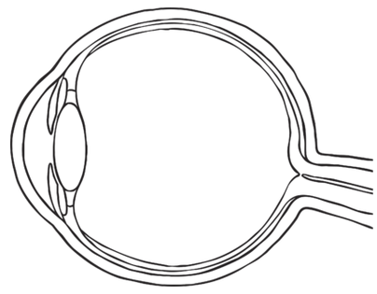
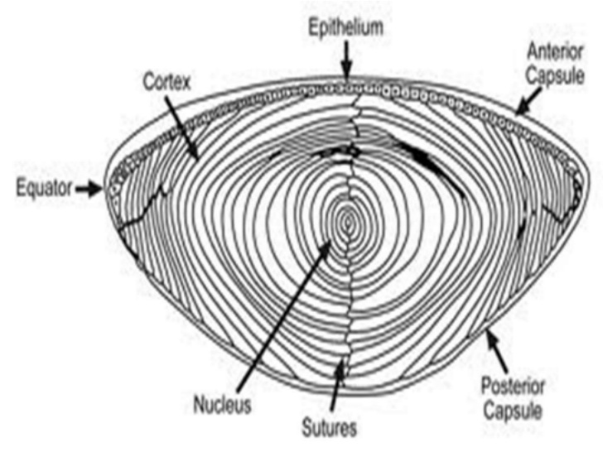
Eye and Lens
Lens is located in front of eye; its function is to focus incoming light onto the retina.
Three parts: capsule (outer elastic layer of cells), epithelium (cells that divide to produce fiber cells), fiber cells (clear, organelle-free cells)
To focus, we change the curvature of the lens

Slide 5
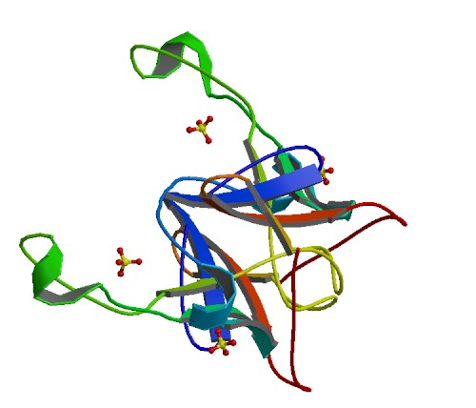
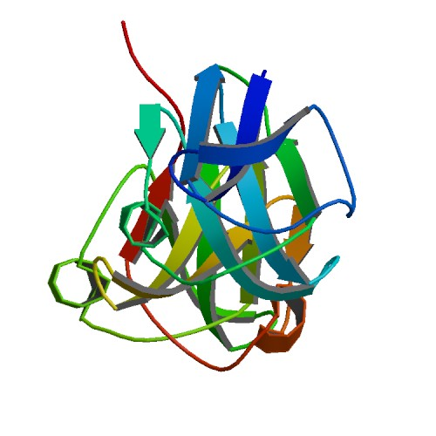
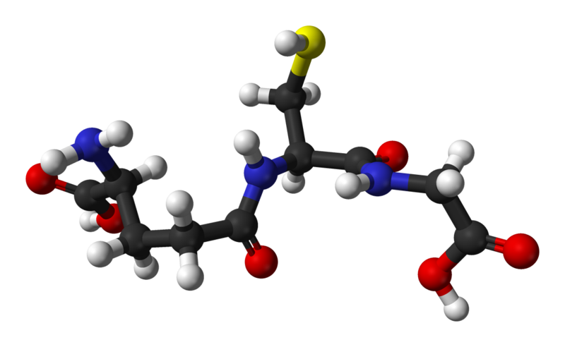
Fiber Cells and Crystallin
Fiber cells' protein: 90% crystallin
Three types:
α-crystallin: Structural protein and "chaperone" (binds to proteins to stabilize and prevent aggregation, but doesn't refold them). Two units: αA, αB
Encoded by CRYAA, CRYAB genes
β- and γ-crystallin: Structural protein, but otherwise no significant function
Encoded by CRYB*, CRYG* genes
Fiber cells are organelle-free; proteins are permanent.
Glutathione (GSH): Anti-oxidant, prevents oxidation of the crystallins.
Encoded by GSTM1, GSTT1 genes
Notes:
CRYBA1 CRYBA4 CRYBA4 CRYBB1 CRYBB2 CRYBB3 CRYBB3 CRYGA CRYGB

Slide 6
Cataract
Cataract is opacification of the lens; when the lens becomes cloudy and blocks vision
Opaque areas are aggregates of desolubilized crystallin proteins
Protein aggregation is caused by oxidation
Naturally over time: age-related cataract
As a result of high sugar concentration in the eye: diabetic cataract (or similar)
Through genetic mutations
Currently, only approved treatment is surgical replacement of the lens
Presents complications in areas with poor healthcare and/or low wealth
Leading cause of blindness worldwide
Estimated 17 million people with bilateral cataracts (Congdon et al, 2003)

Slide 7
Goals
Cataract is an immediate result of two factors:
Decrease of glutathione levels
Formation of lens barrier
Decreased recycling efficiency
Usage of α-crystallin
Limited supply; by age 40, no α-crystallin remains
Mutations in crystallin genes can result in nonfunctional α-crystallin
Goal:
Identify genetic pathways related to cataract formation
Pathways can be targeted by drugs to prevent or treat cataract (non-surgically)

Slide 8









Gene Collection
Gene Clustering
Function Analysis
Pathway Analysis
Methods

Slide 9
Methods
Gene Collection
Gene Clustering
Cataract-related genes were collected from:
PubMed Gene
Using query “cataract & “homo sapiens”[Organism]”
Phenopedia
Genes found under Cataract disease
Gene collections were submitted separately to GeneFriends:RNASeq
GeneFriends-generated networks were mapped in Cytoscape
Clusters were identified via ClusterONE app with parameter “Haircut threshold” set to 0.05, all others left as default

Slide 10
Methods
Function Analysis
Pathway Analysis
Clusters were analyzed within Cytoscape using BinGO app
Yielded function results
Clusters were extracted from Cytoscape and processed in GeneOntology
Yielded function and disease connections
Clusters were processed in DAVID and Ingenuity to search for pathways

Slide 11
Results

Slide 12
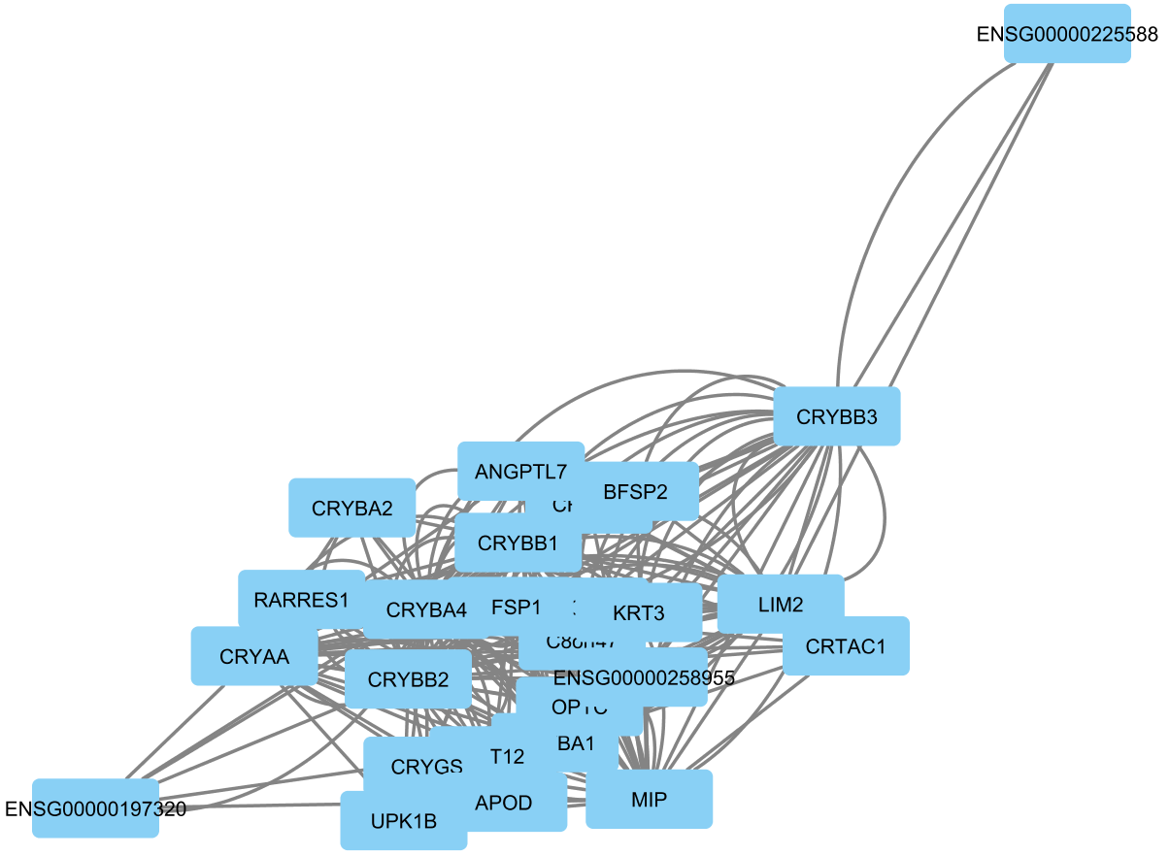
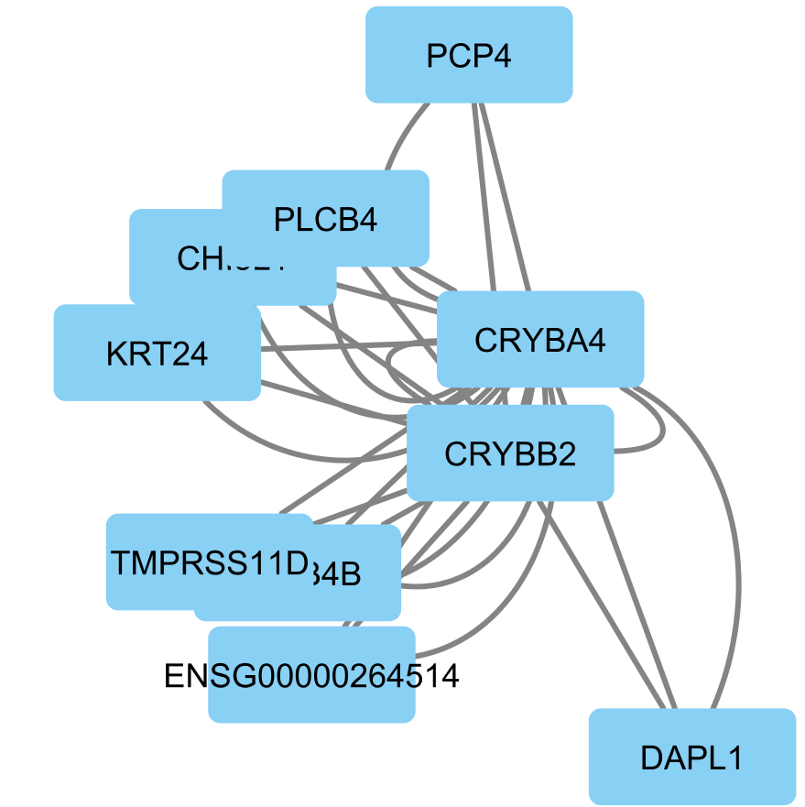
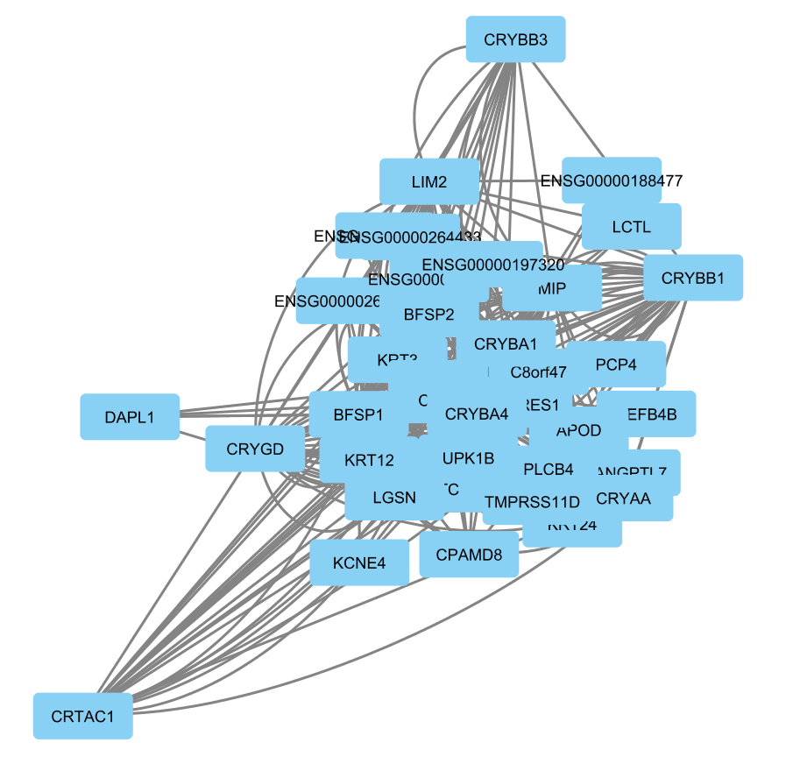
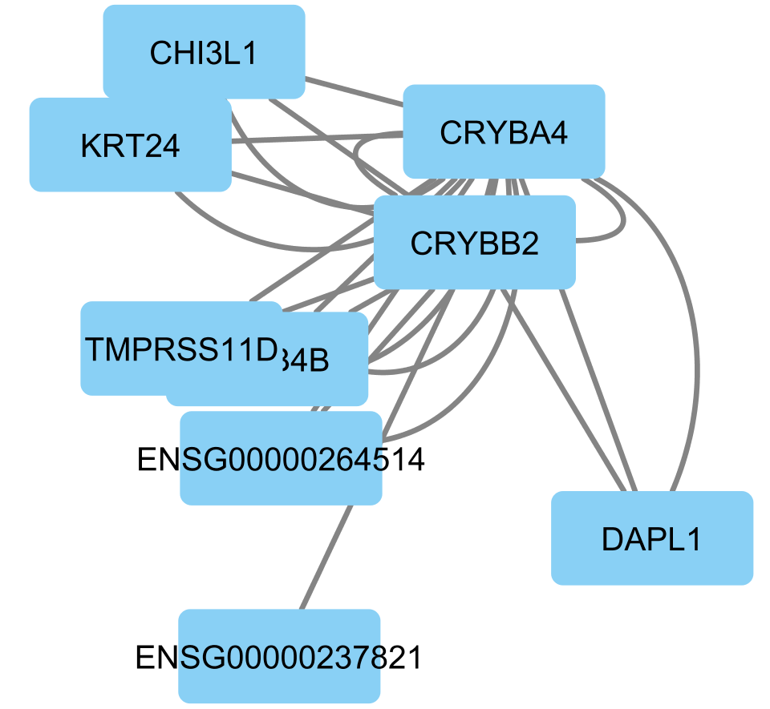
Clusters
Cluster 20
p=0.010
Cluster 7
p=2.896e-4
Cluster 8
p=7.329e-7
Cluster 21
p=0.021
Notes:
Show the entire big fat cytoscape network
shock and awe tactics

Slide 13
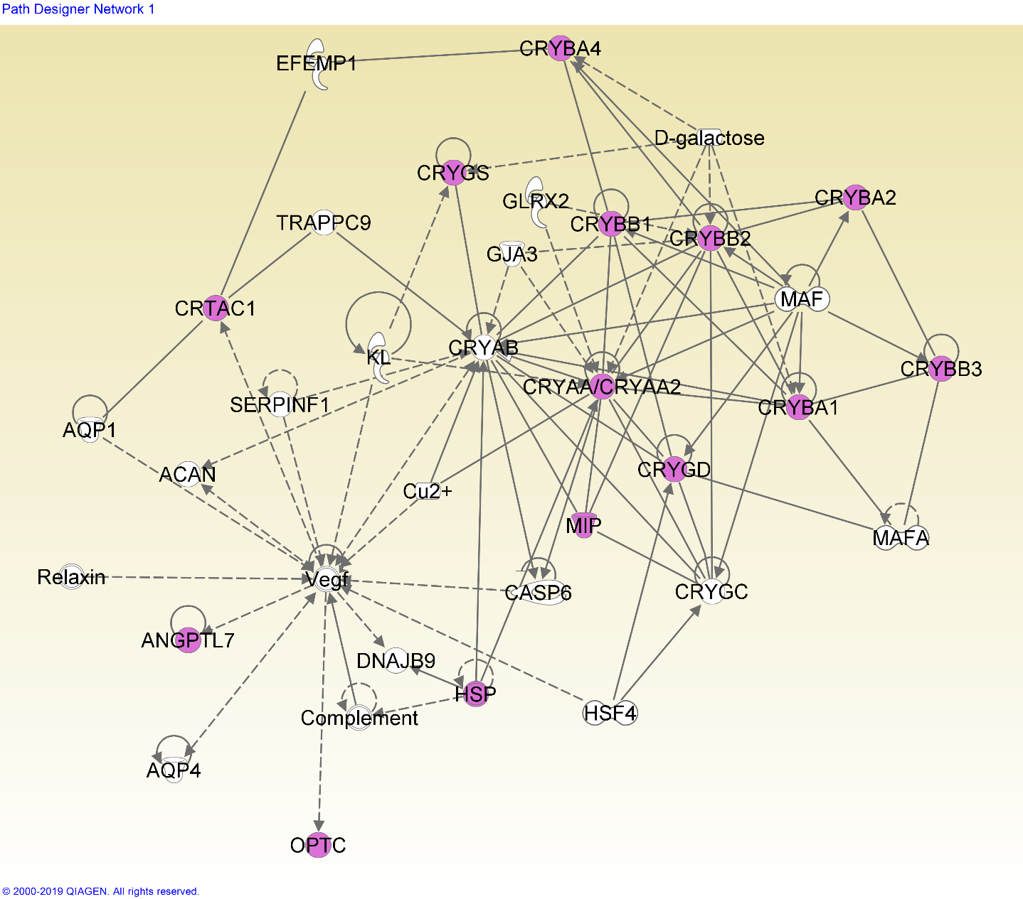
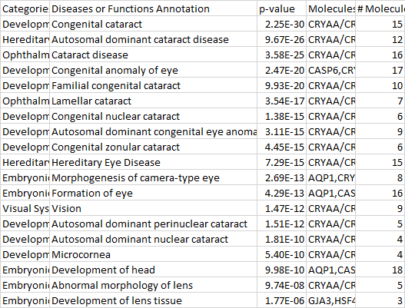
Network 7-1
A standard cataract-related network.

Slide 14
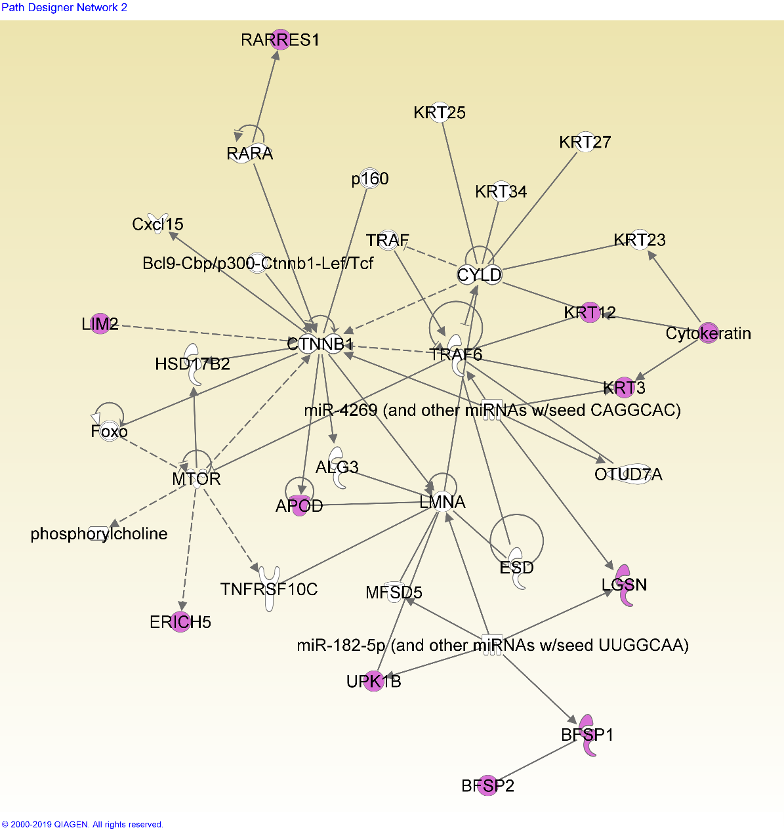
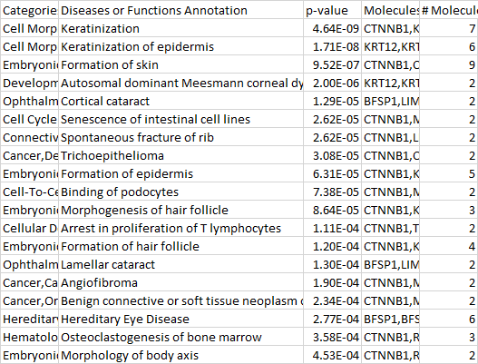
Network 7-2
This network shows many functions related to keratinization (insertion of keratin into skin/hair cells).
Keratin is present in the lens epithelium, and forms a significant part of its structural integrity (Quinlan et al, 1999). This network may imply that keratin in the epithelial and early fiber cells plays a role in later cataract formation.

Slide 15
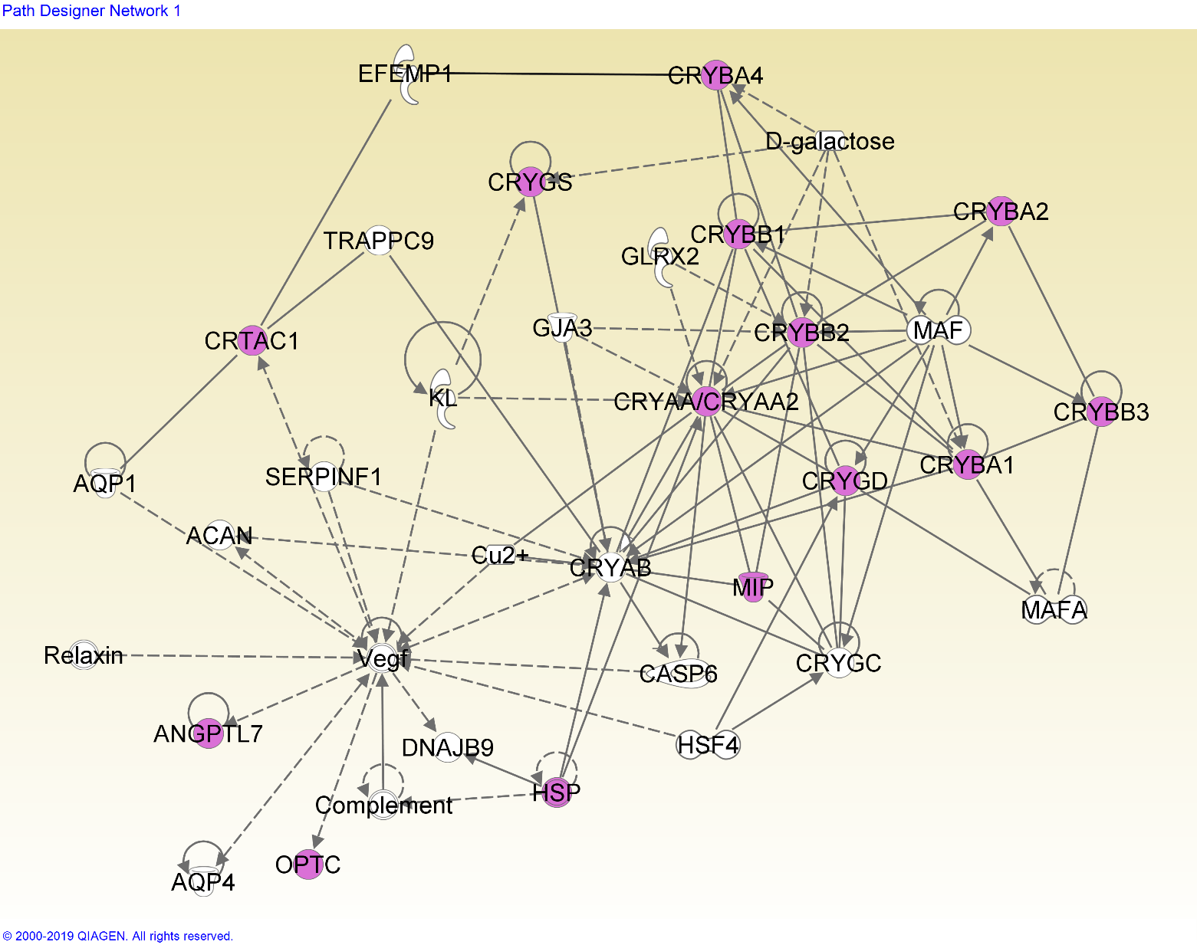
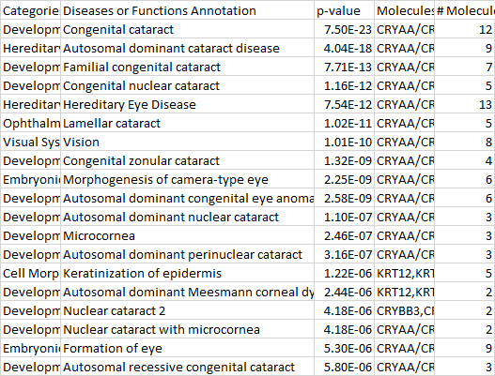
Network 8-1
Another cataract-focused network.

Slide 16
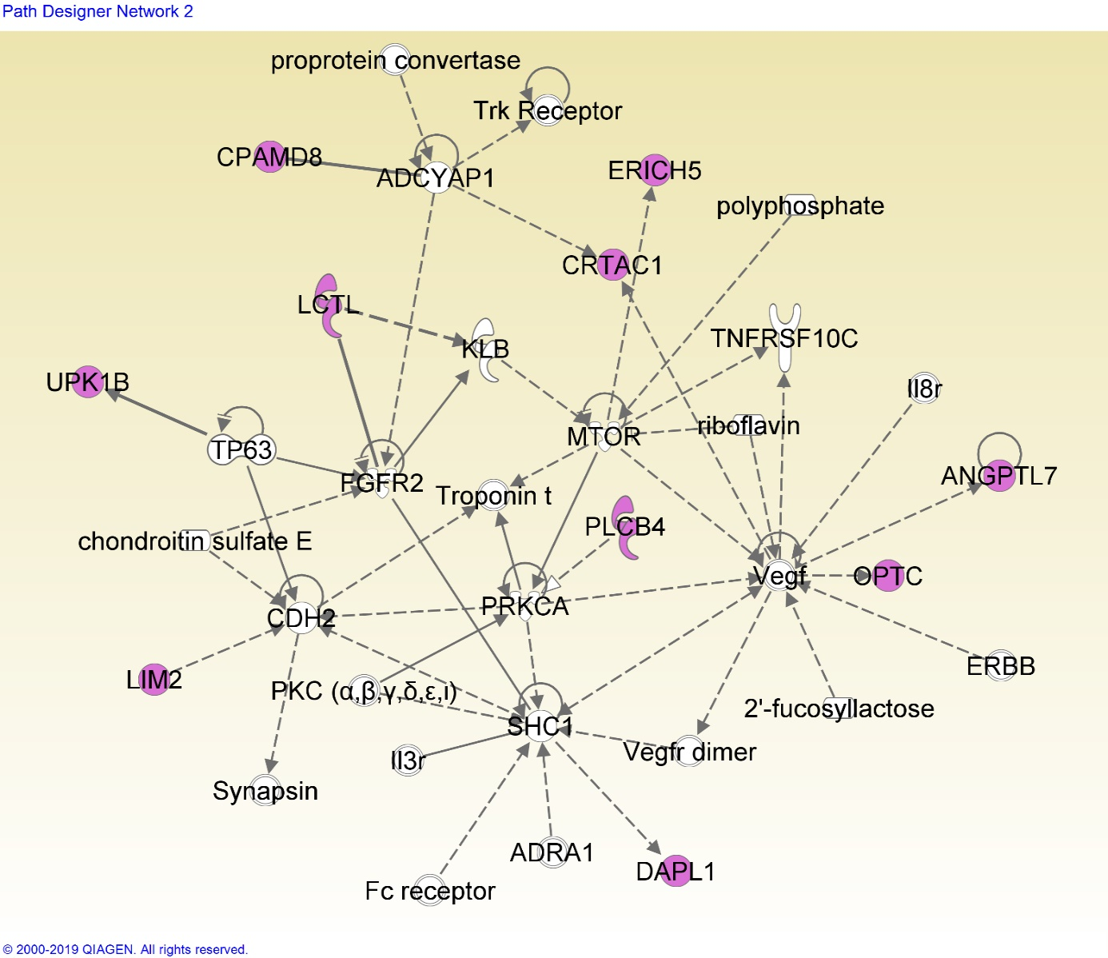
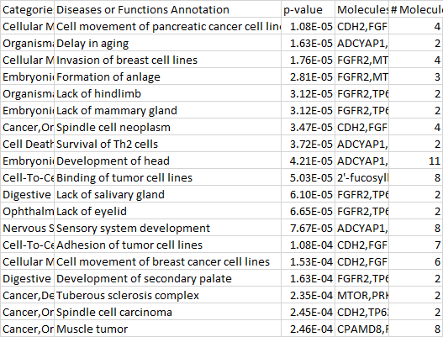
Network 8-2
Notes:
Organ development; overall, developmental functions

Slide 17
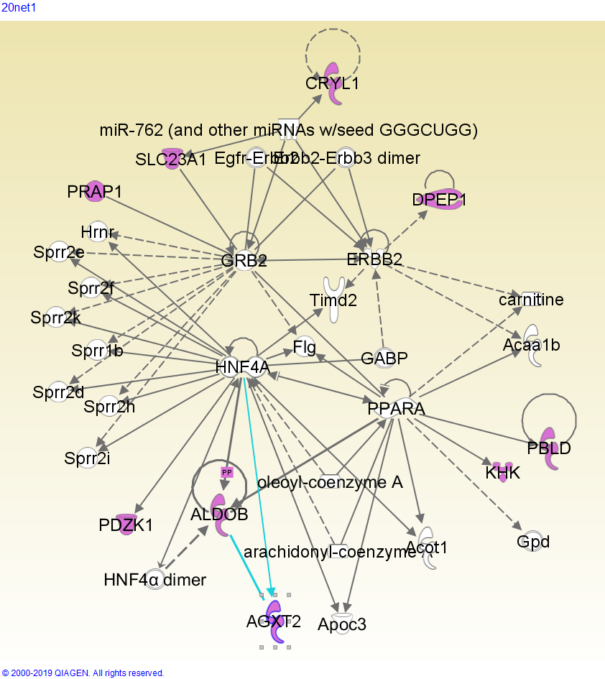
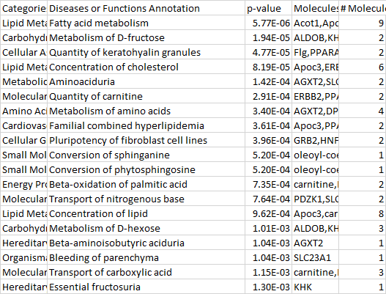
Network 20-1
A network related to metabolism, especially of sugars, fats, and amino acids. Fatty acids affect the expression of lutein, which is shown to prevent cataract formation (Padmanabha & Vallikannan, 2018); sugars are known to cause cataract, since an increased blood sugar concentration affects the concentration of the fiber cell cytoplasm (Pollreisz & Schmidt-Erfurth, 2010)

Slide 18
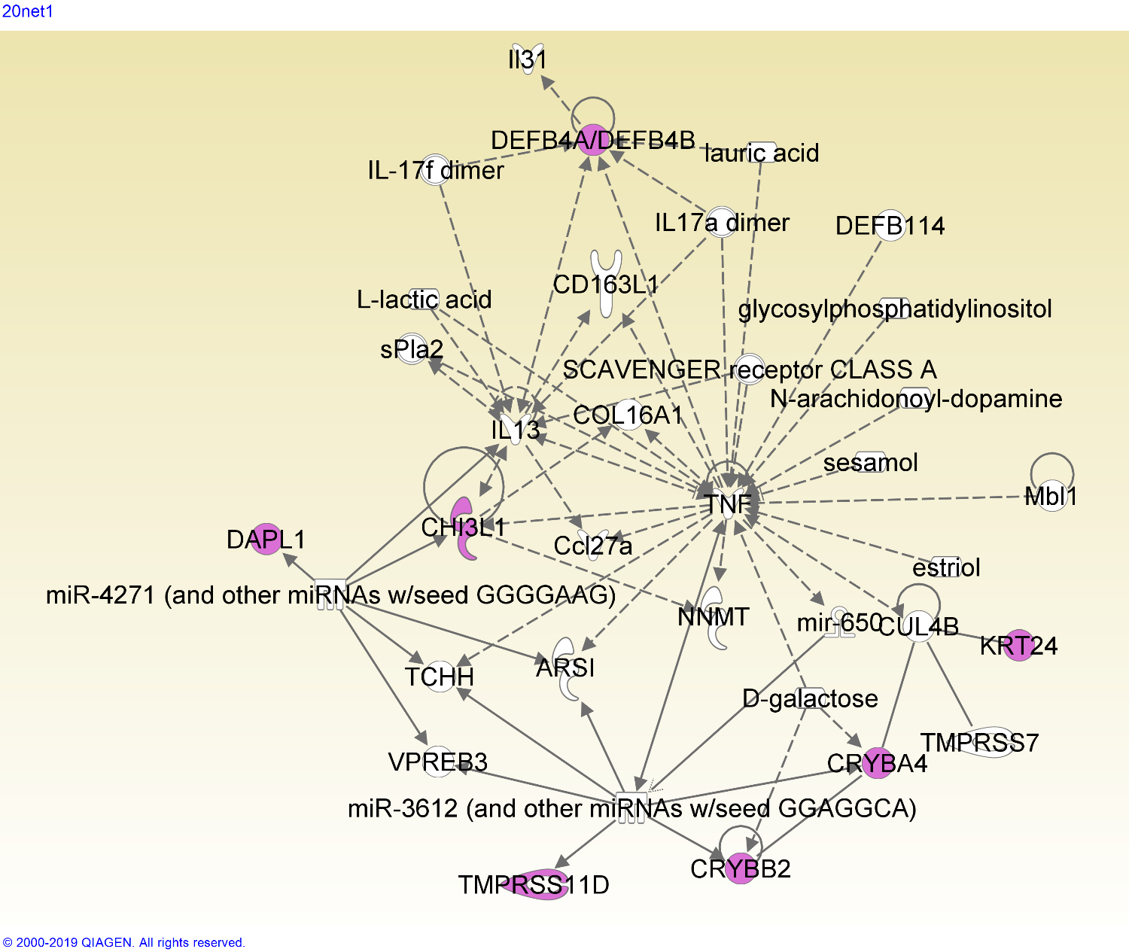
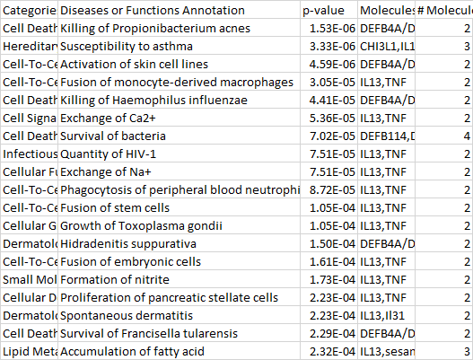
Network 21-1
This network is heavily centered around the TNF (tumor necrosis factor) gene, which has many functions varying from tissue regeneration to apoptosis (Wajant, et al).

Slide 19
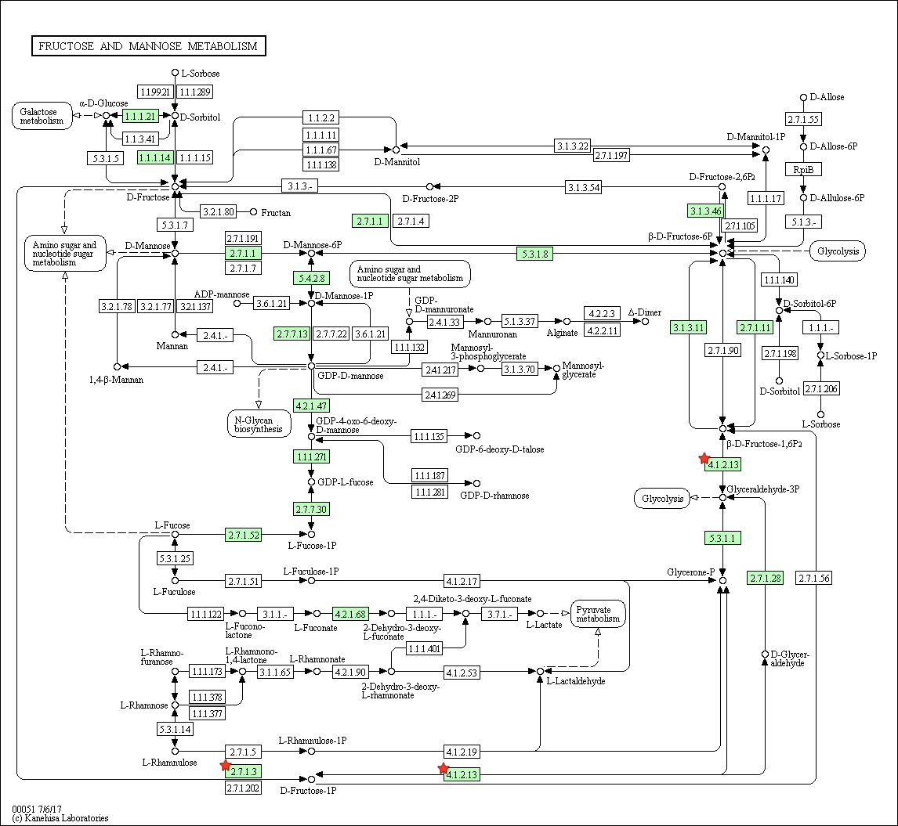
Cluster 20 – fructose metabolism pathway
Notes:
Fructose = sugar = related; emphasize more and downplay the fact that there’s only three (two) genes

Slide 20
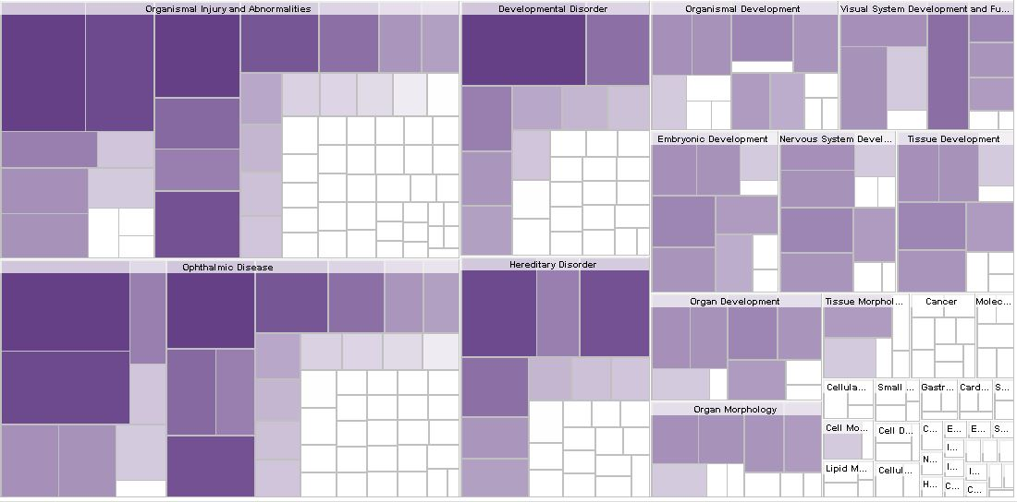

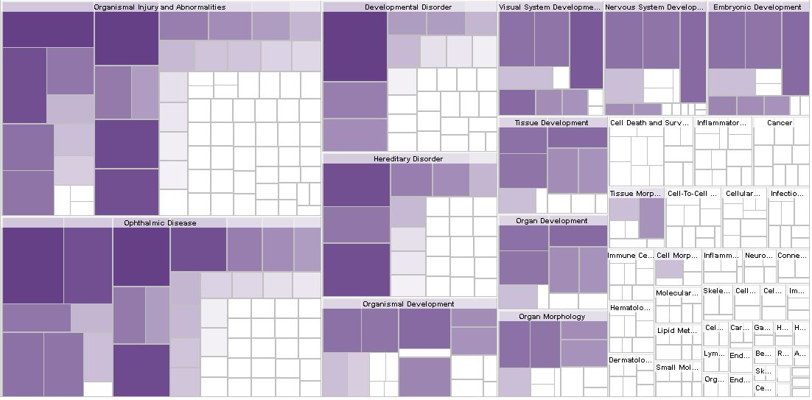


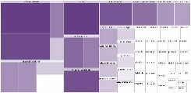
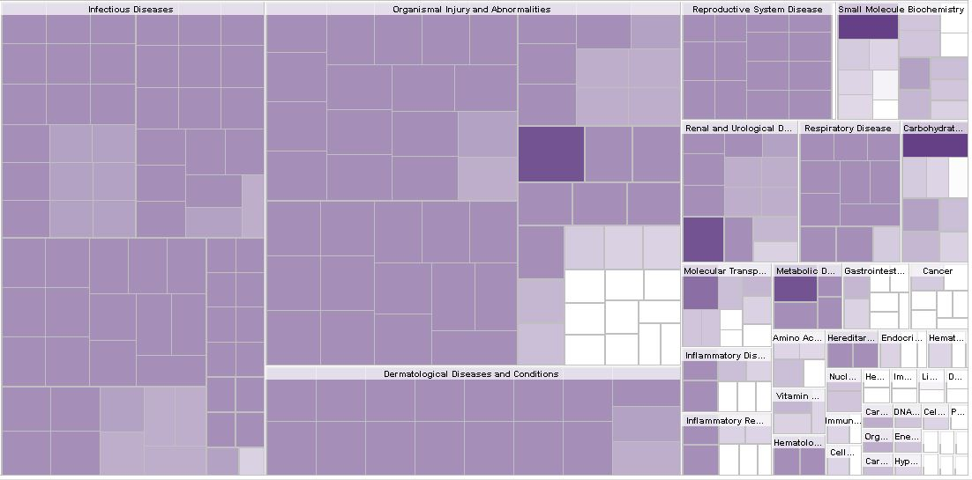

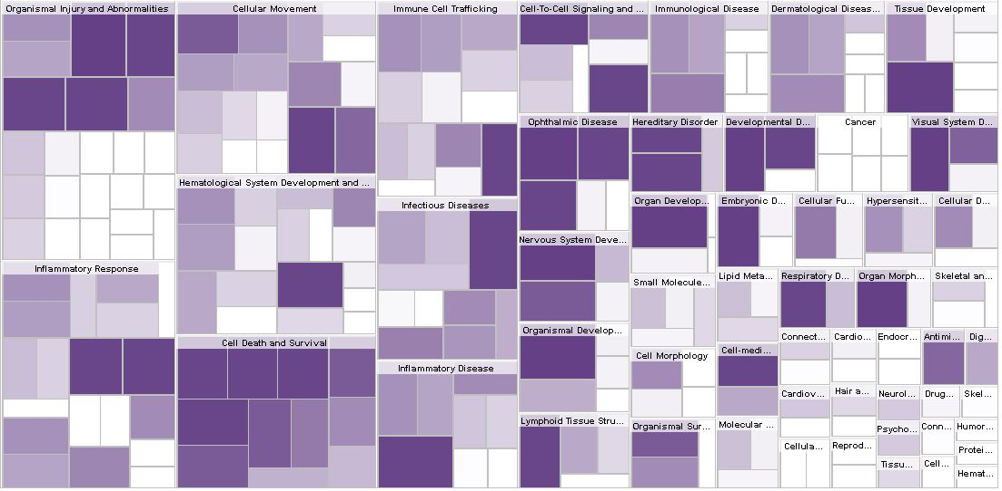



Notes:
Label ._.

Slide 21
Discussion

Slide 22

Networks
The prevalence of keratin genes and keratin-related functions within this network implies that keratin genes play a role in cataractogenesis. As previously stated, keratin is found in lens epithelial and young fiber cells, and this presence may leave structural and/or chemical remnants that lead to development of cataract.
Other genes here (LIM2, BFSP1, BFSP2) also encode lens structural proteins, reinforcing the hypothesis that the structural protein keratin is associated with cataract.
Network 7-2

Slide 23

Networks
TNF affects many of the genes in this network; it causes an increase in DEFB4A/DEFB4B and CHI3L1 genes, and it and CRYBA4/CRYBB2 are both impacted by D-galactose.
The DEFB4 genes encode defensin antimicrobial protein, and CHI3L1 encodes a chitin-hydrolysing enzyme; this may mean that antimicrobial pathways play a role in cataract, and may even imply that cataract is affected by microbial factors.
Network 21-1

Slide 24
Conclusion
We have found two functions previously unassociated with cataractogenesis. The impact of keratin on epithelial and fiber cells may be an important factor in cataract formation during old age. In addition, the action of TNF genes and their impact on other genes may also influence cataract. Of course, further investigation is needed to confirm these links.
Cataract remains a highly prevalent problem around the world. Further elucidation of the causes and pathways leading to cataract can lead to development of therapies and treatments aimed at these causes, helping to prevent and ultimately treat cataracts non-surgically. Such a breakthrough will have large impacts on cataract prevalence, especially in third-world countries and among people with poor healthcare or socioeconomic status.

Slide 25
Citations
Congdon, Nathan G. “Important Causes of Visual Impairment in the World Today.” Jama, vol. 290, no. 15, 15 Oct. 2003, pp. 2057–2060., doi:10.1001/jama.290.15.2057.
Padmanabha, Smitha, and Baskaran Vallikannan. “Fatty Acids Modulate the Efficacy of Lutein in Cataract Prevention: Assessment of Oxidative and Inflammatory Parameters in Rats.” Biochemical and Biophysical Research Communications, vol. 500, no. 2, 2 June 2018, pp. 435–442., doi:10.1016/j.bbrc.2018.04.098.
Pollreisz, Andreas, and Ursula Schmidt-Erfurth. “Diabetic Cataract—Pathogenesis, Epidemiology and Treatment.” Journal of Ophthalmology, vol. 2010, 2 Apr. 2010, pp. 1–8., doi:10.1155/2010/608751.
Quinlan, R A, et al. “The Eye Lens Cytoskeleton.” Eye, vol. 13, no. 3, May 1999, pp. 409–416., doi:10.1038/eye.1999.115.
Wajant, H, et al. “Tumor Necrosis Factor Signaling.” Cell Death & Differentiation, vol. 10, no. 1, 2003, pp. 45–65., doi:10.1038/sj.cdd.4401189.

