Slide 1
Cataract

Slide 2
Introduction

Slide 3
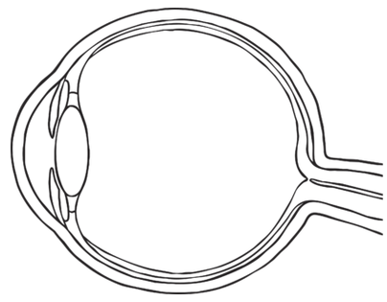
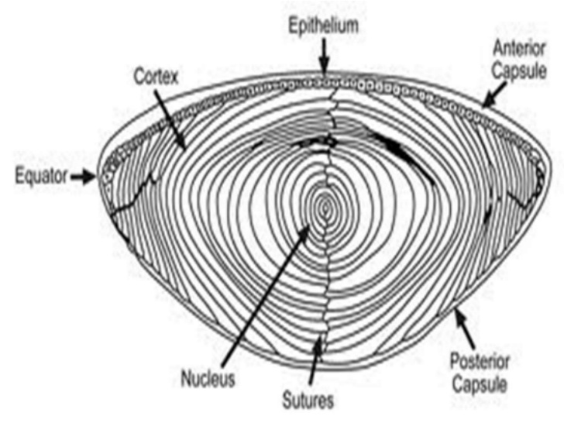
Eye and Lens
Lens is located in front of eye. Focuses light on back of eye.
To focus, we change the curvature of the lens (more or less spherical)
Three parts: capsule (outer elastic layer of cells), epithelium (cells that divide to produce fiber cells), fiber cells (clear, organelle-free cells)

Slide 4
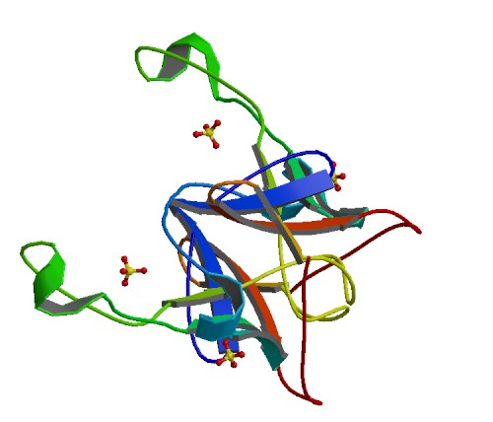
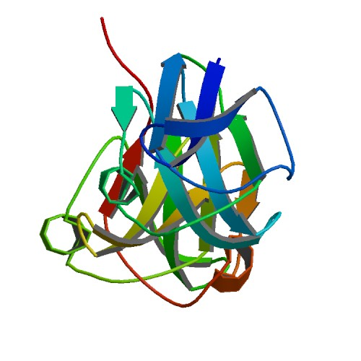
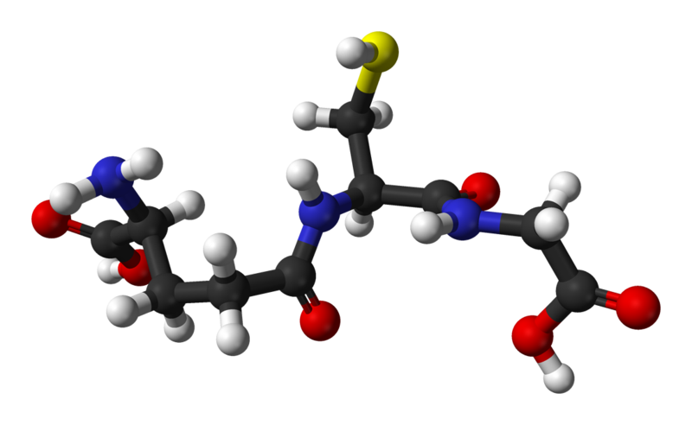
Fiber Cells and Crystallin
Fiber cells' protein: 90% crystallin
Three types:
α-crystallin: Structural protein and "chaperone" (binds to proteins to stabilize and prevent aggregation, but doesn't refold them). Two units: αA, αB
Encoded by CRYAA, CRYAB genes
β- and γ-crystallin: Structural protein, but otherwise no significant function
Encoded by CRYB*, CRYG* genes
Fiber cells are organelle-free; proteins are permanent.
Glutathione (GSH): Anti-oxidant, prevents oxidation of the crystallins.
Encoded by GSTM1, GSTT1 genes
Notes:
CRYBA1 CRYBA4 CRYBA4 CRYBB1 CRYBB2 CRYBB3 CRYBB3 CRYGA CRYGB

Slide 5
Cataract
Cataract is opacification of the lens; when the lens becomes cloudy and blocks vision
Opaque areas are aggregates of desolubilized crystallin proteins
Protein aggregation is caused by oxidation
Naturally over time: age-related cataract
As a result of high sugar concentration in the eye: diabetic cataract (or similar)
Through genetic mutations
Currently, only approved treatment is surgical replacement of the lens
Presents complications in areas with poor healthcare and/or low wealth

Slide 6
Goals
Cataract is an immediate result of two factors:
Decrease of glutathione levels
Formation of lens barrier
Decreased recycling efficiency
Usage of α-crystallin
Limited supply; by age 40, no α-crystallin remains
Mutations in crystallin genes can result in nonfunctional α-crystallin
Goal:
Identify genetic pathways related to cataract formation
Pathways can be targeted by drugs to prevent or treat cataract (non-surgically)

Slide 7









Gene Collection
Gene Clustering
Function Analysis
Pathway Analysis
Methods

Slide 8
Methods
Gene Collection
Gene Clustering
Cataract-related genes were collected from:
PubMed Gene
Using query “cataract & “homo sapiens”[Organism]”
Phenopedia
Genes found under Cataract disease
Gene collections were submitted separately to GeneFriends:RNASeq
GeneFriends-generated networks were mapped in Cytoscape
Clusters were identified via ClusterONE app with parameter “Haircut threshold” set to 0.05, all others left as default

Slide 9
Methods
Function Analysis
Pathway Analysis
Clusters were analyzed within Cytoscape using BinGO app
Yielded function results
Clusters were extracted from Cytoscape and processed in GeneOntology
Yielded function and disease connections
Clusters were processed in DAVID and Ingenuity to search for pathways

Slide 10
Results

Slide 11
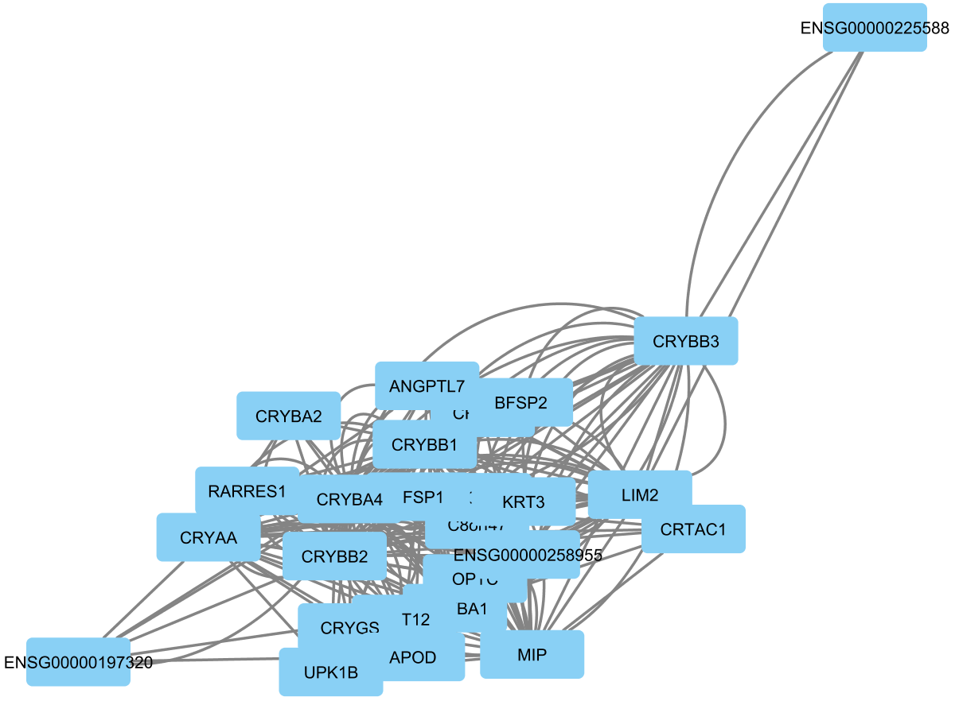
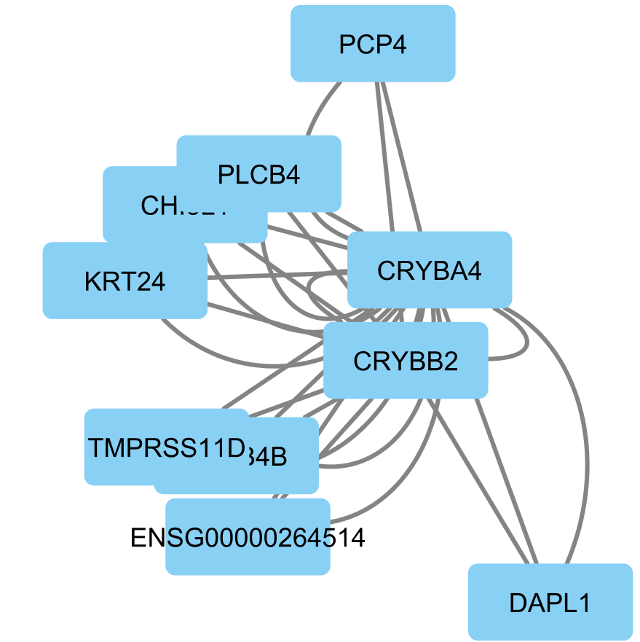
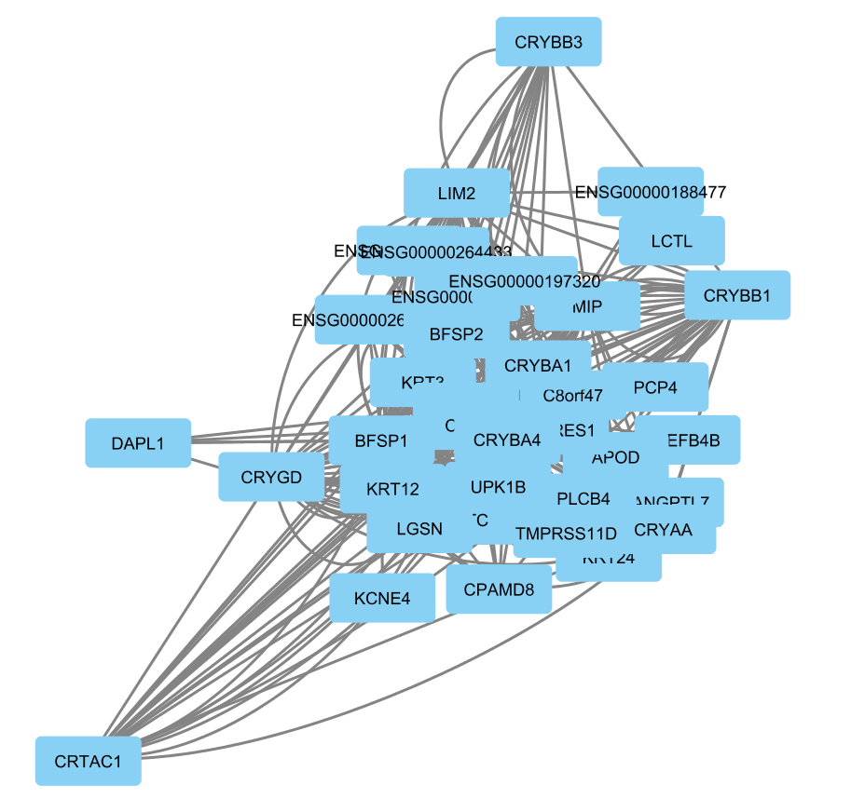
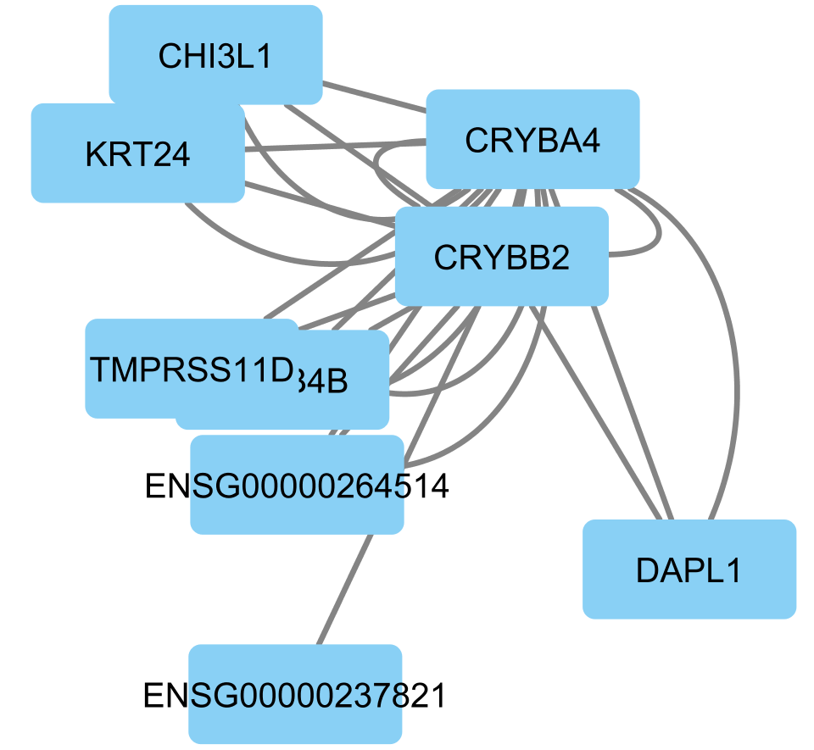
Clusters
Cluster 20
p=0.010
Cluster 7
p=2.896e-4
Cluster 8
p=7.329e-7
Cluster 21
p=0.021

Slide 12
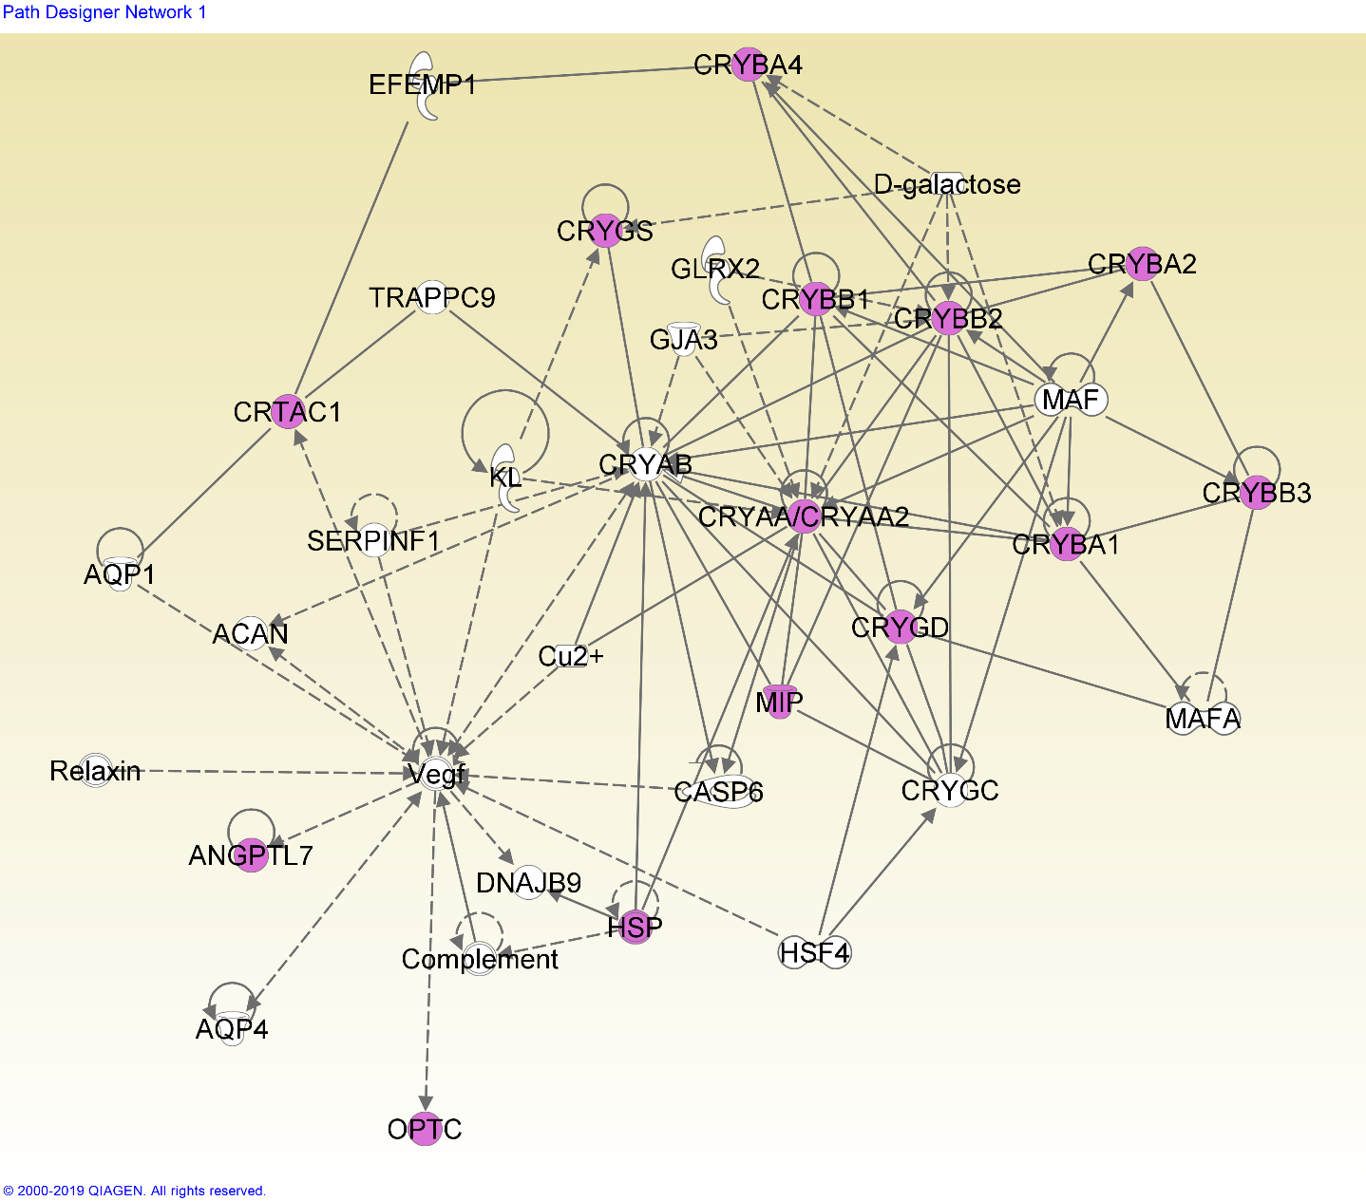
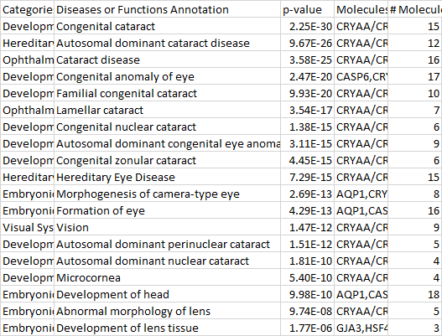
Network 7-1
A standard cataract-related network.

Slide 13
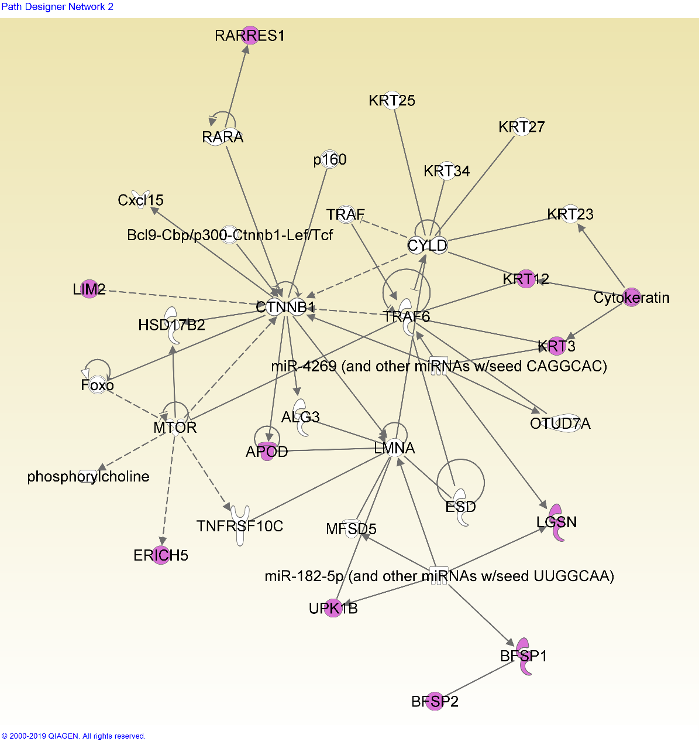
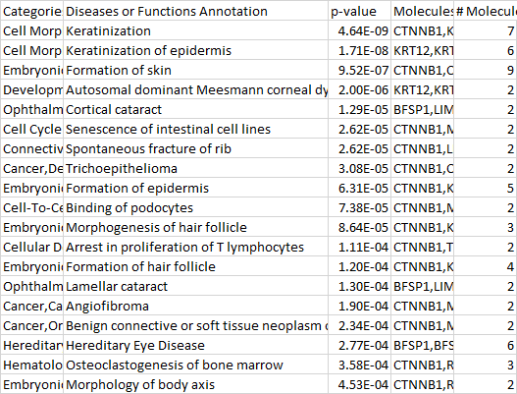
Network 7-2
This network shows many functions related to keratinization (insertion of keratin into skin/hair cells).
Keratin is present in the lens epithelium, and forms a significant part of its structural integrity (Quinlan et al, 1999). This network may imply that keratin in the epithelial and early fiber cells plays a role in later cataract formation.

Slide 14
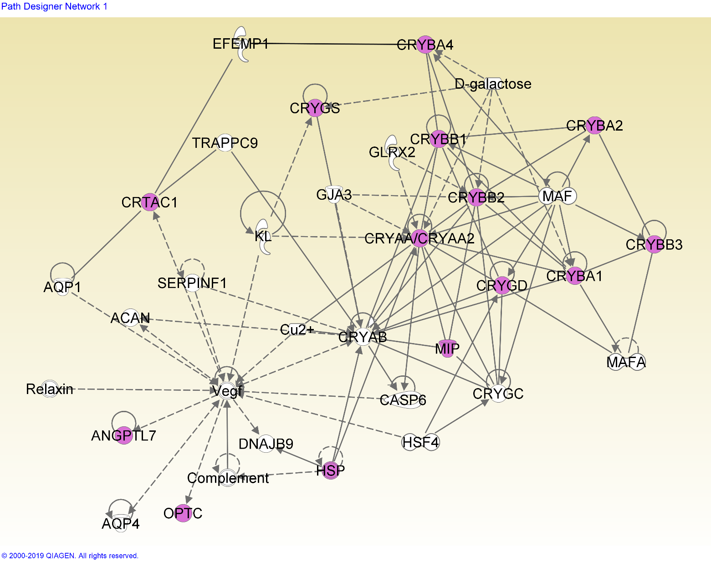
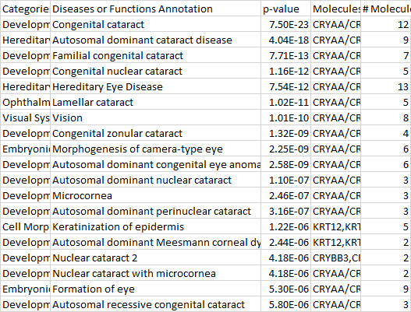
Network 8-1
Another cataract-focused network.

Slide 15
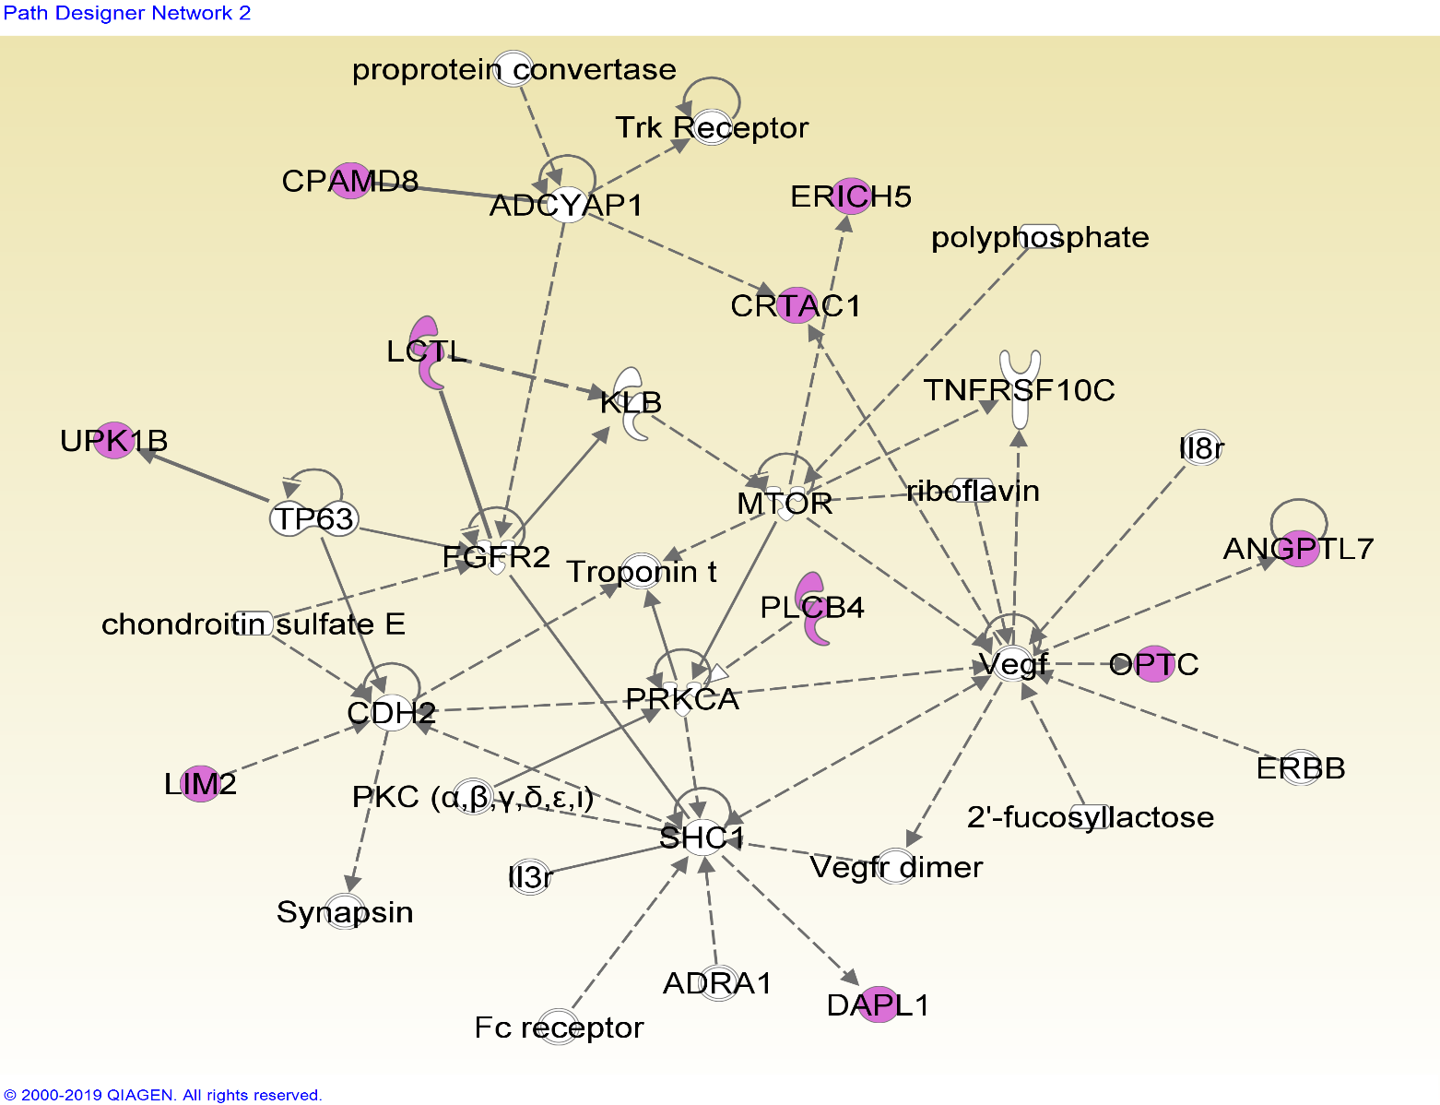
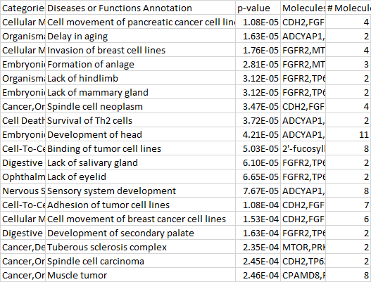
Network 8-2

Slide 16
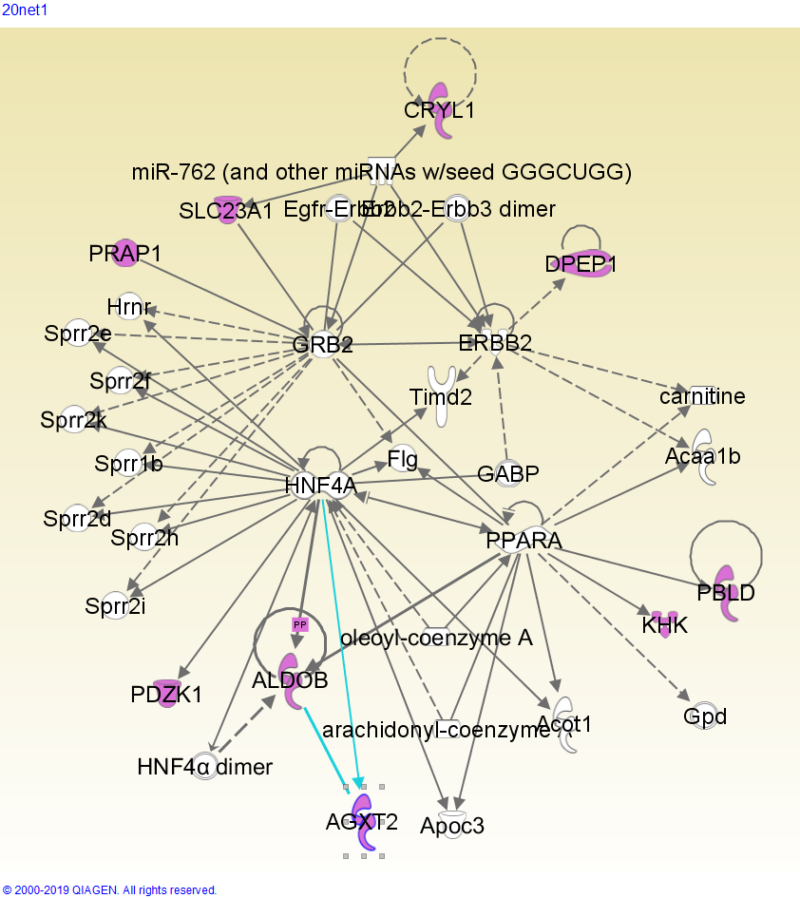
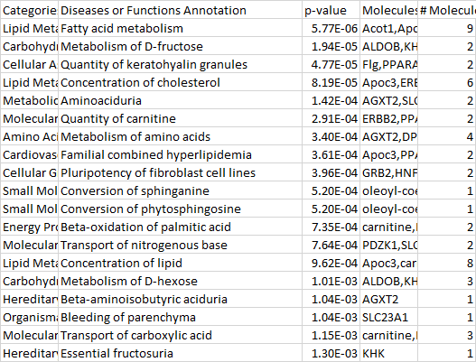
Network 20-1
A network related to metabolism, especially of sugars, fats, and amino acids. Fatty acids affect the expression of lutein, which is shown to prevent cataract formation (Padmanabha & Vallikannan, 2018); sugars are known to cause cataract, since an increased blood sugar concentration affects the concentration of the fiber cell cytoplasm (Pollreisz & Schmidt-Erfurth, 2010)

Slide 17
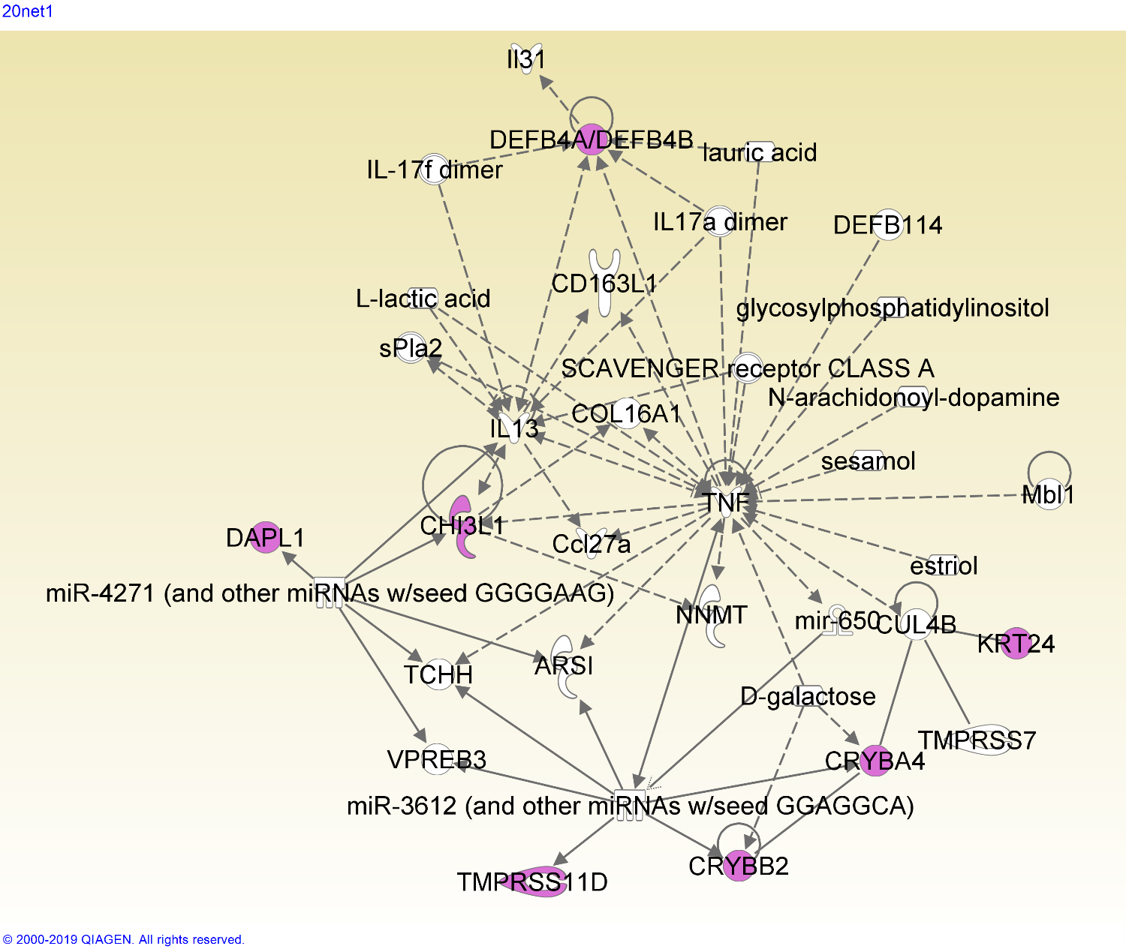
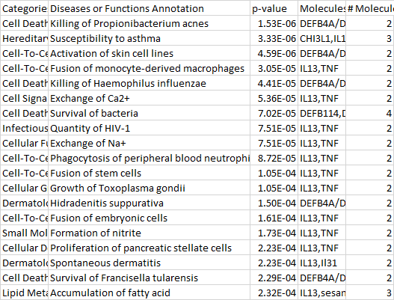
Network 21-1
This network is heavily centered around the TNF (tumor necrosis factor) gene, which has many functions varying from tissue regeneration to apoptosis (Wajant, et al).

Slide 18
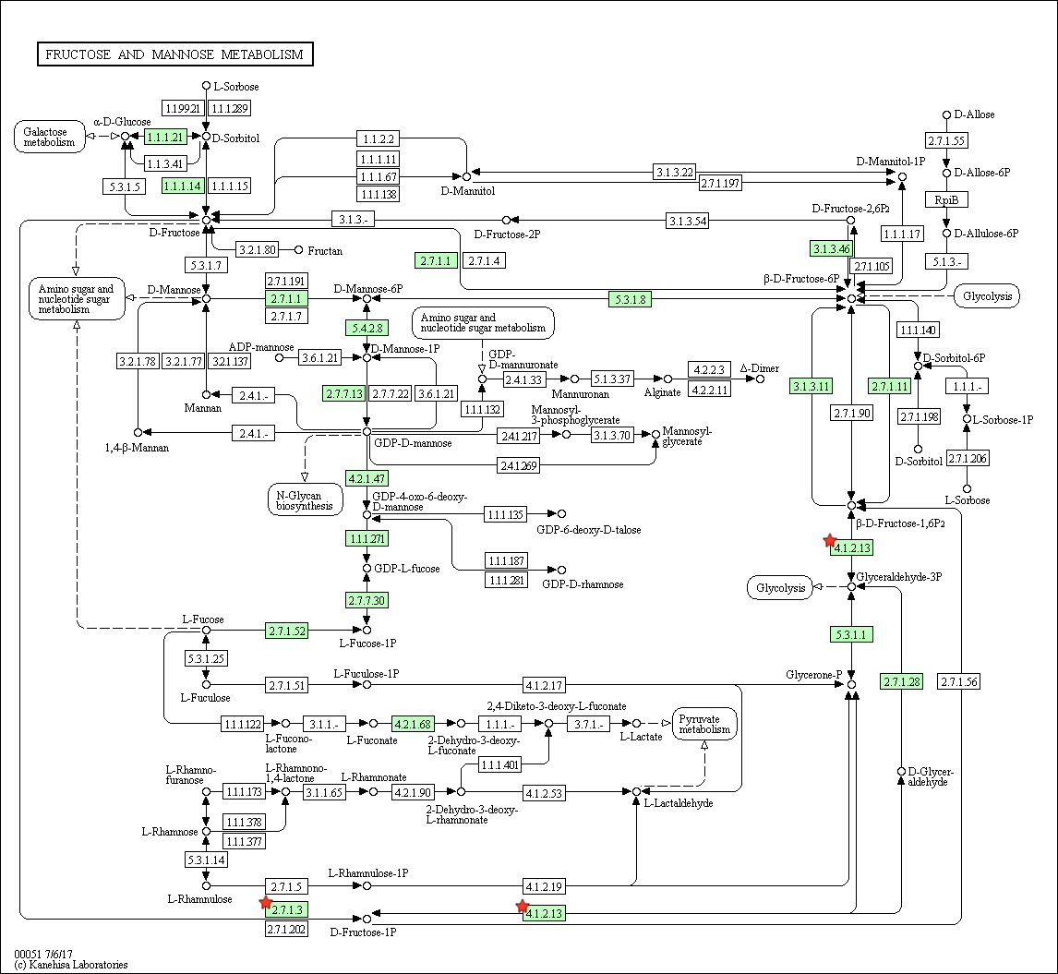
Cluster 20 – fructose metabolism pathway

Slide 19
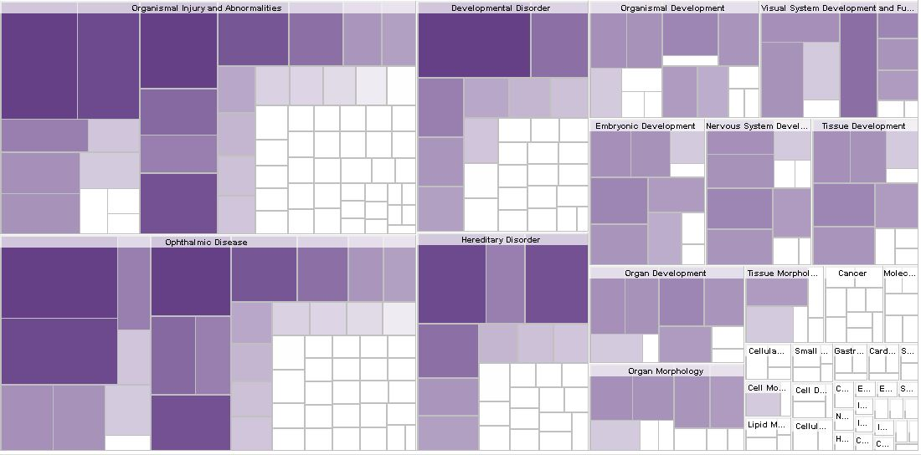

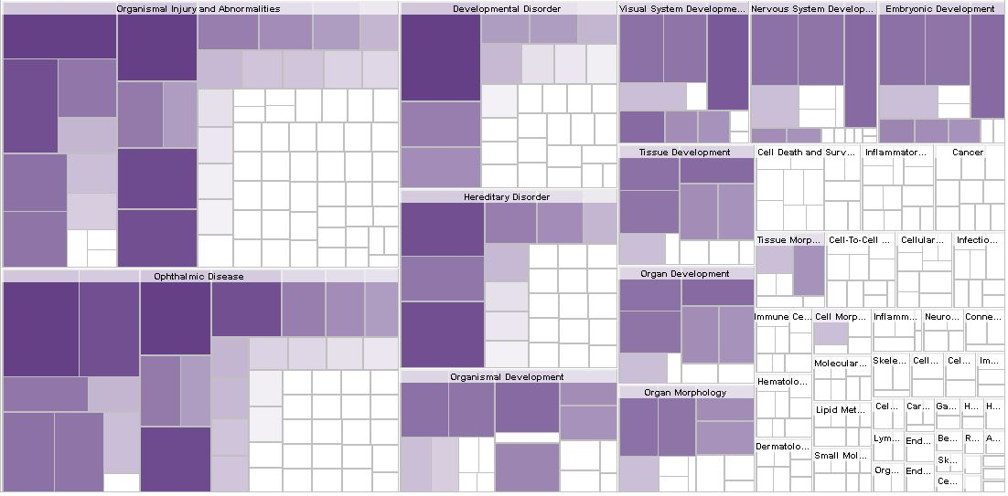


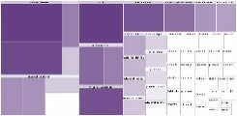
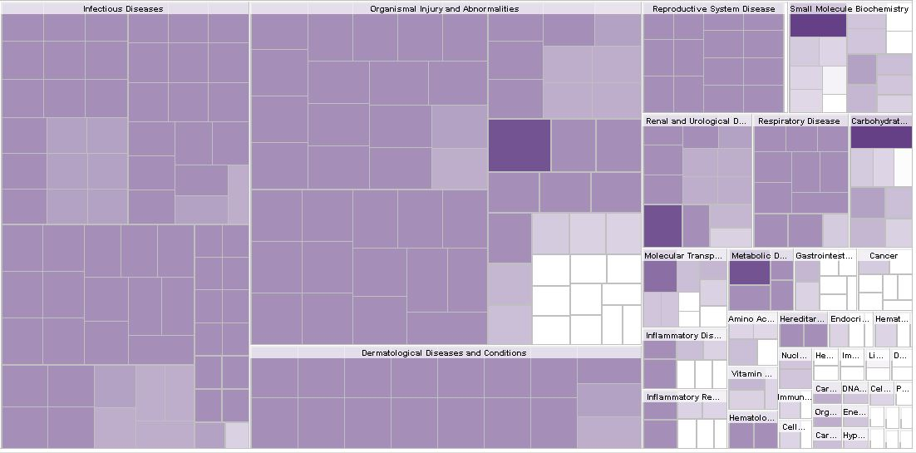

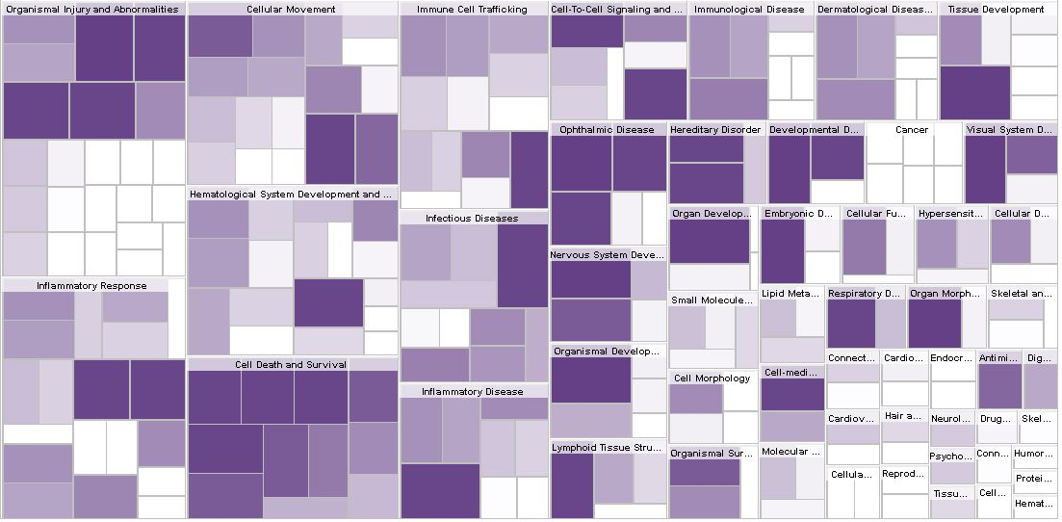




Slide 20
Discussion

Slide 21

Networks
The prevalence of keratin genes and keratin-related functions within this network implies that keratin genes play a role in cataractogenesis. As previously stated, keratin is found in lens epithelial and young fiber cells, and this presence may leave structural and/or chemical remnants that lead to development of cataract.
Other genes here (LIM2, BFSP1, BFSP2) also encode lens structural proteins, reinforcing the hypothesis that the structural protein keratin is associated with cataract.
Network 7-2

Slide 22

Networks
TNF affects many of the genes in this network; it causes an increase in DEFB4A/DEFB4B and CHI3L1 genes, and it and CRYBA4/CRYBB2 are both impacted by D-galactose.
The DEFB4 genes encode defensin antimicrobial protein, and CHI3L1 encodes a chitin-hydrolysing enzyme; this may mean that antimicrobial pathways play a role in cataract, and may even imply that cataract is affected by microbial factors.
Network 21-1

Slide 23
Citations
Padmanabha, Smitha, and Baskaran Vallikannan. “Fatty Acids Modulate the Efficacy of Lutein in Cataract Prevention: Assessment of Oxidative and Inflammatory Parameters in Rats.” Biochemical and Biophysical Research Communications, vol. 500, no. 2, 2 June 2018, pp. 435–442., doi:10.1016/j.bbrc.2018.04.098.
Pollreisz, Andreas, and Ursula Schmidt-Erfurth. “Diabetic Cataract—Pathogenesis, Epidemiology and Treatment.” Journal of Ophthalmology, vol. 2010, 2 Apr. 2010, pp. 1–8., doi:10.1155/2010/608751.
Quinlan, R A, et al. “The Eye Lens Cytoskeleton.” Eye, vol. 13, no. 3, May 1999, pp. 409–416., doi:10.1038/eye.1999.115.
Wajant, H, et al. “Tumor Necrosis Factor Signaling.” Cell Death & Differentiation, vol. 10, no. 1, 2003, pp. 45–65., doi:10.1038/sj.cdd.4401189.

