Slide 1
Cataract

Slide 2
Introduction

Slide 3
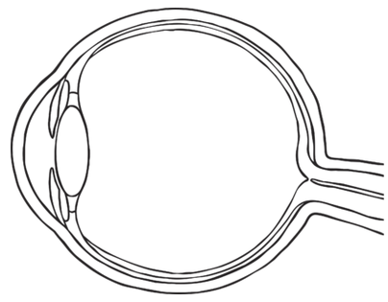
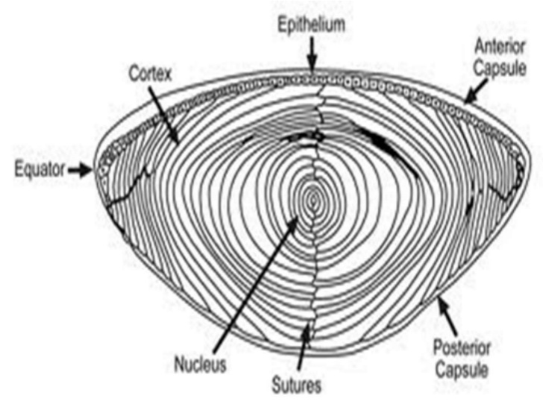
Eye and Lens
Lens is located in front of eye. Focuses light on back of eye.
To focus, we change the curvature of the lens (more or less spherical)
Three parts: capsule (outer elastic layer of cells), epithelium (cells that divide to produce fiber cells), fiber cells (clear, organelle-free cells)

Slide 4
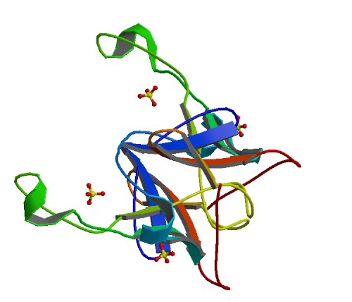
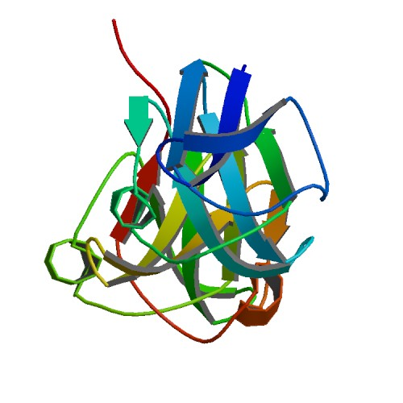
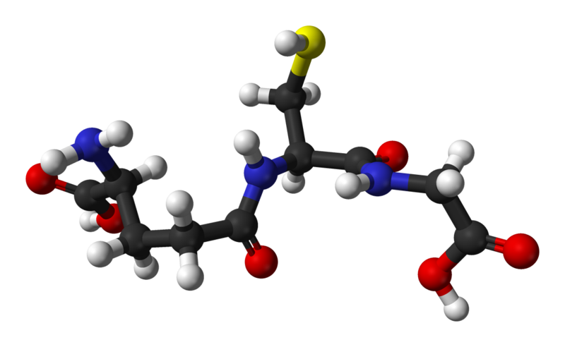
Fiber Cells and Crystallin
Fiber cells' protein: 90% crystallin
Three types:
α-crystallin: Structural protein and "chaperone" (binds to proteins to stabilize and prevent aggregation, but doesn't refold them). Two units: αA, αB
Encoded by CRYAA, CRYAB genes
β- and γ-crystallin: Structural protein, but otherwise no significant function
Encoded by CRYB*, CRYG* genes
Fiber cells are organelle-free; proteins are permanent.
Glutathione (GSH): Anti-oxidant, prevents oxidation of the crystallins.
Encoded by GSTM1, GSTT1 genes
Notes:
CRYBA1 CRYBA4 CRYBA4 CRYBB1 CRYBB2 CRYBB3 CRYBB3 CRYGA CRYGB

Slide 5
Cataract
Cataract is opacification of the lens; when the lens becomes cloudy and blocks vision
Opaque areas are aggregates of desolubilized crystallin proteins
Cataract is an immediate result of two factors:
Decrease of glutathione levels
Formation of lens barrier
Decreased recycling efficiency
Usage of α-crystallin
Limited supply; by age 40, no α-crystallin remains
Mutations in crystallin genes can result in nonfunctional α-crystallin
Currently, only approved treatment is surgical replacement of the lens

Slide 6
Methods

Slide 7
Results

