Slide 1
Lectio Divina: Pray-Read Scripture
Divine Reading

Slide 2
"...lectio divina (divine reading) has no goal other than that of being in the presence of God by praying the Scriptures."

Slide 3
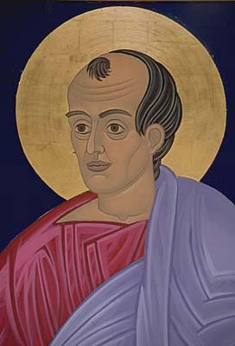

And applying yourself thus to the divine study, seek aright, and with unwavering trust in God, the meaning of the holy Scriptures, which so many have missed. Be not satisfied with knocking and seeking; for prayer is of all things indispensable to the knowledge of the things of God. For to this the Saviour exhorted, and said not only, “Knock, and it shall be opened to you; and seek, and ye shall find,” but also, “Ask, and it shall be given unto you.” (36)

Slide 4
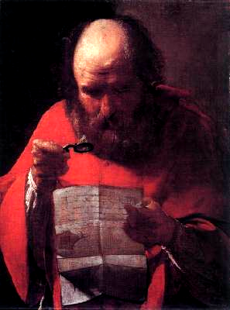

Let there be study of the Divine Word, mingled with prayer…. (37)

Slide 5
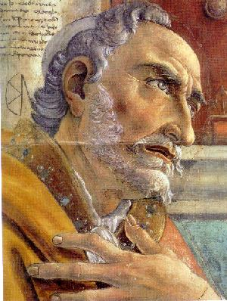

—I read that verse— “I will both lay me down in peace, and sleep; for Thou, Lord, only makest me dwell in safety;” [Psalms 4:8] and, with a loud cry of my heart, I cried out, O “in peace!” O for the self-same! O, what said he, “I will lay me down and sleep?” I read, and kindled… (38)

Slide 6
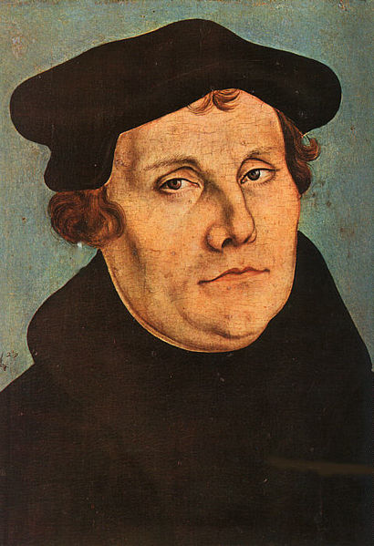
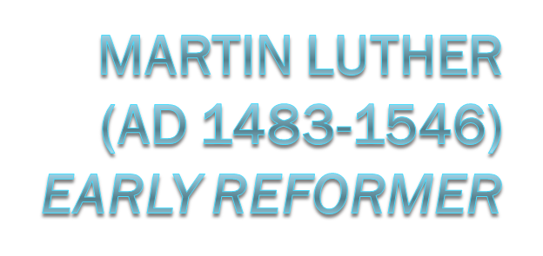
spent a part of almost every day reading the Psalms, with which he mingled his own supplications amid tears and groans. (41)

Slide 7
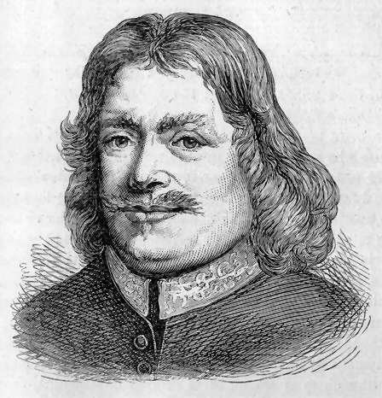

Prayer it is, when it is within the compass of God’s word; and it is blasphemy, or at best vain babbling, when the petition is beside the book. (47)

Slide 8
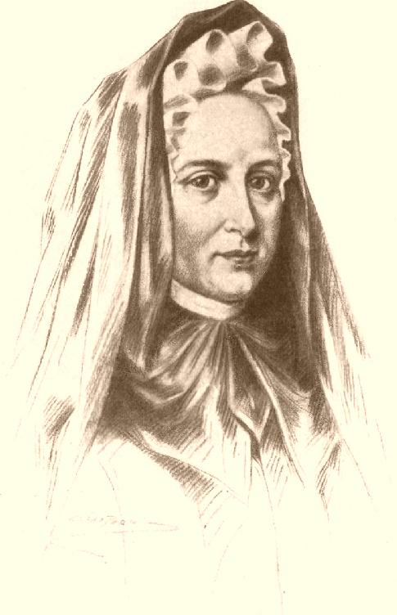

“Praying the Scripture” is a unique way of dealing with the Scripture; it involves both reading and prayer….Be careful as you read. Take in fully, gently and carefully what you are reading. Taste it and digest it as you read.

Slide 9
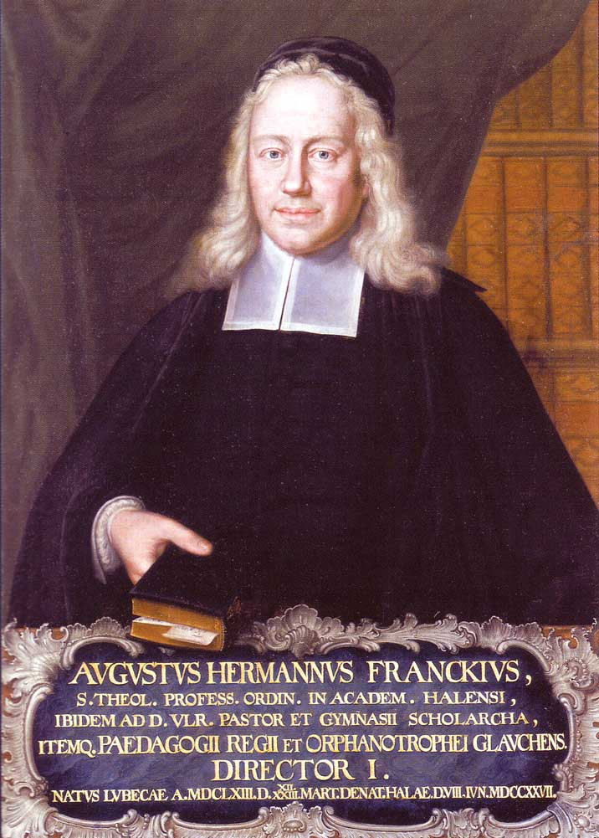

It is also reasonable that the reading of the Holy Scripture be done with all prayer and groaning, as well as praise and thanksgiving. For this is the simple way, that at all times one would have his good edification. (49)

Slide 10
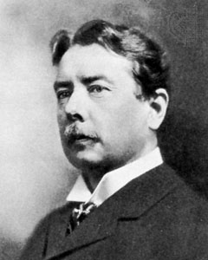

My mind being now more open and enlarged, I began to read the Holy Scriptures upon my knees, laying aside all other books, and praying over, if possible, every line and word. This proved meat indeed, and drink indeed, to my soul. I daily received fresh life, light, and power from above. (55)

Slide 11
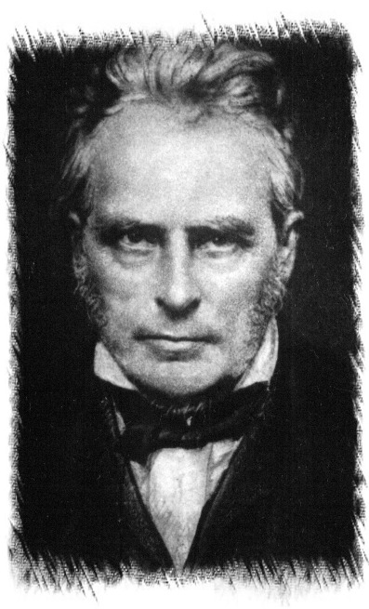

Study the Bible, dear brother, with prayer. Seek the Lord there, and not knowledge—that will come too; but the heart is well directed in seeking the Lord: the eye is single, and then the whole body is full of light. (69)

Slide 12
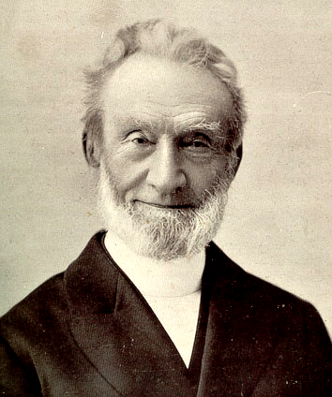

I began therefore to meditate on the New Testament, from the beginning, early in the morning….When thus I have been for a while making confession or intercession or supplication, or have given thanks, I go on to the next words or verse, turning all, as I go on, into prayer for myself or others, as the Word may lead to it, but still continually keeping before me that food for my own soul as the object of my meditation. (69-70)

Slide 13
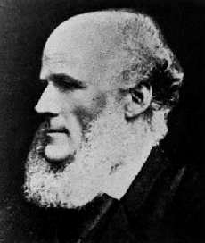

Points of truth however interesting, scriptural knowledge however profound and extensive, Biblical criticism however accurate and valuable, may all leave the heart barren and affections cold. We want to find Christ in the Word; and having found Him, to feed on Him by faith. (70)

Slide 14
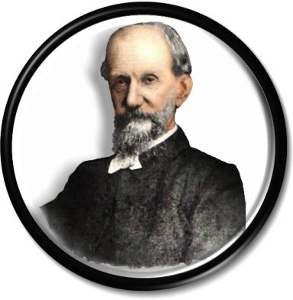

How blessed would the inner chamber be, what a power and an inspiration in our worship, if we only took God’s Word as from Himself, turning it into prayer, and definitely expecting an answer. (66)

Slide 15
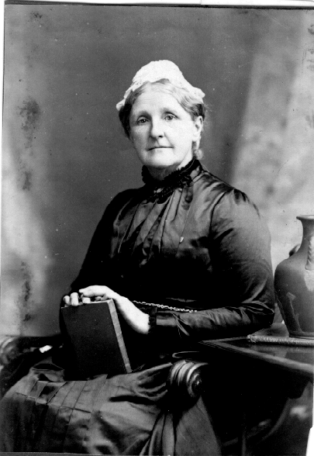

If we will take the words of God, i.e., His revealed truth, into our lips and eat it; that is, if we will dwell upon His words and say them over and over to ourselves, and thoroughly take in and assimilate their meaning in a common-sense sort of way, we shall find that our soul-life is fed and nourished by them, and is made strong and vigorous in consequence. (68)

Slide 16
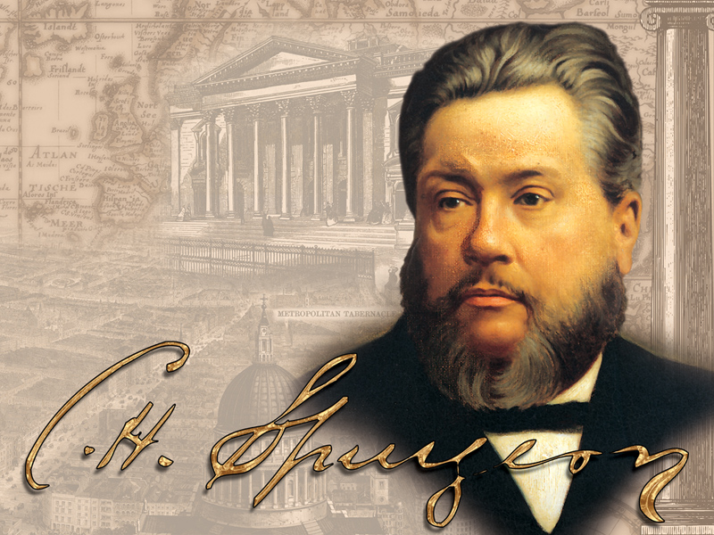
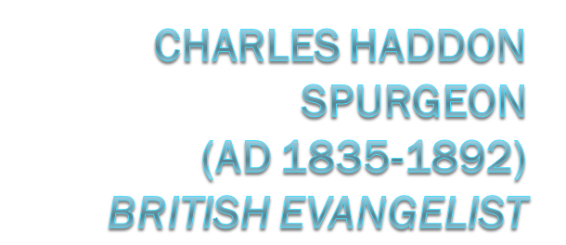
It is a great thing to pray one’s self into the spirit and marrow of the text; working into it by sacred feeding thereon, even as the worm bores its way into the kernel of the nut. Prayer supplies a leverage for the uplifting of ponderous truths. (78)

Slide 17
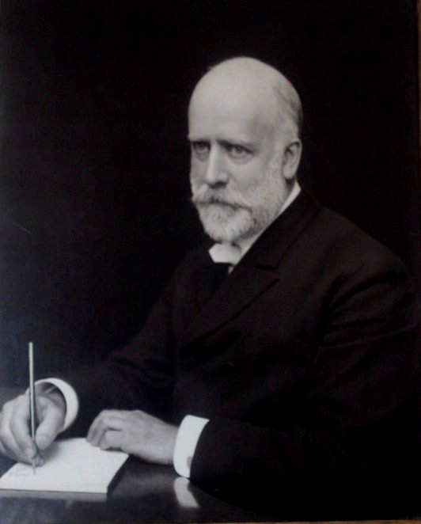

Here is one of the greatest secrets of prevailing prayer: To study the Word to find what God’s will is as revealed there in the promises, and then simply take these promises and spread them out before God in prayer with the absolutely unwavering expectation that He will do what He has promised in His Word. (93)

Slide 18
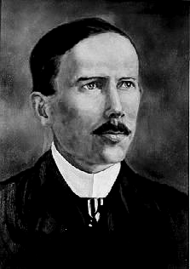

Right on his face on the ground is Praying Hyde. This was his favorite attitude for prayer. Listen! He is praying; he utters a petition, and then waits; in a little time he repeats it, and then waits; and this many times until we feel that that petition has penetrated every fibre of our being and we feel assured that God has heard and without doubt He will answer. How well I remember him praying that we might open our mouth wide that He might fill it (Psalms 81:10). I think he repeated the word “wide” scores of times with long pauses between. “Wide, Lord, wide, open wide, wide.” How effectual it was to hear him address God, “O Father, Father!” (62)

Slide 19
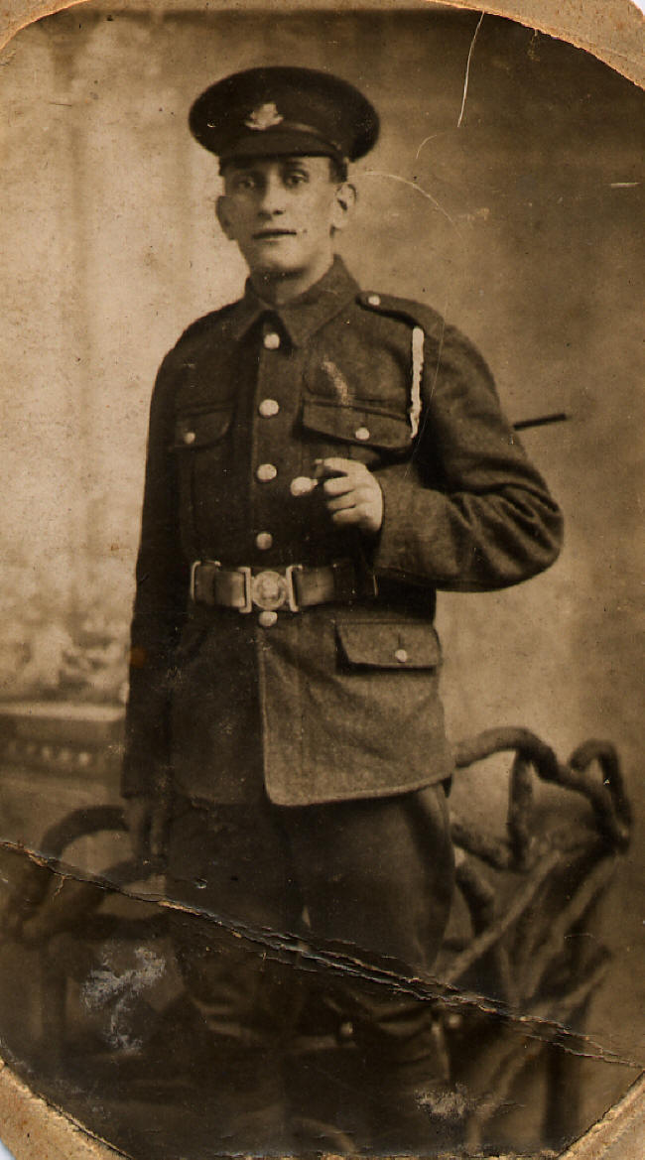

God’s Word is the fuel of our prayer. As we open the page in the morning, the promises prompt us to prayer, the examples incite us to prayer, the warnings urge us to prayer, the hopes of glory stir us to prayer—everything in the portion taken for meditation can be turned into prayer….Depend on it, hiding God’s Word in the heart is the secret of prayer, and the reason why our prayer-life is so weak and barren is that we do not know God through His Word. (95)

Slide 20
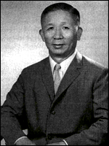

Because He is both the Word and the Spirit, He created us with a mind to understand and a spirit to receive. When we come to the Bible, we should exercise both our mind and our spirit. We exercise our mind by reading and our spirit by praying. Since we need both to read and to pray, we should pray-read the Word. (Ephesians 549)

