Slide 1






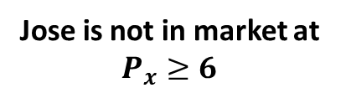




$$P_{x}$$
$$10$$
Jose is not in market at $P_{x}≥6$
$$6$$
$$x_{J}^{∗}$$
$$x_{M}^{∗}$$
$$Q_{D}$$
$$Q_{D}^{x}$$
$$6$$
$$10$$
$$2M$$

Slide 2



$$P_{x}$$
$$Q_{D}$$
$$x_{b}^{∗}$$
$$x_{a}^{∗}$$
$$Q_{D}^{x}$$

Slide 3


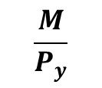
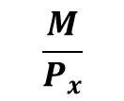
$$Y$$
$$\frac{M}{P_{y}}$$
$$X$$
$$\frac{M}{P_{x}}$$

Slide 4

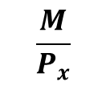
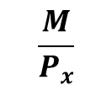
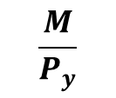

$$Y$$
$$\frac{M}{P_{y}}$$
$$P_{x}↑$$
$$P_{x}↓$$
$$X$$
$$\frac{M}{P_{x}}$$
$$\frac{M}{P_{x}}$$
$$\frac{M}{P_{x}}$$

Slide 5

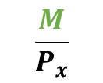
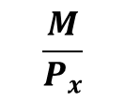
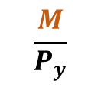
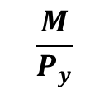
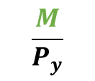
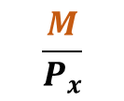

$$Y$$
$$\frac{M}{P_{y}}$$
$$\frac{M}{P_{y}}$$
$$\frac{M}{P_{y}}$$
$$M↓$$
$$M↑$$
$$X$$
$$\frac{M}{P_{x}}$$
$$\frac{M}{P_{x}}$$
$$\frac{M}{P_{x}}$$

Slide 6
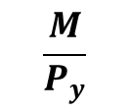


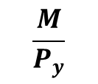
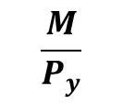
$$Y$$
$$\frac{M}{P_{y}}$$
$$P_{y}↓$$
$$\frac{M}{P_{y}}$$
$$\frac{M}{P_{y}}$$
$$P_{y}↑$$
$$X$$
$$\frac{M}{P_{x}}$$

Slide 7

$$\overline{U}$$

Slide 8
BETTER THAN SET
WORSE THAN SET
$$\overline{U}$$

Slide 9





$$U_{5}$$
$$U_{4}$$
$$U_{3}$$
$$U_{2}$$
$$U_{1}$$

Slide 10




THIS GRAPH SAYS THE FOLLOWING ABOUT THESE BUNDLES:
C
$$A>B$$
$$B>A$$
$$C>D$$
$$D>C$$
A
D
$$U_{2}$$
B
$$U_{1}$$

Slide 11
A
C
B

Slide 12
A
C
B

Slide 13
$$Y$$
BUDGET CONSTRAINT
$$X$$

Slide 14


$$Y$$
INDIFFERENCE CURVE
$$X$$

Slide 15
$$Y$$
$$X$$

Slide 16
$$Y$$
A
D
C
B
$$X$$

Slide 17
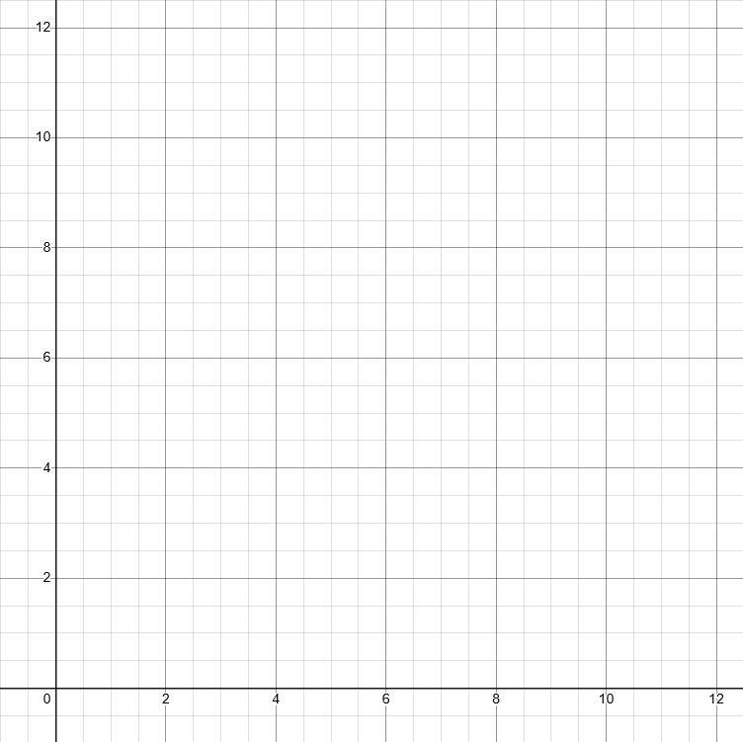





Rice
C
$$U_{2}$$
B
A
$$U_{1}$$
$$BC_{2}$$
$$BC′$$
$$BC_{1}$$
Fish

Slide 18

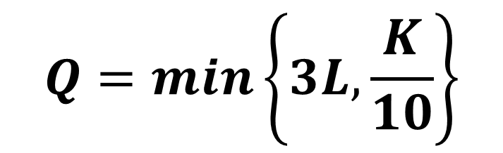










$$K$$
$$Q=min\left\{3L,\frac{K}{10}\right\}$$
$$30$$
$$Q=3$$
$$20$$
$$Q=2$$
$$10$$
$$Q=1$$
$$L$$
$$1/3$$
$$2/3$$
$$1$$

Slide 19


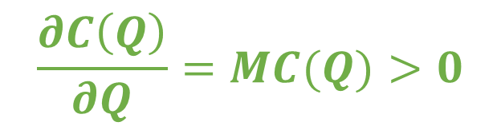
$$Costs$$
$$\frac{∂C\left(Q\right)}{∂Q}=MC(Q)>0$$
$$Q$$

Slide 20


$$Costs$$
$$MC(Q)$$
$$\frac{∂MC\left(Q\right)}{∂Q}>0$$
$$Q$$

Slide 21
$$Costs$$
$$MC(Q)$$
$$\frac{∂MC\left(Q\right)}{∂Q}>0$$
Fixed Costs
$$Q$$

Slide 22

$$Costs$$
$$MC(Q)$$
Positive but Decreasing Marginal Costs
Positive AND Increasing Marginal Costs
Fixed Costs
$$Q$$

Slide 23



$$Costs$$
$$MC(Q)$$
$$C(Q)$$
$$10$$
$$Q$$

Slide 24





$$Costs$$
$$C(Q)$$
$$MC(Q)$$
$$12$$
$$2$$
$$Q$$
$$1$$

Slide 25

$$Costs$$
$$MC$$
$$Q$$

Slide 26

$$Costs$$
$$AFC$$
$$Q$$

Slide 27

$$Costs$$
$$AVC$$
$$Q$$

Slide 28

$$Costs$$
$$ATC$$
$$Q$$

Slide 29

$$Costs$$
$$MC$$
$$ATC$$
$$AVC$$
$$AFC$$
$$Q$$

Slide 30

$$MC$$
$$ATC$$

Slide 31
 | Perfect competition | Monopolistic competition | Oligopoly | monopoly
Number of Firms | Many | many | few | one
Type of products sold | Identical | Differentiated | Identical or differentiated | Unique
Barriers to entry | None | None | Some | many

Slide 32
MORE COMPETITION
LESS COMPETITION
PERFECT COMPETITION
MONOPOLISTIC COMPETITION
OLIGOPOLY
MONOPOLY
LESS CONCENTRATION
MORE CONCENTRATION

Slide 33


$$MC$$
$$P$$

Slide 34



$$P$$
$$MC$$
$$10$$
$$Q$$

Slide 35

$$P$$
$$AFC$$
$$Q$$

Slide 36

$$P$$
$$AVC$$
$$10$$
$$Q$$

Slide 37

$$P$$
$$ATC$$
$$Q$$

Slide 38

$$P$$
$$MC$$
$$ATC$$
$$AVC$$
$$10$$
$$AFC$$
$$Q$$

Slide 39






$$P$$
$$MC$$
$$30$$
$$ATC$$
$$25$$
$$AVC$$
$$20$$
$$10$$
$$AFC$$
$$Q$$
$$10$$
$$15$$
$$20$$

Slide 40

$$P$$
revenue = price $×$ quantity
$$MC$$
$$30$$
$$ATC$$
$$AVC$$
$$10$$
REVENUE
$$AFC$$
$$Q$$
$$20$$

Slide 41

$$P$$
costs = quantity $×$ atc
$$MC$$
$$30$$
$$ATC$$
$$AVC$$
$$10$$
COSTS
$$AFC$$
$$Q$$
$$20$$

Slide 42
$$P$$
PROFIT = REVENUE - COST
$$MC$$
$$30$$
$$ATC$$
$$AVC$$
$$10$$
$$AFC$$
$$Q$$
$$20$$

Slide 43














$$P$$
$$MC$$
$$ATC$$
$$π>0$$
$$AVC$$
$$Q>0$$
$$P=min\{ATC\}$$
$$π<0$$
$$P=min\{AVC\}$$
$$Q<0$$
$$AFC$$
$$Q$$
$$Q_{2}$$
$$Q_{1}$$

Slide 44



$$P$$
Supply Curve
$$Q>0$$
$$P=min\{AVC\}$$
$$Q<0$$
$$Q$$
$$Q_{2}$$

Slide 45
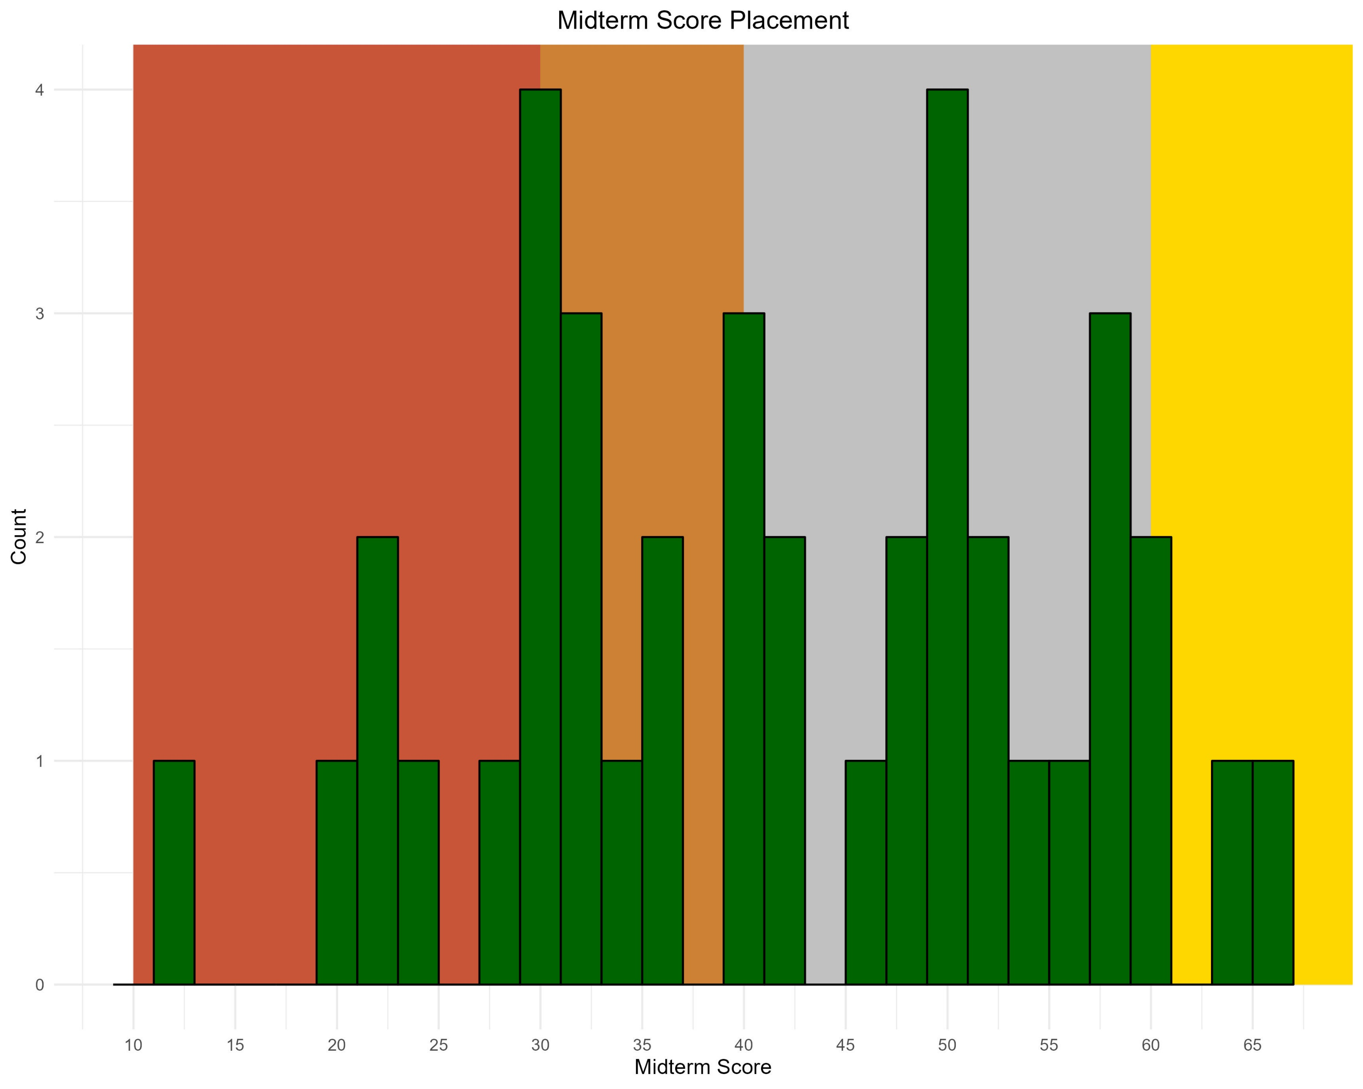
D and below range
C range
B range
a range

Slide 46
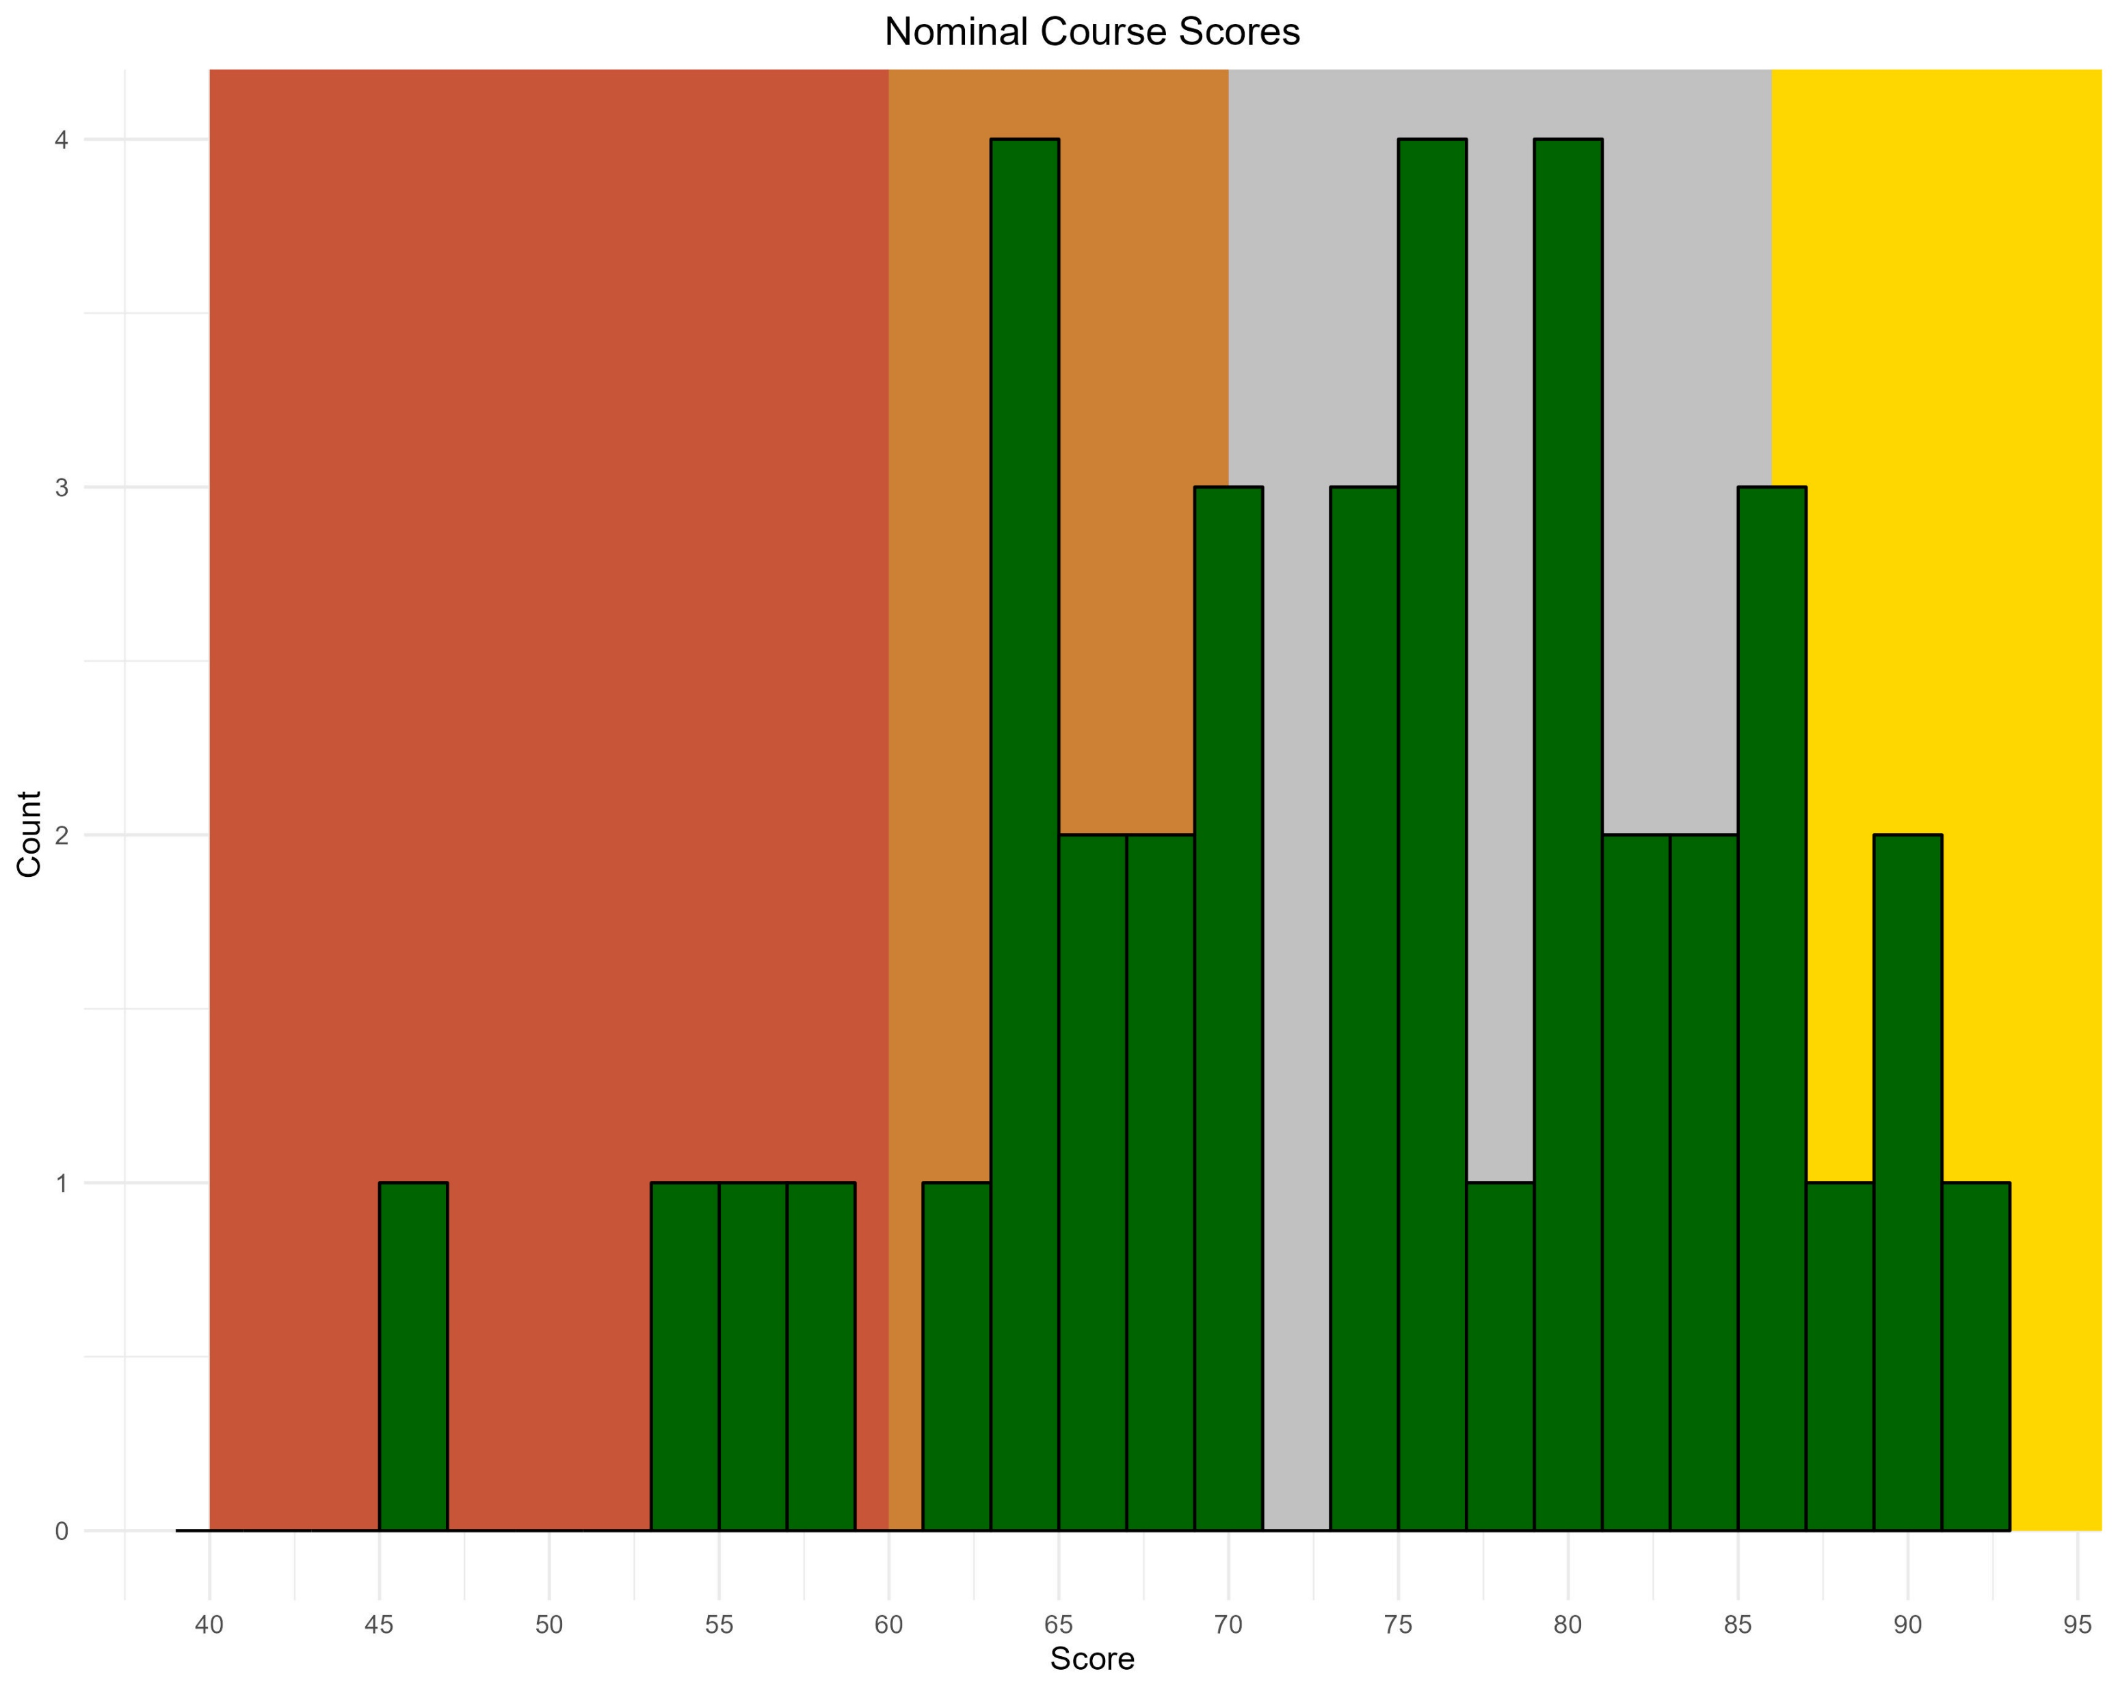
D and below range
C range
B range
a range

Slide 47









$$P$$
$$S_{1}$$
$$S_{2}$$
$$P_{1}^{∗}$$
$$P_{2}^{∗}$$
$$D$$
$$Q$$
$$Q_{1}^{∗}$$
$$Q_{2}^{∗}$$

Slide 48









$$S_{2}$$
$$P$$
$$S_{1}$$
$$P_{2}^{∗}$$
$$P_{1}^{∗}$$
$$D$$
$$Q$$
$$Q_{2}^{∗}$$
$$Q_{1}^{∗}$$

Slide 49






$$P$$
$$40$$
$$S$$
$$25$$
$$10$$
$$D$$
$$Q$$
$$15$$

Slide 50




$$P$$
$$40$$
$$S$$
$$P_{2}$$
$$25$$
$$D_{2}$$
$$10$$
$$D_{1}$$
$$Q$$
$$15$$
$$Q_{2}$$

Slide 51



$$P$$
$$40$$
$$S_{1}$$
$$S_{2}$$
$$P_{2}$$
$$25$$
$$D_{2}$$
$$10$$
$$D_{1}$$
$$Q$$
$$15$$
$$Q_{2}$$
$$Q_{3}$$

Slide 52

$$P$$
$$40$$
$$25$$
$$S^{LR}$$
$$D_{2}$$
$$10$$
$$D_{1}$$
$$Q$$
$$15$$
$$Q_{3}$$

Slide 53





$$P$$
MARKET
$$S^{SR}$$
$$28$$
$$S^{LR}$$
$$D$$
$$Q$$
$$200$$

Slide 54






$$P$$
MARKET
$$S^{SR}$$
$$28$$
$$S^{LR}$$
$$20$$
$$D_{1}$$
$$D_{2}$$
$$Q$$
$$120$$
$$200$$

Slide 55



$$P$$
MARKET
$$S$$
$$S^{SR}$$
$$28$$
$$S^{LR}$$
$$20$$
$$D_{1}$$
$$D_{2}$$
$$Q$$
$$100$$
$$120$$
$$200$$

Slide 56





$$P$$
Oil industry
$$S_{1}^{SR}$$
$$P_{1}$$
$$D$$
$$Q$$
$$Q_{1}$$

Slide 57




$$P$$
Oil industry
$$S_{1}^{SR}$$
$$S_{2}^{SR}$$
$$P_{1}$$
$$S^{LR}=min\left\{ATC_{1}\right\}$$
$$P_{2}$$
$$D$$
$$Q$$
$$Q_{1}$$
$$Q_{2}$$

Slide 58




$$P$$
Oil industry
$$S_{1}^{SR}$$
$$S_{2}^{SR}$$
$$P_{1}$$
$$S^{LR}=min\left\{ATC_{1}\right\}$$
$$S_{3}^{SR}$$
$$P_{2}$$
$$P_{3}$$
$$S^{LR}=min\left\{ATC_{3}\right\}$$
$$D$$
$$Q$$
$$Q_{1}$$
$$Q_{2}$$
$$Q_{3}$$

Slide 59







$$P$$
$$S=MC_{ }=2Q+1$$
$$P_{ }^{∗}$$
$$S_{1}^{LR}$$
MARKET: NO TAXES
$$D$$
$$Q$$
$$Q_{ }^{∗}$$

Slide 60




$$P$$
$$S_{τ}=MC_{τ}=2Q+1+τ$$
$$P_{τ}^{∗}$$
$$S=MC_{ }=2Q+1$$
$$P_{ }^{∗}$$
$$S_{1}^{LR}$$
MARKET: PER-UNIT TAXES
$$τ$$
$$D$$
$$Q$$
$$Q_{τ}^{∗}$$
$$Q_{ }^{∗}$$

Slide 61









$$S_{3}$$
$$P$$
From firms leaving
$$S_{2}$$
$$P_{τ}^{∗}+τ$$
$$S_{2}^{LR}$$
$$τ$$
From tax
$$S_{1}$$
$$P_{τ}^{∗}$$
$$P_{ }^{∗}$$
$$S_{1}^{LR}$$
MARKET: PER-UNIT TAXES
$$τ$$
$$D$$
$$Q$$
$$Q_{τ}^{∗}$$
$$Q_{τ}^{∗}$$
$$Q_{ }^{∗}$$

Slide 62
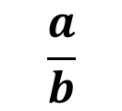

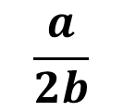




$$P$$
$$a$$
$$MR$$
$$D$$
$$Q$$
$$\frac{a}{2b}$$
$$\frac{a}{b}$$

Slide 63


$$P$$
$$MC$$
$$MR$$
$$D$$
$$Q$$
$$Q_{M}^{∗}$$

Slide 64

$$P$$
$$MC$$
$$P_{M}^{∗}$$
$$MR$$
$$D$$
$$Q$$
$$Q_{M}^{∗}$$

Slide 65



$$P$$
$$MC$$
$$P_{M}^{∗}$$
$$P_{PC}^{∗}$$
$$MR$$
$$D$$
$$Q$$
$$Q_{M}^{∗}$$
$$Q_{PC}^{∗}$$

Slide 66










$$P$$
$$26$$
$$S=MC$$
$$(3,26)$$
$$P_{M}^{∗}=20$$
$$P_{PC}^{∗}=18$$
$$(4,18)$$
$$ATC$$
$$MR$$
$$D$$
$$Q$$
$$Q_{M}^{∗}=3$$
$$Q_{PC}^{∗}=4$$

Slide 67
$$P$$
$$26$$
$$S=MC$$
$$(3,26)$$
$$P_{M}^{∗}=20$$
$$(4,18)$$
$$ATC$$
Monopoly Profit
$$MR$$
$$D$$
$$Q$$
$$Q_{M}^{∗}=3$$
$$Q_{PC}^{∗}=4$$

Slide 68
$$P$$
$$26$$
$$S=MC$$
$$P_{PC}^{∗}=18$$
$$(4,18)$$
$$ATC$$
Perfectly Competitive Firm
Profit
$$MR$$
$$D$$
$$Q$$
$$Q_{M}^{∗}=3$$
$$Q_{PC}^{∗}=4$$

Slide 69


$$P$$
$$MC$$
$$ATC$$
$$P_{M}^{∗}$$
$$MR$$
$$D$$
$$Q$$
$$Q_{M}^{∗}$$

Slide 70




$$P$$
$$MC$$
$$ATC$$
$$AVC$$
$$P_{PC}^{∗}$$
$$MR$$
$$D$$
$$Q$$
$$Q_{PC}^{∗}$$

Slide 71
competitor
low
high
10,10 | 20,0
0,20 | 15,15
low
you
high

Slide 72




$$Q_{A}$$
$$25$$
$$Q_{B}$$
$$100$$

Slide 73


$$Q_{A}$$
$$100$$
$$Q_{B}$$
$$25$$

Slide 74




$$Q_{A}$$
$$BR_{B}$$
Nash Equilibrium
$$Q_{A}=20$$
$$BR_{A}$$
$$Q_{B}$$
$$Q_{B}=20$$
$$100$$

Slide 75




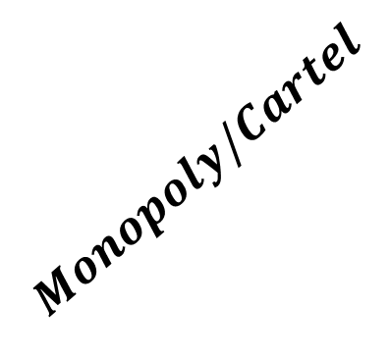





$$P$$
$$S^{ }$$
$${Monopoly/Cartel}_{ }$$
$$Cournot$$
$$Perfect Competition$$
$$D_{ }$$
$$Q_{ }$$
$$Cournot$$
$${Monopoly/Cartel}_{ }$$
$$Perfect Competition$$

Slide 76
Leader
Makes a choice on how much to produce
Observes how much the leader produces
Follower
Makes a choice on how much to produce
We get an equilibrium quantity, which determines price

Slide 77
Leader
Use follower solution to solve leader problem
Makes a choice on how much to produce
Observes how much the leader produces
Follower
Makes a choice on how much to produce
Solve follower problem
We get an equilibrium quantity, which determines price

