Slide 1

Study of closed dynamical system based on the Kapitsa phenomenon (inverted pendulum)
Oleksii Gamov, Kharkiv Academic Lyceum №45 graduate
Mazanov Maksym, PHD student in the ITMO University (St. Petersburg)

Slide 2

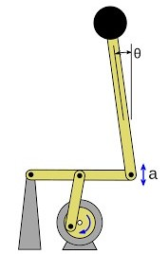
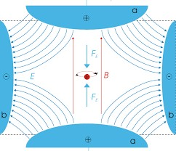
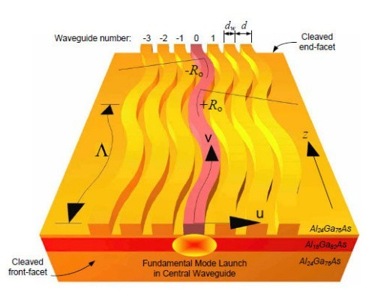
Kapitsa stabilization and analogs
2

Slide 3
System description
The system – double oscillator.
It’s made out of mathematical and spring pendulums connected together.
k
g
For this system we came up with differential equations describing it’s movement:
x
m
L
θ
M

Slide 4
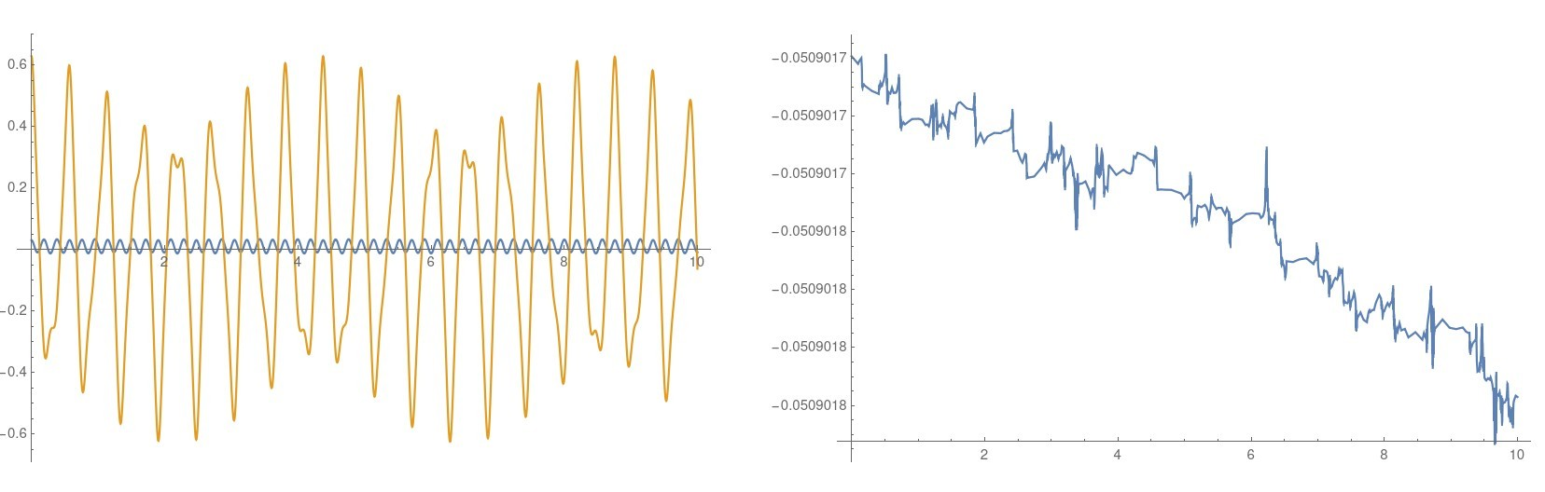
Correction check

Slide 5
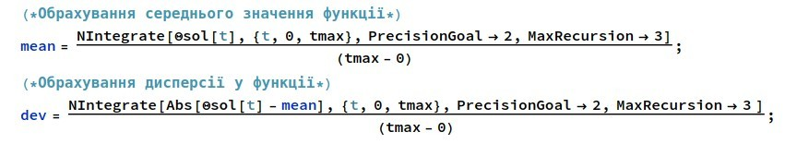
Mode discoveries
For the Kapitsa pendulum and double oscillator we’ve initialized simulation with different starting parameters.
We’ve made plots for average mathematical pendulum position and deviation from it.

Slide 6
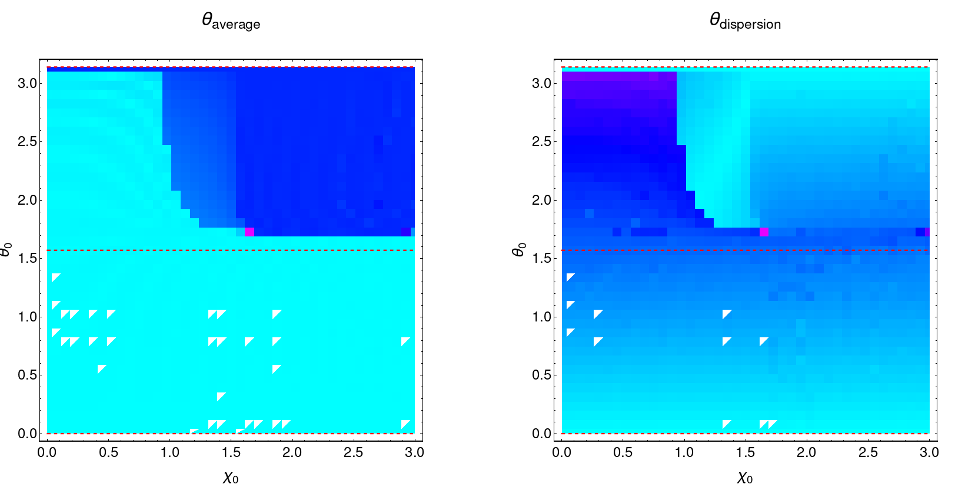
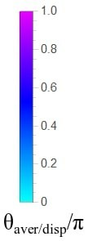
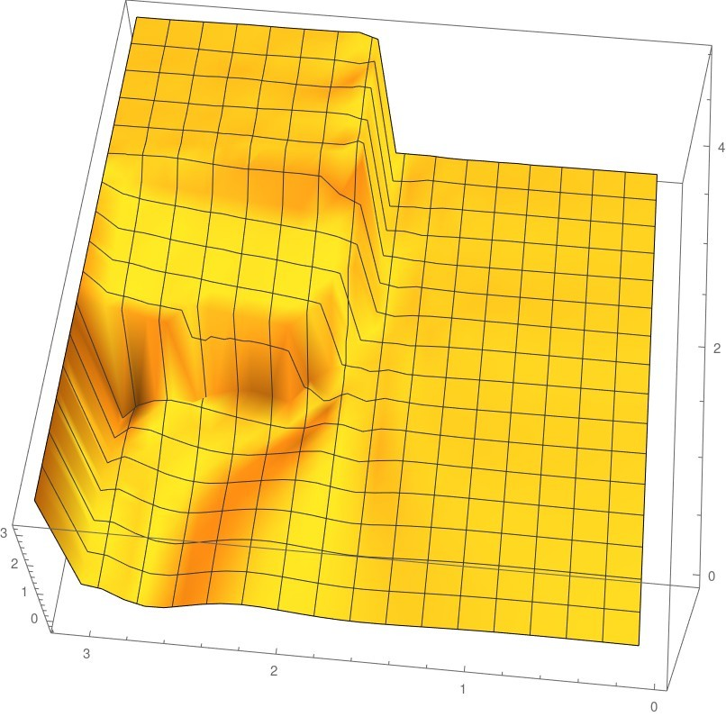
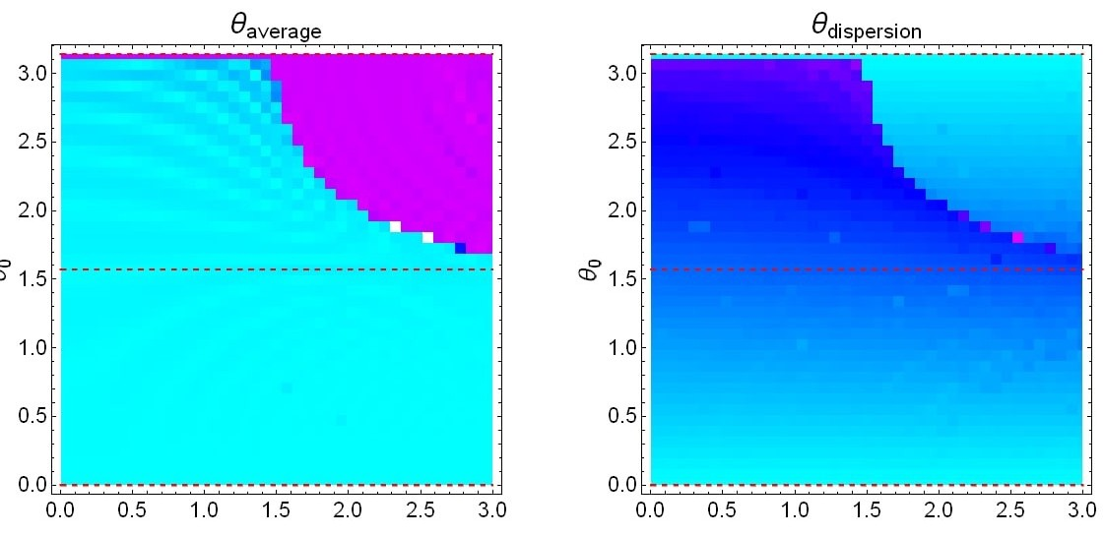
Mode discoveries

Slide 7
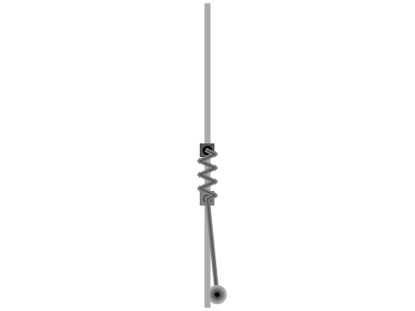
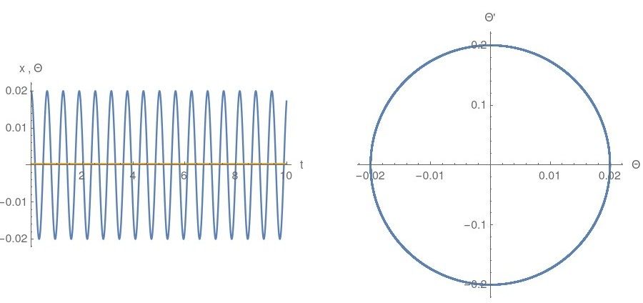
Mode №1

Slide 8
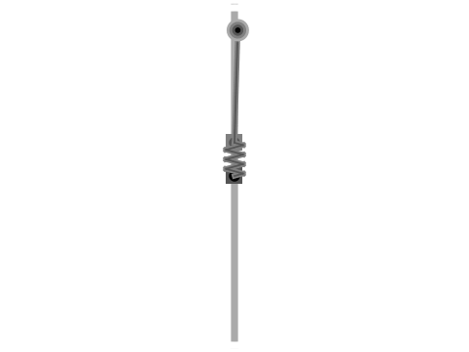
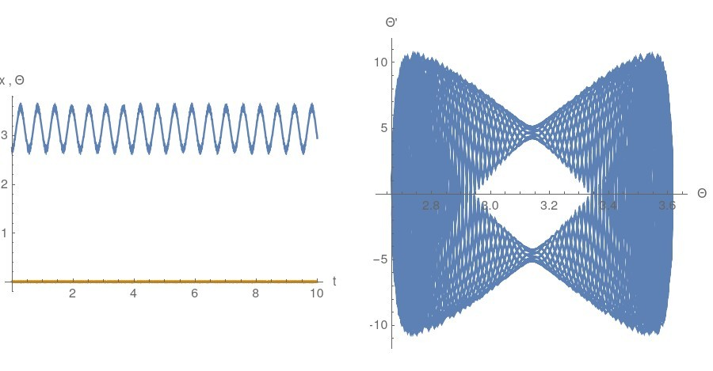
Mode №2

Slide 9

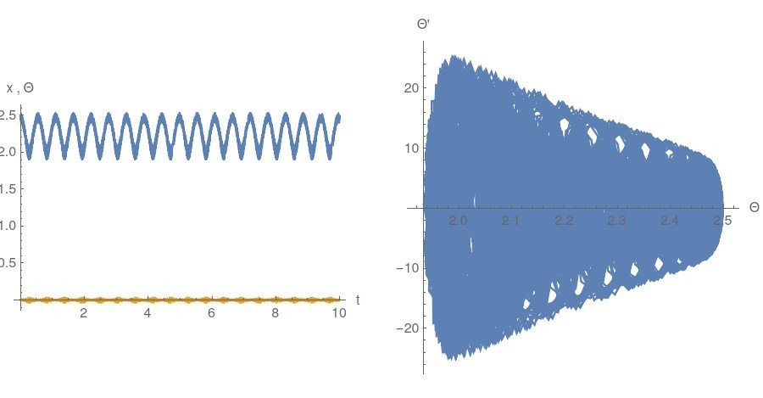
Mode №3

Slide 10
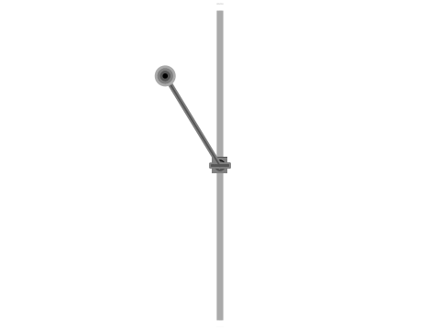
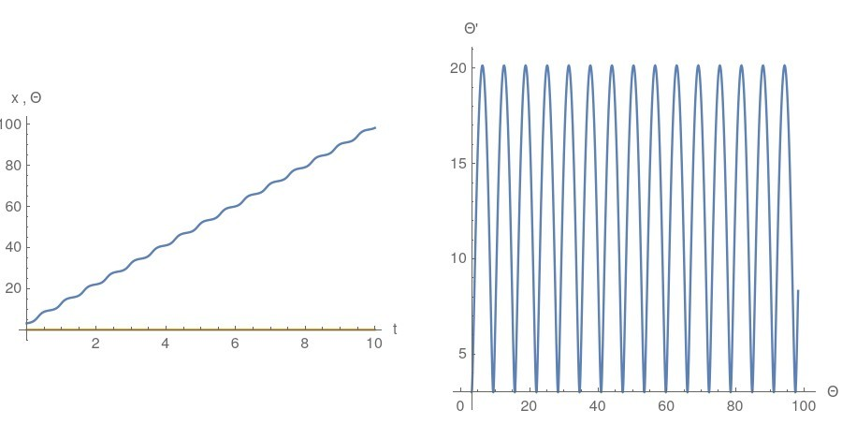
Mode №4

Slide 11
Effective dynamic potential
For this system we can’t find static effective potential. It can be approximately described with dynamic potential.

Slide 12
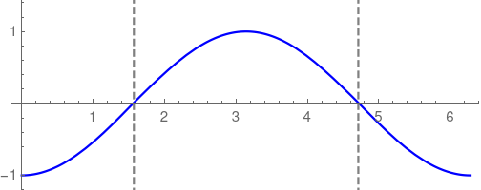
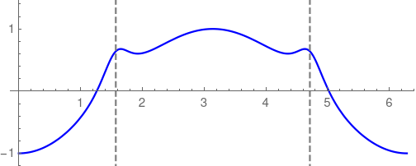
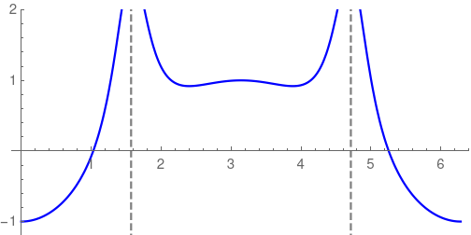
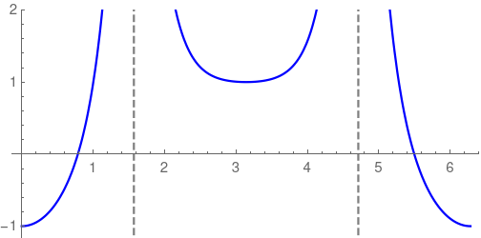
Dynamic effective potential
1
3

Slide 13
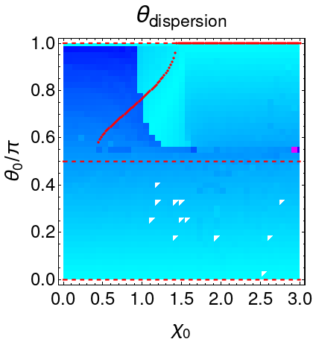
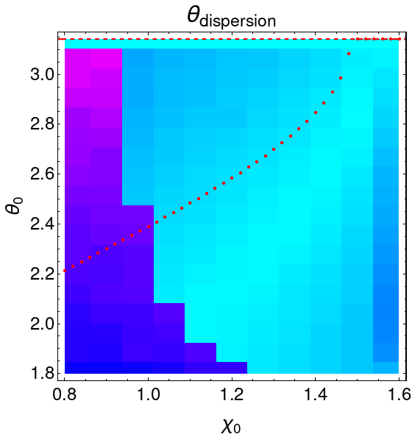
Effective dynamic potential plots

Slide 14
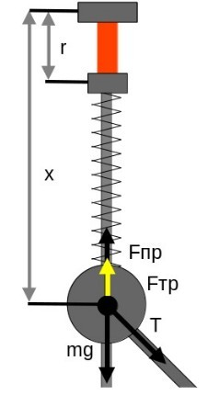
Experimental model
We’re adding friction to the systen and pereodic movement of the suspension point. This will allow system not to lose much energy on friction and will make it possible for stable nontrivial modes to exist.

Slide 15
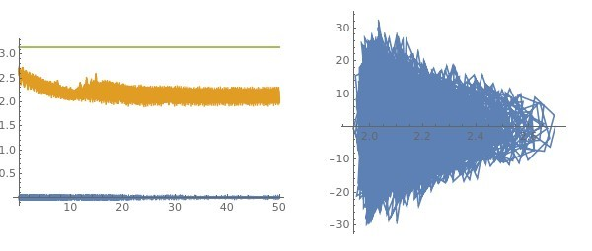
Modulation results

Slide 16
Results
New modes have been found.
Effective dynamic potential is proposed.
Analogies in other fields are proposed.
Experimental model is proposed.

Slide 17

Thanks for your attention!

Slide 18
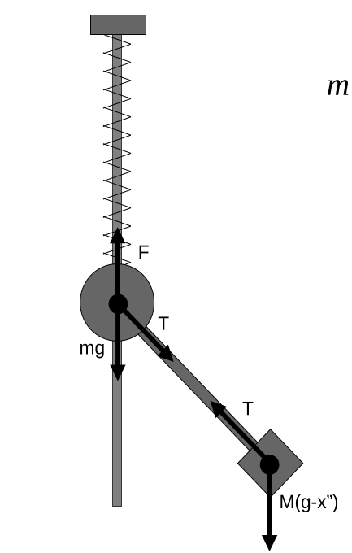
Additional slide №1

Slide 19
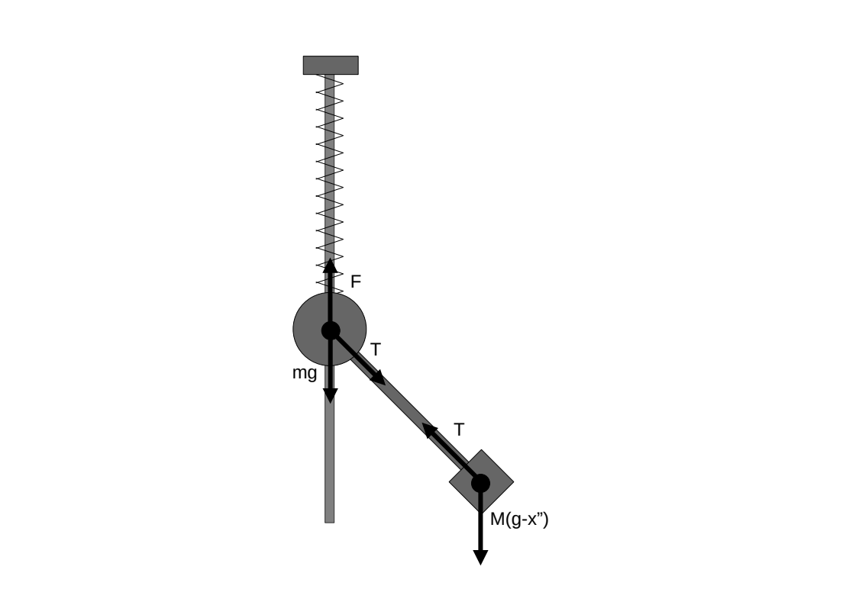
Additional slide №2

Slide 20
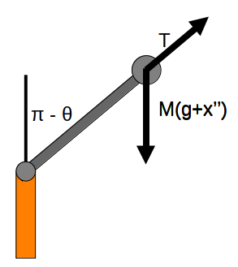
Additional slide №3

